Slide 2
Definition
Seed dispersal is the movement or transport of seeds away from the parent plant.
OR
The process by which the seeds are scattered from the parent plant.
Seeds can be dispersed away from the parent plant individually or collectively, as well as dispersed in both space and time.

Slide 3
To avoid growing very close to each other , plant take help of agent like wind, water and animal to scattered their seeds.

Slide 4
Benefits.
Seed dispersal is likely to have several benefits for different plant species.
seed dispersal may allow plants to colonize vacant habitats and even new geographic regions.
Seed dispersal also allows plants to reach specific habitats that are favorable for survival, a hypothesis known as directed dispersal.

Slide 5
Conti…
In the case of fleshy-fruited plants, seed-dispersal in animal guts (endozoochory) often enhances the amount, the speed, and the asynchrony of germination, which can have important plant benefits.

Slide 6
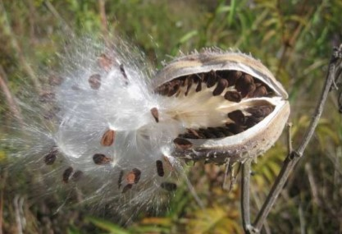
Why to seed need to be dispersed?
If seed are not dispersed, it will just drop just next to it’s mother plant. This will end with a conclusion that the seed might not have the right amount of water, light and temperature to survive or even grow.

Slide 7
Method of seed dispersal
Seed dispersal is sometimes split into Autochory (when dispersal is attained using the plant's own means) and Allochory (when obtained through external means).

Slide 8
Autochory
Autochorous plants disperse their seed without any help from an external vector as a result this limits plants considerably as to the distance they can disperse their seed.
Two other types of autochory are blastochory, where the stem of the plant crawls along the ground to deposit its seed far from the base of the plant.

Slide 9
Conti …
and Herpochory (the seed crawls by means of trichomes and changes in humidity).

Slide 10
Gravity
Barochory or the plant use of gravity for dispersal is a simple means of achieving seed dispersal.
The effect of gravity on heavier fruits causes them to fall from the plant when ripe.
apples, coconuts and those with harder shells (which often roll away from the plant to gain more distance)

Slide 11
Allochory
Allochory refers to many types of seed dispersal where a vector or secondary agent is used to disperse seeds.
This vectors may include wind, water, animals or others.

Slide 13
By Wind
Wind dispersal (Anemochory) is one of the more primitive means of dispersal.
Wind dispersal can take on one of two primary forms: seeds can float on the breeze or alternatively, they can flutter to the ground.
The classic examples of these dispersal mechanisms include Dandelion , maples and Poppy head.

Slide 14
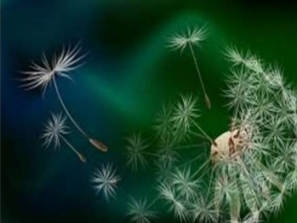
Dandelions
Each seed has a parachute of the fine hairs attached which will help seeds to fly in dry air when air become moist the hairs clumps together and the seeds sinks to the grounds.

Slide 15
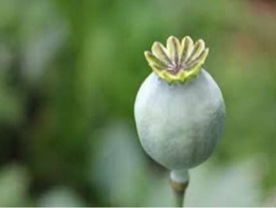
Poppy head
The head dry out as seed mature and seed are scattered through small opening when wind shakes the stalk.

Slide 16
By Water
Many aquatic (water dwelling) and some terrestrial (land dwelling) species use hydrochory, or seed dispersal through water.
Seeds can travel for extremely long distances, depending on the specific mode of water dispersal.

Slide 17
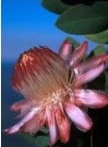
Example
The water lily is an example of such a plant. Water lilie‘s flowers make a fruit that floats in the water for a while and then drops down to the bottom to take root on the floor of the pond.

Slide 18
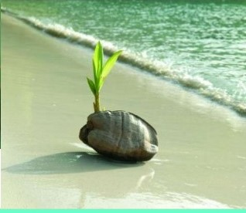
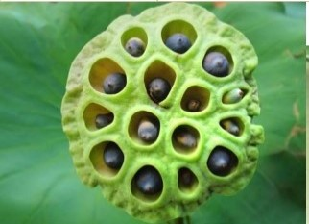
Conti…
Coconut can travel for thousand of kilometres across seas and oceans.
The original coconut palms on south seas island grew from fruit which were carried there from the mainland by ocean current.

Slide 19
By Animals
Animals can disperse plant seeds in several ways, all named Zoochory.
Seeds can be transported on the outside of vertebrate animals (mostly mammals), a process known as Epizoochory.
If the seed are dispersed after passing to the digestive track of the animals called Endozoochory

Slide 20
Conti…
The animal eat the fruit but only the juice part is digested.
The stones and pips pass through animal’s digestive system and excreted to form new plant. This can be far away from the parent plant.
Black berry, cherry and apple seed are dispersed in this way.

Slide 21
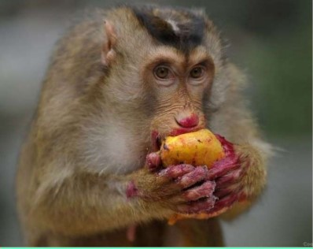
Some seed have sticky hair, bristle hook or barb. They can transported by the sticking to the fur of the animal or ever the clothes of human beings.

Slide 22
By Human
Dispersal by humans (Anthropochory) used to be seen as a form of dispersal by animals.
Dispersal by humans on the one hand may act on large geographical scales and lead to invasive species.
It acts on smaller, regional scales and drives the dynamics of existing biological populations.

Slide 23
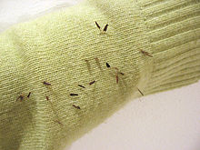
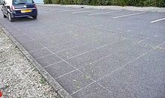
Examples
Dispersal on human clothes (up to 250 m), on shoes (up to 5 km) or by cars (regularly ~ 250 m, singles cases > 100 km)

Slide 24
By Explosion
Some plants have pods that explode when ripe and shoot out the seed.
Lupins , gorse and broom scatter their seed in this way.
Pea and bean plants also keep their seed in their pods. When this seed are ripe and pods has dried, the pods bursts open and the peas and beans are scattered.

Slide 25
