Slide 1
Formation of Saline Soils

Slide 2
Development of saline soils
Development of saline soils depends upon two factors:
Natural conditions of soil
Natural conditions of the area

Slide 3
Natural characteristics of the soil
texture
clay mineral composition;
structure (aggregate status and stability; cracking, shrinkage – swelling characteristics);
compaction rate – porosity (preferably differential porosity and pore-size distribution);
hydrophysical properties (infiltration rate, water storage capacity, water retention, saturated and unsaturated hydraulic conductivity);
salinity indicators (profile, regime, balances and ion composition of salts);
sodicity indicators (pH, SAR, ESP)

Slide 4
Natural conditions of the area
climate (temperature, rainfall, evaporation, wind characteristics, with their spatial distribution and time variability);
geology (potential salt sources, sequence and thickness of aquifers and the vertical and horizontal transmissibility of geological layers);
relief;
vertical and horizontal drainage conditions;
hydrology (quality and quantity of surface waters, groundwaters, deep waters and their fluctuations)

Slide 5
The preconditions of salt accumulation
Driving force to transport
relief for surface runoff
suction gradient for seep in the unsaturated zone
hydraulic gradient for groundwater flow
concentration gradient for solute transport
Negative water balance (at least for certain period of the year)
Vertical and horizontal drainage limitations

Slide 6
The preconditions of salt accumulation
Salt sources
Local weathering
Surface water
Subsurface waters
Human activities
Transporting agents
Wind, water
Horizontal transportation: large watershed with small accumulation area
Vertical transportation: geological strata to accumulation horizon

Slide 7
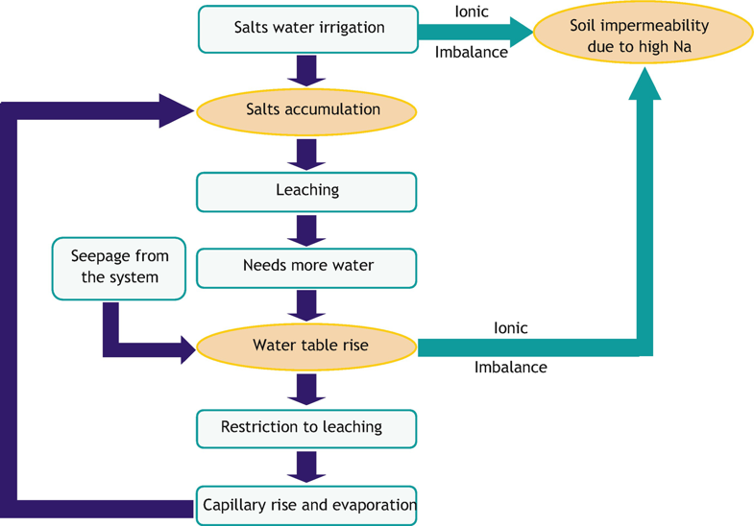
Development of soil salinity (Shahid et al. 2010)

Slide 8
Environmental (natural) factors result in salinisation/sodification:
movements of transgression and regressions that in some particular geological conditions bring about an increase of the concentration of salts in groundwater and consequently in soils;
rise of salt-rich groundwater due to natural factors or human interventions up to the surface, near to the surface or to the overlying horizons;
groundwater seepage into areas lying below sea level, microdepression with no or limited drainage;
floods coming from areas with geological substrates that release high amounts of salts;
wind activities that, in coastal areas, bring moderate amounts of salts in soils.

Slide 9
Human-induced factors may lead to salinisation/sodification:
irrigation of waters rich in salts;
rising water table due to human activities (filtration from unlined canals and reservoirs; uneven distribution of irrigation water; poor irrigation, practice, improper drainage);
use of fertilizers and amendments, especially in situations of intensive agriculture with low permeability and limited possibilities of leaching;
wastewater disposals and wastewater irrigation;
contamination of soils with salt-rich waters and industrial by-products.

Slide 10
Salinity/sodicity are risks to:
plant life (soil fertility, agricultural productivity: cultivated crops and their biomass yield; natural vegetation/ eco-systems);
life and function of soil biota (biodiversity);
soil deterioration (increased erosion potential, desertification, structure destruction, aggregate failure, compaction);
hydrological cycle, moisture regime (increasing hazard –frequency, duration, severity – of extreme moisture events as flood, waterlogging, over-moistening and drought);
biogeochemical cycles of elements (plant nutrients, pollutants, potentially harmful elements and compounds)

Slide 11
PROCESSES OF FORMATION OF SALT AFFECTED SOIL
Salination
Salination is the process of accumulation of soluble salts by which saline soil are formed.
Desalination
The process of leaching of soluble salts out of root zone is called desalination.

Slide 12
PROCESS OF FORMATION OF SALT EFFECTED SOIL.
Sodication
Sodication is the process of accumulation exchangeable sodium in the soil which results in the formation of sodic soil.
Desodication
The process of removal of exchangeable sodium from the soil is known as desodication.

Slide 13
CAUSES OF SALINITY IN PAKISTAN
Poor leaching of salts
Irrigation water
Ground water
Other factors

Slide 14
1. POOR LEACHING OF SALTS
The original source of salt is exposed rocks and minerals. During weathering of rocks and minerals, large quantity of salts are brought in solution. In arid and semi arid regions evapotranspiration exceeds rainfall, and rainfall is not enough to leach out the salts from crop root zone, therefore this salt concentration in the soil and ground water cause salinity.

Slide 15
2. IRRIGATION WATER
Irrigation water is important source of salts
However in river water of Pakistan, concentration of salt is low, but it still make significant contribution to the amount of salts in irrigated soil especially when drainage is poor
Insufficient and unequal application of irrigation water results in salinity

Slide 16
3. GROUND WATER
Ground water is also significant source of salts in the development of secondary salt affected soils
4. OTHER FACTORS
Other factors are given below:
Flood water
Inland saline flats
Marine deposits
Salt loving vegetation
Sewage water
Sea water intrusions.

Slide 17
CLASSIFICATION OF SALINE SOILS
Saline soils can be classified on the basis of following factors
The appearance of soluble salts on soil
On the % of soluble salts
Determining electrical conductivity of saturation
extracts(measure of quality of soluble salts)
ESP(exchangeable sodium percentage), or SAP(sodium absorption ratio)

Slide 18
CLASSIFICATION OF SALINE SOIL
On the basis of above four factors saline soil is divided into following three classes:
Saline soil.
Sodic soil.
Saline sodic soil.

Slide 19
1. SALINE SOIL
The soil containing sufficient amount of soluble salts that hinder the germination and growth of most crop plants are called saline or thur soils
A white salt incrustation is present on soil surface, called white alkali soil
Electrical conductivity of saturation extracts of 4 or
greater , ESP of less than 15, pH is less than 8.5
Chloride and sulphate are the principal anions
The saline soil is highly hygroscopic because of presence of calcium chloride and magnesium chloride, absorb atmospheric moisture and surface soil is moist
Reclamation: By adequate drainage and leaching with water

Slide 20
2. SODIC SOIL
The soil that contain sufficient exchangeable sodium ions which effect their properties and plants growth are called as sodic soil
The ESP of sodic soil is 15 or more, electrical conductivity is less than 4, pH ranges between 8.5-10
The organic matter is dispersed over soil hence it appears darker and called black alkali
Reclamation: By applications of chemicals

Slide 21
3. SALINE SODIC SOIL
The soil that contain both soluble salts and exchangeable sodium in sufficient amount are called saline sodic soil / thur bara. Such soils are result of both the processes of salination and sodication
They have ESP 15 or more , electrical conductance of 4dsm-1 .the pH is either less than 8.5 or more
Reclamation: By application of chemicals like gypsum

Slide 22
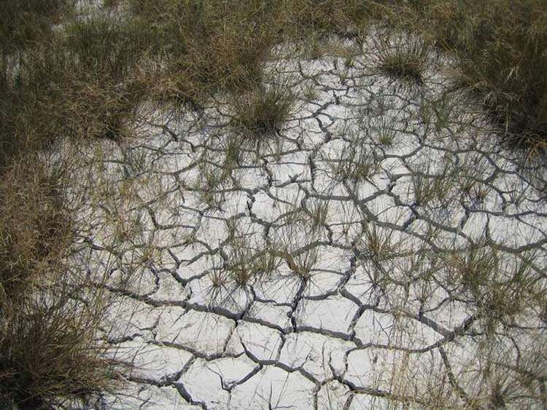

Slide 23
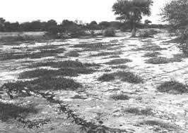
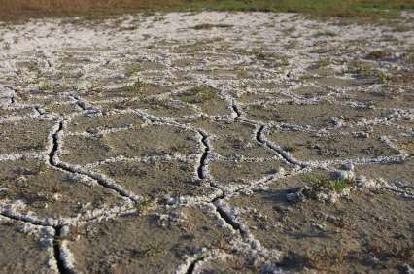
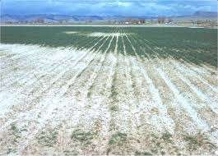

Slide 24
Global salt affected area
According to the statistics given by FAO Land and Nutrition Management Service, 6.5% of the total land in the world is affected by salt
In Asia, around 21.5 million ha of agricultural land is salt-affected, of which 12 million ha is saline and 9.5 million ha is sodic
In terms of absolute affected area, Pakistan ranks eighth among the salt affected countries of the world. 25% of the irrigated land of the country is affected by salinity, out of which 1.4 million hectares has been rendered unproductive and is abandoned

