Slide 1
Leukopoiesis
Leukopoiesis- form of haematopoiesis in which WBC, or leukocytes are formed
in bone marrow in bones in adults/ hematopoietic organs in fetus.
White blood cells, formed from the differentiation of pluripotent hematopoietic
stem cells which give rise to several cell lines with unlimited differentiation
potential.
These immediate cell lines, or colonies, are progenitors of red blood cells , platelets
and the two main groups of WBCs, myelocytes and lymphocytes
Myelocytes leads to myelogenesis (generation of granulocytes and Monocytes)
Lymonhocytes leads to generation of B and T lymphocytes

Slide 2
Leukopoiesis
The progineter cell for all blood elements is CFU-GEMM (Myeloid stem cell)
This stem Cell give rise to :
Granulocytes
Erythroblast
Macrophage
Megakaryoblast
CFU-GEMM
Myeloblast
Lymphoblast
CFU-M
CFU-G
CFU-Ba
CFU-Eo
T-lymphocyte
B-lymphocyte

Slide 3
Leukopoiesis
CFU-GEMM
GM-CSF, G-CSF,
M-CSF
and IL-3
GM-CSF
and IL-3
GM-CSF
IL-3, IL-5
CFU-GM
(Common Precursor) (Neut.+Mono.)
CFU-Ba
CFU-Eo
GM-CSF, G-CSF,
and IL-3
GM-CSF,
M-CSF
IL-3
CFU-G
CFU-M

Slide 4
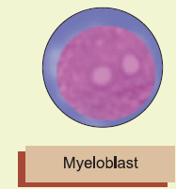
Stages of Granulopoeisis
Some stages for development of all granulocytes are common-No distinction can be made among different cell lines. Stages are:
Myeloblast-- promyelocyte-- myelocyte– metamyelocyte--band cell, and segmented granulocyte
Development of Neutrophils
Myeloblast
Earliest recognizable cell in the granulocytic maturation process.
About 15 to 20 μm in diameter
Large round to oval nucleus,
Small amount of basophilic cytoplasm.
Nucleus contains 2 to 5 nucleoli, nuclear chromatin is fine and reticular in bone marrow in bones in adults/ hematopoietic organs in fetus.

Slide 5
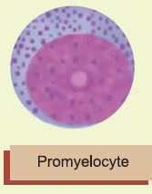
Development of Neutrophils
Promyelocyte
Next stage in the maturation .
Cell become slightly larger in size than myeloblast.
Primary or azurophil granules appear at the promyelocyte
stage.
Nucleus contains nucleoli as in myeloblast stage.
However, nuclear chromatin shows slight condensation.

Slide 6
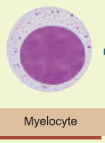
Development of Neutrophils
Myelocyte
Stage is characterized by the appearance of secondary or
specific granules (neutrophilic, eosinophilic, or basophilic)
Myelocyte is smaller cell with round to oval eccentrically
placed nucleus
More condensation of chromatin than in previous stage
Nucleoli absent
Cytoplasm relatively greater than in promyelocyte stage
Contains both primary and secondary granules. Last stage, cell capable of division

Slide 7
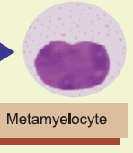
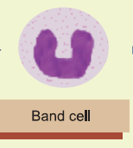
Development of Neutrophils
Metamyelocyte
In this stage, the nucleus becomes indented , kidney shaped
Nuclear chromatin becomes moderately coarse.
Cytoplasm contains both primary and secondary granules.
Band stage (stab form)
Characterised by band-like shape of the nucleus
Constant diameter throughout
Condensed nuclear chromatin

Slide 8
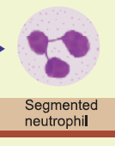
Development of Neutrophils
Segmented neutrophil
With Leishman’s stain, nucleus appears deep purple
With 2 to 5 lobes joined by thin filamentous strands.
Nuclear chromatin pattern is coarse.
Cytoplasm stains light pink and has small, specific granules

Slide 9
Development of Basophils
Under the stimulation of GM-CSF and IL-3, the CFU-GEMM differentiates into CFU-Ba
Myeloblast & Promyelocyte
Common to all granulocytes and no distinction can be made
Basophilic myelocyte & metamyelocyte
Specific granules start to appear in the myelocyte stage,
As the cell develops into the metamyelocyte stage, mitosis ceases
Basophil
Final nuclear shape is masked by the high density of cytoplasmic granules.

Slide 10
Development of Eosinophils
Under the stimulation of GM-CSF, IL-3 and IL-5 the CFU-GEMM differentiates into the CFU-Eo
Myeloblast & Promyelocyte
Common to all granulocytes and no distinction can be made
Eosinnophilic myelocyte & metamyelocyte
Specific granules start to appear in the myelocyte stage,
As the cell develops into the metamyelocyte stage, mitosis ceases
Eosinophil
Mature cell has a bilobed or trilobed nucleus. Species specific variations in granule size once stained

