Slide 1
Early Blight of Potato:
Dr. Salman Ahmad
April 3, 2020

Slide 2
Occurrence & importance:
Occurs in humid and warm areas of world
Cause losses up to 5-78%
$45 million is spent on fungicides to control early blight of potato.

Slide 3
Etiology:
Causal organism: Alternaria solani Order: Moniliales Family: Dematiaceae

Slide 4
Symptoms:
On leaves dark brown spots appear surrounded by yellow halo.
Concentric rings (like target board) develop. These spots resemble with bull’s eye.
In drought spots turn hard, in humid rotting patches appear
Stem show brown to black lesions
In severe attack leaves shriveled, dehisce*(split apart) & fall off.
On infected tubers sunken*(deepen from normal surface) and irregular lesion appear.

Slide 5
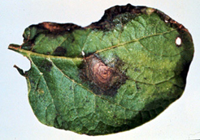
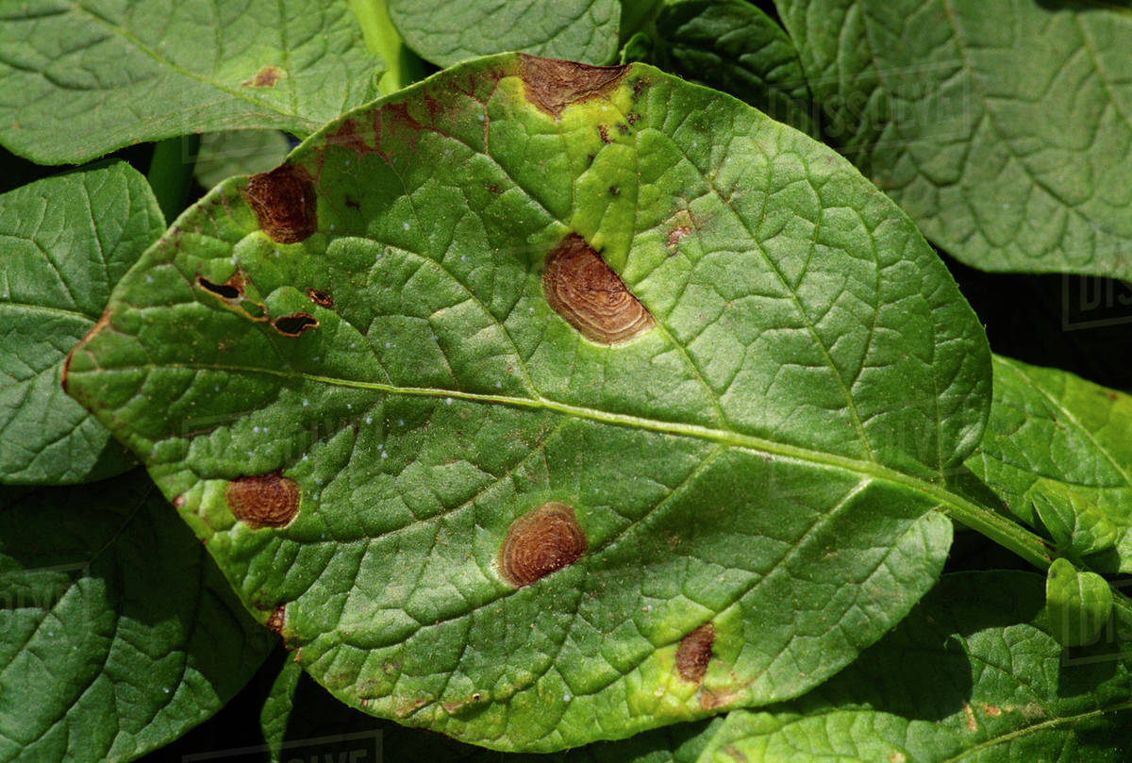
Symptoms:
Concentric Ring
Angular leaf spots.
Concentric rings start from midrib to margin of the leave.

Slide 6
Disease cycle:
Fungi remain viable in dry infected leaves or debris for a year or more
Contaminated tubers also primary source of inoculum
Secondary infection occurs through wind, water & insects that aid fungal spores to move from infected to healthy plants.

Slide 7
Epidemiology:
13.6-23.6°C,
Dew, Infrequent rain & more than 80 % RH favors the fungal growth.

Slide 8
Management:
Cultural practices: a) crop rotation (b) Sanitation (c) burning of residues
Spray Zineb, Dithane M-45 0.2%, Blitox-50 0.25% at 10-21 days interval.
Resesitant genotypes i.e. Desiree

