Slide 1
Subject: Statistics
Class: MA 3rd (Social Work)
Lecture: 5th week
Topic: Two Sample Z and T test

Slide 2
Hypothesis Testing of Two Population’s Means ( when ${σ^{2}}_{1} and {σ^{2}}_{2}$are known)
Suppose there are two population with mean $μ_{1} and μ_{2}$ which are unknown and variances ${σ^{2}}_{1} and {σ^{2}}_{2}$ which are known. Two large samples of size $n_{1} and n_{2}$> 30 are selected from the population and sample means ${\overline{X}}_{1} and {\overline{X}}_{2}$ are calculated. So the testing procedure used to test whether the two population’s means are identical or not by using this kind of information is called two sample Z-test. The test procedure for two sample Z-test is given below
Procedure:
1. We frame the null and alternative hypothesis. Three different forms of null and alternative hypothesis are possible which are:
$H_{0}: μ_{1}−μ_{2}=0 and H_{1}:μ_{1}−μ_{2}≠0$
$H_{0}:μ_{1}−μ_{2}≤0 and H_{1}:μ_{1}−μ_{2}>0$
$H_{0}:μ_{1}−μ_{2}≥0 and H_{1}:μ_{1}−μ_{2}<0$
OR
$H_{0}: μ_{1}=μ_{2} and H_{1}:μ_{1}≠μ_{2}$
$H_{0}:μ_{1}≤μ_{2} and H_{1}:μ_{1}>μ_{2}$
$H_{0}:μ_{1}≥μ_{2} and H_{1}:μ_{1}<μ_{2}$

Slide 3
2. Level of significance α is decided that can be 1%, 5% and 10%
3. Test Statistics $Z=\frac{{(\overline{X}}_{1} −{\overline{X}}_{2})−(μ_{1} − μ_{2})}{\sqrt{\frac{{σ^{2}}_{1}}{n_{1}}+\frac{{σ^{2}}_{2}}{n_{2}}}}$
4. Critical Region
It depends upon alternative hypothesis
If $H_{ 1}:μ_{1}−μ_{2}≠0$ than $\left|Z_{cal}\right|≥Z_{α/2}$ or ($Z_{cal}>Z_{α}$ and ${−Z}_{cal}<−Z_{α}$)
If $H_{1}:H_{1}:μ_{1}−μ_{2}>0$ than $Z_{cal}>Z_{α}$
If $H_{1}:μ_{1}−μ_{2}<0$ than $Z_{cal}<−Z_{α}$
5. Calculation
Put all the information test statistics and get the results
6. Conclusion
If the calculated value of Z falls in the critical region than we say that our null hypothesis is rejected under and the provided information and conclude that the two population’s means are not identical..

Slide 4
Table that can be use to take the tabulated value at different alpha’s is given below:
α | Two sided (α/2) | One sided right (α) | One sided left (-α)
0.10 (10%) | -1.645 and +1.645 | 1.282 | -1.282
0.05 (5%) | -1.96 and 1.96 | 1.645 | -1.645
0.02 (2%) | -2.326 and 2.326 | 2.054 | -2.054
0.01 (1%) | -2.575 and 2.575 | 2.326 | -2.326

Slide 5
Question
Suppose you wish to estimate the effects of certain sleeping pill on men and women. Two samples are independently selected, and the relevant data are shown below:
 | Men | Women
Sample size | $$n_{1}=36$$ | $$n_{2}=64$$
Sample Mean | $${\overline{X}}_{1}=8.75$$ | $${\overline{X}}_{2}=7.25$$
Population Variance | $${σ^{2}}_{1}=9$$ | $${σ^{2}}_{2}=4$$
Test the null hypothesis $H_{0}: μ_{1}=μ_{2}$ against the alternative hypothesis $H_{1}:μ_{1}>μ_{2}$ at α = 0.05.

Slide 6
Solution
Null hypothesis: $H_{0}: μ_{1}=μ_{2}$ Alternative hypothesis:$H_{1}:μ_{1}>μ_{2}$
Level of significance: α = 0.05
Test statistics: $Z=\frac{{(\overline{X}}_{1} −{\overline{X}}_{2})−(μ_{1} − μ_{2})}{\sqrt{\frac{{σ^{2}}_{1}}{n_{1}}+\frac{{σ^{2}}_{2}}{n_{2}}}}$
Critical region: $Z_{cal}>Z_{0.05}$
From the table Z we got the value of $Z_{0.05}$=1.645 for one tail positive. So the critical region will be.
$Z_{cal}>1.645$
2.683 > 1.645

Slide 7
5. Calculations:
Here
$n_{1}=36, n_{2}=64$, ${\overline{X}}_{1}=8.75,{\overline{X}}_{2}=7.25, {σ^{2}}_{1}=9 and{σ^{2}}_{2}=4$
So put all this information in the test statistics we got
$$Z=\frac{\left(8.75 −7.25\right)−0}{\sqrt{\frac{9}{36}+\frac{4}{64}}}=2.683$$
6. Conclusion: Since the calculated value of Z = 2.683 falls in the critical region, so we reject our null hypothesis and conclude that sleeping pills effect more men than women.

Slide 8
Hypothesis Testing of Two Population’s Means ( when ${σ^{2}}_{1} and {σ^{2}}_{2}$are unknown)
Suppose there two population with mean $μ_{1} and μ_{2}$ which are unknown and variances ${σ^{2}}_{1} and {σ^{2}}_{2}$ which are also unknown but assumed to be equal. Two small samples of size $n_{1} and n_{2}<$ 30 are selected from the population and sample means ${\overline{X}}_{1} and {\overline{X}}_{2}$ are calculated. So the testing procedure used to test whether the two population’s means are identical or not by using this kind of information is called two sample t-test. The testing procedure for two sample
t-test is given below
Procedure:
1. Formulating Hypothesis: We frame the null and alternative hypothesis. Three different forms of null and alternative hypothesis are possible which are:
$H_{0}: μ_{1}−μ_{2}=0 and H_{1}:μ_{1}−μ_{2}≠0$
$H_{0}:μ_{1}−μ_{2}≤0 and H_{1}:μ_{1}−μ_{2}>0$
$H_{0}:μ_{1}−μ_{2}≥0 and H_{1}:μ_{1}−μ_{2}<0$
OR
$H_{0}: μ_{1}=μ_{2} and H_{1}:μ_{1}≠μ_{2}$
$H_{0}:μ_{1}≤μ_{2} and H_{1}:μ_{1}>μ_{2}$
$H_{0}:μ_{1}≥μ_{2} and H_{1}:μ_{1}<μ_{2}$

Slide 9
2. Level of significance α is decided that can be 1%, 5% and 10%
3. Test Statistics $t=\frac{{(\overline{X}}_{1} −{\overline{X}}_{2})−(μ_{1} − μ_{2})}{s_{p}\sqrt{\frac{1}{n_{1}}+\frac{1}{n_{2}}}}$
Where
$$s_{p}=\sqrt{\frac{\sum{{(X_{1}−{\overline{X}}_{1})}^{2}}+\sum{{(X_{2}−{\overline{X}}_{2})}^{2}}}{n_{1}+n_{2}−2}}$$
OR
$s_{p}=\sqrt{\frac{\left(n_{1}−1\right){s^{2}}_{1}+(n_{2}−1){s^{2}}_{2}}{n_{1}+n_{2}−2} }$
And
$(μ_{1} − μ_{2})$ is either equals to zero or there may given a value in the question.

Slide 10
4. Critical Region
It depends upon alternative hypothesis
If $H_{1}: μ_{1}−μ_{2}≠0$ than $\left|t_{cal}\right|≥t_{α/{2(v)}}$ or ($t_{cal}>t_{α(v)}$and${−t}_{cal}<−t_{α(v)}$)
If $H_{1}:μ_{1}−μ_{2}>0$ than $t_{cal}>t_{α(v)}$
If $H_{1}:μ_{1}−μ_{2}<0$ than $t_{cal}<−t_{α(v)}$
Where
$v=n_{1}+n_{2}−2$ which is the degree of freedom for two sample t-test
5. Calculation
Put all the information test statistics and get the results
6. Conclusion
If the calculated value of t falls in the critical region than we say that our null hypothesis is rejected under and the provided information and conclude that the selected value is not the correct estimate about population mean.

Slide 11
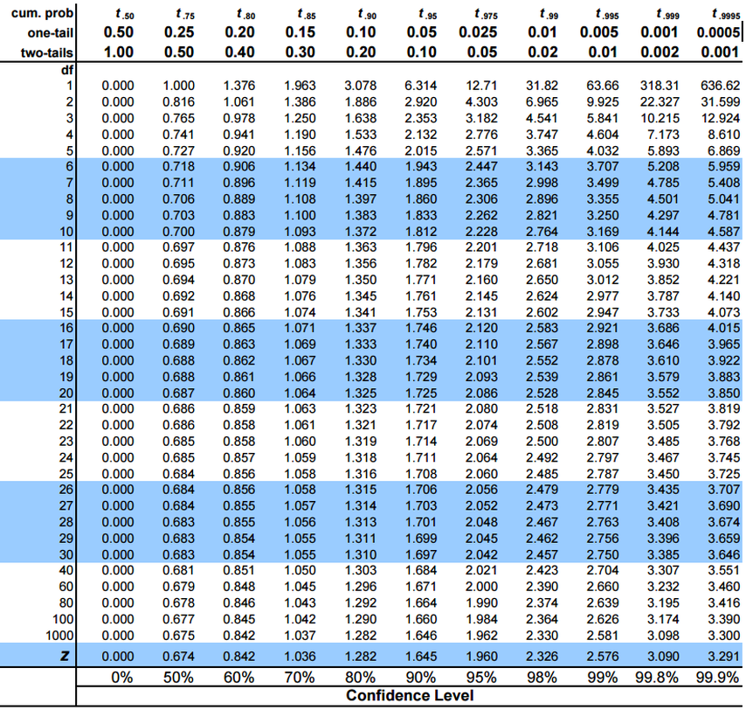

Slide 12
Question
Two samples are randomly selected from two classes of students who have been taught by different methods. An examination is given and the results are shown as follows
 | S 1 | S 2
Sample size | $$n_{1}=8$$ | $$n_{2}=10$$
Sample Mean | $${\overline{X}}_{1}=95$$ | $${\overline{X}}_{2}=97$$
Sample Variance | $${s^{2}}_{1}=9$$ | $${s^{2}}_{2}=4$$
On the assumption that the test scores of the two classes of students have identical variances, determine whether the two different methods of teaching are equally effective at α = 0.01.

Slide 13
Solution
Null hypothesis: $H_{0}: μ_{1}=μ_{2}$ Alternative hypothesis: $H_{1}:μ_{1}≠μ_{2}$
Level of significance: α = 0.01
Test statistics: $t=\frac{{(\overline{X}}_{1} −{\overline{X}}_{2})−(μ_{1} − μ_{2})}{s_{p}\sqrt{\frac{1}{n_{1}}+\frac{1}{n_{2}}}}$
Critical region: ${\text{|}t_{cal}\text{| }\text{≥} t}_{α/2(v)}$
$${\text{|}t_{cal}\text{| }\text{≥} t}_{α/2(n_{1}+n_{2}−2)}$$
$${\text{|}t_{cal}\text{| }\text{≥} t}_{0.01/2(8+10−2)}$$
$${\text{|}t_{cal}\text{| }\text{≥} t}_{0.005(16)}$$
From t-table, we have $t_{0.005(16)}=2.291$
So the critical region will be
${|t}_{cal}|≥2.291$
|0.689|>2.291

Slide 14
5. Calculations:
Here $n_{1=}8,n_{2}=10{, \overline{X}}_{1}=8.75,{\overline{X}}_{2}=7.25, {s^{2}}_{1}=9 and {s^{2}}_{2}=4$
So first we have to find $s_{p}$
$$s_{p}=\sqrt{\frac{\left(8−1\right)9+\left(10−1\right)4}{8+10−2}}=37.4375$$
Now
$t=\frac{(95 −97)−0}{37.4375\sqrt{\frac{1}{8}+\frac{1}{10}}}=−0.689$
6. Conclusion: Since the calculated value of t does not fall in the critical region we therefore do not reject our null hypothesis and conclude that two different methods of teaching are equally effective.

