Slide 1
Autosomal Dominant and Recessive Inheritance

Slide 2
Characteristics of Autosomal Dominant Inheritance
Autosomal dominant inheritance is characterized by vertical transmission of the disease phenotype, a lack of skipped generations, and roughly equal numbers of affected males and females. Father-to-son transmission may be observed
The recurrence risk for an autosomal dominant disorder is 50%. Because of independence, this risk remains constant no matter how many affected or unaffected children are born.

Slide 3
BASIC CONCEPTS OF FORMAL GENETICS
Gregor Mendel’s Contributions Mendel’s key contributions were the principles of dominance and recessiveness, segregation, and independent assortment.
The Concept of Phenotype The phenotype, which is physically observable, results from the interaction of genotype and environment.

Slide 4
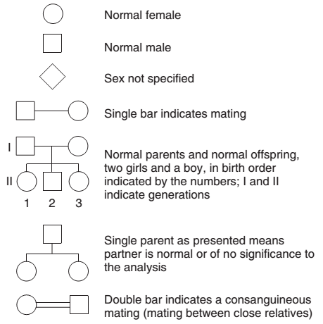

Slide 5
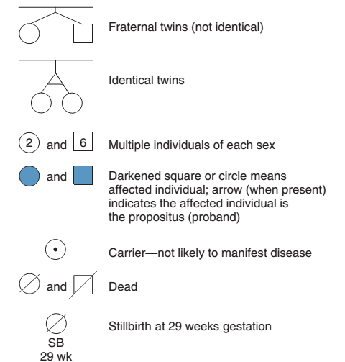

Slide 6
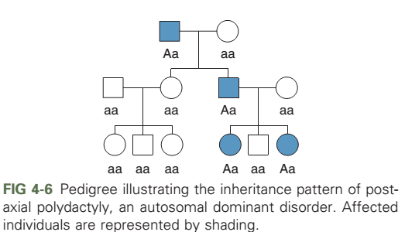

Slide 7
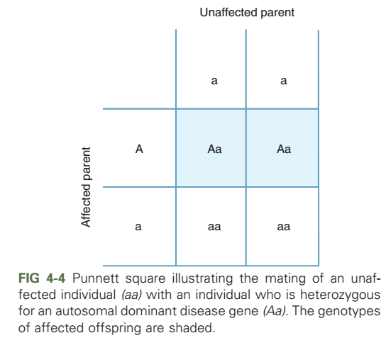

Slide 8
AUTOSOMAL RECESSIVE INHERITANCE
Autosomal recessive inheritance is characterized by clustering of the disease phenotype among siblings, but the disease is not usually seen among parents or other ancestors. Equal numbers of affected males and females are usually seen, and consanguinity may be present

Slide 9
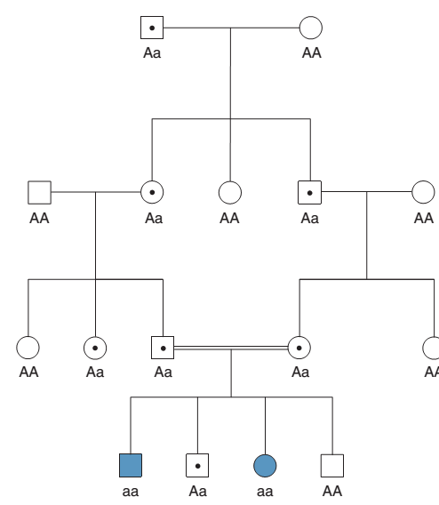
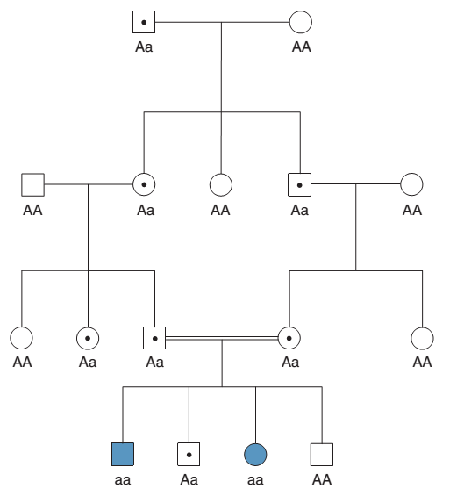

Slide 10
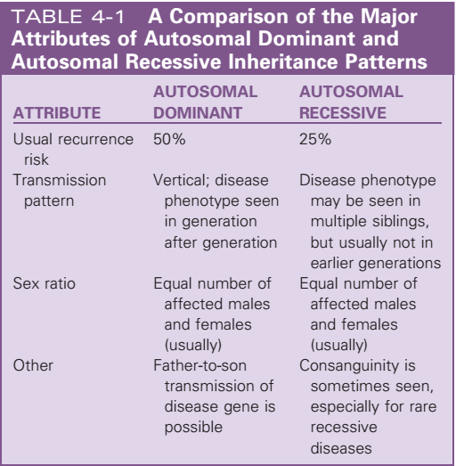

Slide 11
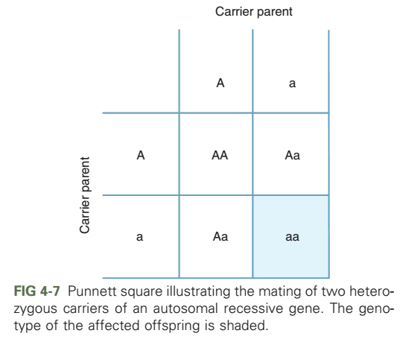

Slide 12
“Dominant” Versus “Recessive”: Some Cautions
Most dominant diseases are actually more severe in affected homozygotes than in heterozygotes. A useful and valid way to distinguish dominant and recessive disorders is that heterozygotes are clinically affected in most cases of dominant disorders, whereas they are almost always clinically unaffected in recessive disorders.
In some cases, a disease may be inherited in either autosomal dominant or autosomal recessive fashion, depending on the nature of the mutation that alters the gene product like Familial isolated growth hormone deficiency (IGHD) and β-thalassemia
A final caution is that the terms dominant and recessive, strictly speaking, apply to traits, not genes like sickle cell disease. Heterozygotes, who are said to have sickle cell trait, are usually clinically normal. However, a heterozygote has an increased risk for splenic infarctions at very high altitude.

Slide 13
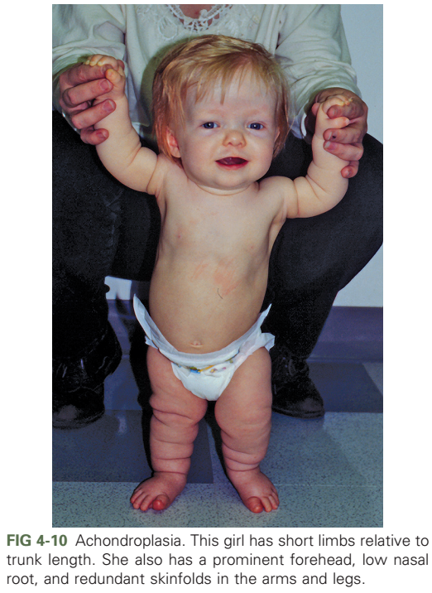

Slide 14
FACTORS THAT AFFECT EXPRESSION OF DISEASE-CAUSING GENES
New mutations are a common cause of the appearance of a genetic disease in a person with no previous family history of the disorder.
The recurrence risk for the person’s siblings is very low, but the recurrence risk for the person’s offspring may be substantially increased.
A large fraction of the observed cases of many autosomal dominant diseases are the result of new mutations. For example, approximately 7/8 of all cases of achondroplasia are caused by new mutations, and only 1/8 are inherited from an affected parent.

Slide 15
Germline Mosaicism
Germline mosaicism occurs when all or part of a parent’s germline is affected by a disease causing mutation but the somatic cells are not
Germline mosaicism has been studied extensively in the lethal perinatal form of osteogenesis imperfecta
Although germline mosaicism has been demonstrated for type II OI, most noninherited cases (approximately 95%) are thought to be caused by new mutations
Other diseases in which germline mosaicism has been observed include achondroplasia, neurofiromatosis type 1, Duchenne muscular dystrophy, and hemophilia A
Notes:
The fact that unaffected parents sometimes produced multiple offspring affected with this disease led to the conclusion that type II OI was an autosomal recessive trait. This was disputed by studies in which the polymerase chain reaction (PCR) technique was used to amplify DNA from the sperm of a father of two children with type II OI. This DNA was compared with DNA extracted from his somatic cells (skin firoblasts). Although procollagen mutations were not detected in the firoblast DNA, they werefound in approximately one of every eight sperm cells. This was a direct demonstration of germline mosaicism in this man.

Slide 16
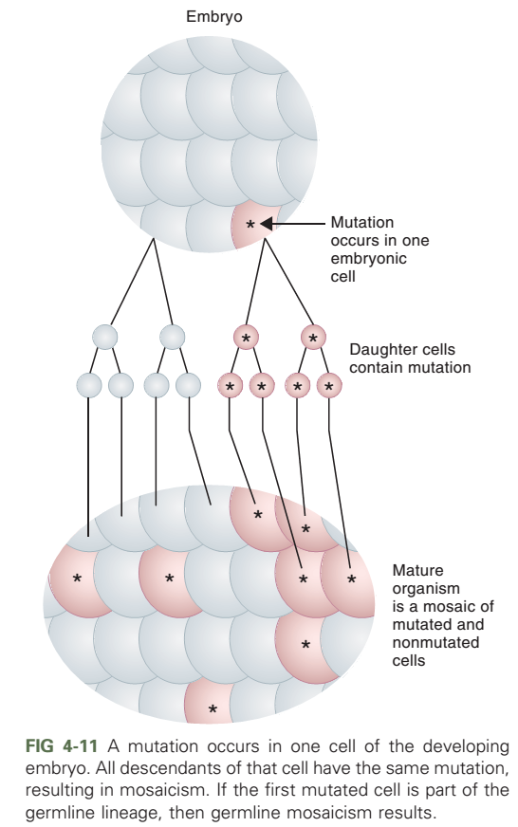

Slide 17
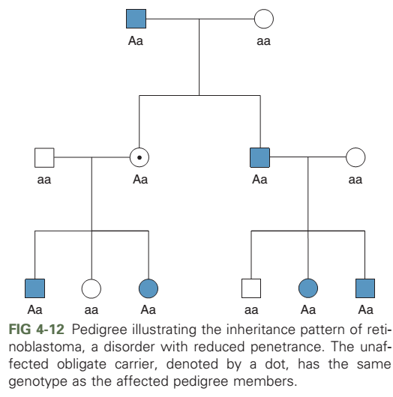
Notes:
Another important characteristic of many genetic diseases is reduced (or incomplete) penetrance: a person who has a disease-causing genotype might not exhibit the disease phenotype at all, even though he or she can transmit the disease causing allele to the next generation

Slide 18
Age-Dependent Penetrance
A delay in the age of onset of a genetic disease is known as age-dependent penetrance.
One of the best-known examples is Huntington disease others are hemochromatosis, a recessive disorder of iron storage, familial Alzheimer disease and many inherited cancers, including autosomal dominant breast cancer
Age-dependent penetrance is observed in many genetic diseases. It complicates the interpretation of inheritance patterns in families.
Notes:
If the disease were present at birth, nearly all affected persons would die before reaching reproductive age, and the frequency of the disease in the population would be much lower. Delaying the age of onset of the disease thus reduces natural selection against a disease-causing allele, increasing its frequency in a population.

Slide 19
