Slide 1
Subject: Statistics
Class: BS 4th (Social Work)
Lecture: 7th week
Topic: F-test

Slide 2
F-Test for Equality of Two Population Variances
An F-test (Snedecor and Cochran, 1983) is used to test if the variances of two populations are equal. This test can be a two-tailed test or a one-tailed test. The two-tailed version tests against the alternative that the variances are not equal. The one-tailed version only tests in one direction, that is the variance from the first population is either greater than or less than (but not both) the second population variance. The choice is determined by the problem. For example, if we are testing a new process, we may only be interested in knowing if the new process is less variable than the old process.

Slide 3
General Procedure for F-test
The procedure to perform an F-test is given as follows:
Formulating Hypothesis: We frame the null and alternative hypothesis. Three different forms of null and alternative hypothesis are possible which are:
$H_{0}:{σ^{2}}_{1}={σ^{2}}_{2} and H_{1}:{σ^{2}}_{1}≠{σ^{2}}_{2}$
$H_{0}:{σ^{2}}_{1}≤{σ^{2}}_{2} and H_{1}:{σ^{2}}_{1}>{σ^{2}}_{2}$
$H_{0}:{σ^{2}}_{1}≥{σ^{2}}_{2} and H_{1}:{σ^{2}}_{1}<{σ^{2}}_{2}$
2. Level of significance α is decided that can be 1%, 5% and 10%
3. Test Statistics $F=\frac{{s^{2}}_{1}}{{s^{2}}_{2}}$

Slide 4
4. Critical Region
It depends upon alternative hypothesis. The hypothesis that the two variances are equal is rejected if
If $H_{1}:σ^{2}≠{σ^{2}}_{0}$ than $F<F_{1−α/2(n_{1}−1)(n_{2}−1)}$
OR
$F>F_{α/2(n_{1}−1)(n_{2}−1)}$
If $H_{1}:σ^{2}>{σ^{2}}_{0}$ than $F>F_{α (n_{1}−1)(n_{2}−1)}$
If $H_{1}:σ^{2}<{σ^{2}}_{0}$ than $F<F_{1−α (n_{1}−1)(n_{2}−1)}$
Where
$$n_{1}−1=v_{1} and n_{2}−1=v_{2}$$
Are degrees of freedom for F-test.
5. Calculation
Put all the information test statistics and get the results
6. Conclusion
If the calculated value of F falls in the critical region than we say that our null hypothesis is rejected under and the provided information and conclude that the population variance is not equal to the specific value we assumed.

Slide 5
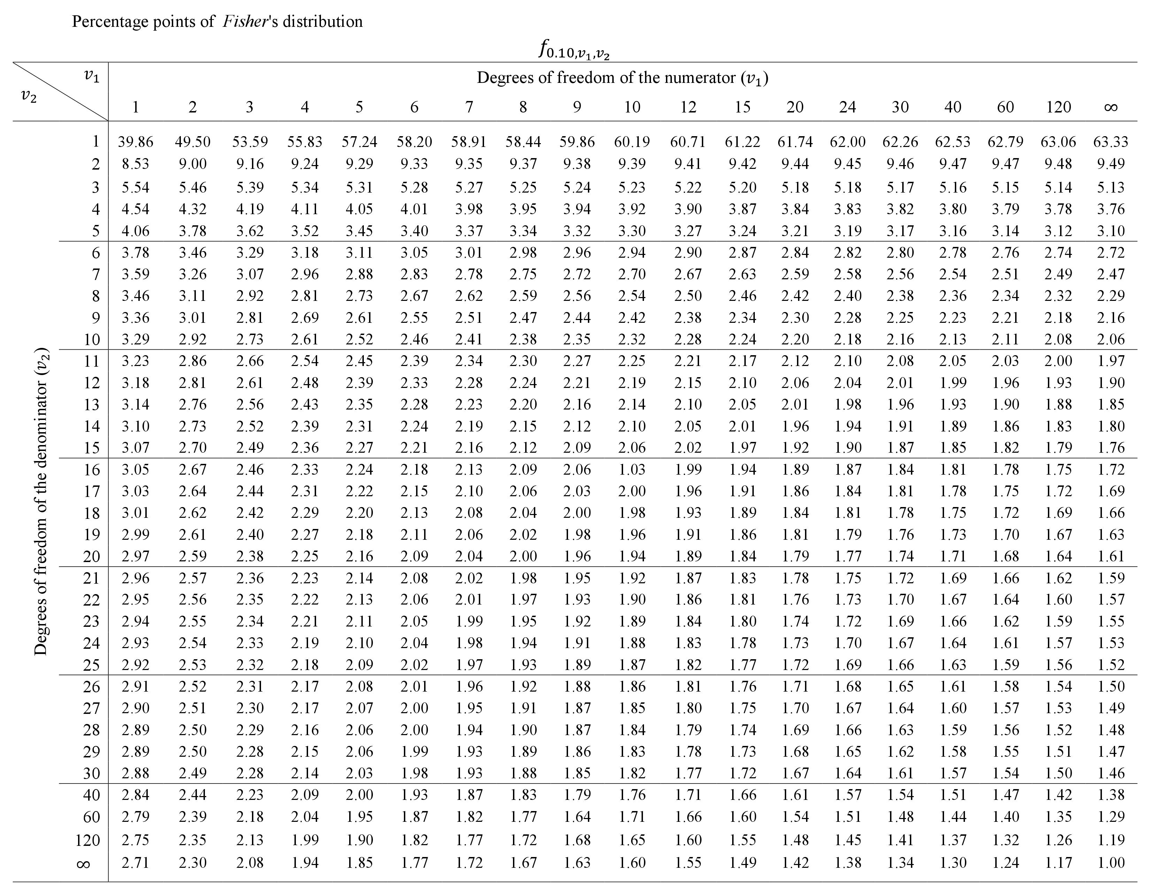

Slide 6
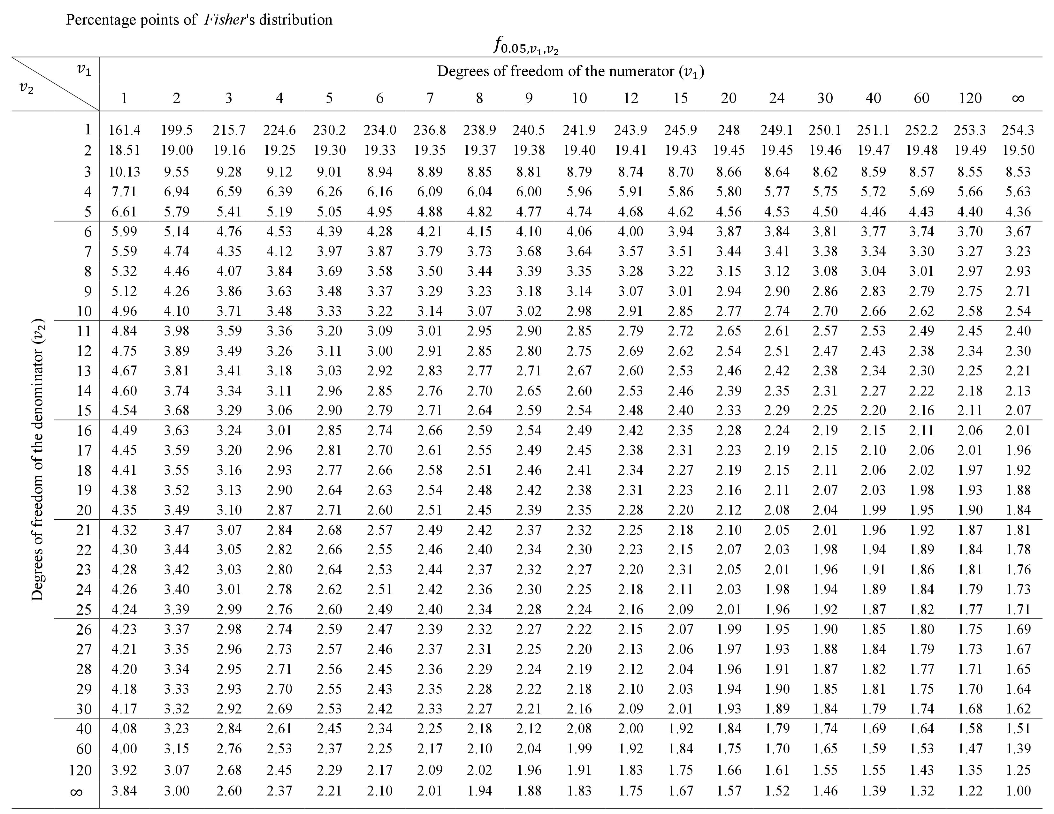

Slide 7
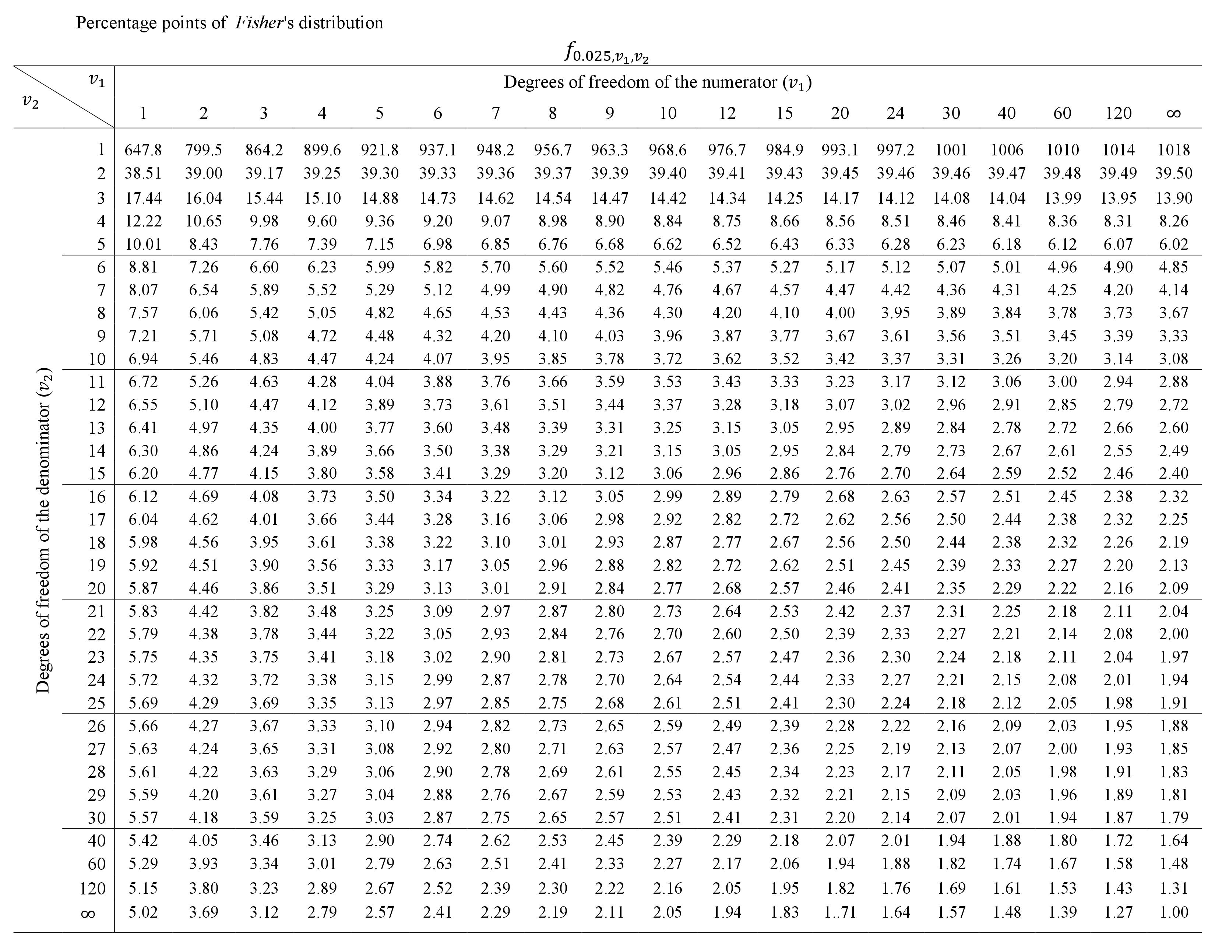

Slide 8
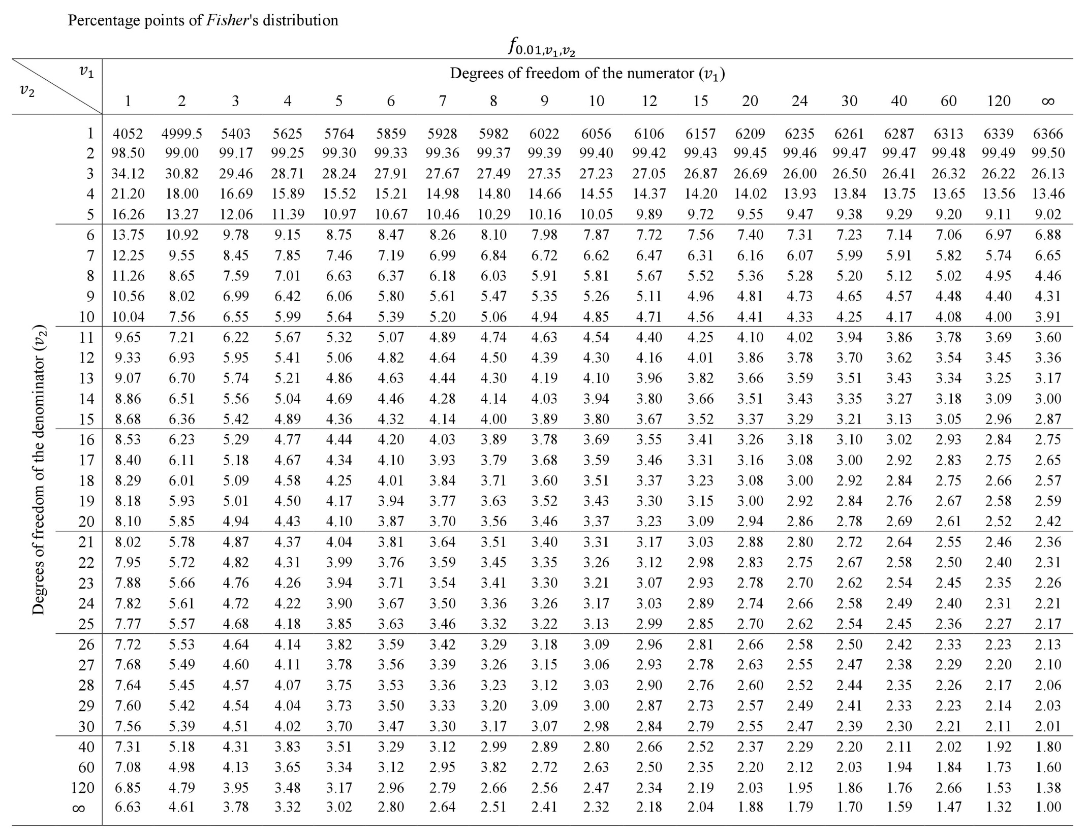

Slide 9
Questions:
Q 1: Given two random sample of size n1 = 12 and n2 = 10 from two normal populations, with standard deviations $s_{1}=2.3 and s_{2}=1.5,$ test at 0.05 level of significance, the hypothesis $H_{0}:{σ^{2}}_{1}={σ^{2}}_{2}$ against the alternative. $H_{1}:{σ^{2}}_{1}>{σ^{2}}_{2}$
Solution
Null Hypothesis: ${σ^{2}}_{1}={σ^{2}}_{2}$ Alternative Hypothesis: ${σ^{2}}_{1}>{σ^{2}}_{2}$
Level of Significance: α = 0 . 05
Test Statistics: $F=\frac{{s^{2}}_{1}}{{s^{2}}_{2}}$
Critical Region: As our alternative hypothesis is $H_{1}:σ^{2}>{σ^{2}}_{0}$ than $F>F_{α (n_{1}−1)(n_{2}−1)}$
From F-table the value of $F_{α (n_{1}−1)(n_{2}−1)}$ is as follows
$$F>F_{0.05 (12−1)(10−1)}$$
$F_{0.05 (11)(9)}=$ 3.105
$F>3.105$
2.35 > 3.105

Slide 10
5. Calculations:
Here n1=12 and n2 = 10 and we are with standard deviations. But in test statistics we need variances so we take the squares of standard deviation values we got
$${s^{2}}_{1}^{}=12.167$$
$${s^{2}}_{2}^{}=2.25$$
So now
$$F=\frac{12.167}{2.25}=2.35$$
6. Conclusion: Since the computed value of F does not falls in the critical region, we therefore do not reject our null hypothesis and may conclude that there is a sufficient evidence to conclude that the two variances are equal.

Slide 11
Practice Question
Q 1: Two random samples are drawn from two normal populations are
Sample 1: 20, 16, 26, 27, 23, 22, 18, 24, 25 and 19
Sample 2: 27, 22, 42, 35, 32, 34, 38, 28, 41, 43, 30, and 27.
Obtain the estimates of the variances of the populations and test whether the populations have same variance.

