Slide 1
Sociology ^{BBA} Semester: 3rd ^{Lecture No. 16} ^{Instructor: Mumtaz Hussain} University of Sargodha Sb Campus ^{Bhakkar}

Slide 2
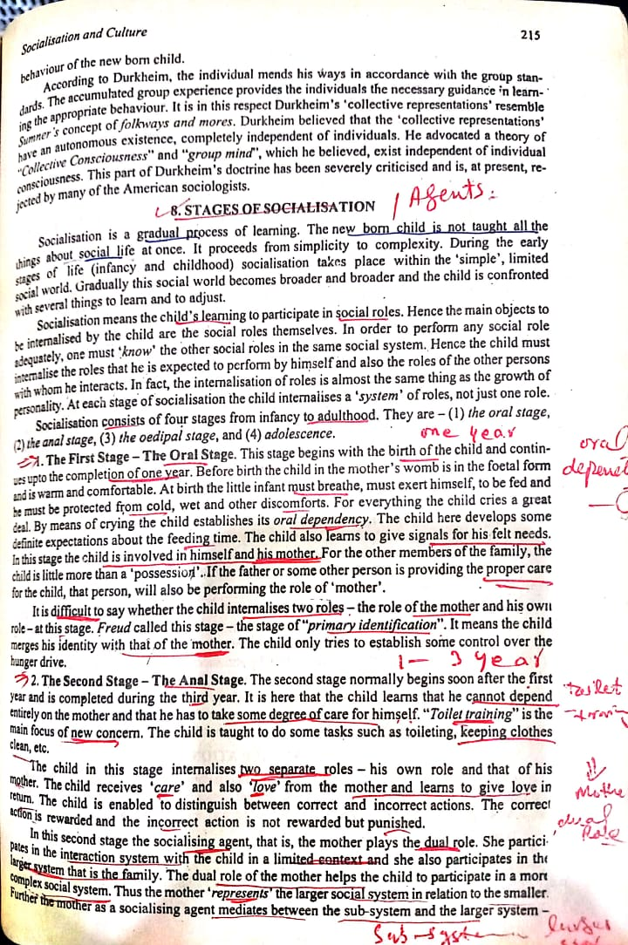

Slide 4
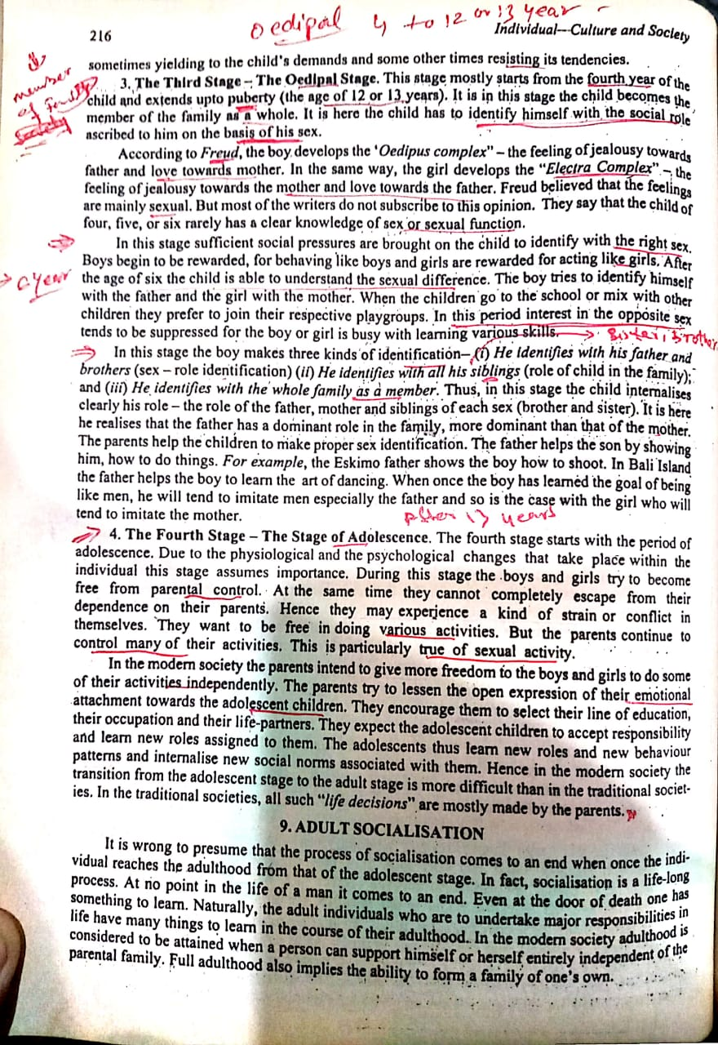

Slide 6
The 4 Stages of Cognitive Development
Jean Piaget's theory of cognitive development suggests that children move through four different stages of mental development.
His theory focuses not only on understanding how children acquire knowledge, but also on understanding the nature of intelligence.
Piaget's stages are:
Sensorimotor stage: birth to 2 years
Preoperational stage: ages 2 to 7
Concrete operational stage: ages 7 to 11
Formal operational stage: ages 12 and up
Piaget believed that children take an active role in the learning process, acting much like little scientists as they perform experiments, make observations, and learn about the world. As kids interact with the world around them, they continually add new knowledge, build upon existing knowledge, and adapt previously held ideas to accommodate new information.

Slide 8
The Sensorimotor Stage
Ages: Birth to 2 Years
Major Characteristics and Developmental Changes:
The infant knows the world through their movements and sensations.
Children learn about the world through basic actions such as sucking, grasping, looking, and listening
Infants learn that things continue to exist even though they cannot be seen (object permanence).
They are separate beings from the people and objects around them.
They realize that their actions can cause things to happen in the world around them

Slide 9
The Preoperational Stage
Ages: 2 to 7 Years
Major Characteristics and Developmental Changes:
Children begin to think symbolically and learn to use words and pictures to represent objects.
Children at this stage tend to be egocentric and struggle to see things from the perspective of others.
While they are getting better with language and thinking, they still tend to think about things in very concrete terms.

Slide 10
The Concrete Operational Stage
Ages: 7 to 11 Years
Major Characteristics and Developmental Changes
During this stage, children begin to thinking logically about concrete events.
They begin to understand the concept of conservation; that the amount of liquid in a short, wide cup is equal to that in a tall, skinny glass, for example.
Their thinking becomes more logical and organized, but still very concrete.
Children begin using inductive logic, or reasoning from specific information to a general principle

Slide 11
The Formal Operational Stage
Ages: 12 and Up
Major Characteristics and Developmental Changes:
At this stage, the adolescent or young adult begins to think abstractly and reason about hypothetical problems.
Abstract thought emerges.
Teens begin to think more about moral, philosophical, ethical, social, and political issues that require theoretical and abstract reasoning.
Begin to use deductive logic, or reasoning from a general principle to specific information

Slide 12
Thank You

