Slide 1
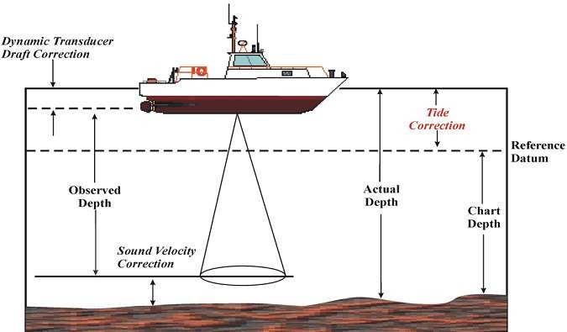
Lecture # 16 Hydrographic Surveying

Slide 2
It is the branch of surveying which deals with water bodies
e.g. Lake, river etc.
Hydrographic Surveying includes all types of hydrological observations which are necessary for design of hydraulic or marine structure.
For design of dams barrages, and weirs , it is essential to know amount of rainfall on catchment area and discharge of water in rivers.
The usual fundamental principles of surveying and leveling are adopted for acquiring data for determination of :
Water volume
Rate of flow
To determine the shape of the area underlying the water surface etc.
2

Slide 3
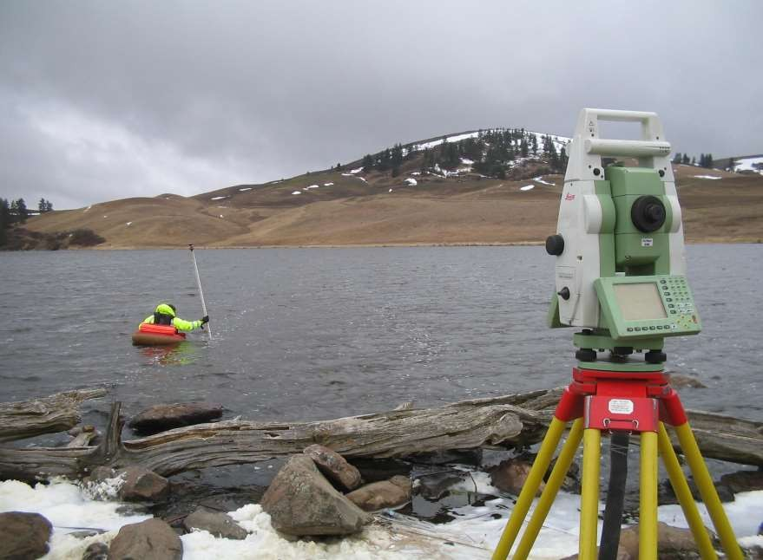

Slide 4
To determine the quantities of subaqueous excavations.
Measure areas subjected to scouring or silting in harbours or docks.
Locate rocks and other objects such as buoys, lights etc to aid safe navigation.
To prepare navigation charts exhibiting the depths available for navigation.
Control floods, and to plan water supply and storage from rivers.
To develop water resources for power, irrigation and recreation
4

Slide 5
The measurement of depth of water at various points is termed as sounding.
Depth of Sounding is referred to the water level at the time it is made.
A number of benchmarks (B.M.) are established at frequent intervals along the shorelines, and gauges are set on them.
5

Slide 6
The field work consists of both horizontal as well as vertical control.
The horizontal control is established by traversing or triangulation.
For vertical control, the tide gauges are kept in operation continuously since the water level at the gauge must also be known when soundings are recorded.
6

Slide 7
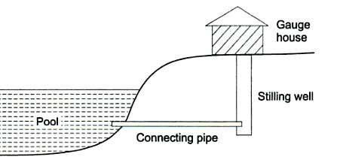
These are used to determine the exact water surface level.
The movement of tides during the time soundings are made.
The gauges are read at regular intervals, varying from 10 min to 30 min.
7

Slide 8
These gauges may be non-registering or self registering types.
Non registering types requires an observer to record the water level.
Staff gauge.
Float gauge
Weight gauge
8

Slide 9
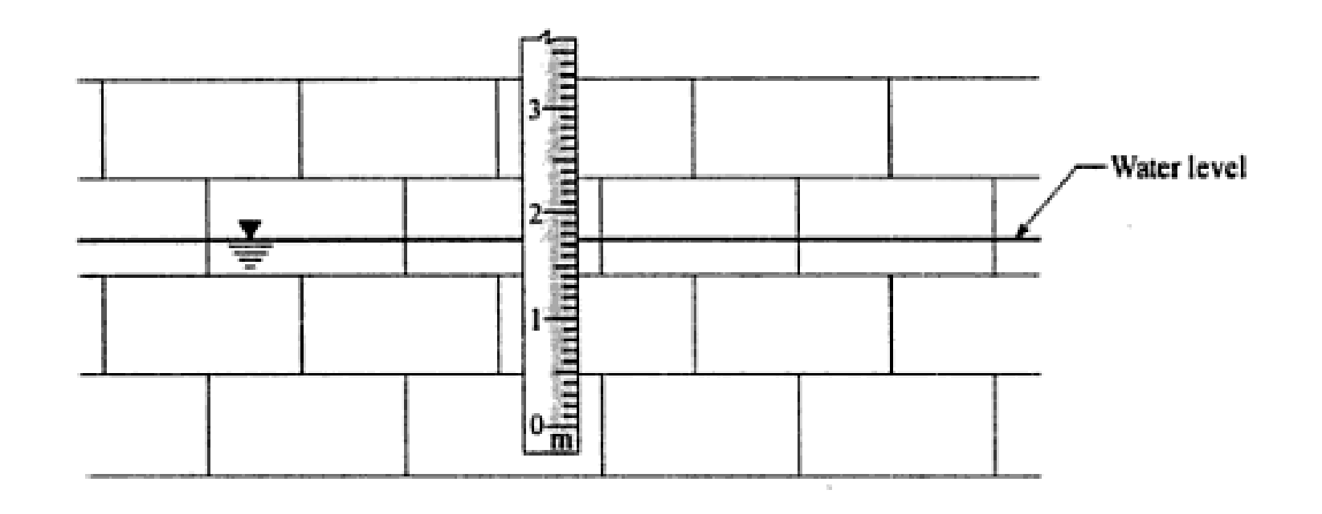
1. Simplest type of gauge.
2. It consists of a graduated board, 150 to 250 mm wide and 100 mm thick, fixed in vertical position.
9

Slide 10
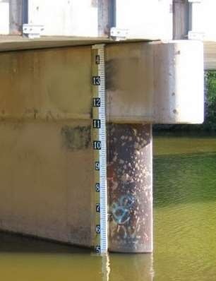
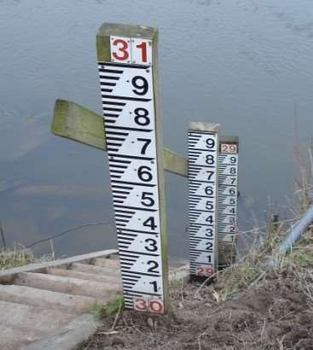

Slide 11
1. The float gauge is designed to overcome the difficulty in reading a staff gauge when the intensity of tides is high and the variations of water level is more.
2. It consists of a float to which a graduated vertical staff is attached.

Slide 12
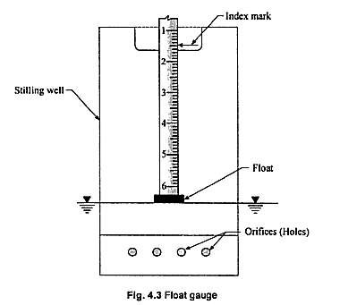

Slide 13
The weight gauge consists a weight attached to brass chain or wire.
The chain passes over a pulley, and is laid horizontal along the side of a graduated scale.
The weight is lowered to touch the water surface, and the reading is taken on the graduated scale against an index attached to the chain.

Slide 14
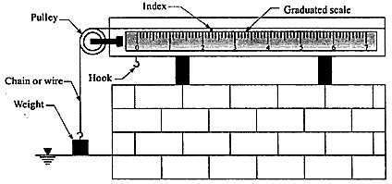

Slide 15
The process of determining depth below water surface is called as sounding.
The step before undergoing sounding is determining the mean sea level.
Depth of Sounding is referred to the water level at the time it is made.
The reduced level of any point of a water body is determined by subtracting the sounding from mean sea level, Which it is analogous to levelling.
A number of benchmarks (B.M.) are established at frequent intervals along the shorelines, and gauges are set on them.

Slide 16
Preparation of accurate charts for navigation.
Determination of the quantities of the material to be filled.
Obtaining information for design of breakwaters, sea wells etc.
Material that to be dredged has to be determined early to facilitate easy movement in project without any confusion.
Material dredging should also accompany where filling has to be done. Material dumping is also measured

Slide 17
The sounding points should be selected keeping in mind that all the important irregularities are recorded.
The soundings are thus made along a series of straight lines at right angles to the shoreline.
The spacing between the sounding lines and between the sounding points depends upon the nature of submarine surface as well as on the object of the survey.
Usually Spacing between sounding lines is kept 30 m and spacing between sounding points is kept 7.5m to 15 m.

Slide 18
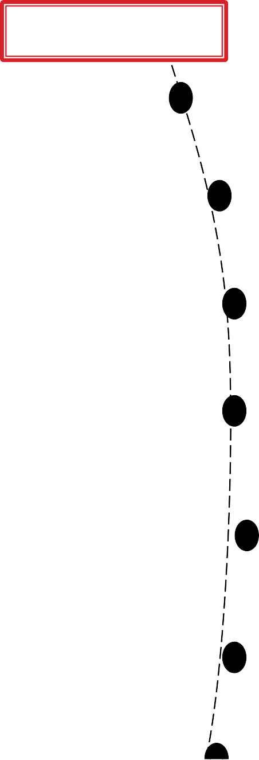
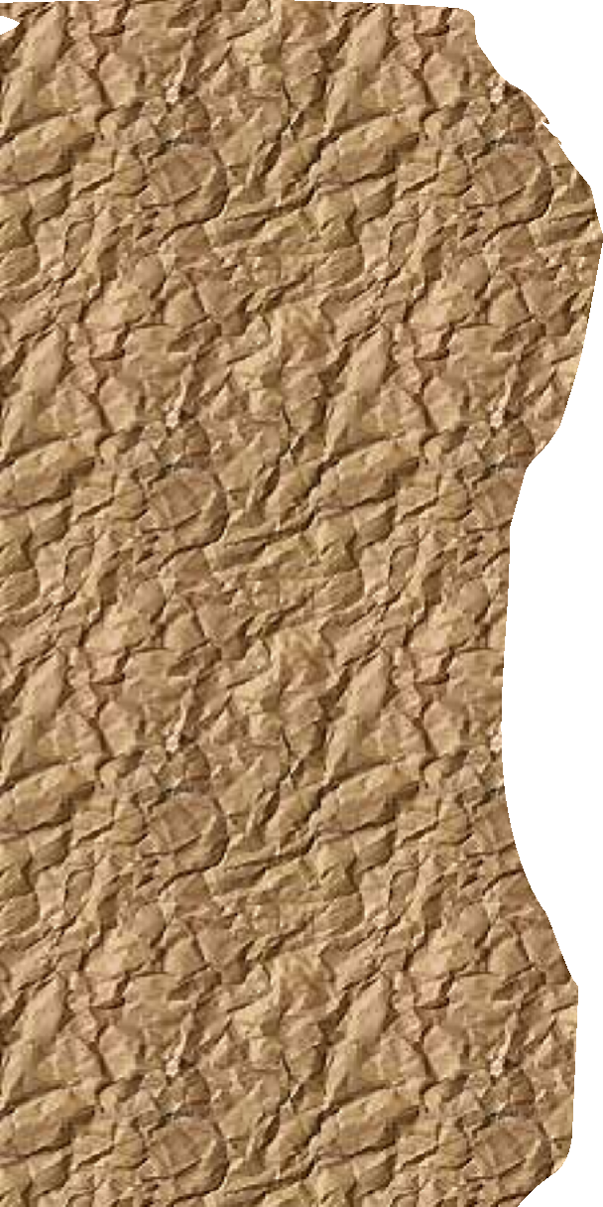
Sounding point
Range line
Shore line
20

