Slide 1
Replication of Plant Viruses (RNA)
Key concepts: • The vast majority of plant RNA viruses have positive (mRNA sense) single-stranded RNA genome • Some plant RNA viruses have negative single-stranded, or double-stranded RNA genome • Replication is at the core of the infection cycle of plant RNA viruses and occurs solely through RNA intermediates of positive and negative polarities • Replication of most plant RNA viruses takes place in viral replication complexes tethered to modified membranes of cytoplasmic organelles • Viral replication complexes are dynamic, and contain the viral RNA, viral replication proteins and proteins from the host • A viral RNA-dependent RNA polymerase is responsible for the synthesis of new genomic RNA using parental genome as template • Viral proteins and co-opted host factors orchestrate the targeting of the genomic RNA to the membranes where replication takes place; they also contribute to the remodeling of the membranes that are used as scaffolds for tethering the viral replication complexes • In addition to the role of co-opted host factors in controlling the biogenesis of replication organelles and the composition, assembly and/or activity of the viral replication complex, they can post-translationally modify viral proteins to regulate replication

Slide 2
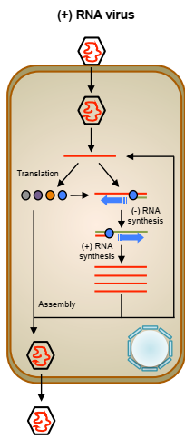
For (+) RNA viruses,
The most abundant class of plant RNA viruses, the gRNA is first translated into the different viral proteins, including the RNA dependent RNA polymerase (RdRp) that is the responsible for the copy of (+) strands into (-) strands.
The later ones serve as templates for generating multiple (+) strands that are translated, replicated or assembled into virions that may spread throughout the plant and/or be transmitted to new hosts

Slide 3
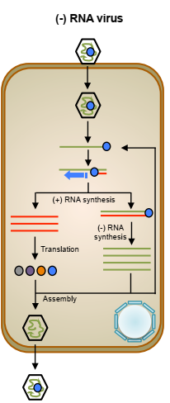
In the case of (-) RNA viruses, the viral RdRp is packaged along the gRNA within the virion so that it can initiate synthesis of (+) strands complementary to the infectious (-) gRNA.
The (+) strands are then translated into viral proteins or used as templates for the generation of new (-) strands that can either serve as templates for additional replication rounds or be assembled into progeny virions

Slide 4
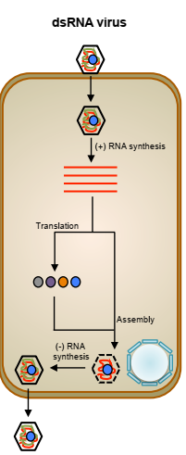
Regarding dsRNA viruses, the viral RdRp is also incorporated into the virions where it synthesizes (+) RNA strands that are extruded from the particle.
Such (+) RNA strands are first translated to produce, among others, the RdRp and the CP and then packaged to form immature virions that develop by synthesizing (-) RNA strands.
In this way, while the dsRNA genome is being produced, it is protected from host antiviral systems such as RNA silencing that detect and inactivate dsRNA molecules

