Slide 1
Production technology of Pear

Slide 2
Introduction
Pear (genus Pyrus), genus of some 20–45 trees and shrubs in the rose family (Rosaceae), including the common pear (Pyrus communis).
One of the most important fruit trees in the world, the common pear is cultivated in all temperate-zone countries of both hemispheres.
The fruit is commonly eaten fresh or is canned. It is used to produce perry, an alcoholic beverage. Several species, such as the Callery pear (P. calleryana), are grown as ornamentals.

Slide 3
Description
Tree:
The common pear tree is broad-headed and up to 13 metres (43 feet) high at maturity.
The trees are relatively long-lived (50 to 75 years) and may reach considerable size unless carefully trained and pruned.
Leaves:
The roundish to oval leathery leaves, somewhat wedge-shaped at their bases, appear about the same time as the flowers, which are about 2.5 cm (1 inch) wide and usually white.

Slide 4
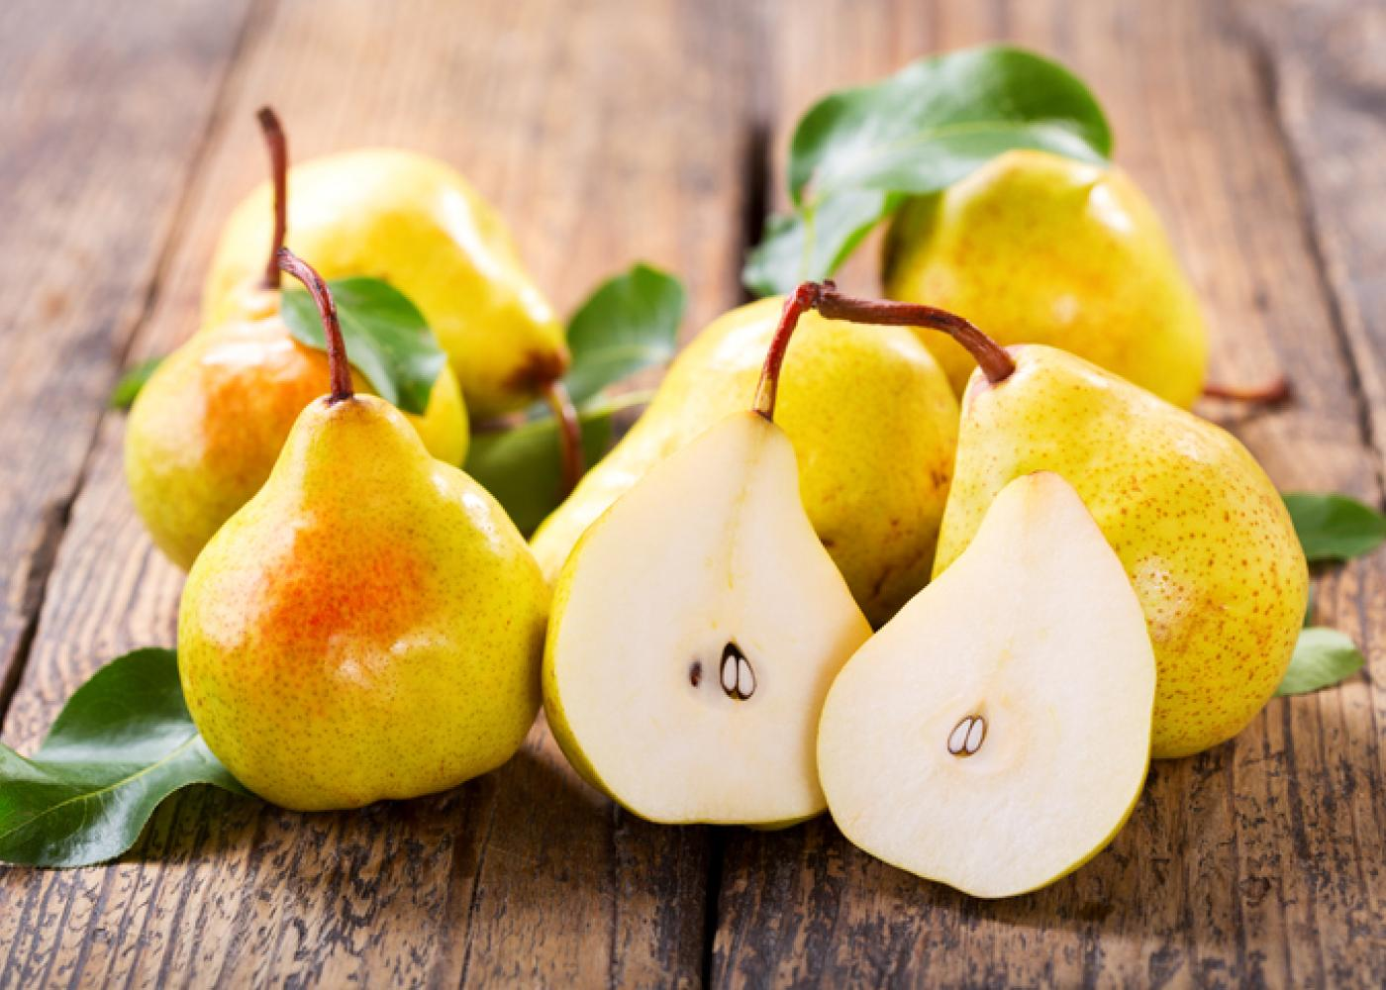
Fruit:
Pear fruits are generally sweeter and of softer texture than apples and are distinguished by the presence of hard cells in the flesh, the so-called grit, or stone cells. In general, pear fruits are elongate, being narrow at the stem end and broader at the opposite end.

Slide 5
Flower: Pear flowers are usually white or pink and have five petals and sepals; the bases of the five styles are separated.

Slide 6
Propagation
Pears are usually propagated by budding or grafting onto a rootstock, usually of Pyrus communis origin.
In Europe the main rootstock used is quince (Cydonia oblonga), which produces a dwarfed tree that fruits at an earlier age than most of the trees on pear rootstocks.

Slide 7
History and origin
The probable origin of the Pyrus genus is mountainous China. From there it moved to East and West and in the different ecological conditions, the evolution would have taken place. Pear is next to apple in the temperate fruits.
The pear was introduced into the New World by Europeans as soon as the colonies were established. Early Spanish missionaries carried the fruit to Mexico and California.

Slide 8
In most pear-growing countries of the world outside Asia, by far the most widely grown pear variety is Williams’ Bon Chrétien, known in the United States as Bartlett. In the United States and Canada, varieties such as Beurré Bosc, D’Anjou, and Winter Nelis are grown. A highly popular variety in England and the Netherlands is Conference. Common Italian varieties include Curato, Coscia, and Passe Crassane, the latter also being popular in France. In Asian countries the pear crop comprises primarily local varieties of native species, such as the Asian, or Chinese, pear (P. pyrifolia).

Slide 9
Climatic Requirements:
Pear is adapted to a wide range to climatic condition from as low as –26 °C (in dormancy) and as high as 45 °C (in growing period). However most of the pear cultivars require about 1200 hours below 7 °C during winter to complete their chilling requirement in order to flower and fruit to a satisfactory level.
After bud break, at blossoming and fruiting phase, below freezing temperature will affect the crop severely.
Because of its tolerance to wide range of climate and soil, it is grown both in temperate and subtropical conditions.
In the tropical belt pear can be grown at an elevation of 1300-2100 M above sea level.

Slide 10
Soil Requirements
Deep, well drained, fertile, medium textured clayey loam soil is the bet for pears.
A neutral pH range of 6.0-7.5 will be ideal.
A minimum soil depth of 180 cm is required. When compared to apple, pear is less tolerant to drought but more tolerant to wet soils.

Slide 11
Varieties
Pear cultivars can be classified in to 3 groups viz., European types, Asian types and the hybrids of European and Asian types.
The Asian types (oriental pears) are mainly derived from Pyrus pyrifolia, Pyrus ussuriensis or their hybrids.
The European types are derived from Pyrus communis.

Slide 12
European types (Tail pears)
Bartlett (or) William’s Pear
Anjou
Flemish Beauty
Max Red Bartlett
Jorgonelle
Starcrimson
Early China
Kieffer
Gola
Le Conte
Patharnakh
Propagation

Slide 13
Preparation of Field and planting:
One year ahead of planting, the field should be prepared by removing stems and roots of previous trees and shrubs, levelled giving a gentle slope for drainage of excess water during heavy rains.
For a crop on its own rootstock (pear), an initial spacing of 3mx2m is given which is changed to 6mx 4m after 4-5 years.
For pear on Quince, a planting distance of 3.5m x 1.1m is enough since quince has the effect of dwarfing the trees.

Slide 14
The pit size should be 1m x 1m x 1m and the pits are filled with a mixture of soil and compost.
The planting can be taken up during late fall or early spring.
Immediately after planting the basin should be formed and irrigated.

Slide 15
Training and pruning:
Pears are trained in a number of systems like pine shaped, pyramid, spindle, palette and trellis. Among these, palette system and trellis are found to be commercially superior.
In trellis, the rows are oriented North-South. Each tree is topped to develop two arms to from ‘Y’ shape in East – West direction within 50 -60 crotch angle. Tensioned wires on steel frames support the arms to a height of 4-5m and the branches on each arm are trained on each arm are trained on these trellises.

Slide 16
Bearings trees are pruned by combining heading back and thinning out.
Pear bears fruit bud on spurs arising on two year old wood and a spur continues to bear for more than six years.

Slide 17
Manures and manuring
An optimum dose of major nutrients is 600g N, 150 g P and 300g K per tree to get the maximum yield.
Normally in pears, the response to P and K can be seen only in soils of low availability of P&K.
At higher altitudes where soil pH will be less than7, the ‘P’ will not be available.
When the soil pH is more than 7 (alkaline condition) too, the ‘P’ availability will be less.

Slide 18
Under these conditions, application of additional ‘P’ will increase the yield.
Nitrogen 60g/tree in two splits (2/3rd in January and 1/3rd in May) along with a basal dressing of 40g each of phosphorus and potash was found the best in Bagugosha.

Slide 19
Intercultural operations :
Weeds can effectively controlled by the use of chemical herbicides like 10kg/ha dalaphon or the combination of 2,4-D 1kg/ha with 10kg dalaphon.
For protection to breakage bracing of limbs is necessary.

Slide 20
Physiological problems:
Some problems we are facing in pear are:
1) Pear core breakdown.
2) Watery breakdown.
3) Internal browning.
4) Black spot disorder.
5) Flesh spot decay.

Slide 21
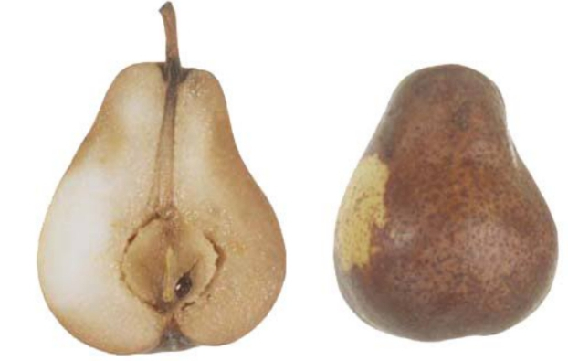
Pear core breakdown
A senescent disorder resulting from storing fruit beyound its postharvest life.A brown ,soft breakdown of the core and surrounding tissue develop in storage or soon after transfer to warm temperature.

Slide 22
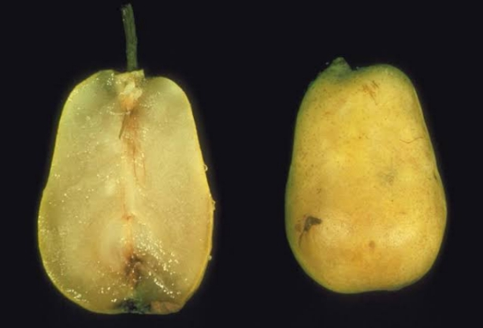
Watery breakdown
As the name implies watery breakdown is a soft ,watery deterioration of affected tissue. When the affected tissue is cut or punctured juice flows out of the fruit. The involved tissue is in the outer portions of the flesh but in severe cases can move into the core tissue. The affected tissues becomes brown with the time.

Slide 23
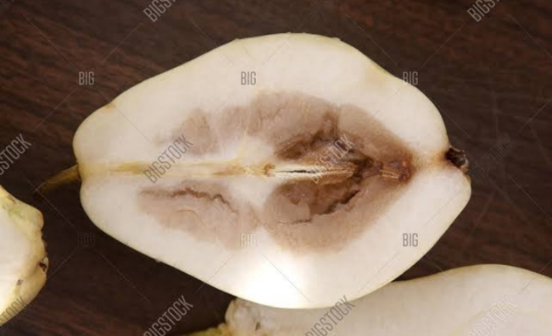
Internal browning
Development of brown to dark brown water soaked areas in the core or flesh occur during storage. There is no visible external indication of internal browning.

Slide 24
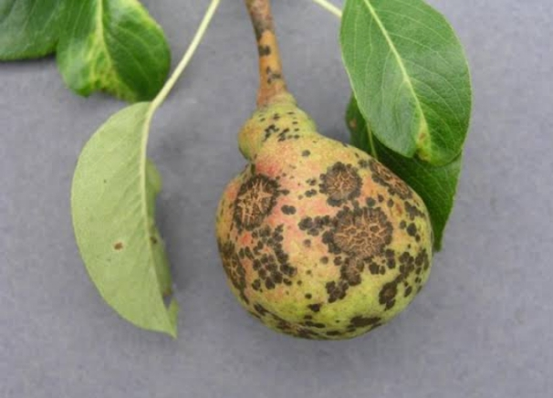
Black spot
Fabraea leaf spot also known as leaf blight and black spot is caused by the fungus Fabraea maculata.This disease usually appears late in the growing season but can occasionlly develop in late may and early june .Fabraea leaf spot attacks leaves ,fruits and twigs of pear.

Slide 25
Diseases:
The disease are common in pear are fire blight ,pear scab,sooty blotch ,pear rust which is caused by rust fungus Gymnosporangiun sabinae, which cause bright orange spots on the upper surface of pear.Weather conditions greatly influence both the occurance and severity of plant disease.

Slide 26
Post harvest insect pests
Pear psylla is one of the most serious insect pest of pear because of its ability to develop resistance to insecticides and to vector the pathogen that cause pear decline.
Pear phylla nymphs pass through five instars,four of which are almost completely encased in honeydew.

Slide 27
Processing and storage
Pears are stored in cool cells and controlled atmosphere cells. They can be stored for up 12 months with CA/ ULO storage.
They remain in good condition at a temperature between -1 and 0 degree depending on variety.
In order to keep moisture loss to a minimum pear should be stored in 90-95% atmospheric humidity. If pears are not ripe store at room temperature in a single layer until they darken in color, when they ripe store in the refrigerator where they actually last for a few weeks.

Slide 28
Post Harvesting
The unripe fruits harvested at optimum maturity can be stored for even 5 months at a temperature of –1°C. Ripening can be accomplished by keeping at 15 to 21 and 21 to 25°C and 80-85% RH in 3-6 days depending on the cultivar. Most of the commercial cultivars require this post harvest chilling treatment for proper ripening.When such post harvest cold treatment are not available, the fruits can be treated with ethylene, so that they ripen properly and get good quality (both taste and colour).

Slide 29
Yield
From a well maintained orchard an yield of 30 – 40 tonnes/ha/year can be expected.

