Slide 1
Sport psychology Chapter no 6
Social factors in sporting performance
Attiya Rehman

Slide 2
Group and team
Group; two or more persons who interact with one another such that each person influences and is influenced by each other person
Team ; a team is more than just a group
Team is a group of people who share a common team purpose and a number of challenging goals. Members of the team are mutually committed to the goals and to each other.

Slide 3
Group formation
group formation is defined as more than two people that have a common identity or objective, with an organised structure, eventually leading to the same fate at the end of their journey together as a group.

Slide 4
Stages of group formation
The five stages of team development in sport are:
Stage 1: Forming
In this stage group members get to know each other and basic rules for the conduct of group members are established.
Stage 2: Storming
members compete for status in the group and group members take on different roles.
Stage 3: Norming
Gradually, the team moves into the norming stage. This is when people start to resolve their differences, appreciate colleagues' strengths, and respect your authority as a leader.
Now that your team members know one another better, they may socialize together, and they are able to ask one another for help and provide constructive feedback. People develop a stronger commitment to the team goal, and you start to see good progress towards it.
Stage 4: Performing
The team reaches the performing stage, when hard work leads, without friction, to the achievement of the team's goal. The structures and processes that you have set up support this well.
Stage 5: Adjourning
In this final stage the task of group has been accomplished and it drifts apart.

Slide 5
Group cohesion
Group cohesion refers to the willingness in which a team sticks together and works together within their performance to achieve success.

Slide 6
Factors affecting team cohesion
There are many factors that affect team cohesion, and these are often identified as:
Leadership and coaching - All group need a leader, someone to direct and support the group. However there are ways to lead a group that affect group cohesive. Leadership styles include autocratic - one person taking the lead, democratic - all members contributing to the decisions. An effective leader will know how to communicate with the group effectively. This could potentially increase productivity and consideration with others in the group.

Slide 7
Factors affecting team cohesion
Individual factors; refers to the characteristics of the athlete that make up the teams .
Situational factors ; include the physical environment in which the team meets and the size of the group .
Team factors; include past shared successes, communication between members and having collective goals.

Slide 8
Cohesiveness and performance
The relation between cohesion and performance was studied by many researchers; and most concluded that “the connection between cohesion and performance is reciprocal”. Present researches suggested that (Grieve et al .,2000) cohesiveness does not influence performance but that performance does influence cohesiveness.

Slide 9
Development of team cohesion
Sports Psychology Build Team Cohesion by followings things
Building Respect. One of the first goals is to build respect among team members.
Building Communication. Building communication is critical for team cohesion. Team members must be able to communicate both verbally and nonverbally on and off the playing field.
Task Focus. Working together toward a common goal is one way to build cohesion within a team.
Leadership.
Regular meetings

Slide 10
Social facilitation
social facilitation defined as improvement in individual performance when working with other people rather than alone.

Slide 11
Co-action and audience effects
Co- action
Audience effect
Co- action effects occur when other people are carrying out the same task alongside us, as in a race or when training with friends or team-mates.
Audience effects occur when we are being watched
An audience effect arises when a participant's behaviour changes because they believe another person is watching them.

Slide 12
The home advantage effect
A definition of home advantage describes it as a phenomenon in which the home teams in sport win over 50% of games played under a balanced home and away schedule (Courneya & Carron, 1992).
The home advantage effect operates when performance is enhanced by the presence of a large supportive home audience.

Slide 13
Example of home advantage effect
For example no team other than brazil has even won the competition when playing outside its own continent.

Slide 14
Explanations for audience and co-action effects
Drive theory
Evaluation apprehension theory
Zajonc's ( 1965)proposed that the presence of other individuals affects performance because it directly raises arousal levels.
Cottrel(1968) offered an alternative to zajonc’s drive theory to explain why the presence of others might lead to increase arousal. In evaluation apprehension theory the presence of others causes an increase in our arousal because we feel that we are about to be evaluated.

Slide 15
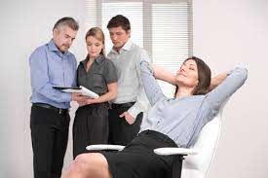
Negative effects of team membership
Social loafing ; social loafing is the phenomenon of a person exerting less effort to achieve a goal when they work in a group than when working alone.

Slide 16
Task oriented and ego oriented
Task oriented
Ego eriented
task oriented people feel successful when they apply effort and learn something new
ego oriented define success in terms of performing better than their classmates and demonstrating their superior ability to others.

Slide 17
Groupthink
The presence of others affects us in many ways not just in our arousal levels and efforts. One other way in which we differ when alone or in a group is in the way we make decision. Groupthink can cause serious problems for teams because the entire team can become so focused on a particular goal that important considerations of practicality and safety are abandoned.

Slide 18
Leadership
Leadership is the process of influencing team members to work hard towards, and be committed to, team goals

Slide 19
Leadership styles
Three leadership styles have been identified
authoritarian
democratic
laissez-faire.

Slide 20
authoritarian leader
authoritarian leader makes decisions alone and expects unquestioning obedience from the group .
The main advantage of this leadership style is that team member is can still be directed towards purposeful action when they are exhausted, stressed while the disadvantage is that in the absence of the leader the members may have difficulty in motivating themselves.

Slide 21
Laissez-faire leader
The Laissez-Faire Leadership Style is when a leader does not take an active approach. A laissez-faire leader may decide what needs to be done but will then seek advice from players/athletes and then enable athletes to make the decision. laissez faire leader leaves group members to get on with the task at hand without interference.

Slide 22
Democratic leader
The democratic leader takes decisions and enforces them , but decisions always take account of the view of the rest of the group . Democratic leadership can cause difficulties when very rapid decision making is required in an emergency but in most cases this is the most successful style of leadership.

Slide 23
Theories of leadership
Trait Theories of Leadership
Trait theory which suggests that certain great leaders have personality traits and personality characteristics that make them ideally suited for leadership.
Supporters of trait theory believe that successful leaders have certain personality characteristics or leadership
traits that make it possible for them to be successful leaders in any situation.

Slide 24
Characteristics of of successful leader (Kirkpatric&locke)
Honesty
Motivation to lead
Self-confidence
Intelligence
Expertise in the purpose of the group
Creativity
Flexibility
Imagination and orignality

Slide 25
fielder’s contigency theory
According to this theory the success of leadership depends on the characteristics of leaders and the situation in which they are leading fielder identified two categories
Task-oriented. Leader’s main focus is the task of the group
Person-oriented. Leader’s main focus is on members of group.

Slide 26
Least-prefered co-worker (LPC)
The leaders are asked to rate a person on a scale ranging from lowest (1) to highest (8) on several parameters to identify the worker with whom they least like to work. Certain parameters on the LPC scale are: pleasant/unpleasant, friendly/unfriendly, tense/relaxed, supportive/hostile, cooperative/uncooperative, The leaders with high LPC scores are said to be relationship-oriented whereas the ones with the low LPC scores are considered as task-oriented.

Slide 27
The coach and athlete
Athlete spend much time with their coaches and rely on them for information ,direction ,feedback and support .
Relationship of athlete and coach can be understood in term of three key variables
Closeness. Is the emotional aspects of relationship , referring to the attachment between coach and athlete.
Co-orientation. Is the cognitive aspect of relationship refers to the commonality of knowledge.
Complementarity. Is the behavioural aspect of relationship.

Slide 28
Coaching as decision making
Coaching activities involve decision making and he suggested that we can understand the leadership displayed by coaches in terms of their style of decision making . Decision making is affected by several factors such as
Time pressure
Decision importance
Information location
Problem complexity
Group acceptance
Coach power
Group integration

Slide 29
Factors affecting decision making
Time pressure
when decisions have to be made very quickly , the coach often has to make them without athlete participation.
Decision importance
When problem can be resolved by several options athlete participation is more likely.
Information location
Whoever possesses the necessary information is likely to take a role in decision making.
Problem complexity
The more complex the problem the more likely it is that only the coach will possess all the information necessary to make the decision therefore he is more likely to do so without participation by athletes.
Group acceptance
A coach is likely to make a unilateral decision either when it will be fully accepted by the team.
Coach power
Coaches may exert power over athletes by means of reward , punishment, the authority of their position.
Group integration.
The more integrated a team the more likely its members are to participate in decision making.

Slide 30
Chapter no 7
Arousal , Anxiety and sporting performance

Slide 31
Arousal , Anxiety and stress
Arousal
A general psychological and physiological activation varying on a continuum from deep sleep to intense excitement.
Anxiety
Anxiety is known as negative emotional state with feelings of nervousness, worry and apprehension associated with activation or arousal of the body .
Stress
Stress is a feeling of emotional or physical tension. It can come from any event or thought that makes you feel frustrated, angry, or nervous.

Slide 32
Cognitive and somatic anxiety
Cognitive anxiety
Somatic anxiety
Common symptoms of cognitive anxiety include negative thoughts, feelings of apprehension or nervousness , self doubts and images of losing and humiliation.
Common symptoms of somatic anxiety include, experiencing butterflies, sweating, heavy breathing or a elevated heart rate.

Slide 33
Effects of anxiety on sporting performance
When an athlete experiences worry and negative thoughts (cognitive state anxiety) it causes decision making to become poor and concentration levels to drop, increasing the number of errors. This can be monitored by the increase in somatic state anxiety responses, which include an increase in heart rate, sweating and blood pressure. Some of these symptoms of anxiety are beneficial to sporting performance, but if the athlete perceives them as happening because they are unable to meet the demands of the activity they further increase cognitive state anxiety.

Slide 34
State and trait anxiety
State anxiety
Trait anxiety
state anxiety is refers to the emotional state of anxiety ( cognitive and somatic ) typically experienced prior to and during competition.
Trait anxiety is a personality characteristic that remains relatively stable over time, a person high in trait anxiety will be frequently anxious almost irrespective of the situation.

Slide 35
Factors inducing anxiety and stress
How anxious we feel at any time is a product of both individuals and situational factors

Slide 36
Situational factors
Event importance
The more important important a sporting event is , the more stressful we are likely to find it .it is probably true to say for example that most footballers would find themselves more anxious competing in the world cup than in a friendly
Expectations
It seems likely that both high and low expectations can be linked to anxiety . Team can be adversely affected by the pressure of high expectations.

Slide 37
Individual factors
Trait anxiety
Some people are prone to suffer more anxiety than others whatever the situation. Individuals high in trait anxiety are likely to see competition as particularly stressful.
Performance concern
One way in which we vary as athlete is the manner in which we are concerned about our performance and it is a factor of inducing stress or anxiety.
Locus of control
Locus of control describes the extent to which we believe that we are in control of our lives. Individual low in locus of control are generally more vulnerable to anxiety and stress.

Slide 38
The relationship between arousal and performance
Drive Theory
Inverted U hypothesis
Catastrophe Theory
Zone of Optimal Functioning (ZOF) Theory

Slide 39
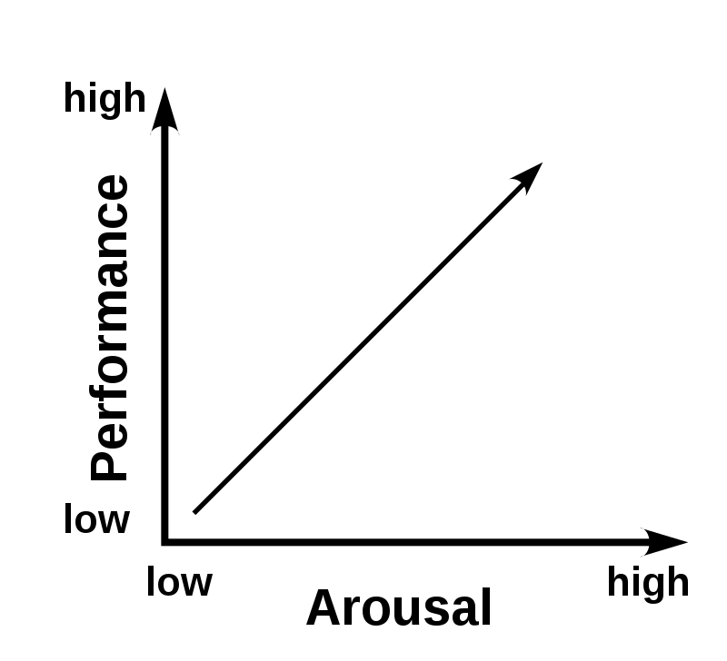
Drive theory
According to drive theory three factors influence performance; complexity of task , arousal and learned habit. the greater the arousal ,the more likely we are adopt the dominant response to a situation that is our habits. the higher the arousal the better will be our performance.

Slide 40
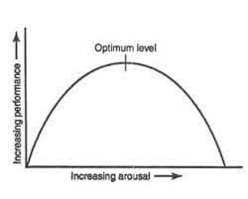
Inverted U hypothesis
This theory states that there is an optimal level of arousal (which will differ from sport to sport and athlete to athlete). Performance levels will be at their highest at the optimal point of arousal. If arousal is too low or too high performance will be lower.

Slide 41
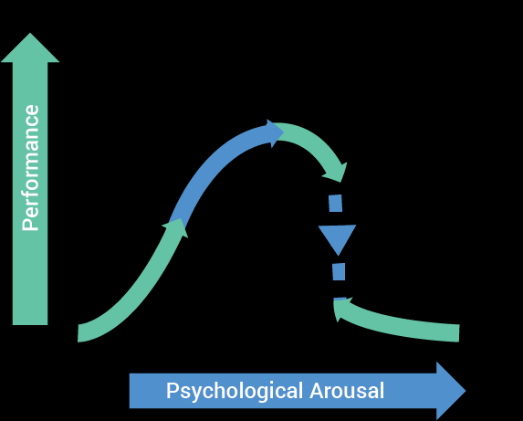
The relationship between anxiety and performance
Catastrophe model
This theory differs from the inverted U hypothesis by linking arousal and anxiety. If the athlete is experiencing high levels of cognitive state anxiety as arousal rises towards the athletes threshold, the athlete experiences a dramatic drop in performance. This theory does also rely on the need for both arousal and cognitive anxiety to achieve optimal performance.

Slide 42
. Zone of Optimal Functioning (ZOF)
The athlete’s preferred anxiety level is called individual zone of optimal functioning .The relationship of stress, anxiety and arousal all impact upon motivation and the improvement of performance up to a point. However optimal performance has many other variables that impact upon arousal and the individual.

Slide 43
Stress management
stress management refers to the environmental, physiological, cognitive, and behavioral techniques employed by an individual to manage the factors and components that underlie the stress process or experience of stress . followings are the techniques which can be used for reducing stress.
Relaxation techniques
Biofeedback
Progressive muscle relaxation(PMR)
Cognitive behavioral techniques

Slide 44
biofeedback
Biofeedback can help control autonomic physiological stress responses, such as increased HR and BP. It also has been used to control anxiety disorders as well as anxiety connected to particular environments or contexts. The premise behind biofeedback is for the athlete to become aware of how stress is manifested physiologically, such as changes in BP, HR, breathing, or muscle tightness, using different modes of objective feedback and monitoring. With this increased awareness, athletes are better equipped to control their actions. With training, athletes become less reliant on the feedback, learning to control their physiological responses on their own.

Slide 45
Progressive muscle relaxation (PMR)
In progressive muscle relaxation, you tense a group of muscles as you breathe in, and you relax them as you breathe out. You work on your muscle groups in a certain order. When your body is physically relaxed, you cannot feel anxious. Practicing progressive muscle relaxation for a few weeks will help you get better at this skill, and in time you will be able to use this method to relieve stress. In the modern version of (PMR) , four sections of the body are relaxed in turn. These are the arm , face , neck, shoulders and upper back, stomach and lower back and the hip and the legs.

Slide 46
Cognitive behavioural technique
Cognitive behavioral therapy (CBT) is based on the connections between your thoughts, emotions, and behaviors, and how they can influence each other. Cognitive Behavioral Training (Gustafsson & Lundqvist, 2016) by which athletes practice to change dysfunctional performance- related behaviors (e.g., avoiding certain anxiety provoking situations) into functional behaviors (e.g., follow the game plan)

Slide 47
Goal setting theory
First, setting goals directs effort and attention toward goal-related activities and away from irrelevant activities. Second, goals can energize an individual within a task, with higher effort expected for more challenging goals than easier goals.
In this coach set long term and short term goal and directed to athlete and this is known as goal setting thoery.

Slide 48
Imagery techniques
Imagery is also called visualization or mental rehearsal.
Imagery means using all of your senses (e.g., see, feel, hear, taste, smell) to rehearse your sport in your mind.
Types of imagery
Internal imagery.in this type of imagery athlete view themselves performing from inside their own body.
External imagery. In this type of imagery athlete picture themselves from outside performing

Slide 49
Mental rehearsal
The ability to picture a performance or aspects of it is a skill that will enhance performance. Mental rehearsal, visualization and imagery are used by athletes to manage and reduce anxiety during a performance.
Mental rehearsal occurs when a performer rehearses in his or her mind the physical skills that the performer wishes to practice. In this process, there is no visible physical movement. The process involves imagining the performance, and rehearsing the activity in the mind, in an attempt to prepare the mind and body for competition (Browne et. Al., 2009).

