Slide 1
Logical reasoning
Constructing arguments
By Sana Ghaffar

Slide 2
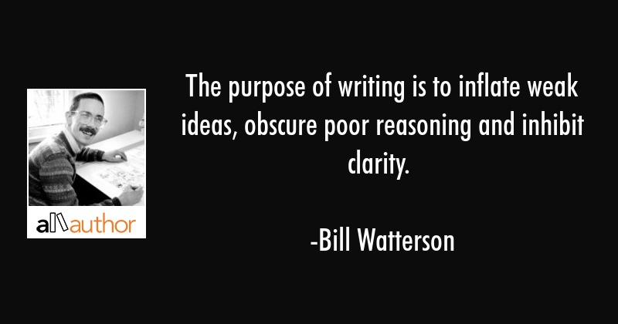

Slide 3
What stating logically is not
Unsupported assertion (supported notions overtakes well-reasonned arguments)
Ambiguous or incomplete assertions
Circular reasoning
For example: “Public transportation is necessary because everyone needs it,” or “The play is unsophisticated because it lacks a refined sense of character and plot development.”
Appealing through emotions
False analogies
For example: “An industrialist who pollutes the air with his factory has the same careless attitude toward others as the thug who breaks a store window.”

Slide 4
WHAT STATING LOGICALLY IS?
Presuming that there is no shared knowledge
Well defined and illustrated background
Ask a purpose or reason before accepting conclusion
Source of generation of logical
Analyze the others’ logical
Judging whether to accept or not
Equal to critical thinking
Proving evidences right
Convincing the readers regarding the worth of understandability

Slide 5
Logic
Greek word ‘logos’
Meaning the word or what is spoken
Valid rule of inference
A statement made as a general law of truth (logic)
Studies valid and invalid relations between statements
Operates evidences, claims, arguments and conclusion

Slide 6
Logic in academic writing
Usage of logical statements which are proved by evidences
For example: recycling saves the planet Earth.
Collection of claims connected logically: logical argument
Logical premise: statement providing evidences and reasons of inferences
Logical conclusion: proposition made on the bases of inferences

Slide 7
Various types of reasoning in academic writing
Claims
Conclusions driven from evidences
Thesis and conclusion statements
Two modes
Experience leading to claim
Claim leading to evidences

Slide 8
Continued…
2. Induction
Inferring the conclusions on the base of patterns
The perceived patterns might be wrong
Induction of the existing patterns
For example: A,D,G….
Insurance rates
Limits
For conforming patterns sufficient data is required
Assuming on the bases of probability
Risky sort of reasoning

Slide 9
Continued…
3. Deduction
Inferring things through correlation
One explanation elaborates another
For example: If A = B, B=C then A = C
For deductive reasoning, the audience should be well-aware about the facts
Should have universal perspectives
Can be reproducible

Slide 10
Continued…
4. Causal
A verified caused and effect pattern
Reproducible
For example: A is caused by B
It has nearly predictable consequences
Other explanations can be suggested
Mostly found in social sciences
Long procedure to test

Slide 11
Continued…
Limits
No over-simplification
One cause can possess many effects
Single effect can have many causes
Unconsidered factors can be the causes of an effect

Slide 12
Continued…
5. Analogies
Generalization of characteristics
Predictions related to grouping
For example: People living on borders are deprived of basic life necessities
Risks
Based on probability instead of certainty
Not everything belonging to group an be parallel example

Slide 13
Fallacies (a mistake of reasoning)
Rhetorical fallacies or informal fallacies
Statistical fallacies
Logic fallacy or formal fallacies

Slide 14
Rhetorical fallacies
Appeal to authority
Ad hominem (judging on the bases of personalities)
Straw man argument (invalid argument to prove oneself right)
Circular reasoning
"Fundamentals of academic writing is a popular class. Most students like popular classes. Therefore, most students like fundamentals of academic writing.“
Appeal to ignorance (if something is not true then it is false or vice versa)

Slide 15
Statistical fallacies
Correlation is not causation
Base rate fallacy (ignoring the base rate)
Biased sample

Slide 16
Logical fallacies
Affirming the consequent (truth of one idea leading to consequences)
Syllogistic fallacies (correlating the two inferences)

