Slide 1
Post Harvest Management Of Potato
Prof. Dr. Sarfraz Hussain IFSN FST 508

Slide 2
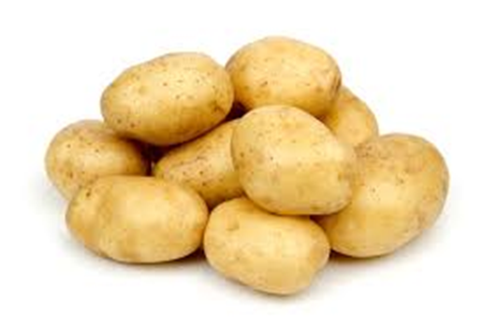
INTRODUCTION
Potato (Solanum tuberosum )
Family : Solanaceae
Grown in more than 100 countries in the world, native to South America and is staple food.
Varieties
Ultimus
USA-5, SH-5
Multa,Desiree,Patrones
Giewont, Wilja, Cardinal
Spunta, Ajax, Laal-e-faisal
Diamant, Sialkot Sufaid
Faisalabad White
Faisalabad Red

Slide 3
Importance
Consumed by more than 1 billion people around the world.
Known as king of vegetables.
Used as ingredient in more than 100 recipes.
The protein of potato has high biological value than milk & cereals.

Slide 4
Nutritive Value

Slide 5
Post harvest Management
Post harvest losses
Due to poor handling & storage the losses are reported to be about 40%
Losses of potato may be
Qualitative
Quantitative.

Slide 6
Qualitative Losses

Slide 7
Quantitative Losses

Slide 8
Maturity Indices
Harvest the tubers when they reached desirable size for the variety or market.
Immature potatoes are harvested in spring or early summer.
Brightness of color, well shaped, uniformity, firmness, freedom from adhering soil, sprouting, insect damage, decay, greening and other defects.

Slide 9
Harvesting
Follow the practice of Dehaulming [cutting of haulms aerial parts by sickle or machines] killing by chemicals (e.g. Gramoxone) or destroying by when the crop attains 80-90 days and when the aerial part of the plant turns yellow.
Always harvest in dry weather.
Stop irrigation about two weeks before Dehaulming.
Avoid bruising and skinning of tubers otherwise tubers become susceptible to rot diseases.
Harvest the crop after 10-15 days of haulm cutting.

Slide 10
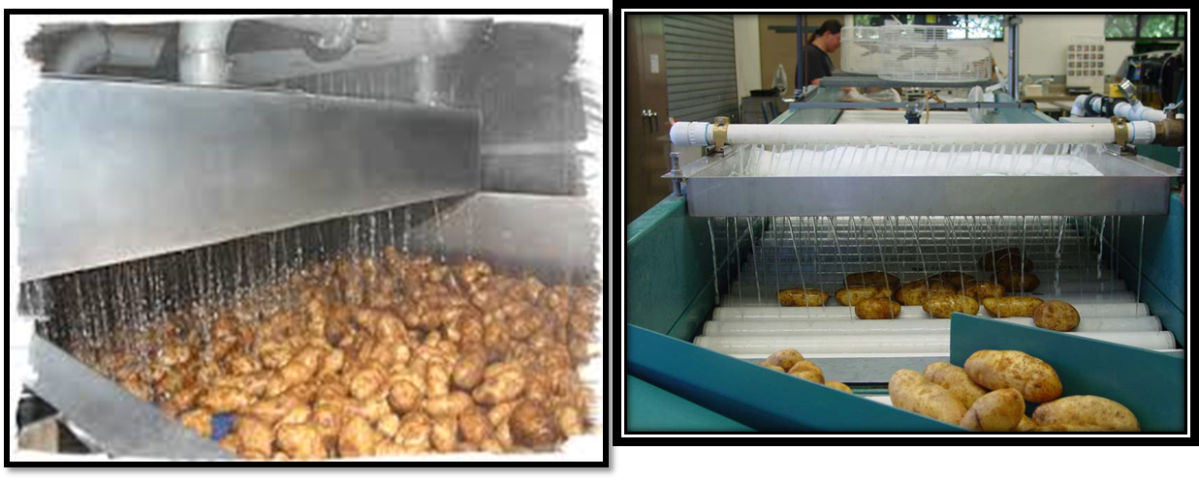
Washing
Washing is done to remove adhesive soil.
Hot water is used & pre-soaking is done to facilitate the process of washing.

Slide 11
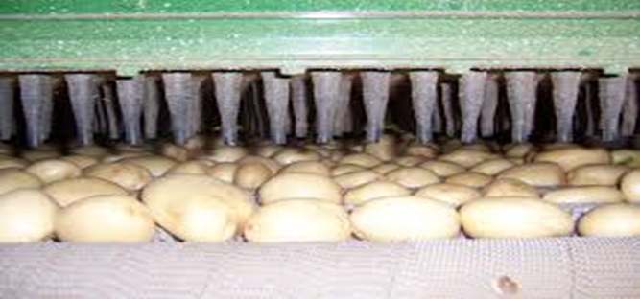
Drying
Dry the harvested tuber quickly to Always remove excess moisture from the
surface of tubers for improving their keeping quality.
Always dry the harvested tuber in storage shed, exposing to sun cause greening of potatoes.
Do not store the tubers immediately if they are exposed to rain after harvest.

Slide 12
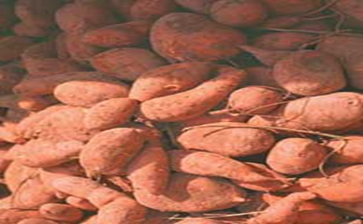
Curing
Curing is essential for healing the wounds of tubers by developing epidermal layer resulted from cutting and bruising during harvesting.
Cure by storing in a warm, humid room for 5-10 days. A temperature of 25-30⁰ C and a relative humidity of 80-90% is ideal. These conditions are achieved without a additional cost at farm.

Slide 13
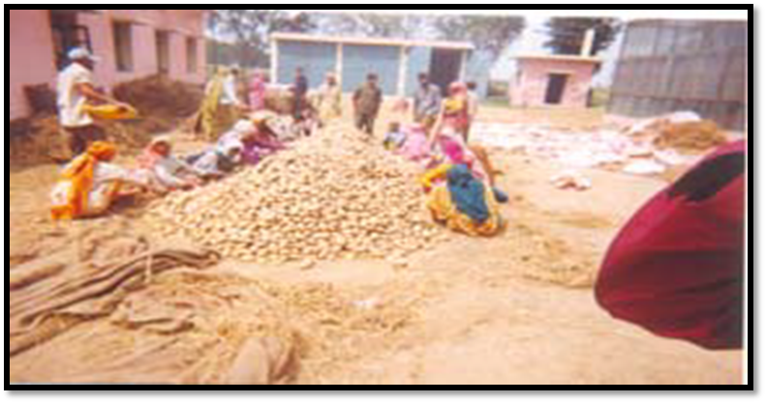
Sorting & Grading
All the damaged and diseased tubers should be removed during sorting.

Slide 14
Benefits of Sorting & Grading
Grading helps the potato producer and seller to
determine the price.
It reduces the cost of marketing and helps the consumers to get standard potato at fair price.
It has a direct influence on utilization point of view, as the small to medium sized tubers are prepared for ‘seed tubers’ and large sized tubers are preferred for processing purpose.
Maximum utilization of produce, fetch high price
Produce high quality products,

Slide 15
Packaging
Handling and packaging of potatoes are done generally on farm.
Material used for packaging is Nylone Nettlon bags (25kg)

Slide 16
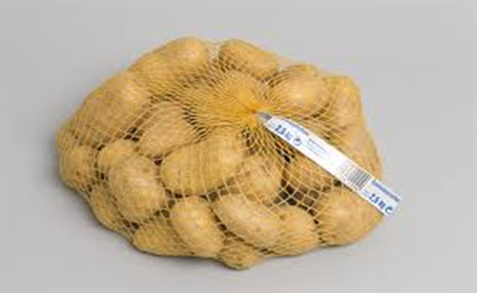
Packing Materials

Slide 17
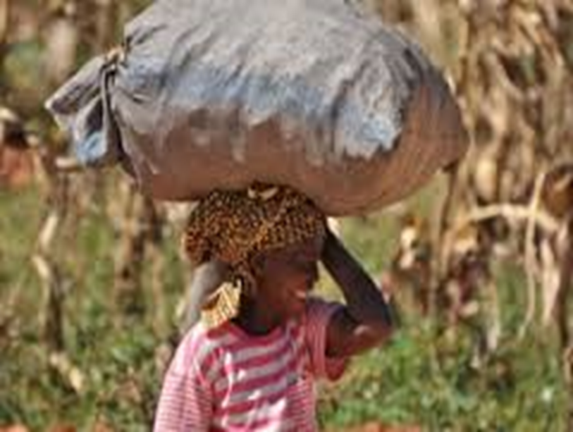
Transportation
Head load

Slide 18
Bullock/ camel carts

Slide 19
Tractor trolley

Slide 20
Trucks

Slide 21
Railways

Slide 22
Storage
Storing potatoes for longer period at normal temperature is not possible as it is a living material and through respiration, the changes occur due to heat, resulting in loss of dry matter and ultimate deterioration of quality of tubers. At optimum condition, the quality of potatoes remains good in storage for 3-5 weeks.

Slide 23
Marketing Channels

Slide 24
Institutional

Slide 25
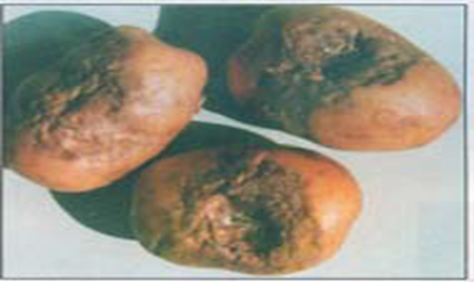
Major storage pests

Slide 26
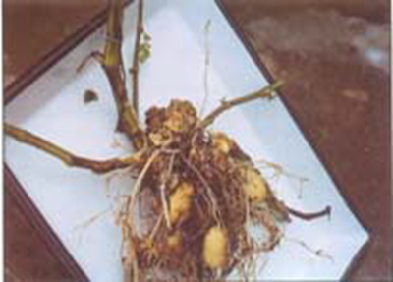
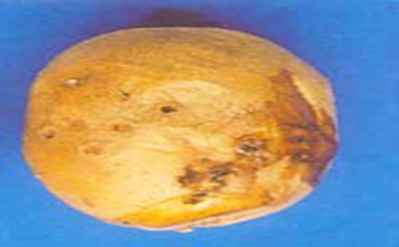
Pathological storage diseases

Slide 27
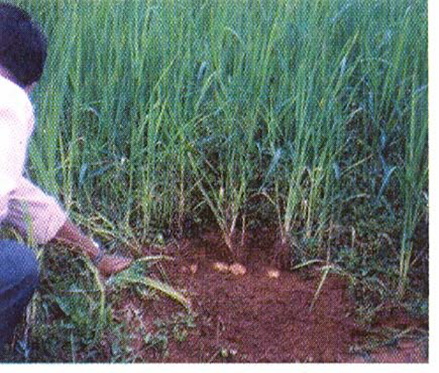
Storage Structure
Traditional Storage:
a) In situ storage :
1. Cover the potato beds with grass in
upland areas.
2. Cover the potato beds with paddy
crop in low land areas.

Slide 28
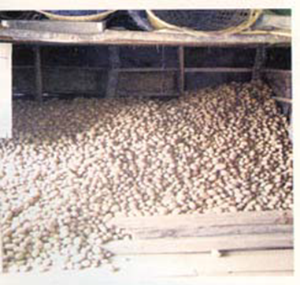
b) Heap storage

Slide 29
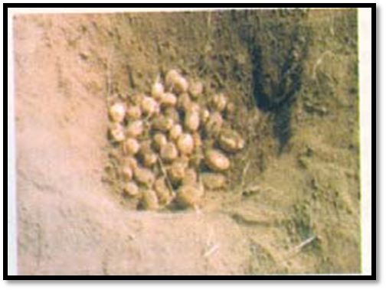
c) Pit storage
This is a traditional method of
storage. In this storage system, two types of pits are prepared i.e. Katchha and pucca pits.
Katchha pit is rectangular in shape measures 4.5 m. (length) x 3.6 m. (width) x 14 m.(depth)*
Pucca pit is normally circular in shape with a diameter of about 4.2 m.
All the pits are covered with 0.3m. thick available straw material (wheat, paddy).

Slide 30
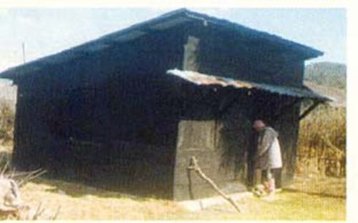
d) Wooden storage structure
In this system, small wooden rooms like
stores about 10 ft. heights are built in the field or near residential area.
The walls of the store are built by horizontally fixed overlapping wooden planks which help in preventing seepage in store and running off the rain water.
The roof of the store is covered with tin sheet and a gap is left between roof and wall for aeration purpose.

Slide 31
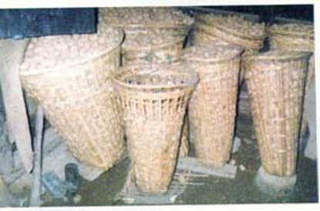
e) Storage in baskets
Potatoes are stored in bamboo baskets known as “polo” which provides better aeration to the tubers.
The baskets are made of different sizes hold 10 -12 kg potatoes.
Smaller baskets are suitable for use as they are convenient to carry to the fields.

Slide 32
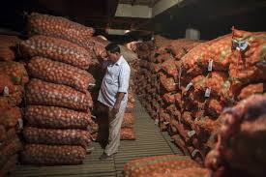
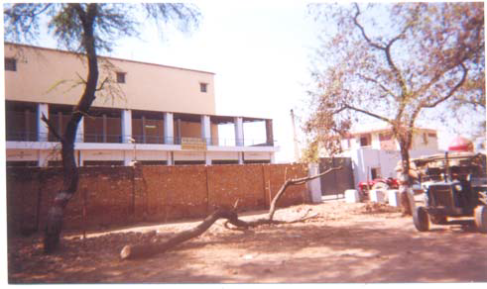
Other improved storage facilities
Farmer storage
Private/public storage

Slide 33
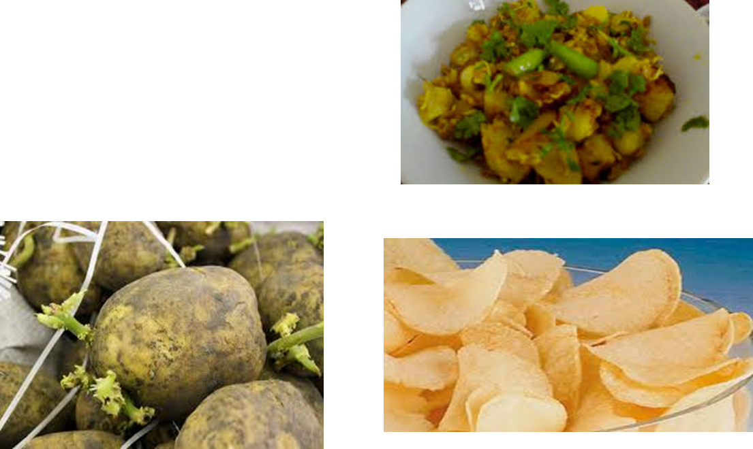
Uses of potatoes
As vegetable
As processed food
As seed

