Slide 1
Introduction to Earthquake Engineering Lec#3
Engr. Muhammad Mubashir Ajmal
Department of Civil Engineering, University of Sargodha, Sargodha

Slide 2
List of Content
Terminology
Department of Civil Engineering, University of Sargodha, Sargodha

Slide 3
Magnitude and Intensity
Terminology:
The point on the fault where slip starts is the Focus or Hypocenter, and the point vertically above this on the surface of the Earth is the Epicenter (Figure 1).
The depth of focus from the epicenter, is called as Focal Depth.
Most of the damaging earthquakes have shallow focus with focal depths less than about 70km.
Distance from epicenter to any point of interest is called epicentral distance.
A number of smaller size earthquakes take place before and after a big earthquake (i.e., the Main Shock).
Those occurring before the big one are called Foreshocks, and the ones after are called Aftershocks.
Department of Civil Engineering, University of Sargodha, Sargodha

Slide 4
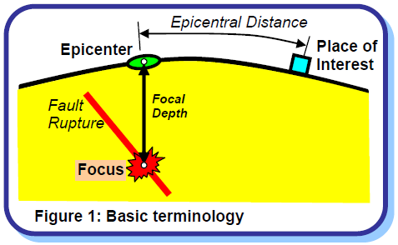
Magnitude and Intensity
Department of Civil Engineering, University of Sargodha, Sargodha

Slide 5
Magnitude and Intensity
Magnitude:
Magnitude is a quantitative measure of the actual size of the earthquake.
Professor Charles Richter noticed that (a) at the same distance, seismograms (records of earthquake ground vibration) of larger earthquakes have bigger wave amplitude than those of smaller earthquakes; and (b) for a given earthquake, seismograms at farther distances have smaller wave amplitude than those at close distances.
These prompted him to propose the now commonly used magnitude scale, the Richter Scale. It is obtained from the seismograms and accounts for the dependence of waveform amplitude on epicentral distance.
This scale is also called Local Magnitude scale.
There are other magnitude scales, like the Body Wave Magnitude, Surface Wave Magnitude and Wave Energy Magnitude.
These numerical magnitude scales have no upper and lower limits; the magnitude of a very small earthquake can be zero or even negative.
Department of Civil Engineering, University of Sargodha, Sargodha

Slide 6
Magnitude and Intensity
Magnitude:
An increase in magnitude (M) by 1.0 implies 10 times higher waveform amplitude and about 31 times higher energy released.
For instance, energy released in a M7.7 earthquake is about 31 times that released in a M6.7 earthquake, and is about 1000 (≈31×31) times that released in a M5.7 earthquake.
Most of the energy released goes into heat and fracturing the rocks, and only a small fraction of it (fortunately) goes into the seismic waves that travel to large distances causing shaking of the ground en-route and hence damage to structures.
The energy released by a M6.3 earthquake is equivalent to that released by the 1945 Atom Bomb dropped on Hiroshima!!)
Earthquakes are often classified into different groups based on their size (Table 1).
Annual average number of earthquakes across the Earth in each of these groups is also shown in the table; it indicates that on an average one Great Earthquake occurs each year.
Department of Civil Engineering, University of Sargodha, Sargodha

Slide 7
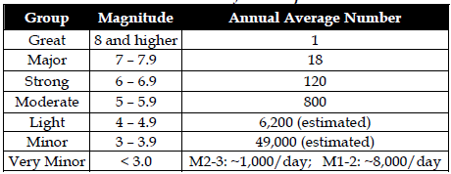
Magnitude and Intensity
Department of Civil Engineering, University of Sargodha, Sargodha

Slide 8
Magnitude and Intensity
Intensity:
Intensity is a qualitative measure of the actual shaking at a location during an earthquake, and is assigned as Roman Capital Numerals.
There are many intensity scales. Two commonly used ones are the Modified Mercalli Intensity (MMI) Scale and the Medvedev Sponheuer Karnik MSK Scale.
Both scales are quite similar and range from I (least perceptive) to XII (most severe).
The intensity scales are based on three features of shaking
perception by people and animals
performance of buildings
changes to natural surroundings.
Table 2 gives the description of Intensity VIII on MSK Scale.
The distribution of intensity at different places during an earthquake is shown graphically using isoseismals, lines joining places with equal seismic intensity (Figure 2).
Department of Civil Engineering, University of Sargodha, Sargodha

Slide 9
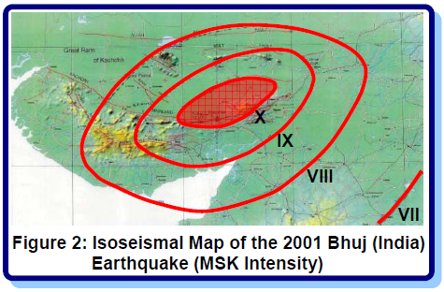
Magnitude and Intensity
Department of Civil Engineering, University of Sargodha, Sargodha

Slide 10
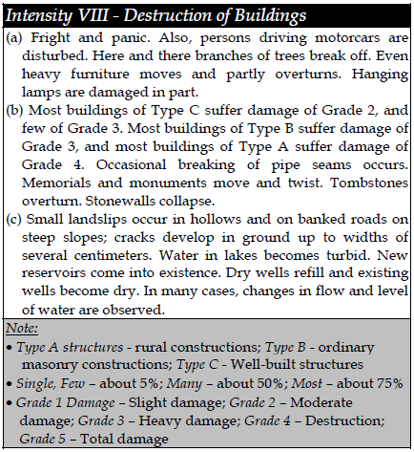
Magnitude and Intensity
Department of Civil Engineering, University of Sargodha, Sargodha

Slide 11
Magnitude and Intensity
Basic Difference – Magnitude versus Intensity:
Magnitude of an earthquake is a measure of its size.
For instance, one can measure the size of an earthquake by the amount of strain energy released by the fault rupture.
This means that the magnitude of the earthquake is a single value for a given earthquake.
On the other hand, intensity is an indicator of the severity of shaking generated at a given location.
Clearly, the severity of shaking is much higher near the epicenter than farther away.
Thus, during the same earthquake of a certain magnitude, different locations experience different levels of intensity.
Department of Civil Engineering, University of Sargodha, Sargodha

Slide 12
Magnitude and Intensity
To elaborate this distinction, consider the analogy of an electric bulb (Figure 3).
The illumination at a location near a 100-Watt bulb is higher than that farther away from it.
While the bulb releases 100 Watts of energy, the intensity of light (or illumination, measured in lumens) at a location depends on the wattage of the bulb and its distance from the bulb.
Here, the size of the bulb (100-Watt) is like the magnitude of an earthquake, and the illumination at a location like the intensity of shaking at that location.
Department of Civil Engineering, University of Sargodha, Sargodha

Slide 13
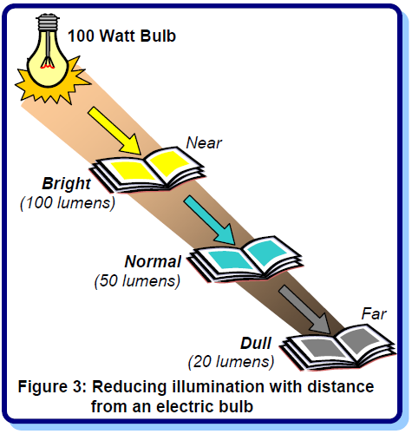
Magnitude and Intensity
Department of Civil Engineering, University of Sargodha, Sargodha

Slide 14
Magnitude and Intensity
Magnitude and Intensity in Seismic Design:
One often asks: Can my building withstand a magnitude 7.0 earthquake?
But, the M7.0 earthquake causes different shaking intensities at different locations, and the damage induced in buildings at these locations is different.
Thus, indeed it is particular level of intensity of shaking that buildings and structures are designed to resist, and not so much the magnitude.
The peak ground acceleration (PGA), i.e., maximum acceleration experienced by the ground during shaking, is one way of quantifying the severity of the ground shaking.
Department of Civil Engineering, University of Sargodha, Sargodha

Slide 15
Magnitude and Intensity
Approximate empirical correlations are available between the MM intensities and the PGA that may be experienced (e.g., Table 3).
For instance, during the 2001 Bhuj earthquake, the area enclosed by the isoseismal VIII (Figure 2) may have experienced a PGA of about 0.25-0.30g.
However, now strong ground motion records from seismic instruments are relied upon to quantify destructive ground shaking.
These are critical for cost-effective earthquake-resistant design.
Department of Civil Engineering, University of Sargodha, Sargodha

Slide 16
Magnitude and Intensity
Department of Civil Engineering, University of Sargodha, Sargodha

Slide 17
Department of Civil Engineering, University of Sargodha, Sargodha

