Slide 1
Engineering Materials

Slide 2
Structure of Metal
Crystal structure:
Study of structure necessary
Solid exist as two types :
Crystalline Material
Amorphous Material

Slide 3
Crystalline Material: is one in which all the atoms are situated in an orderly repeating pattern extending in all three dimensions i.e Nacl

Slide 5
Crysrtal
A crystal of a substance in which constituent particles are arranged in systematic & geometrical particles. Mostly shape they aquire is regular polyhedron.

Slide 17
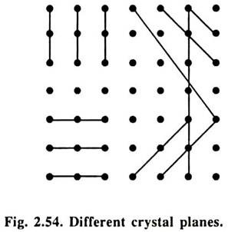
Crystal Planes
A crystal lattice may be regarded as the aggregrate of different set of parallel planes passing through lattice points such as each set of parallel planes has particular orientation of direction with reference to coordinate axes.Lines shown in fig 2.54 will appear as planes when geometry is extended to 3-D. The problem is how to designate the orientation and direction of these parallel set of crystal planes. Miller evolve a method to designate orientation of direction of parallel set of planes w.r.t to coordinate axis by three numbers(integer) called miller indices

Slide 18
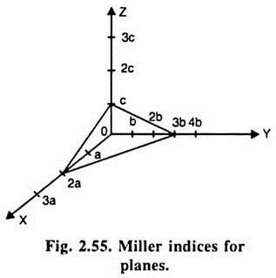
Concept to find miller indices of a plane
Step 1:Take a point or atom as origin of construct three coordinate axis. Find the intercepts of the plane along three coordinate axes. X , Y, Z
X Y Z
2a 2b 1c

Slide 19
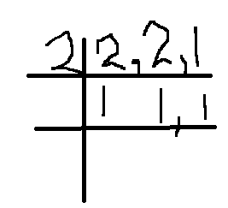
Step 2: Express the intercepts as multiples of a,b,c
2 2 1
Step 3: Take reciprocal of intercepts
½ ½ 1
Step 4: Reduce reciprocal of intercept into smallest set of integer in the same ratio by multiplying with their LCM.L.c.m=2
½*2 ½*2 1*2
1 1 2

Slide 20
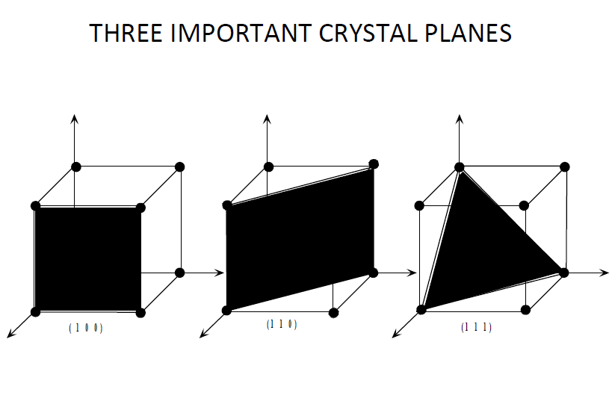
The three indices are not separated by commas and are enclosed in curved brackets: (hkl) (112)
If any of the indices is negative, a bar is placed in top of that index

