Slide 8
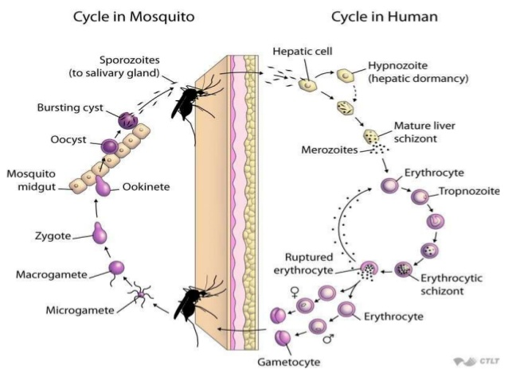

Slide 13
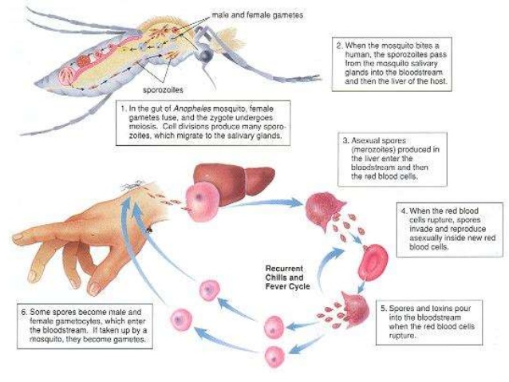

Slide 14
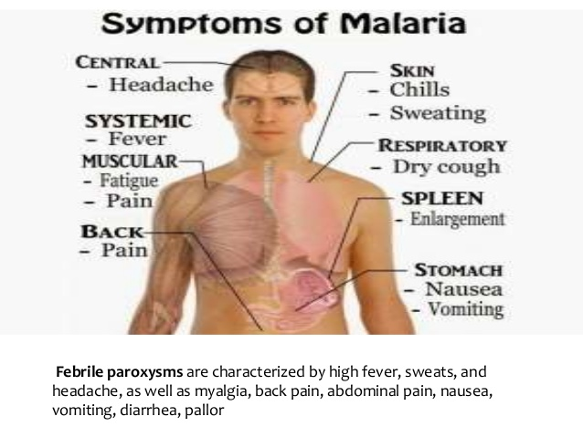

Slide 17
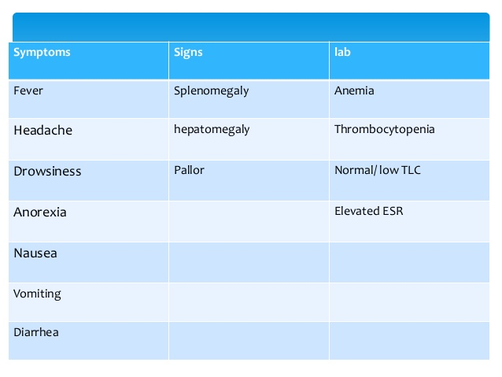

Slide 28
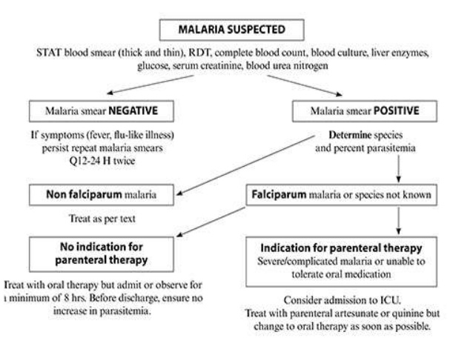

Slide 33
Vaccine
RTS,S vaccine
Efficacy 17-56% in uncomplicated
30-50% in complicated cases

