Slide 1
Chapter 11 Computer Security, Ethics and Privacy

Slide 2
Chapter 11 Objectives
Describe the types of computer security risks
Discuss the types of devices available that protect computers from system failure
Identify ways to safeguard against computer viruses, worms, Trojan horses, botnets, denial of service attacks, back doors, and spoofing
Explain the options available for backing up computer resources
Identify risks and safeguards associated with wireless communications
Discuss techniques to prevent unauthorized computer access and use
Recognize issues related to information accuracy, rights, and conduct
Identify safeguards against hardware theft and vandalism
Discuss issues surrounding information privacy
Explain the ways software manufacturers protect against software piracy
Discuss ways to prevent health-related disorders and injuries due to computer use
Define encryption and explain why it is necessary
Next

Slide 3
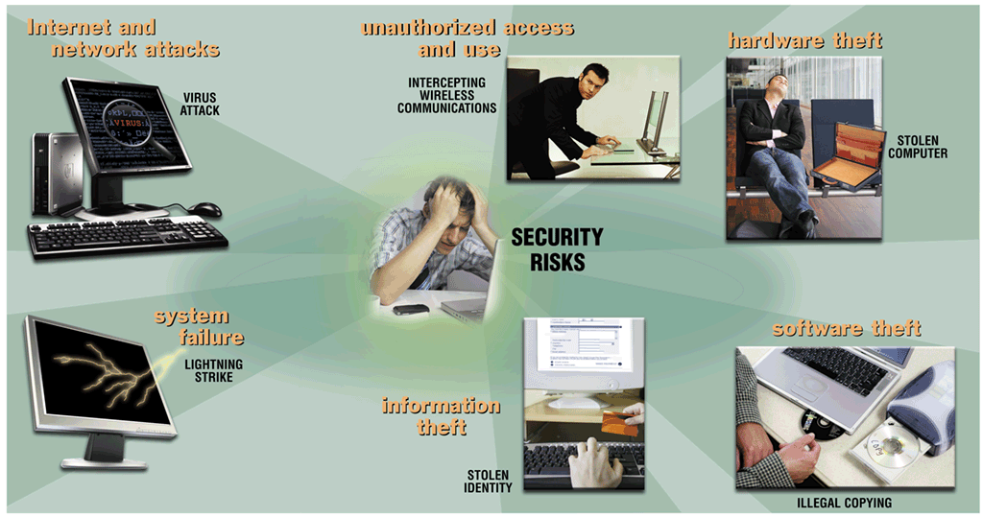
Computer Security Risks
What is a computer security risk?
Event or action that causes loss of or damage to computer system
Click to view Web Link, click Chapter 11, Click Web Link from left navigation, then click Computer Emergency Response Team Coordination Center below Chapter 11
p. 556 - 558 Fig. 11-1
Next

Slide 4
Internet and Network Attacks
What are viruses, worms, and Trojan horses?
Virus is a potentially damaging computer program
Worm copies itself repeatedly, using up resources and possibly shutting down computer or network
Trojan horse hides within or looks like legitimate program until triggered
Payload (destructive event) that is delivered
Can spread and damage files
Does not replicate itself on other computers
p. 558
Next

Slide 5
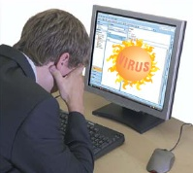
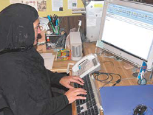
Internet and Network Attacks
How can a virus spread through an e-mail message?
Step 1. Unscrupulous programmers create a virus program that deletes all files. They hide the virus in a picture and attach the picture to an e-mail message.
Step 2. They use the Internet to send the e-mail message to thousands of users around the world.
Step 3b. Other users do not recognize the name of the sender of the e-mail message. These users do not open the e-mail message - instead they delete the e-mail message. These users’ computers are not infected with the virus.
Step 3a. Some users open the attachment and their computers become infected with the virus.
p. 559 Fig. 11-2
Next

Slide 6
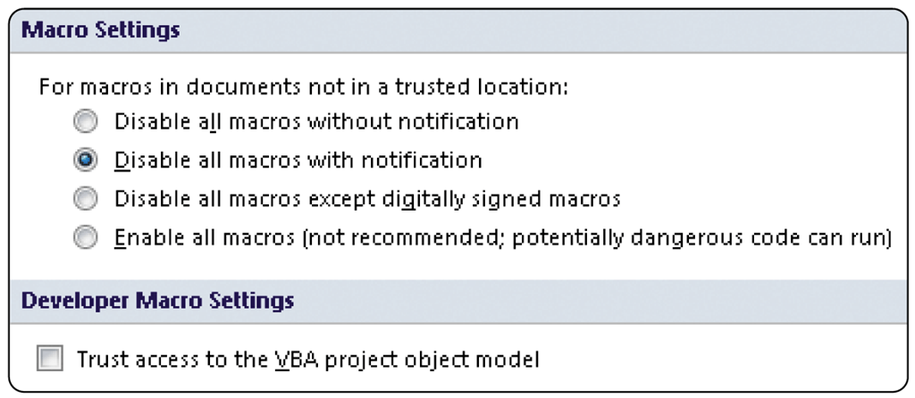
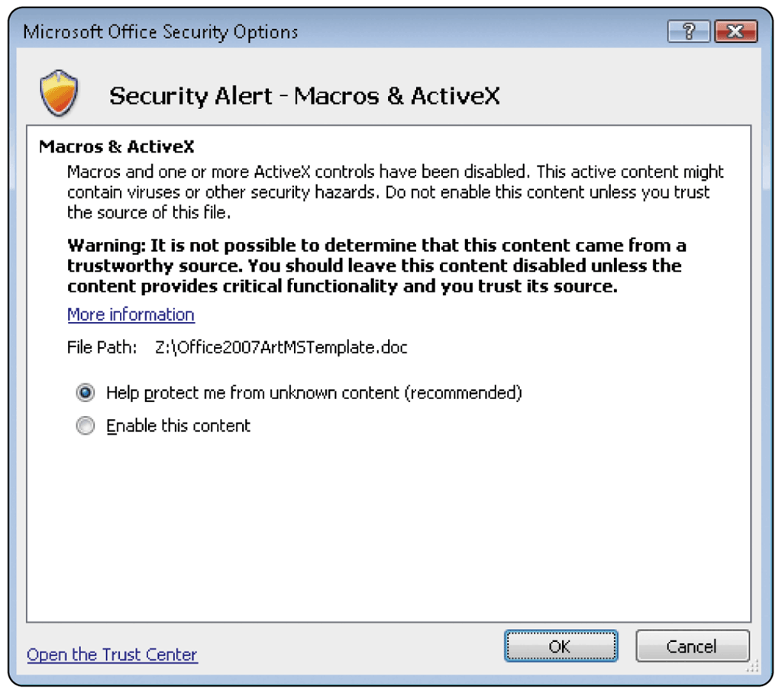
Internet and Network Attacks
How can you protect your system from a macro virus?
Set macro security level in applications that allow you to write macros
Set security level so that warning displays that document contains macro
Macros are instructions saved in an application, such as word processing or spreadsheet program
p. 560 Fig. 11-3
Next

Slide 7
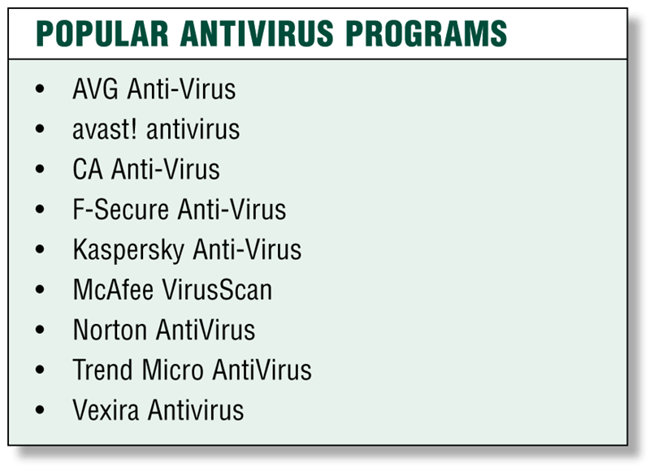
Internet and Network Attacks
What is an antivirus program?
Identifies and removes computer viruses
Most also protect against worms , Trojan horses, and spyware
p. 560 - 561 Fig. 11-4
Next

Slide 8
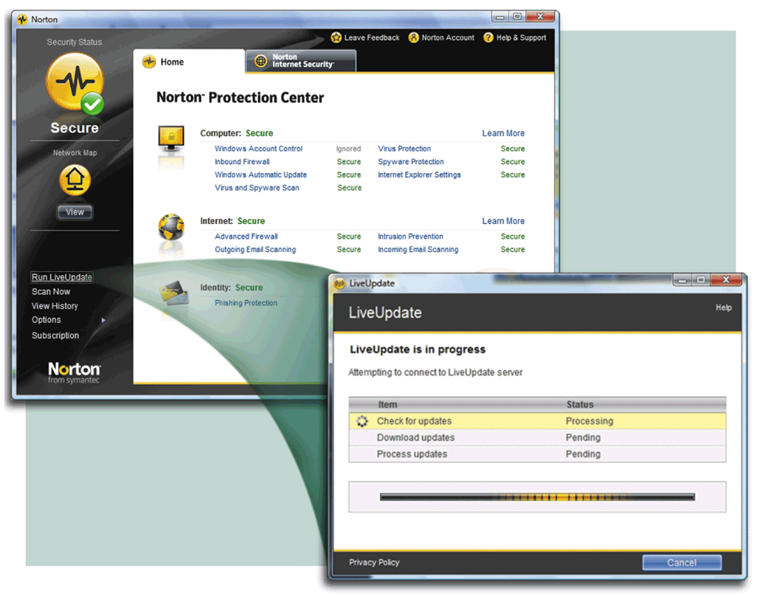
Internet and Network Attacks
What is a virus signature?
Specific pattern of virus code
Also called virus definition
Antivirus programs look for virus signatures
p. 561 Fig. 11-5
Next

Slide 9
Internet and Network Attacks
How does an antivirus program inoculate a program file?
Records information about program such as file size and creation date
Uses information to detect if virus tampers with file
Attempts to remove any detected virus
Quarantines infected files that it cannot remove
Keeps file in separate area of hard disk
p. 561
Next

Slide 10
Internet and Network Attacks
What are some tips for preventing virus, worm, and Trojan horse infections?
Never start a computer with removable media inserted
Install an antivirus program on all of your computers
Never open an e-mail attachment unless you are expecting it and it is from a trusted source
If the antivirus program flags an e-mail attachment as infected, delete the attachment immediately
Check all downloaded programs for viruses, worms, or Trojan horses
Install a personal firewall program
Click to view Web Link, click Chapter 11, Click Web Link from left navigation, then click Virus Hoaxes below Chapter 11
p. 562
Next

Slide 11
Internet and Network Attacks
What are a denial of service attack, back door and spoofing?
A denial of service attack is an assault which disrupts computer access to an Internet service such as the Web or e-mail
A back door is a program or set of instructions in a program that allow users to bypass security controls when accessing a computer resource
Spoofing is a technique intruders use to make their network or Internet transmission appear legitimate to a victim computer or network
p. 562 - 563
Next

Slide 12
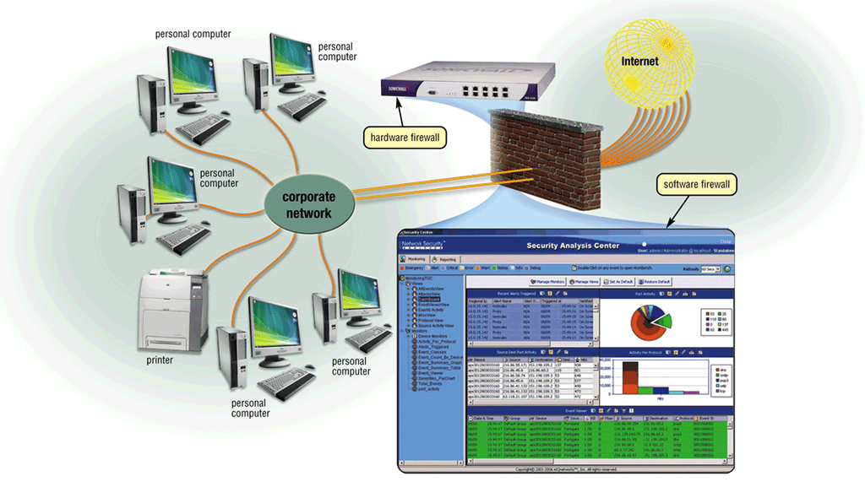
Internet and Network Attacks
What is a firewall?
Security system consisting of hardware and/or software that prevents unauthorized intrusion
p. 563 Fig. 11-7
Next

Slide 13
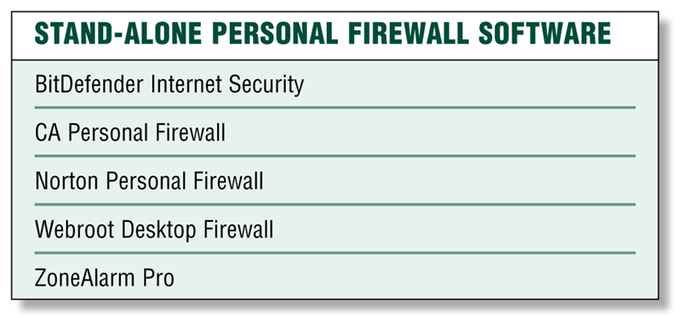
Internet and Network Attacks
What is a personal firewall?
Program that protects personal computer and its data from unauthorized intrusions
Monitors transmissions to and from computer
Informs you of attempted intrusion
p. 564 Fig. 11-8
Next

Slide 14
Unauthorized Access and Use
How can companies protect against hackers?
Intrusion detection software analyzes network traffic, assesses system vulnerabilities, and identifies intrusions and suspicious behavior
Access control defines who can access computer and what actions they can take
Audit trail records access attempts
p. 564 - 565
Next

Slide 15
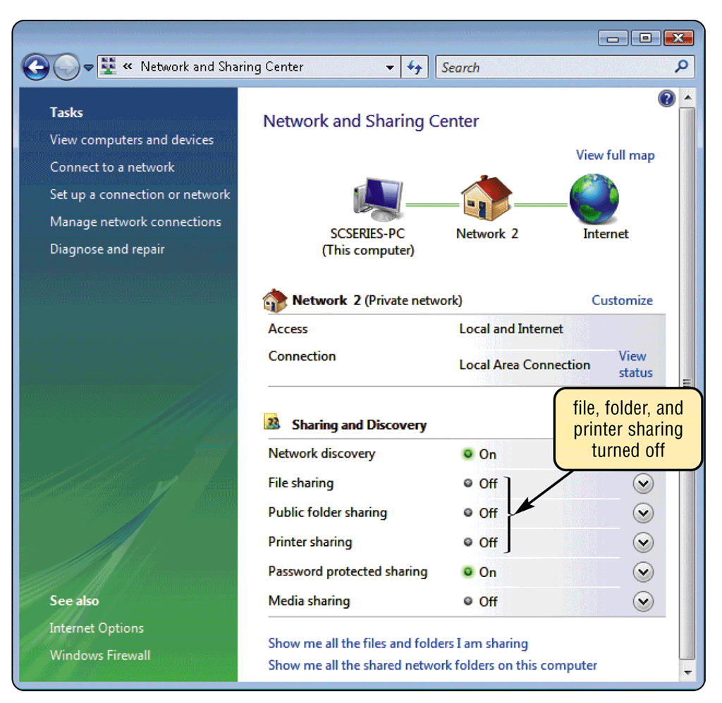
Unauthorized Access and Use
What are other ways to protect your personal computer?
Disable file, folder, and printer sharing on Internet connection
p. 565 Fig. 11-9
Next

Slide 16
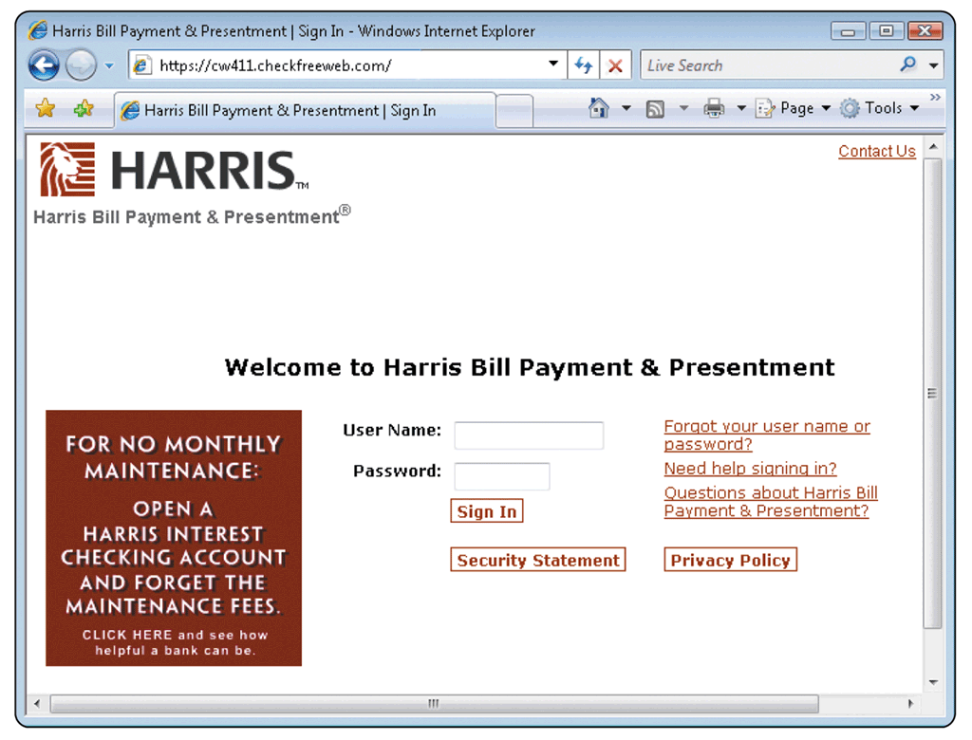
Unauthorized Access and Use
What is a user name?
Unique combination of characters that identifies user
Password is private combination of characters associated with the user name that allows access to computer resources
Click to view Web Link, click Chapter 11, Click Web Link from left navigation, then click CAPTCHAs below Chapter 11
p. 566 Fig. 11-10
Next

Slide 17
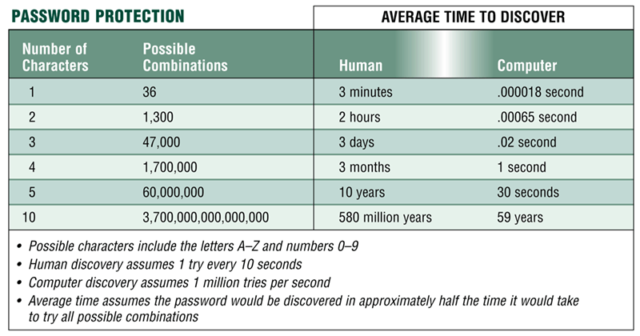
Unauthorized Access and Use
How can you make your password more secure?
Longer passwords provide greater security
p. 566 - 567 Fig. 11-11
Next

Slide 18
Unauthorized Access and Use
What is a possessed object?
Item that you must carry to gain access to computer or facility
Often used with numeric password called personal identification number (PIN)
p. 567
Next

Slide 19
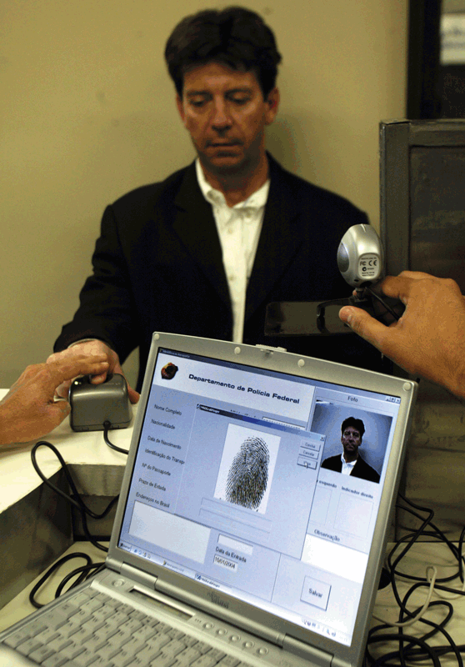
Unauthorized Access and Use
What is a biometric device?
Authenticates person’s identity using personal characteristic
Fingerprint, hand geometry, voice, signature, and iris
p. 567 - 568 Fig. 11-13
Next

Slide 20
Digital Forensics
Digital forensics, also called computer forensics, network forensics, or cyberforensics, is the discovery, collection, and analysis of evidence found on computers and networks.
Next

Slide 21
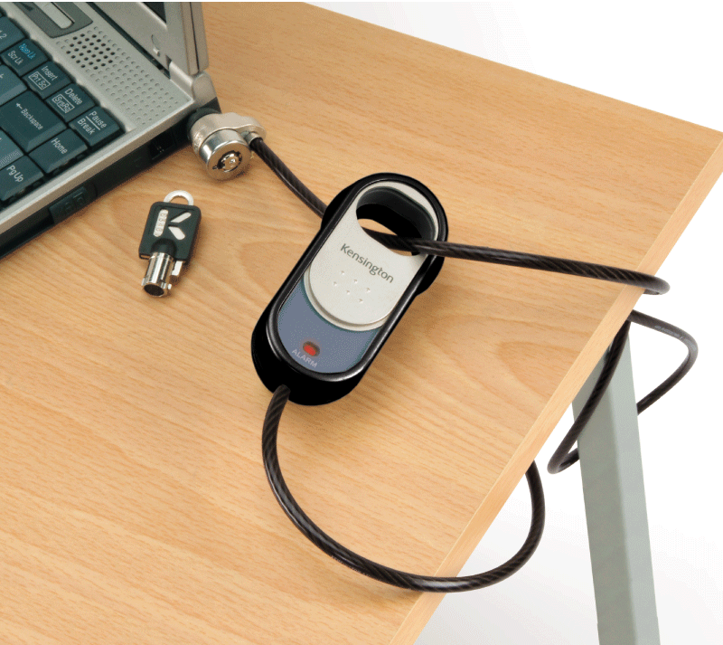
Hardware Theft and Vandalism
What are hardware theft and hardware vandalism?
Hardware theft is act of stealing computer equipment
Cables sometimes used to lock equipment
Some notebook computers use passwords, possessed objects, and biometrics as security methods
You can password protect mobile devices
Hardware vandalism is act of defacing or destroying computer equipment
Click to view Web Link, click Chapter 11, Click Web Link from left navigation, then click RTLS below Chapter 11
p. 569 - 570 Fig. 11-14
Next

Slide 22
Software Theft
What is software theft?
Act of stealing or illegally stealing software, copying software or intentionally erasing programs
Software piracy is illegal duplication of copyrighted software
p. 570
Next

Slide 23
Software Theft
Perpetrator physically stealing the media
Programmer is terminated
software is stolen from software manufacturers. This type of theft, called piracy
software theft involves users illegally obtaining registration numbers and/or activation codes. A program called a keygen, short for key generator, creates software registration numbers and sometimes activation codes.
Next

Slide 24
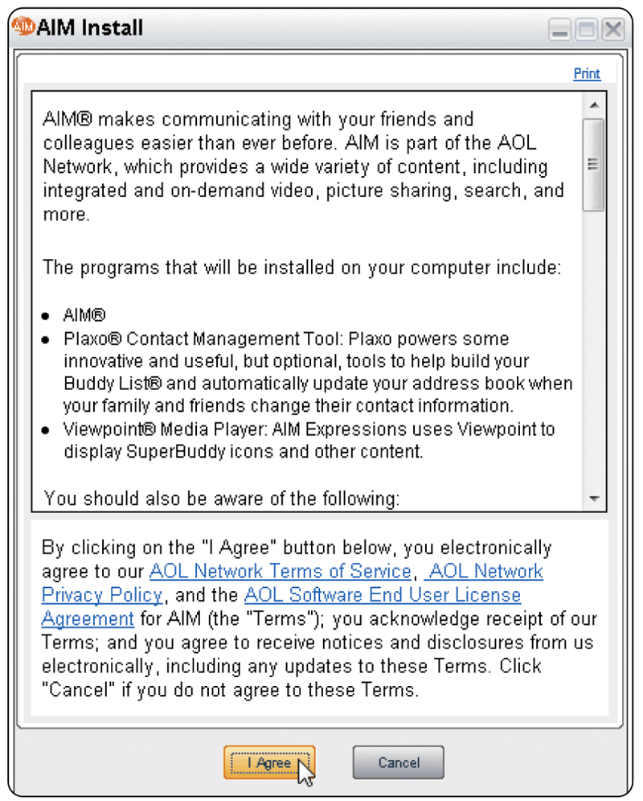
Software Theft
What is a license agreement?
Right to use software
Single-user license agreement allows user to install software on one computer, make backup copy, and sell software after removing from computer
p. 570 - 571 Fig. 11-15
Next

Slide 25
Users are permitted to:
• Install the software on only one computer.
(Some license agreements allow users to install
the software on one desktop computer and one
notebook computer.)
• Make one copy of the software as a backup.
• Give or sell the software to another individual,
but only if the software is removed from the
user’s computer first.

Slide 26
Users are not permitted to:
• Install the software on a network, such as a
school computer lab.
• Give copies to friends and colleagues, while
continuing to use the software.
• Export the software.
• Rent or lease the software.

Slide 27
Software Theft
What are some other safeguards against software theft?
Product activation allows user to input product identification number online or by telephone and receive unique installation identification number
Business Software Alliance (BSA) promotes better understanding of software piracy problems
Click to view Web Link, click Chapter 11, Click Web Link from left navigation, then click Business Software Alliance below Chapter 11
p. 571
Next

Slide 28
Information Theft
What is encryption?
Safeguards against information theft
Process of converting plaintext (readable data) into ciphertext (unreadable characters)
Encryption key (formula) often uses more than one method
To read the data, the recipient must decrypt, or decipher, the data
p. 572 Fig. 11-16
Next

Slide 29
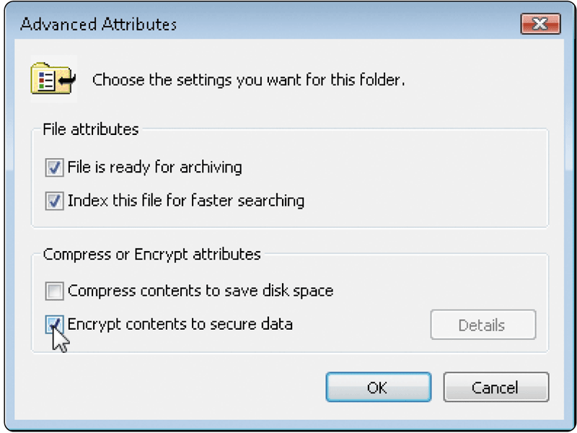
Information Theft
How can I encrypt the contents of files and folders in Windows Vista?
Click to view Web Link, click Chapter 11, Click Web Link from left navigation, then click BitLocker below Chapter 11
p. 573 Fig. 11-17
Next

Slide 30
Information Theft
How do Web browsers provide secure data transmission?
Many Web browsers use encryption
Secure site is Web site that uses encryption to secure data
Digital certificate is notice that guarantees Web site is legitimate
Click to view Web Link, click Chapter 11, Click Web Link from left navigation, then click Digital Certificates below Chapter 11
p. 573
Next

Slide 31
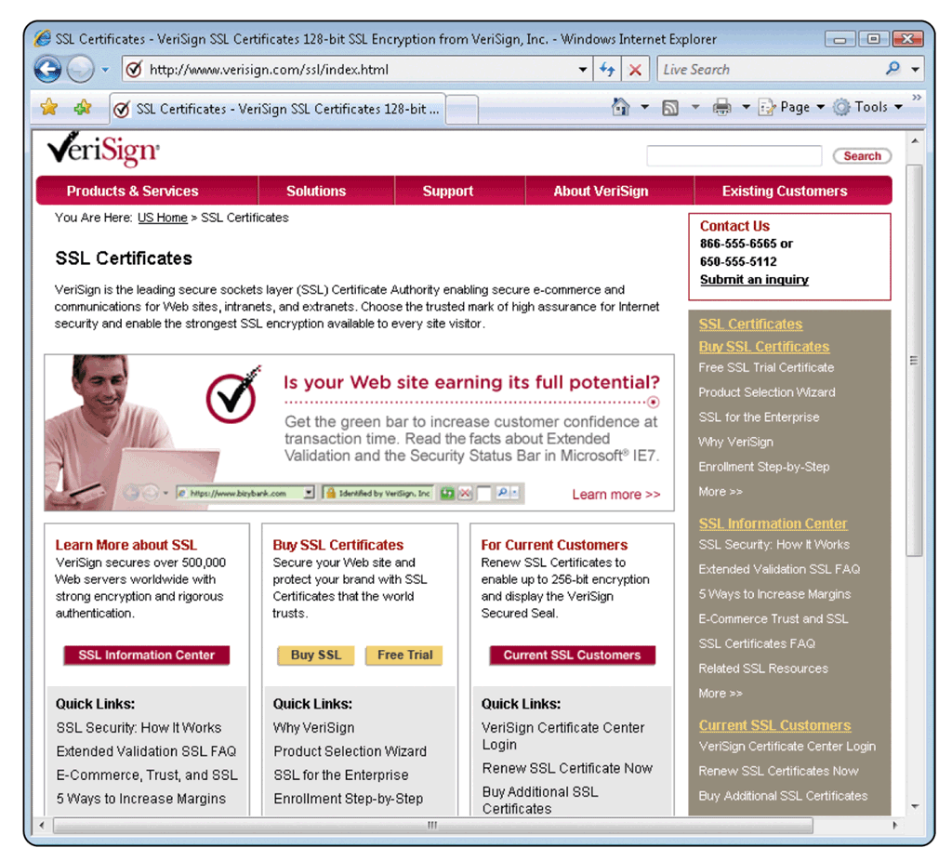
Information Theft
What is a certificate authority (CA)?
Authorized person or company that issues and verifies digital certificates
Users apply for digital certificate from CA
p. 573 Fig. 11-18
Next

Slide 32
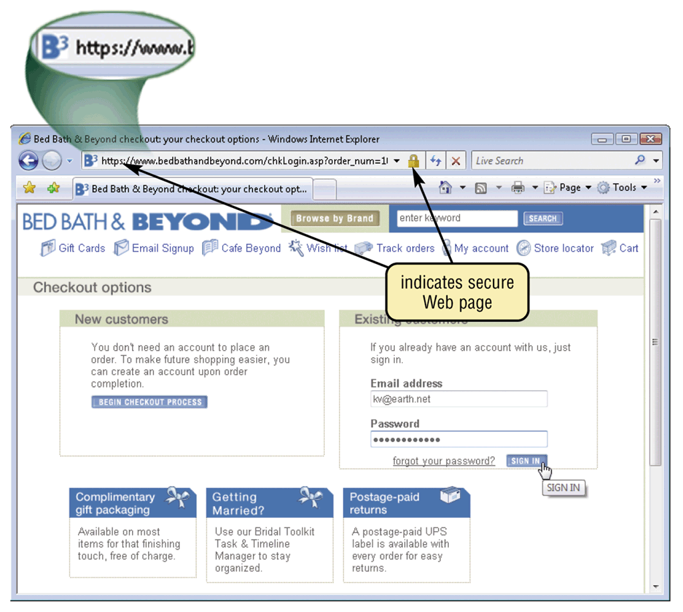
Information Theft
What is Secure Sockets Layer (SSL)?
Provides encryption of all data that passes between client and Internet server
Web addresses beginning with “https” indicate secure connections
p. 574 Fig. 11-19
Next

Slide 33
System Failure
What is a system failure?
Prolonged malfunction of computer
Can cause loss of hardware, software, or data
Caused by aging hardware, natural disasters, or electrical power disturbances
Noise—unwanted electrical signal
Overvoltage or power surge— significant increase in electrical power
Undervoltage—drop in electrical supply
p. 574
Next

Slide 34
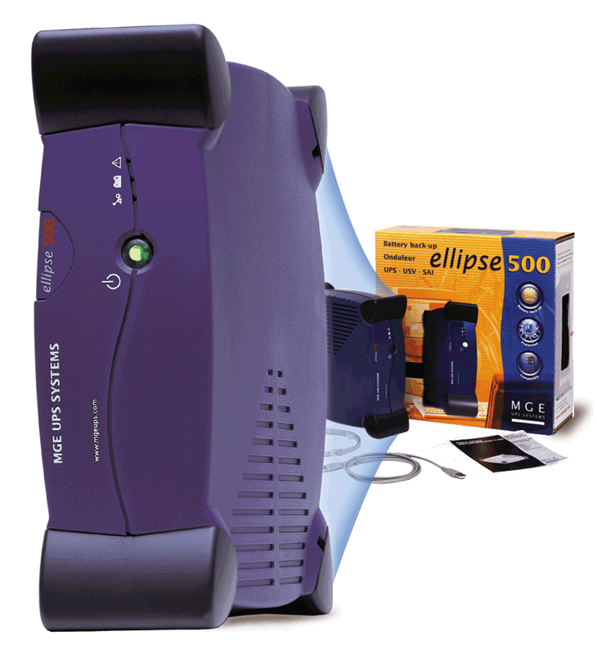
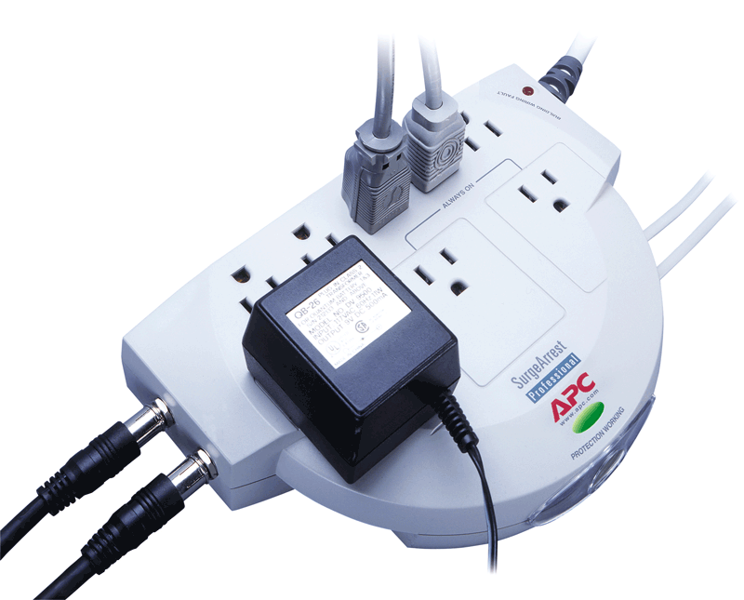
System Failure
What is a surge protector?
Protects computer and equipment from electrical power disturbances
Uninterruptible power supply (UPS) is surge protector that provides power during power loss
Click to view Web Link, click Chapter 11, Click Web Link from left navigation, then click Uninterruptible Power Supply below Chapter 11
p. 574 - 575 Figs. 11-20–11-21
Next

Slide 35
Backing Up — The Ultimate Safeguard
What is a backup?
Duplicate of file, program, or disk
Full backup all files in computer
Selective backup select which files to back up
Three-generation backup preserves three copies of important files
In case of system failure or corrupted files, restore files by copying to original location
p. 576
Next

Slide 36
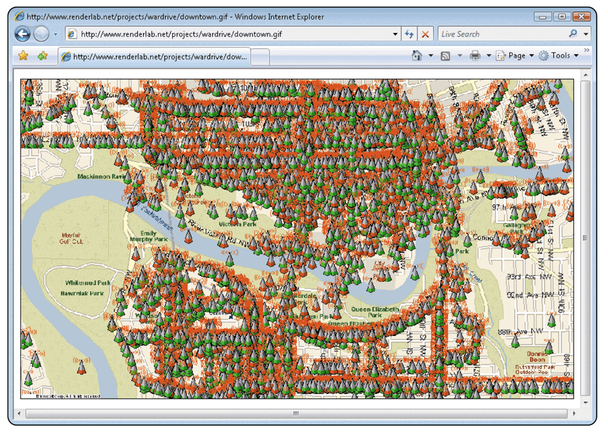
Wireless Security
How can I ensure my wireless communication is secure?
Secure your wireless access point (WAP)
WAP should not broadcast your network name
Enable Wi-Fi Protected Access (WPA)
802.11i
p. 577 Fig. 11-22
Next

Slide 37
Ethics and Society
What are computer ethics?
Moral guidelines that govern use of computers and information systems
Unauthorized use of computers and networks
Software theft
Information accuracy
Intellectual property rights—rights to which creators are entitled for their work
Codes of conduct
Information privacy
Click to view Web Link, click Chapter 11, Click Web Link from left navigation, then click Digital Rights Management below Chapter 11
p. 578 - 579
Next

Slide 38
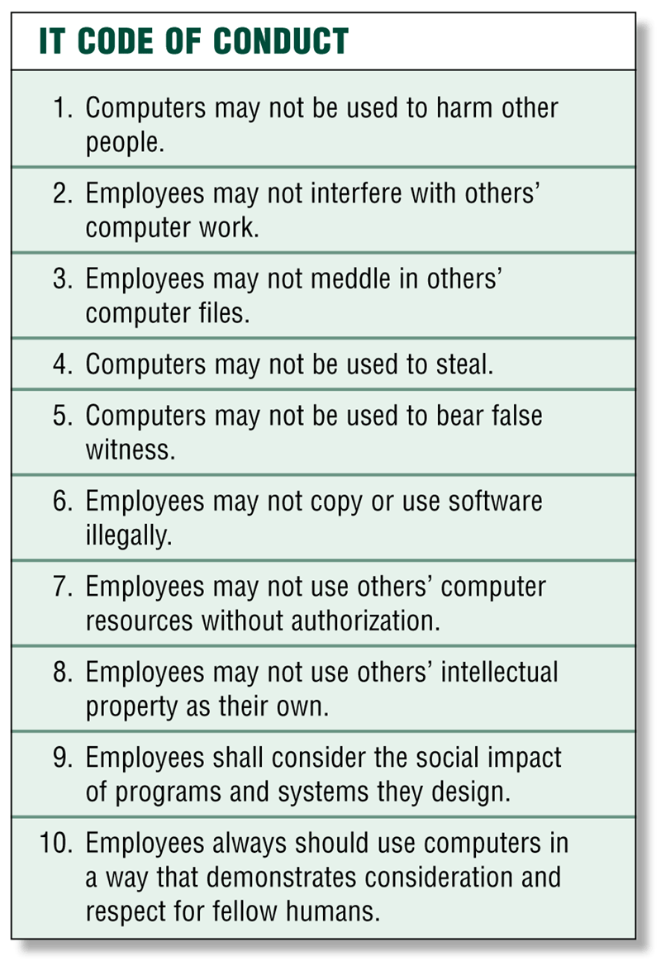
Ethics and Society
What is an IT code of conduct?
Written guideline that helps determine whether computer action is ethical
Employers can distribute to employees
p. 580 Fig. 11-25
Next

Slide 39
Information Privacy
What is information privacy?
Right of individuals and companies to deny or restrict collection and use of information about them
Difficult to maintain today because data is stored online
Employee monitoring is using computers to observe employee computer use
Legal for employers to use monitoring software programs
p. 580 and 586
Next

Slide 40
Information Privacy
What are some ways to safeguard personal information?
Fill in only necessary information on rebate, warranty, and registration forms
Install a cookie manager to filter cookies
Sign up for e-mail filtering through your Internet access provider or use an antispam program, such as Brightmail
Clear your history file when you are finished browsing
Avoid shopping club and buyers cards
Set up a free e-mail account; use this e-mail address for merchant forms
Do not reply to spam for any reason
Inform merchants that you do not want them to distribute your personal information
Turn off file and print sharing on your Internet connection
Surf the Web anonymously with a program such as Freedom Web Secure or through an anonymous Web site such as Anonymizer.com
Limit the amount of information you provide to Web sites; fill in only required information
Install a personal firewall
p. 581
Next

Slide 41
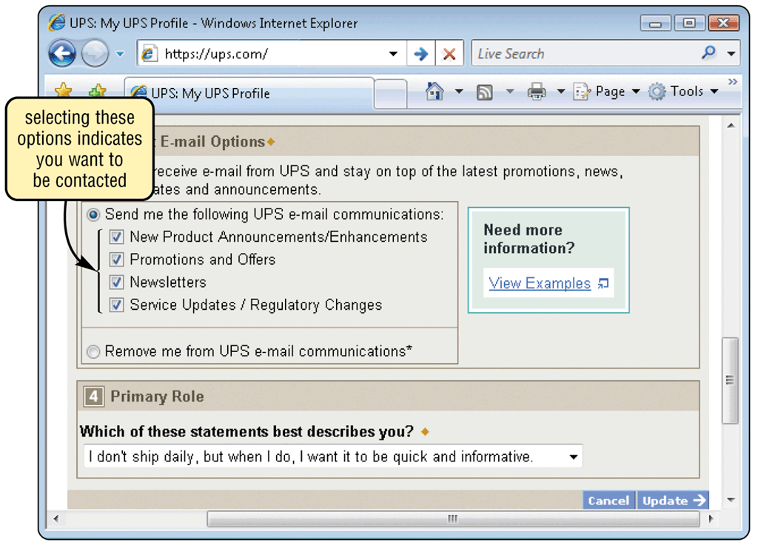
Information Privacy
What is an electronic profile?
Data collected when you fill out form on Web
Merchants sell your electronic profile
Often you can specify whether you want personal information distributed
p. 581 - 582 Fig. 11-27
Next

Slide 42
Information Privacy
What is a cookie?
Small text file on your computer that contains data about you
Some Web sites sell or trade information stored in your cookies
Set browser to accept cookies, prompt you to accept cookies, or disable cookies
User preferences
How regularly you visit Web sites
Interests and browsing habits
p. 582
Next

Slide 43
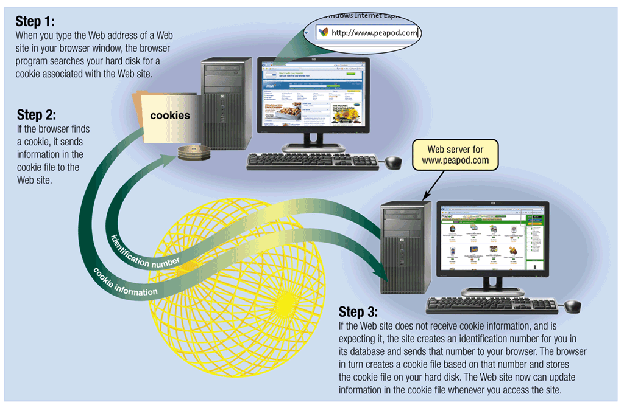
Information Privacy
How do cookies work?
p. 583 Fig. 11-28
Next

Slide 44
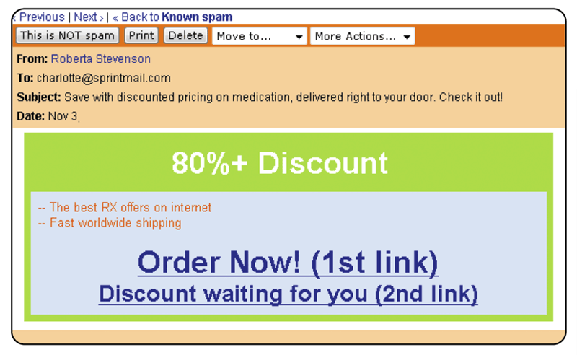
Information Privacy
What are spyware, adware, and spam?
Spyware is program placed on computer without user’s knowledge
Adware is a program that displays online advertisements
Spam is unsolicited e-mail message sent to many recipients
Click to view Web Link, click Chapter 11, Click Web Link from left navigation, then click Spam below Chapter 11
p. 583 - 584 Fig. 11-29
Next

Slide 45
Information Privacy
How can you control spam?
E-mail filtering
Service that blocks e-mail messages from designated sources
Collects spam in central location that you can view any time
Anti-spam program
Attempts to remove spam
Sometimes removes valid e-mail messages
p. 584
Next

Slide 46
Information Privacy
What is phishing?
Scam in which a perpetrator sends an official looking
e-mail that attempts to obtain your personal and financial information
p. 584
Next

Slide 47
Information Privacy
What privacy laws have been enacted?
p. 585 Fig. 11-30
Next

Slide 48
Information Privacy
What privacy laws have been enacted? (cont’d)
p. 585 Fig. 11-30
Next

Slide 49
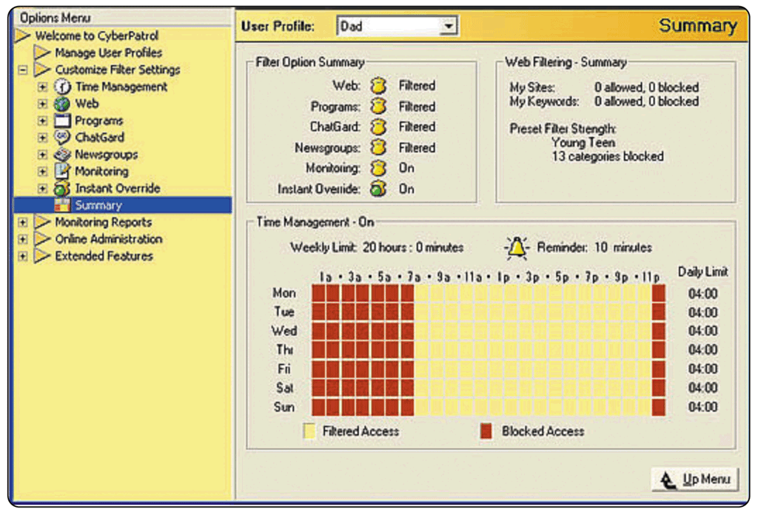
Information Privacy
What is content filtering?
Process of restricting access to certain material
Internet Content Rating Association (ICRA) provides rating system of Web content
Web filtering software restricts access to specified sites
p. 586 - 587 Fig. 11-31
Next

Slide 50
Information Privacy
What is computer forensics?
Also called digital forensics, network forensics, or cyberforensics
Discovery, collection, and analysis of evidence found on computers and networks
Computer forensic analysts must have knowledge of the law, technical experience, communication skills, and willingness to learn
p. 587
Next

Slide 51
Health Concerns of Computer Use
What are some health concerns of computer use?
Computer vision syndrome (CVS)—eye and vision problems
Carpal tunnel syndrome (CTS)—inflammation of nerve that connects forearm to palm
Repetitive strain injury (RSI)
Tendonitis—inflammation of tendon due to repeated motion
Computer addiction—when computer consumes entire social life
p. 587 - 589
Next

Slide 52
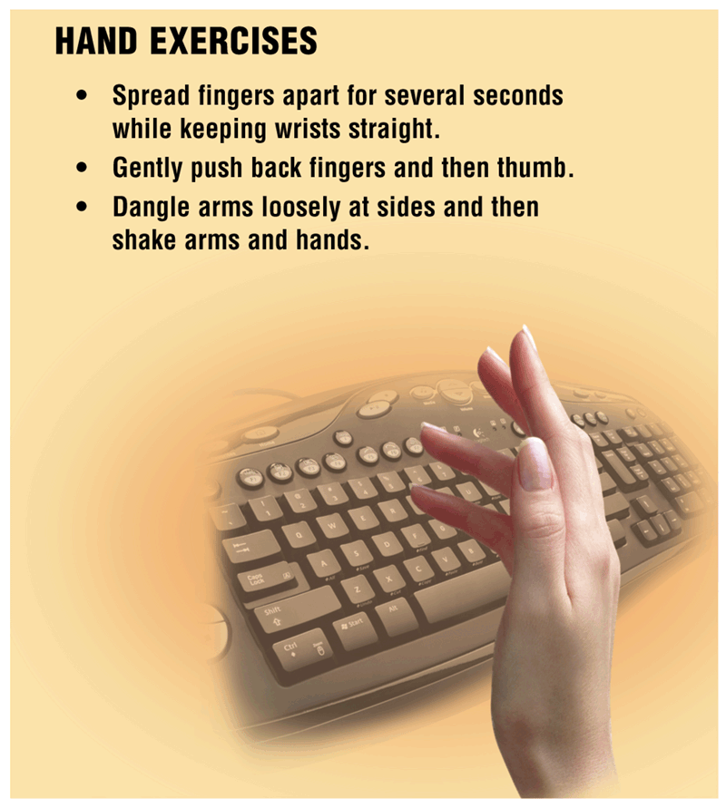
Health Concerns of Computer Use
What precautions can prevent tendonitis or carpal tunnel syndrome?
Spread fingers apart for several seconds while keeping wrists straight
Gently push back fingers and then thumb
Dangle arms loosely at sides and then shake arms and hands
p. 588 Fig. 11-32
Next

Slide 53
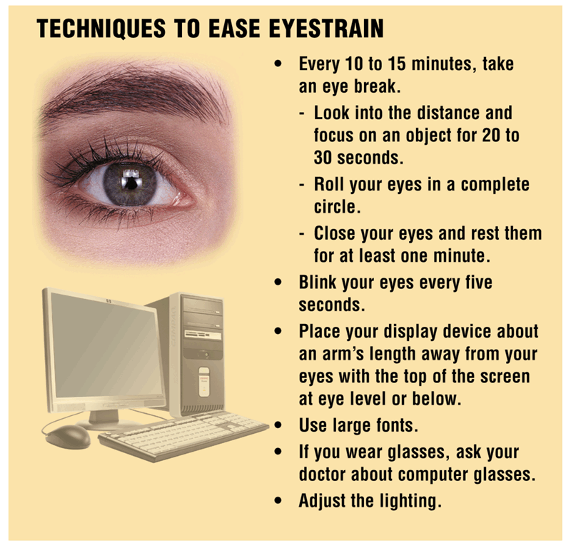
Health Concerns of Computer Use
How can you ease eyestrain when working at the computer?
p. 588 Fig. 11-33
Next

Slide 54
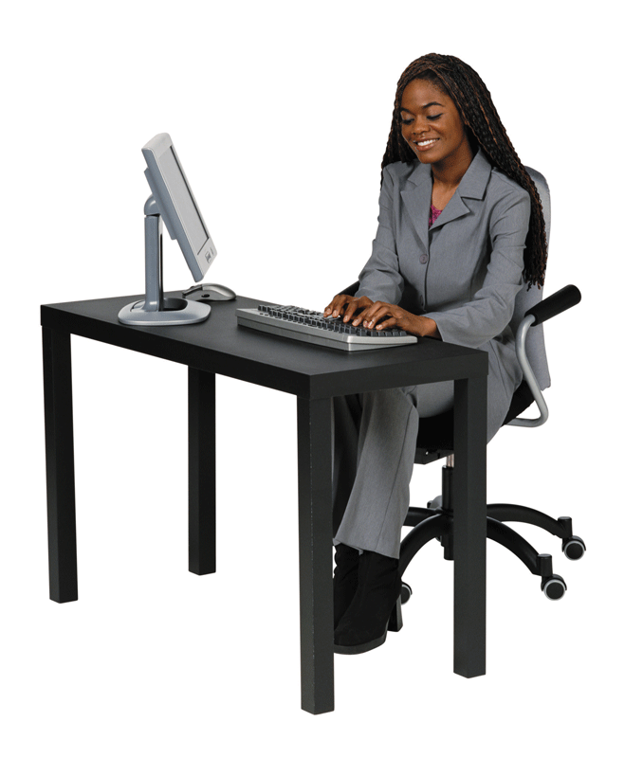
Health Concerns of Computer Use
What is ergonomics?
Applied science devoted to comfort, efficiency, and safety in workplace
elbows at 90° and arms and hands parallel to floor
keyboard height: 23” to 28”
adjustable seat
adjustable height chair with 4 or 5 legs for stability
p. 589 Fig. 11-34
feet flat on floor
Next

Slide 55
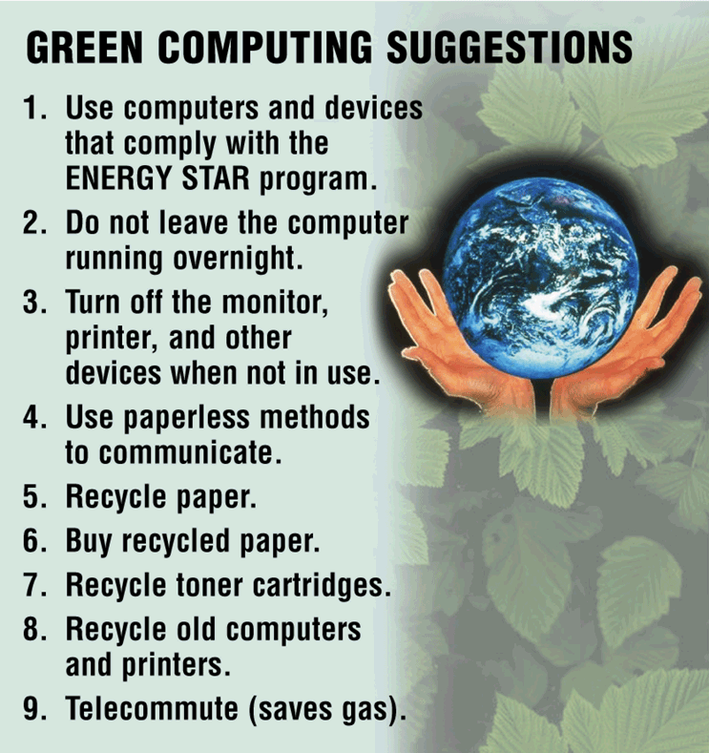
Health Concerns of Computer Use
What is green computing?
Reducing electricity and environmental waste while using computer
Click to view Web Link, click Chapter 11, Click Web Link from left navigation, then click Green Computing below Chapter 11
p. 590 Fig. 11-35
Next

Slide 56
Summary of Computer Security, Ethics and Privacy
Potential computer risks
Ethical issues surrounding information accuracy, intellectual property rights, codes of conduct, and information privacy
Safeguards that schools, business, and individuals can implement to minimize these risks
Computer-related health issues, their preventions, and ways to keep the environment healthy
Wireless security risks and safeguards
Chapter 11 Complete

