Slide 1
Geometry BS Education-V Teaching Mathematics (EDU-511)
Department of Education University of Sargodha

Slide 2
Rimsha Akhtar (Roll no: BEUF16E160)
Teaching of Mathematics (EDU - 511)
BS Education ( Semester 5)
Department of Education
University of Sargodha, 40100 Sargodha
Pakistan October 2020

Slide 3
What is geometry?
Geometry refers to a branch of mathematics which is focused on the measurement and relationship of lines, angles, surfaces, solids and points.

Slide 4
Basics of geometry
Some basic geometry concepts, words and notations that you would need to know are points midpoint, lines ,intersection line, rays , plane and space.

Slide 5
Point:
We may think of a point as a "dot" on a piece of paper or the pinpoint on a board. In geometry, we usually identify this point with a number or letter. A point has no length, width, or height - it just specifies an exact location. It is zero-dimensional.
Every point needs a name. To name a point, we can use a single capital letter. The following is a diagram of points A, B, and M:

Slide 6
Lines
We can use a line to connect two points on a sheet of paper. A line is one-dimensional. That is, a line has length, but no width or height. In geometry, a line is perfectly straight and extends forever in both directions. A line is uniquely determined by two points.
Lines need names just like points do, so that we can refer to them easily. To name a line, pick any two points on the line.
The line passing through the points A and B is denoted by

Slide 7
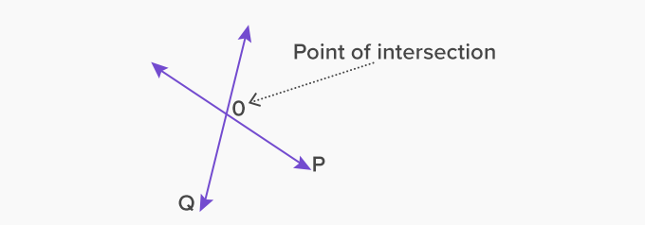
Intersection lines
When two or more lines cross each other in a plane, they are called intersecting lines. The intersecting lines share a common point, which exists on all the intersecting lines, and is called the point of intersection.
Here, lines P and Q intersect at point O, which is the point of intersection.

Slide 8
Parallel Lines
If a pair of lines lie in the same plane and do not intersect when produced on either side, then such lines are parallel to each other.
If L and M are two parallel lines, we read it as L is parallel to M

Slide 9
Line segments
Because the length of any line is infinite, we sometimes use parts of a line. A line segment connects two endpoints. A line segment with two endpoints A and B is denoted by .
A line segment can also be drawn as part of a line.

Slide 10
Midpoint
The midpoint of a segment divides the segment into two segments of equal length. The diagram below shows the midpoint M of the line segment . Since M is the midpoint, we know that the lengths AM = MB.

Slide 11
Rays
A ray is part of a line that extends without end in one direction. It starts from one endpoint and extends forever in one direction.
A ray starting from point A and
passing through B is denoted by

Slide 12
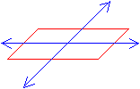
Planes
Planes are two-dimensional. A plane has length and width, but no height, and extends infinitely on all sides. Planes are thought of as flat surfaces, like a tabletop. A plane is made up of an infinite amount of lines. Two-dimensional figures are called plane figures.
All the points and lines that lie on the same plane are said to be coplanar.
A plane

Slide 13
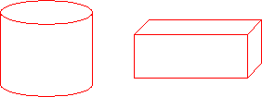
Space
Space is the set of all points in the three dimensions - length, width and height. It is made up of an infinite number of planes. Figures in space are called solids.
Figures in shapes

