Slide 1
Fitness Training

Slide 2
Improving physical fittness
Exercise can be any physical exertion to improve mental & physical health including prevention or correction of impairments,
Exercise must be performed to certain extent to achieve benefits.

Slide 3
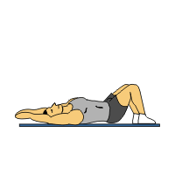
Improving Physical Fitness Types of Exercise
Aerobic Exercise
exercise requiring the continual use of oxygen or any activity that uses large muscle groups ,can be maintain continuously ,and is rhythmic in nature.
Exp: bicycling, walking, jumping rope, running, stair climbing, skating etc.
Duration
10 min/day ____ 2-3 times/day, 5dys/week
30 min session is optimal for many people
Benefits
Improve cardiovascular fitness
Improve body composition
Improve mental fitness
Skeletal muscle endurance
Better sleep, less depression, improved mood.

Slide 4
Benefits of aerobic exercises
Exercise increases your stamina and endurance.
Exercise reduces stress. Exercise activates your endorphins, causing a natural high and a sense of well-being.
Exercise reduces your risk for heart disease and stroke. Coronary heart disease is the leading killer in the United States, and nearly half of them are women.
Exercise strengthens your immune system. It actually increases your resistance to stress and illness.
Exercise strengthens your bones and joints &decrease a woman’s chance for osteoporosis.

Slide 5
Benefits of aerobic exercises
Exercise decreases your appetite. You won’t be as hungry because exercise acts as a natural appetite suppressant.
Exercise will increase the number of calories you burn. This increase will accelerate your weight loss and encourage weight control.
Exercise will strengthen your heart and lungs so that they will work more efficiently.
Exercise decreases a woman’s risk for breast cancer.
Exercise decreases blood pressure and blood cholesterol. Exercise decreases LDL, or bad cholesterol, while raising your HDL, or good cholesterol.

Slide 6
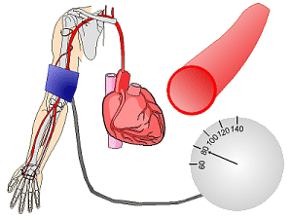
Anaerobic exercise
Performed in the absence of continual oxygen source. Short in duration and high in intensity, involving short burst of exertion followed by periods of rest. Eg, weight lifting, etc.
Benefits
Increase caloric consumption
Increase metabolism
Shorter workouts
Improved brain function
Increased lean muscle tissue
Isometric exercise (care in cardiac and respiratory patients)(heavy wt lift-→valsalva effect)
Isotonic exercise
Isokinetic exercise
concentric muscle work
eccentric muscle work

Slide 7
Comparison of isometric, isotonic, isokinetic
Advantages
Disadvantages
Isometric
Not aggravate sensitive joint surfaces
Easy to perform & remember
Reproducible, Convenient
Cost effective
Isotonic
Functional
Easy to monitor
Convenient
Best improve strength n endurance
Isokinetic
max loading through whole ROM
Objective, reproducible
Muscle easily isolated
Safest form of exercises
Few contraindication
Isometric
Not functional
Improvement speed n angle specific
Many contraindications
Not efficient in term of strength
No endurance improved
ISOTONIC
Max loading at specific angle
Momentum key factor
Unsafe for joints
Likelihood of injuries
Gives DOMS
Many contraindications
Difficult to monitor
Isokinetic
Time consuming
Requires time and skill to use
Costly
Not functional

Slide 8
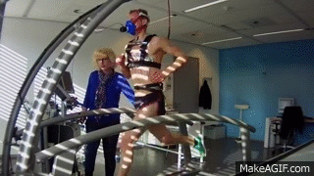
Sports Exercise
Any type of exercise involving physical games and competition.
Benefits
Physical activity and playing sports are among best preventive medicine
Combating obesity and osteoporosis
Enhancing cardiovascular fitness
Psychological benefits

Slide 9
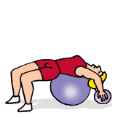
Therapeutic Exercise
Corrective exercise, used bodily movements to restore normal function in diseased or injured tissue to maintain well being.
Goals
Improve ambulation
Releasing contracted muscle, tendons, fascias.
Mobilizing joints
Improving circulation, respiratory capacity, coordination
Reducing rigidity
Increasing balance and muscle strength
Promoting relaxation etc etc etc
exercise
Active assisted ex.
AROM AAROM PROM

Slide 10
Benefits of physical activity
Table 4-1
Lower overall mortality
Lower risk of cancer, including colon cancer and breast cancer
Lower risk of diabetes
Lower risk of hypertension, also treat it
Lower risk of obesity
Lower risk of depression
Improved mood and lower the symptoms of depression
Improved quality of life and improved functioning
Improved function in persons with arthritis
Lower risk of fall and injury

Slide 11
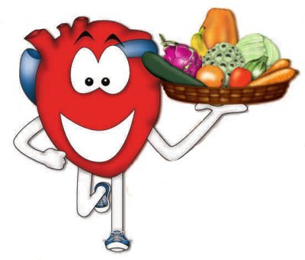
Cont……
Prevention of bone loss and post menopausal fractures
Improved quality of sleep
Improved memory
Increased endurance
Increased strength
Reduce stress and tension
Increased energy
Slowed aging process
Boasted confidence

Slide 12
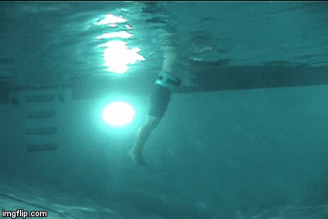
Therapeutic activities for special populations
Aquatherapy
Therapeutic intervention using water as an environment for performing aerobic exercise or relaxation activities.
Aquatic immersion provides various types of stimulation, including hydrostatic pressure, buoyancy, resistance and heat n affect the cardiopulmonary, neurological and musculoskeletal system in individuals with or without impairments

Slide 13
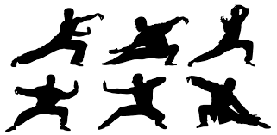
TAI CHI
T‘ai-chi (Mandarin: is an internal Chinese martial art practiced for both defense training and its health benefits.
Is an ancient chinese practice designed to exercise body, mind and spirit. These are slow controlled movements which are gentle and continuous and circular.
Require proper motor control and Improve balance.

Slide 14
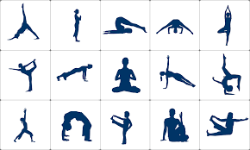
YOGA
Yoga is a group of physical, mental, and spiritual practices or disciplines which originated in ancient India
Type of exercise to attain body and mental control through variety of postures,
the root of yoga means to bind or to connect referring spiritual aspects of these exercise and suggesting a connection of soul with GOD.
Designed to incorporate breathing & meditation to calm mind.
HATHA yoga is physical path of yoga and use physical poses & breathing techniques designed to develop a strong, healthy, and flexible body.
Use stretching techniques for Physical & spiritual relaxation.

Slide 15
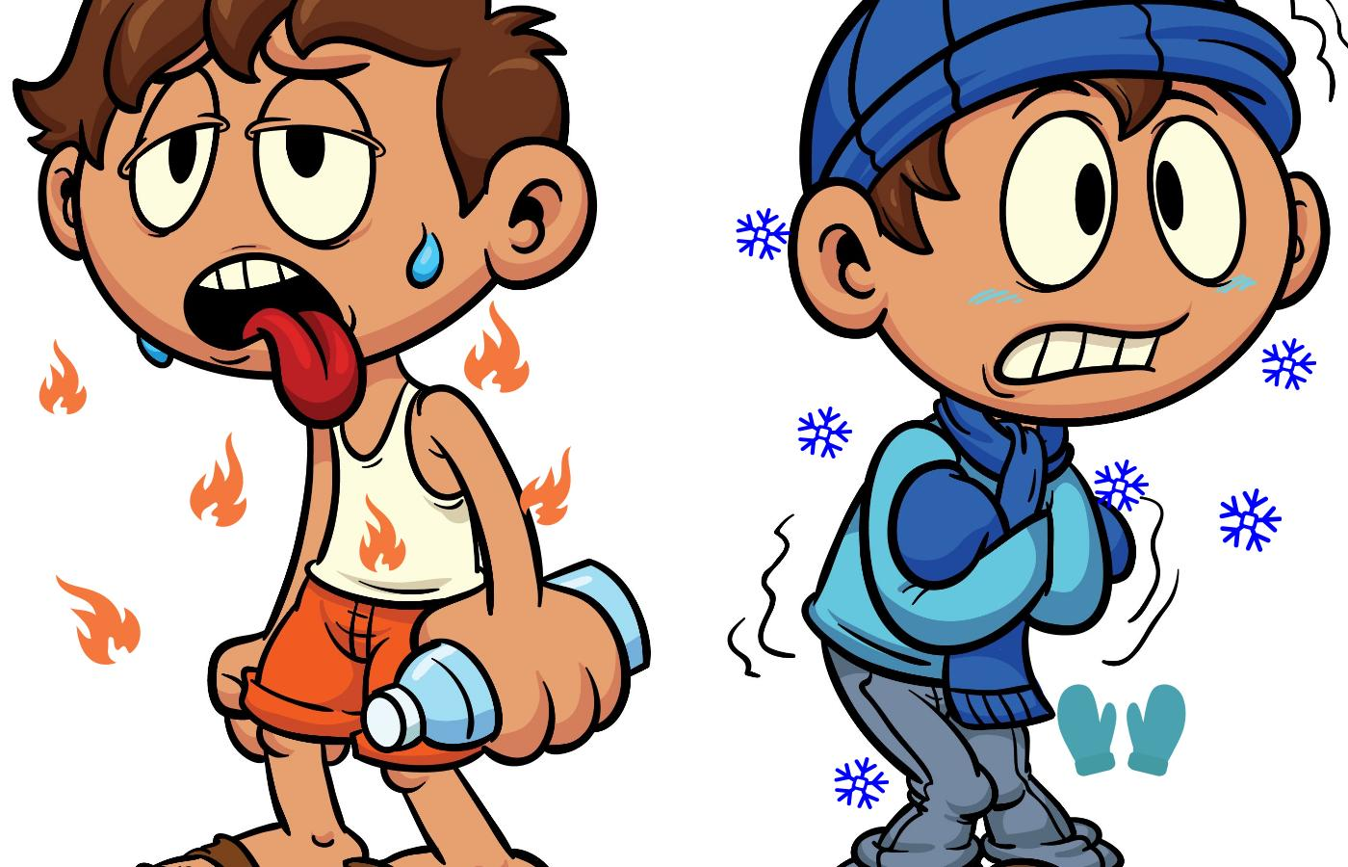
Consideration for exercise and physical activity
1.:::Weather condition:
bad weather pose significant hazards for outdoor activities
Vigorous exercise not advised when temperature is over 98F & humidity is high.
Hazards are dehydration.
Introduce electrolyte replacement ie diluted fruit juices
Not coffee n cola drinks as they are diuretics
2:::::::::::Proper attire:
clothing according to the weather & allow body to breathe yet protect from excessive sunlight
Fit the body properly, light colored (reflect sunlight)
Absorb moist
Early morning and late afternoon decrease weather hazards

Slide 16
Exercise should be limited when temp. below freezing point and accompanied by wind. During cold weather individual wear layered clothe.
3::;;Time of the day:
avoid peak sunlight
2 to 3 hours after meal
30 min break postexercise is suggested
4::::Proper nutrition:
balanced diet, hydration during exercise
Small meals 4 hours before ex.
Older adults should monitor nutrient intake for glucose and protein

Slide 17
Illness:
if patien has cold and no other medical condition: low intensity ex unless
Contraindicated in fever, sore muscle or joints, diarrhea or a productive cough.
First resolve these symptoms then go to ex.
Medications:
Caffeine, cold medication, diet pills, allergy remedies, and certain herbal teas, can elevate heart rate
Antihistamine…. Individual feel drowsy, increase in reaction time, poor balace….so avoid these medicine
Some medications can enhance performance hense banned by International Olympic Committee ie steroids, diuretics, pain relievers
Fluoroquinolones has linked with serious tendon injuries, ankle , shoulder and hand
Anti inflammatory drugs: stomach problem
anti-angina
All Carefully monitor before exercise
Notes:
Fluoroquinolones (see Table: Fluoroquinolones) exhibit concentration-dependent bactericidal activity (see Effectiveness) by inhibiting the activity of DNA gyrase and topoisomerase, enzymes essential for bacterial DNA replication.
Fluoroquinolones are divided into 2 groups, based on antimicrobial spectrum and pharmacology:
Older group: Ciprofloxacin, norfloxacin, and ofloxacin
Newer group: Gemifloxacin, levofloxacin, and moxifloxacin
Many newer fluoroquinolones have been withdrawn because of toxicity;

Slide 18
Preparation for ex/exercise prescription
Fitte equation
F: frequency:
( how often) no of session, twice per day
I : intensity:
( how hard) resistance exercise, max weight, submax, to the point of fatigue etc.
T : time duration:
(how long) time of exercise with adequate rest periods
T : type: (specificity of activity)
E : enjoyment:
General exercise principle:::: overload principal & specificity principal

Slide 19
Exercises that can cause injury
Hyperextending or overextending any joint
Placing excessive stress on joints, such as performing double leg lifts
Performing ballistic movements with the spine either the low back or cervical spine
Performing excessive hyperflexion of joints, potentially damaging ligaments, bursae, cartilage, and other joint structures
Moving into positions that pinch nerves in the head, neck, trunk, extremities

Slide 20
Hyperkinetic conditions
Certain individuals are at risk of too much exercise. These individuals have a conditions called “ Activity Nervosa” (strain, sprain, shin splint etc)
“ too much activity and too little rest”
often seen in conjunction with pathological eating disorders
1 anorexia nervosa(too little eating)
2 bulimia nervosa(too much eating)

Slide 21
Factors influence maintenance of physical activity
Multiple theories and models related to health promotion that explain how change occurs & individual adopt physical activity.
whether the person is ready to change there are many factors influence physical activity & maintenance of activity.
1:Behavioral Change Theories
Social cognitive theory (SCT)
Deals with belief systems of individuals. An individual must believe that he or she can change a particular behavior and that changing that behavior will lead to the desired outcome.
Example, a patient may want to lose weight.
In addition to change behavior , the patient needs to believe that he or she is capable of succeeding and that the outcome will improve his or her health.
If the patient decides to use exercise to lose weight, clear instructions on how to perform and progress the exercise program must be given.

Slide 22
Factors influence maintenance of physical activity
Health belief model (HBM)
Based on several factors.
First: concern about developing illness (perceived threat).
Next step….following the health recommendations it is possible to achieve desired outcomes….. (perceived benefits) at an acceptable cost (perceived barriers).
Example:
over weight…………..>heart disease,….threat family history… …> understand modifying diet and physical activity can help with weight…..> joining a weight loss program but may not be sure he or she can afford the weekly fee .

Slide 23
2: Trans-theoretical model(TTM_
looks at the 5-stages required to make changes.
Precontemplation: no intention of making any changes within next 6 months
Contemplation: intend to make changes within next 6 months
Preparation: has begun to take steps toward desired change and plan to make the changes within the next 30 days
Action: has changed the behavior for less than 6 months
Maintenance: keep changed behavior for more than 6 months ,
the physical therapist can assist in planning the intervention, particularly if individuals are not ready to make any changes. It allows the therapist to give information needed at the appropriate time.

Slide 24
Several studies point to “self efficacy”, as single most imp factor.
That determine a persons change, including exercise program participation.
Factors that contribute to relapse include negative emotional or physiological states, limited coping skills, social pressure, interpersonal conflicts, limited social support, low motivation, high risk situations and stress.

Slide 25
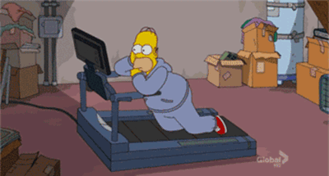
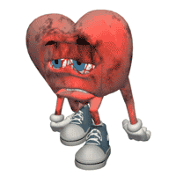
TABLE 4-6 BARRIERS TO EXERCISE ADHERENCE (MILL-RAPE-CASID
Personal barriers
Lack of time
Lake of motivation
Injury
Rapid fatigability
Misconception
Physical discomfort
Emotional discomfort
Control in life
Attitude towards exercise
Assessment of benefits of exercise
Self efficacy in performing exercises
difficulty changing life style behaviors
Isolation

Slide 26
Environment barriers
Access: don’t access to facilities of exercise
Cost: health clubs are too expensive
Climate: weather unsafe for outdoor activities for 6months (excessive cold or hot weather)

