Slide 1
Computer Systems
And Components

Slide 2
COMPUTER SYSTEM:
Definition: Is a collection of entities(hardware, software and live ware) that are designed to receive, process, manage and present information in a meaningful format. COMPONENTS OF COMPUTER SYSTEM:
Computer hardware - Are physical parts/ intangible parts of a computer. e.g. Input devices, output devices, central processing unit and storage devices
Computer software - also known as programs or applications. They are classified into two classes namely - system software and application software
Live ware - is the computer user. Also kwon as orgwareor the human ware. The user commands the computer system to execute on instructions.

Slide 3
a) COMPUTER HARDWARE Hardware refers to the physical, tangible computer equipment and devices, which provide support for major functions such as input, processing (internal storage, computation and control), output, secondary storage (for data and programs), and communication.

Slide 4
HARDWARE CATEGORIES (Functional Parts):
A computer system is a set of integrated devices that input, output, process, and store data and information. Computer systems are currently built around at least one digital processing device. There are five main hardware components in a computer system: Input, Processing, Storage, Output and Communication devices.
INPUT DEVICES
Are devices used for entering data or instructions to the central processing unit. Are classified according to the method they use to enter data.
KEYING DEVICES
Are devices used to enter data into the computer using a set of Keys eg Keyboard. i) The keyboard
Keyboard (similar to a typewriter) is the main input device of a computer . It contains three types of keys-- alphanumeric keys, special keys and function keys. Alphanumeric keys are used to type all alphabets, numbers and special symbols like $, %, @, A etc. Special keys such as <Shift>, <Ctrl>, <Alt>, <Home>, <Scroll Lock> etc. are used for special functions. Function keys such as <Fl>, <F2>, <F3> etc. are used to give special commands depending upon the software used e.g.F5 reloads a page of an internet browser. The function of each and every key can be well understood only after working on a PC. When any key is pressed, an electronic signal is produced. This signal is detected by a keyboard encoder that sends a binary code corresponding to the key pressed to the CPU.

Slide 5
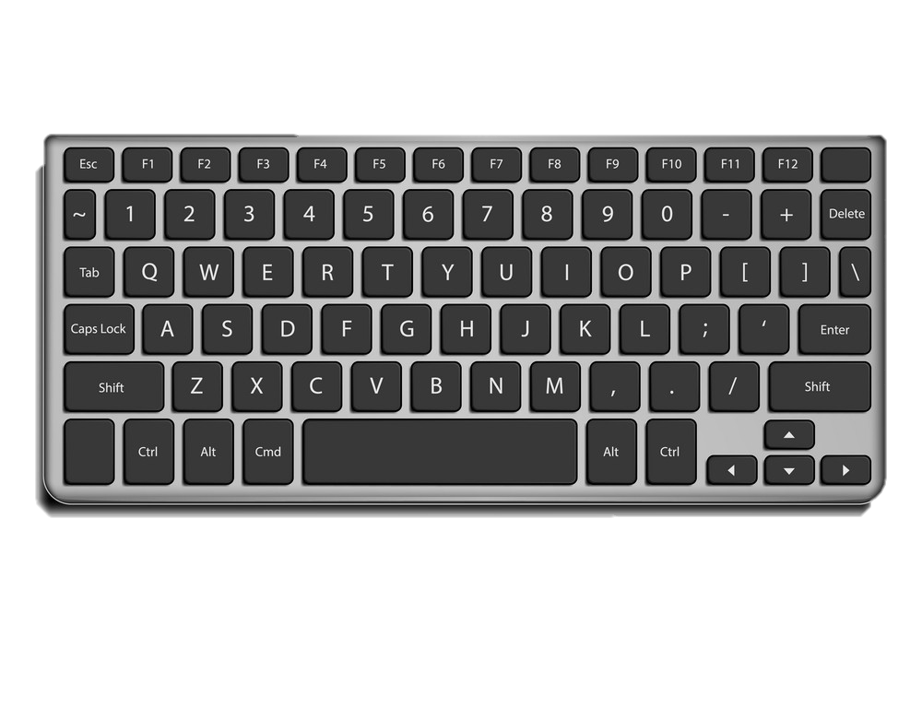
How the keys are organized
The keys on your keyboard can be divided into several
groups based on function:
Typing (alphanumeric) keys. These keys include the
same letter, number, punctuation, and symbol keys found on a traditional typewriter.
Special (Control) keys. These keys are used alone or in combination with other keys to perform certain actions. The most frequently used control keys are CTRL, ALT, the Windows key, and ESC.
Function keys. The function keys are used to perform specific tasks. They are labelled as F1, F2, F3, and so on, up to F12. The functionality of these keys differs from program to program.
Cursor Movement (Navigation) keys. These keys are used for moving around in documents or WebPages and editing text. They include the arrow keys, HOME, END, PAGE UP, PAGE DOWN, DELETE, and INSERT and ARROW KEYS.
Numeric keypad. The numeric keypad is handy for entering numbers quickly. The keys are grouped together in a block like a conventional calculator or adding machine.

Slide 6
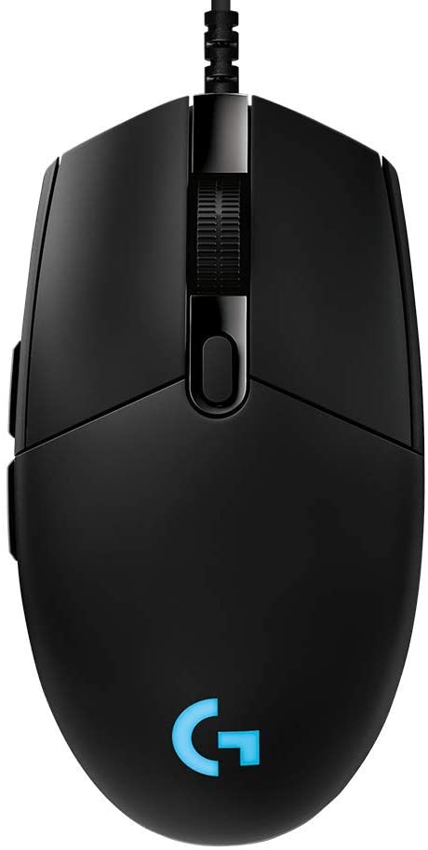
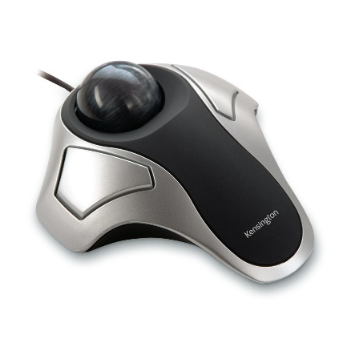
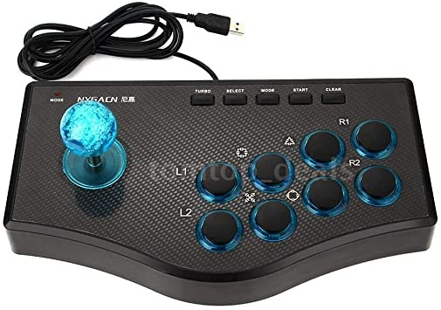
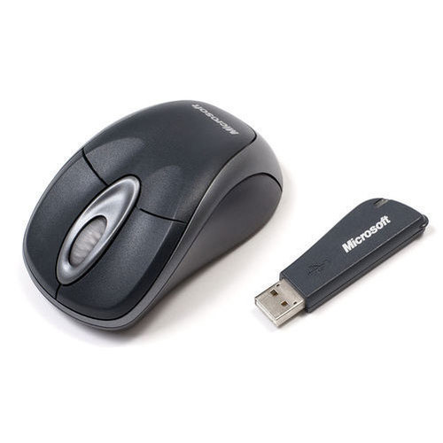
B. POINTING DEVICES:
Are devices that enter data and instructions into the computer using a pointer that appears on the screen. The items to be entered are selected by either pointing to or clicking on them.e.g mice, joystick, touch sensitive screen, trackballs.
i) THE MOUSE A mouse is a small device used to point to and select items on your computer screen. Although mice come in many shapes, the typical mouse does look a bit like an actual mouse. It's small and connected to the system unit by a long wire that resembles a tail and the connector which can either be PS/2 or USB. Some newer mice are wireless.
A mouse usually has two buttons: a primary button (usually the left button) and a secondary button. Many mice also have a wheel between the two buttons, which allows you to scroll smoothly through screens of information.
When you move the mouse with your hand, a pointer on your screen moves in the same direction. (The pointer's appearance might change depending on where it's positioned on your screen.) When you want to select an item, you point to the item and then click (press and release) the primary button. Pointing and clicking with your mouse is the main way to interact with your computer. There are several types of mice: Mechanical mouse, optical mouse, optical-mechanical mouse and laser mouse.

