Slide 1
DISTILLATION

Slide 2
Definition
“Distillation is an unit operation which involves separation of a vaporizable component from a multi-component system and subsequent condensation of vapours.”
“Distillation is a process of separating the component substances from a liquid mixture by selective evaporation and condensation.”

Slide 3
Distillation is the separation of the constituents of a mixture including a liquid by partial vaporization of the mixture and separate collection of the vapour.
“Distillation is defined as the separation of the components of a liquid mixture by a process involving vaporization and subsequent condensation at another place.”

Slide 4
History
Practiced as early as 3500 BC for isolation of odoriferous principles from flowers, leaves etc.
In 11th and 12th century it was used for isolation of alcohol from wines.
In Ayurveda the process of separation for active constituents of crud drugs also mentioned.

Slide 5
Distillation Vs Evaporation Vs Drying
Distillation
Vaporization of bulk liquid above boiling point
Product desired is distillate(solvent used)
Process of separation of the components of liquid mixture
Evaporation
Vaporization of bulk liquid below boiling point
Product desires is concentrated liquid(concentrated solute)
Process of removal of the liquid solvent
Drying
Slow evaporation of wet solid bulk (small amount of liquid)
Product desires is Solid residue(dried solute)
Process of complete removal of the liquid solvent

Slide 6
Applications:
Separation of volatile oils- cloves(Eugenol comprises 72-90%, Vanilin, acetyl eugenol).
Separation of drugs obtained from plant and animal sources- Vit. A from fish liver oil
Purification of organic solvents-absolute alcohol (100%).
Purification of drugs obtained from chemical process.
Manufacture of official preparations -sprit of nitrous ether, sprit of ammonia, D.water and water for inj.
Quality control methods- Alcohol content in elixir(4-40%).
Refining of petroleum products- Petroleum ether 60,80.
Recovery of solvents- synthesis.

Slide 7
Applications in Pharmacy
Distillation is used in Pharmacy either to extract volatile active principles from vegetable drugs or to separate volatile substances from their less volatile impurities.
It also provides a method of recovering volatile solvents, notable alcohol for further use.
It is used to separate or purify the thermolabile chemicals.
To purify water and other solvents

Slide 8
Liquid Mixtures Can be composed of
Miscible liquids
Partial Miscible liquids
Immiscible Liquids

Slide 9
Terminology
Binary Mixture
When two liquids mixed together, they may be miscible with each other in all proportion, such miscible liquid are known as binary mixtures of liquid.
Example:
- Ethanol + Water
- Acetone + Water
- Benzene + Carbon tetrachloride

Slide 10
Terminology
Ideal Solution (Perfect solution)
Ideal solution is defined as the one in which there is no change in the properties of components other than dilution, when they mixed to form a solution.
Property of ideal solution
Total volume of solution is equal to sum of volumes of each component
No heat absorbed and No heat evolved
No Chemical reaction in-between
Final volume of solution represents additive property of individual components
Follow Raoult’s low

Slide 11
Terminology
Real Solution
Most system shows varying degree of deviation from raoult’s law, depending on nature of liquids and temperature. These solution are known as real solution.
Property of Real solution
Heat may absorbed or evolved
Chemical reaction occurs in-between
Final volume of solution represents additive property of individual components
Don’t Follow Raoult’s low
Example
Carbon tetra-chloride + Cyclohexane
Choroform + Acetone

Slide 12
Terminology
Volatility
The volatility of any substance in solution may be defined as the equilibrium partial pressure of substance in vapour phase divided by the mole fraction of substance in the solution.
For example, a substance A in a liquid mixture has partial pressure PA and its concentration in the mixture is XA on mole fraction scale.
Partial vapour pressure of A
Volatility of component A, = _________________________________
Mole fraction XA of A in solution
vA = PA/XA
The volatility of a material in the pure state is equal to the vapour
pressure of the material.

Slide 13
Terminology
Relative Volatility
Consider a liquid mixture containing two component A and B, In such case, the volatility of one component is expressed in terms of second as below,
Volatility of component A (VA)
Relative Volatility () = _________________________________
Volatility of component B (VB)
 = VA/VB

Slide 14
Distillation Assembly

Slide 15
General Equipment for Distillation:
STILL :
It is a vaporizing chamber and used to place the material to be distilled.
The still is heated by a suitable means for vaporization of the volatile constituents.
On laboratory scale round bottom flasks made of glass are used so that the progress of the distillation can be noticed.
A condenser is attached to the still using appropriate joints. A trap is inserted between distillation flask and condenser.

Slide 16
General Equipment for Distillation:
CONDENSER :
Used to condense the vapor
It is kept cold by circulating water/air through jacket.
Types:
Single-surface condensers
- Straight Tube
- Bulb type
- Spiral
- Coiled type
Double-surface condensers
Multi-tubular condensers
The condenser is connected to a receiver through a suitable adapter.

Slide 17
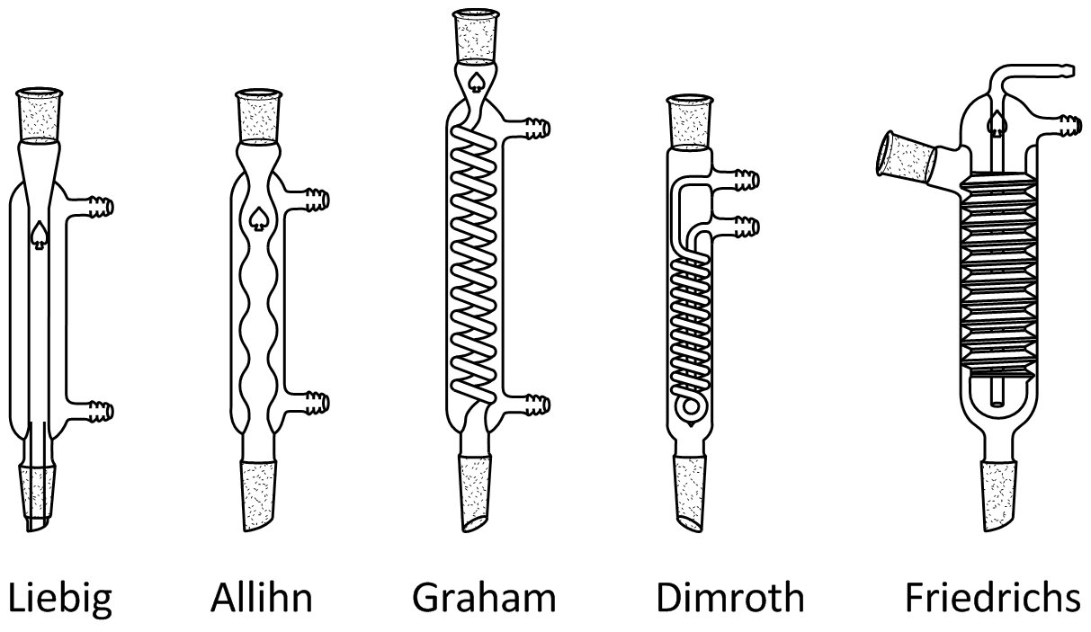
General Equipment for Distillation:
CONDENSER :
Lucas’s
Double Surface
Straight Tube type
Cold finger, Spiral type
Bulb type
Spiral type
Coiled type

Slide 18
General Equipment for Distillation:
RECEIVER :
It is used to collect the distillate.
It may be a simple flask.
It immersed in ice-bath to minimize loss of volatile matter.
Florentine receivers are used for the separation of oil and water.
Types of Florentine receivers :
Type-I :- for separation of oil heavier than water.
Type-II :- for separation of oil lighter than water.

Slide 19
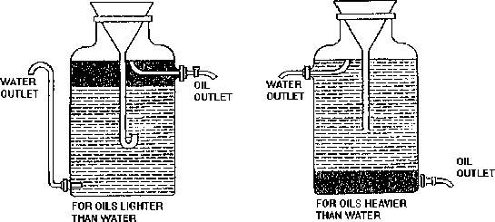
General Equipment for Distillation:
RECEIVER :

Slide 20
Classification of distillation methods
Simple Distillation (Differential distillation)
Flash Distillation (Equilibrium distillation)
Vacuum distillation (distillation under reduced pressure)
Molecular Distillation (Evaporation distillation or short path distillation.)
Fractional Distillation (Rectification)
Aezotropic and extractive Distillation
Steam Distillation
Destructive Distillation
Compression Distillation

Slide 21
1. SIMPLE DISTILLATION
Simple distillation is a process of converting a single constituent from a liquid (or mixture) into its vapour, transferring the vapour to another place and recovering the liquid by condensing the vapour, usually by allowing it to come in contact with a cold surface.
This process is known differential distillation, as distillation is based on the differences in volatilities and vapour pressures of the components in the mixture.

Slide 22
1. SIMPLE DISTILLATION
Principle: Liquid boils when its vapour pressure is equal to atmospheric pressure.
Simple distillation is conducted at its boiling point.
The higher the relative volatility of a liquid, the better is the separation by simple distillation.
Heat is supplied to the liquid so that it boils. The resulting vapour is transferred to a different place and condensed.

Slide 23
1. SIMPLE DISTILLATION
Applications:
For the preparation of distilled water and water for injection.
Volatile and aromatic waters are prepared.
Organic solvents are purified.
A few official compounds are prepared by distillation. Examples are spirit of nitrous ether and aromatic spirit of ammonia.
Non-volatile solids are separated from volatile liquids.

Slide 24
1. SIMPLE DISTILLATION

Slide 25
1. SIMPLE DISTILLATION
Assembling of apparatus:
It consists of a distillation flask with a side arm sloping downwards.
Condenser is fitted into the side arm by means of a cork.
The condenser is usually water condenser, i.e., jacketed for circulation of water.
The condenser is connected to a receiver flask using an adapter with ground glass joints.
On a laboratory scale, the whole apparatus is made of glass.

Slide 26
1. SIMPLE DISTILLATION
Procedure:
The liquid to be distilled is filled into the flask to one-half to two-third of its volume.
Bumping is avoided by adding small pieces of porcelain before distillation.
A thermometer is inserted into the cork and fixed to the flask.
The thermometer bulb must be just below the level of the side arm.
Water is circulated through the jacket of the condenser.
The contents are heated gradually. The liquid begins to boil after some time.

Slide 27
The vapour begins to rise up and passes down the side arm into the condenser.
The temperature rises rapidly and reaches a constant value.
The temperature of the distillate is noted down, which is equal to the boiling point of the liquid.
The vapour is condensed and collected into the receiver.
The flame is adjusted so that the distillate is collected at the rate of one to two drops per second.
Distillation should be continued until a small volume of liquid remains in the flask.

Slide 28
2. Flash Distillation

Slide 29
2. Flash Distillation
Flash distillation is defined as a process in which the entire liquid mixture is suddenly vaporized (flash) by passing the feed from a high pressure zone to a low pressure zone.
Flash distillation is also known as equilibrium distillation, i.e., separation is attempted when the liquid and vapour phases are in equilibrium.
This method is frequently carried out as a continuous process and does not involve rectification.

Slide 30
2. Flash Distillation
Principle: When a hot liquid mixture is allowed to enter from a high-pressure zone into a low-pressure zone, the entire liquid mixture is suddenly vaporized.
This process is known as flash vaporization.
During this process the chamber gets cooled. The individual vapour phase molecules of high boiling fraction get condensed, while low boiling fraction remains as vapour.

Slide 31
2. Flash Distillation
Uses: Flash distillation is used for separating components, which boil at widely different temperatures. It is widely used in petroleum industry for refining crude oil.
Advantages: Flash distillation is a continuous process.
Disadvantages:
It is not effective in separating components of comparable volatility.
It is not an efficient distillation when nearly pure components are required, because the condensed vapour and residual liquid are far from pure.

Slide 32
2. Flash Distillation
Working:
The feed is pumped through a heater at a certain pressure.
The liquid gets heated, which enters the vapour-liquid separator through a pressure-reducing valve.
Due to the drop in pressure, the hot liquid flashes, which further enhances the vaporization process.
The sudden vaporization induces cooling. The individual vapour phase molecules of high boiling fraction get condensed, while low boiling fraction remains as vapour.

Slide 33
The mixture is allowed for a sufficient time, so that vapour and liquid portions separate and achieve equilibrium.
The vapour is separated through a pipe from above and liquid is collected from the bottom of the separator.
By continuously feeding into the still, it is possible to obtain continuous flash distillation.

Slide 34
The operating conditions can be adjusted in such a way that the amount of feed exactly equals the amount of material removed.
Therefore, vapour and liquid concentrations at any point remain constant in the unit.

Slide 35
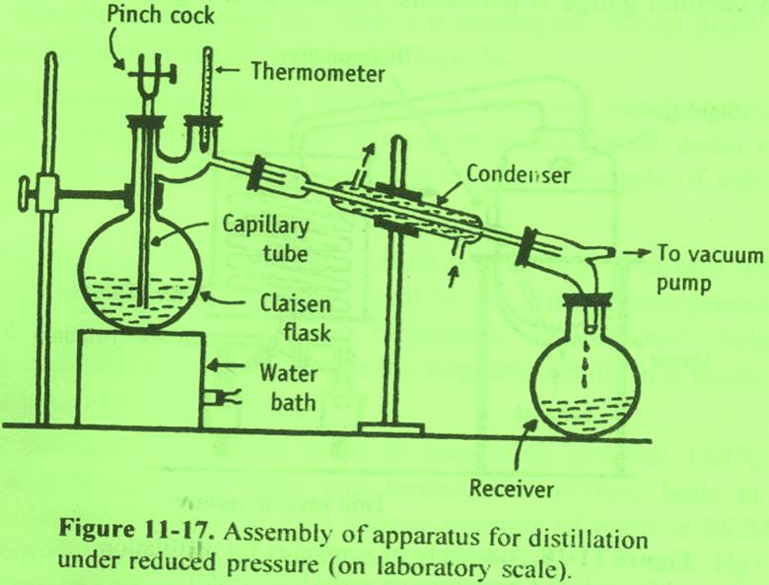
3. VACUUM DISTILLATION

Slide 36
3. VACUUM DISTILLATION
The distillation process in which the liquid is distilled at a temperature lower than its boiling point by the application of vacuum.
Vacuum pumps, suction pumps, etc. are used to reduce the pressure on the liquid surface.
Distillation under the reduced pressure is based on the principle of the simple distillation with some modifications.

Slide 37
3. VACUUM DISTILLATION
Principle:
Liquid boils when vapour pressure is equal to the atmospheric pressure, i.e., pressure on its surface. If the external pressure is reduced by applying vacuum, the boiling point of liquid is lowered.
Therefore, the liquid boils at a lower temperature. This principle is illustrated using an example of water.
Water boils at an 100°C at an atmospheric pressure is 760 mm Hg. At 40°C, the vapour pressure of water is approximately 70 mm Hg. Hence, the external pressure is reduced to 70 mm Hg where water boils at 40°C. The net result is the increase in rate of mass transfer into vapour.

Slide 38
3. VACUUM DISTILLATION
The important factor in evaporation is:
Mass of vapour formed ά vapour pressure of evaporating liquid
external pressure
According to this formula, water is allowed to evaporate at 40°C and 9.33 kPa (70 mm Hg) pressure, the mass of vapour formed in unit time is approximately 11 times, i.e. 760/70 for water.

Slide 39
3. VACUUM DISTILLATION
Assembling of apparatus:
It consists of a double-neck distillation flask known as Claisen flask .
Thick walled glass apparatus with interchangeable standard glass joints are used for vacuum distillation.
In one of the necks of the Claisen flask, a thermometer is fitted. The second neck prevents splashing of the violently agitated liquid.
Bumping occurs readily during vacuum distillation. Placing a fine capillary tube in the second neck of the flask can prevent bumping.

Slide 40
The capillary tube is dipped in the boiling liquid, so that a stream of air bubbles is drawn out.
Water bath or oil bath is used for heating.
The Claisen flask is connected to a receiver through a condenser.
Vacuum pump is attached through an adapter to the receiver. A small pressure gauge (manometer) should be inserted between the pump and the receiver

Slide 41
3. VACUUM DISTILLATION
Applications:
Preventing degradation of active constituents (≈ 55◦C)
Enzymes - malt extract, pancreatin
Vitamins - thiamine, ascorbic acid
Glycosides - anthraquinones
Alkaloids - hyocyamine to atropine
Disadvantages:
In vacuum distillation, persistent foaming occurs. This may be overcome by adding capryl alcohol to the liquid or by inserting a fine air capillary tube in the second neck of the Claisen flask.
The stream of air is drawn in and breaks the rising foam. The above method is not suitable for the preparation of semisolid or solid extracts by distillation under vacuum.

Slide 42
4. Molecular distillation
It is defined as a distillation process in which each molecule in the vapour phase travels mean free path and gets condensed individually without intermolecular collisions on application of vacuum. Molecular distillation is based on the principle of the simple distillation with some modifications. This is also called Evaporation distillation or Short path distillation.

Slide 43
4. Molecular distillation
Principle:
The substances to be distilled have very low vapour pressures. examples are viscous liquids, oils, greases, waxy materials and high molecular weight substances.
These boil at very high temperature. In order to decrease the boiling point of the liquids, high vacuum must be applied.
The pressure exerted by vapors above the liquid is much lower. At very low pressure, the distance between the evaporating surface and the condenser is approximately equal to the mean free path of the vapour molecules.
Molecules leaving the surface of the liquid are more likely hit the condenser surface nearby. each molecule is condensed individually. the distillate is subsequently collected.

Slide 44
4. Molecular distillation
Applications:
Molecular distillation is used for the purification and separation of chemicals of low vapour pressure.
1. Purification of chemicals such as tricresyl phosphate, dibutyl phthalate and dimethyl phthalate.
2. More frequently used in the refining of fixed oils.
3. Vitamin A is separated from fish liver oil. Vitamin's is concentrated by this method from fish liver oils and other vegetable oils.
4. Free fatty acids are distilled at 100°C.
5. Steroids can be obtained between 100°C and 200°C,
6. Triglycerides can be obtained from 200°C onwards.
Proteins and gums will remain as nonvolatile residues. Thus, the above mixture can be separated by molecular distillation.

Slide 45
4. Molecular distillation
Requirements for design the equipment:
The evaporating surface must be close to the condensing surface. This ensures the molecules to come in contact with the condenser as soon as they leave the evaporating surface. For this reason, this process is also known as short path distillation.
The molecular collisions should be minimized because they change the direction of the path of molecules. In other words, intermolecular distances should be fairly high. It can be achieved under very high vacuum, usually of the order of 0.1 to 1.0 pascals.
The liquid surface area must be as large as possible as so that the vapour is evolved from the surface only, but not by boiling. Thus this process is also called evaporation distillation.

Slide 46
4. Molecular distillation Centrifugal molecular distillation still

Slide 47
4. Molecular distillation Centrifugal molecular distillation still
Principle:
In this method, liquid feed is introduced into a vessel, which is rotated at very high speed (centrifugal action).
On account of heating, vaporization occurs from a film of liquid on the sides of the vessel.
The vapour (molecules) travels a short distance and gets condensed on the adjacent condenser.
Each molecule is condensed individually. The distillate is subsequently collected.

Slide 48
4. Molecular distillation Centrifugal molecular distillation still
Construction:
It consists of a bucket-shaped vessel having a diameter of about 1 to 1.5 m.
It is rotated at high speed using a motor.
Radiant heaters are provided externally to heat the fluid in the bucket.
Condensers are arranged very close to the evaporating surface.
Vacuum pump is connected to the entire vessel at the top.
Provisions are made for introducing the feed into the centre of the bucket, for receiving the product and residue for re-circulation.

Slide 49
4. Molecular distillation Centrifugal molecular distillation still
Working:
Vacuum is applied at the centre of the vessel.
The bucket shaped vessel is allowed to rotate at high speed.
The feed is introduced from the centre of the vessel.
Due to centrifugal action of the rotating bucket, liquid moves outward over the surface of the vessel and forms a film.
Since, the radiant heaters heat the surface, the liquid evaporates directly from the film.
The vapour (molecules) travels its mean tree path and strikes the condenser.
The condensate is collected into another vessel.
The residue is collected from the bottom of the vessel and is recirculated through the feed port for further distillation.

Slide 50
4. Molecular distillation Wiped film molecular distillation still

Slide 51
4. Molecular distillation Wiped film molecular distillation still
Construction:
The vessel has a diameter of 1 m.
The walls of the vessel are provided with suitable means of heating (jacket).
Wipers are provided adjacent to the vessel wall. Wipers are connected to a rotating head through a rotor.
The condensers are arranged very close to the wall (evaporating surface).
Vacuum pump is connected to a large diameter pipe at the centre of the vessel.
Provisions are made for collecting the distillate and the undistilled liquid residue at the bottom.

Slide 52
4. Molecular distillation Wiped film molecular distillation still
Working:
The vessel is heated by suitable means.
Vacuum is applied at the centre of the vessel and wipers are allowed to rotate.
The feed is entered through the inlet of the vessel.
As the liquid flows down the walls, it is spread to form a film by PTFE (polytetrafluoroethylene) wipers, which are moving at a rate of 3 m per second.
The velocity of the film is 1.5 m per second.
Since the surface is already heated, the liquid film evaporates directly.
The vapour (molecules) travels its mean free path and strikes the condenser.
The condensate is collected into a vessel.
The residue (undistilled or mean free path not travelled) is collected from the bottom of the vessel and re-circulated through the feed port for further distillation. Capacity is about 1000 L / hour.

Slide 53
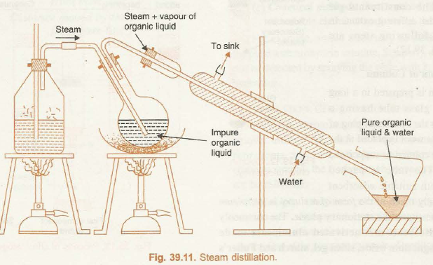
5. Steam distillation

Slide 54
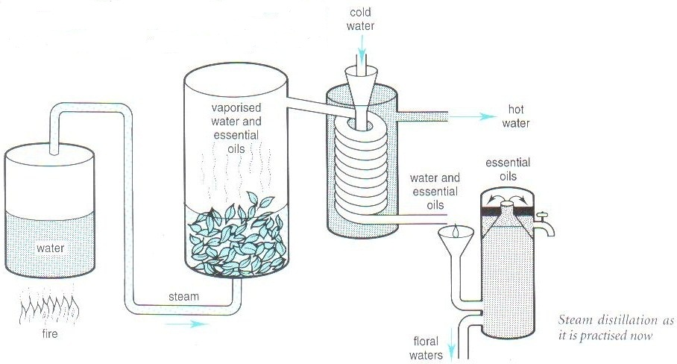
5. Steam distillation

Slide 55
5. Steam distillation
Steam distillation is method of distillation carried out with aid of steam.
It is used to separate
- High boiling substances from non-volatile impurities - Separate immiscible liquids

Slide 56
5. Steam distillation
Example:
Boiling point of Turpentine = 160 °C
Boiling point of Water + Turpentine Mixture = 95.6 °C
At this temperature Vapour pressure of
Water = 86.245 kPa (647 mmHg)
Turpentine = 15.06 kPa (113 mmHg)
Sum of vapour pressure = 101.31 kPa (760 mmHg)
Which is normal atmospheric pressure and thus high boiling liquid may be distilled with water at a temperature much below its boiling point.

Slide 57
5. Steam distillation
Principle:
A mixture of immiscible liquids begins to boil when sum of their vapour pressure is equal to atmospheric pressure.
In case of mixture of water and turpentine, mixture boils below the boiling point of pure water, though the turpentine boils at a much higher temperature than that of water.

Slide 58
5. Steam distillation
Application:
Used to separate immiscible liquids. Ex- Water + Toluene
Extraction at much lower temperature to protect from decomposition without loss of aroma
To extract volatile oils like clove, anise and eucalyptus oils.
Purification of essential oils like almond oil.
Camphor is distilled by this method.
Aromatic water are prepared.
Limitation:
Not suitable when two immiscible liquids reacts with each other.

Slide 59
5. Steam distillation
Construction of assembly:
Metallic steam can fitted with cork having two holes.
Safety tube inserted up to bottom through one hole to maintain pressure in side stem can, more over when steam comes out from safety tube indicates that can is empty.
Through other hole band tube is passed and other end of this tube is connected to flask containing non-aqueous liquid in which tube is dipped.
Flask and condenser is connected with delivery tube.
Condenser is connected to receiver with help of adopter.
Provision are made to heat both steam can and flask separately.

Slide 60
6. Destructive Distillation (Dry distillation)
Distillatilate is decomposition product of constituents of the organic matter burnet in absence of air.
Not used in lab practices but very useful in industrial process to obtain valuable product from wood, coal and animal matter.
It involve the heating of dry organic matter in suitable vessel in absence of air, until all volatile substances are driven off.
The distillate is the decomposition product of constituents.
Wood distillation industry and coal carbonation industry provides many useful fuel material with this method

Slide 61
7. Compression Distillation
Compression distillation method was developed to meet the need of navy and army for fresh water from sea-water.
Product obtained is quite pure and pyrogen-free, there for it meets the requirement of pharmaceutical industry.
It is economical from the standpoint of consuption of fuel and water

Slide 62
7. Compression Distillation
The feed water is heated in an evaporator for boiling.
The vapour produced in tubes is separated from entrained distilland in separator.
The vapour is than conveyed to compressor, which compresses it and raises its temperature to about 118 c.
It than flows to the steam chest where it is condensed on the outer surface of tube.
During condensation, heat is released which is allowed for heating of fresh feed in the tube.
The vapour condensed and drained off as distillate.

Slide 63
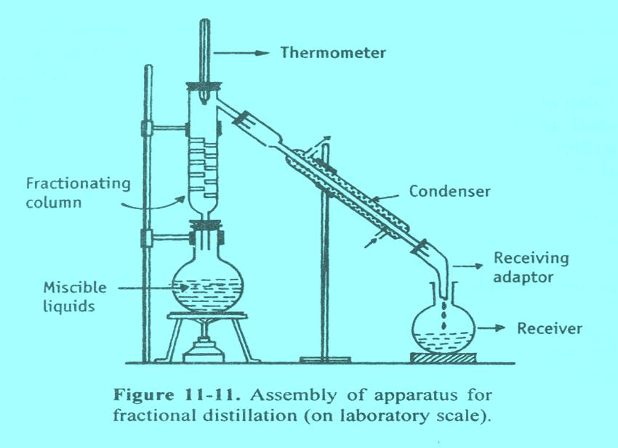
8. Fractional Distillation

Slide 64
8. Fractional Distillation
This method is also known as rectification, because a part of the vapour is condensed and returned as a liquid.
This method is used to separate miscible volatile liquids, whose boiling points are close, by means of a fractionating column.
Fractional distillation is a process in which vaporisation of liquid mixture gives rise to a mixture of constituents from which the desired one is separated in pure form.

Slide 65
8. Fractional Distillation
Simple Distillation Vs Fractional Distillation
In fractional distillation the vapour must pass through a fractionating column in which partial condensation of vapour is allowed to occur.
Condensation takes place in the fractionating column, so that a part of the condensing vapour returns to the still.
In simple distillation, vapour is directly passed through the condenser.
Condensate is collected directly into the receiver,

Slide 66
8. Fractional Distillation
Principle:
When a liquid mixture is distilled, the partial condensation of the vapour is allowed to occur in a fractionating column.
In the column, ascending vapour from the still is allowed to come in contact with the condensing vapour returning to the still.
This results is enrichment of the vapour with the more volatile component.
By condensing the vapour and reheating the liquid repeatedly, equilibrium between liquid and vapour is set up at each stage, which ultimately results in the separation of a more volatile component.

Slide 67
8. Fractional Distillation
Applications:
Fractional distillation is used for the separation of volatile miscible liquids with near boiling point such as
Acetone and water
Chloroform and benzene
Disadvantage:
Fractional distillation cannot be used to separate miscible liquids, which form PURE azeotropic mixtures.

Slide 68
8. Fractional Distillation
Fractionating columns
In fractional distillation, special type of still-heads are required so that condensation and re-vaporisation are affected continuously.
These are known as fractionating columns.
A fractionating column is essentially a long vertical tube in which the vapour passes upward and partially condensed. The condensate flows down the column and is returned eventually to the flask.
The columns are constructed so as to offer the following advantages simultaneously.
(1) It offers a large cooling surface for the vapour to condense.
(2) An obstruction to the ascending vapour allows easy condensation.

Slide 69
8. Fractional Distillation
Fractionating columns Types
A] Packed columns and
B] Plate columns

Slide 70
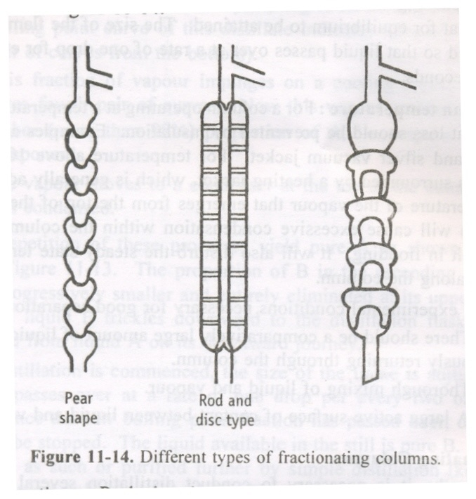
8. Fractional Distillation
Fractionating columns Types
A] Packed columns

Slide 71
8. Fractional Distillation
Fractionating columns Types
A] Packed columns
Some form of packing is used in the column to affect the necessary liquid/vapour contact. The packing may consist of single turn helices (spirals) of wire or glass, glass rings, cylindrical glass beads, stainless steel rings etc.
Construction: Packed column consists of a tower containing a packing that becomes wetted with a film of liquid, which is brought into contact with the vapour in the intervening spaces.
(a) A long fractionating column is necessary when the boiling points of the constituents are lying fairly close together.
(b) A short fractionating column is necessary when the boiling point of the constituents differ considerably.
Applications: Packing must be uniform so as to obtain proper channels. If packing is irregular, mass transfer becomes less effective.

Slide 72
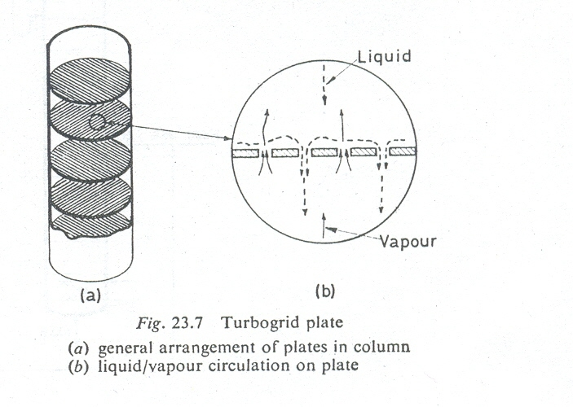
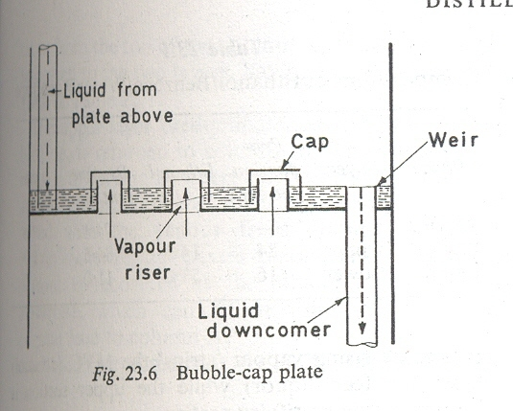
8. Fractional Distillation
Fractionating columns Types
B] Plate columns

Slide 73
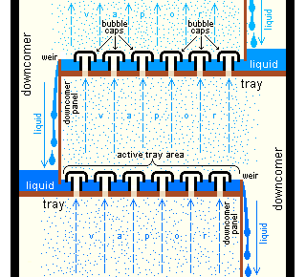
8. Fractional Distillation
Fractionating columns Types
B] Plate columns (Bubble cap)

Slide 74
8. Fractional Distillation
Fractionating columns Types
B] Plate columns
Many forms of plates are used in the distillation using different columns. It can be divided into two types, which are commonly used in pharmacy.
(a) Bubble cap plates
(b) Turbo grid plates
Bubble cap column is used in large distillation plants and is described below.
Construction: The column consists of a number of plates mounted one above the other. Caps are present on each plate, which allow the vapour to escape by bubbling through the liquid.
Working: Ascending vapour from the still passes through the bubble-caps on plate A and the rising vapour will be richer in the more volatile component. This vapour passes through the liquid on plate B and partially condensed. The heat of condensation partially vaporizes the liquid. The process of condensation and vaporisation will be repeated at plate C and so on all the way up the column. Each bubble-cap plate has the same effect as a separate still.

Slide 75
8. Fractional Distillation
Fractionating columns Types
B] Plate columns (Bubble cap)
Advantages:
The bubble cap plate is effective over a wide range of vapour-liquid proportions. There is excellent contact as the vapour bubbles through the liquid.
Disadvantages:
(I) A layer of liquid on each plate results in considerable
hold-up of liquid over the entire column.
(2) The need to force the vapour out of the caps, through the liquid, led to a large pressure drop through the column.
(3) The column does not drain when it is not in use.
(4) The structure is complicated making construction and maintenance expensive.

Slide 76
8. Fractional Distillation
Theory:
Fractional distillation is suitable for a system when the boiling point of the mixture is always intermediate between those of pure components.
There is neither a maximum nor a minimum in the composition curves. These systems are known as zeotropic mixtures.
Examples
Benzene and toluene
Carbon tetrachloride and cyclohexane

