Slide 1
Developing an Argument
Strengthening your ideas in writings
By Sana Ghaffar

Slide 2
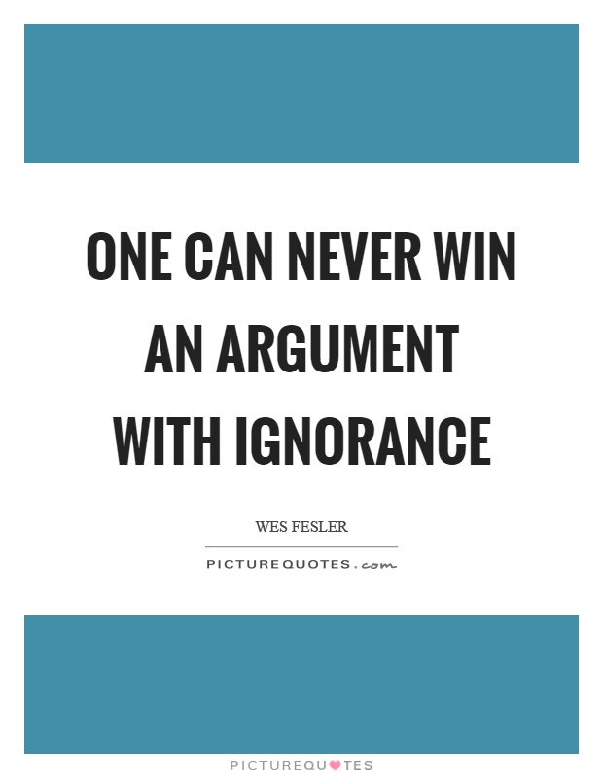

Slide 3
Questioning session

Slide 4
What argument is?
Latin word “arguer”
Means to make clear
Rationality through evidences
Strengthens the point of view
Representation of your critical thinking skills
Persuasiveness is important

Slide 5
Features of argument
1) Well supported by evidences driven from relevant data
For example:
The analysis confirmed that the coronavirus outbreak and the spillover to the global economy which triggered the global recession in 2020. Policy makers in many countries were under pressure to respond to the coronavirus outbreak. As a result, many governments made fast policy decisions that had far-reaching positive and negative effects on their respective economy – many countries plunged into a recession.
2) Presence of your critical thought is mandatory
For example:
On the bright side, the coronavirus-induced public health crisis created an opportunity for many governments to make lasting reforms in the public health sector.

Slide 6
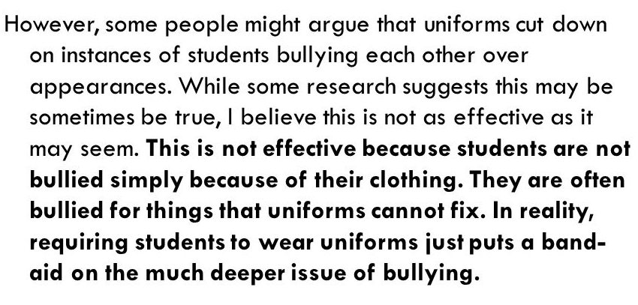
Continued…
3) Well prepared and supportive against all counter arguments
For example

Slide 8
Components of argument
Claim
Warrant
Proof
Objection/ counter arguments
Conclusion

Slide 9
Claim
The base of the reason of your writing
Argument should be worth arguing over
Must be included in your introduction
Full of proofs
Following points must be followed:
Identification of claim
Reason of supporting
Whether the evidence is reliable
Link between reasons of supporting claim
Prepare in mind against the defense of counter arguments

Slide 10
warrant
Part of argument which make your argument strong
How your convince your reader
Mention the source of reception of proofs

Slide 11
Types of evidences/proofs

Slide 12
Objections/counter arguments
Alternative points
It enhances the validity of argument
Implicitly give a direction to support your thinking
Ensures that argument is not flawed
Narrow arguments

Slide 13
Activity 1:

Slide 14
Activity 2:

Slide 15
Activity 3:

Slide 16
Continued…

Slide 17
Conclusion
A balanced summary of the argument
Appropriateness is mandatory
In accordance with your proofs
Prediction or recommendation

Slide 18
Argument on page

