Slide 1
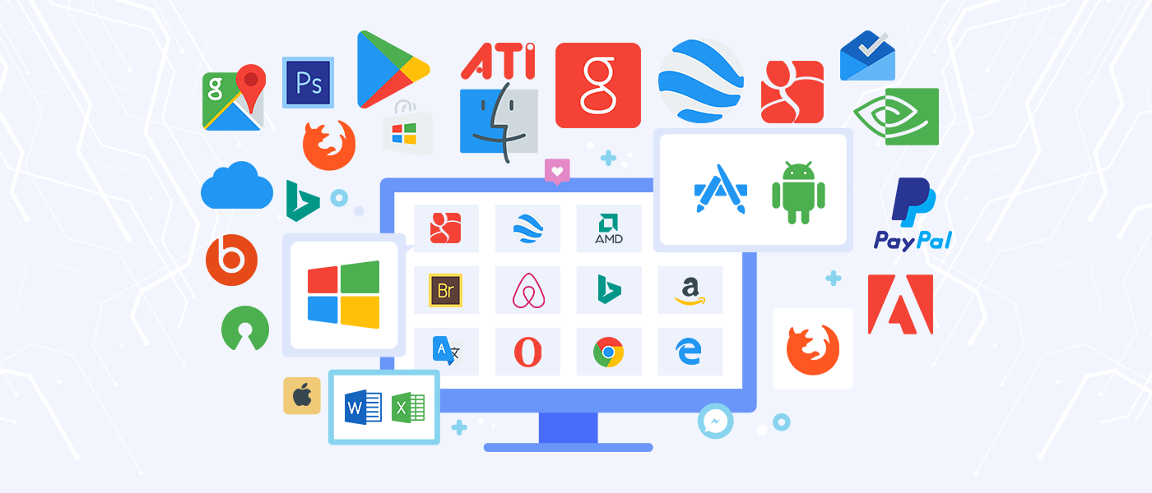
Application Software's

Slide 2
Application Software: Task Oriented
Computer software is basically programs and procedures intended to perform specific tasks on a system. From the lowest level assembly language to the high level languages, there are different types of application software. Computer software systems are classified into three major types namely system software, programming software and application software.
While system software comprises device drivers, OS, servers and software components, programming software helps in writing programs through tools such as editors, linkers, debuggers, compilers/interpreters and ore. Application software , in contrast to these two, is used for attaining specific tasks.
Application software uses the capacity of a computer directly for specific tasks and are used to manipulate text, graphics and numbers.

Slide 3
Types of Application Software:
The different types of application software include the following:
Application Software Type | Examples
Word processing software | MS Word, WordPad and Notepad
Database software | Oracle, MS Access etc
Spreadsheet software | Apple Numbers, Microsoft Excel
Multimedia software | Real Player, Media Player
Presentation Software | Microsoft Power Point, Keynotes
Educational Software | Dictionaries: Encarta, BritannicaMathematical: MATLABOthers: Google Earth, NASA World Wind
Simulation Software | Flight and scientific simulators
Content Access Software | web browsers
Application Suites | OpenOffice, Microsoft Office
Software for Engineering and Product Development | IDE or Integrated Development Environments

Slide 4
There are various different types of application software such as licensed, sold, freeware, shareware,and open source.
Application software’s either need to be installed or can run online. Application software’s can also be distinguished on the basis of usage into the following:
Specific software
Word processing software
Spreadsheet software
Database software
Presentation software
Internet Browsers
Email Programs
Graphic Programs (Pixel based)
Graphic Programs (vector based)
Communication software: Communication through audio, video or chat based means

Slide 5
I. Basic Software Application Types
Following are the software application types:
Word Processing Software: Flexible Tool
If the pen is mightier than the sword, the word processor is even better. Word processors create text based documents. This set of software tools are most flexible and widely used. Word processors are used for creating memos, faxes and letters. Word processors are also used to create reports and personalized pages on the Web.
Top 3 Word Processing Softwares: Microsoft Word, Lotus Word Pro and Corel WordPerfect
Word processors provide numerous features making entering, editing and formatting written documents quick and precise.
Basic Features: Word Processing Software
Word processors have word wrap which move the insertion point to the next line when the current line is complete. This saves time and effort.
Editing precision and efficiency is also offered by this software. Consider the Thesaurus which provides synonyms, antonyms and related words for chosen word or phrase. Find and replace feature enables users to scan and replace selected words or phrases.
There are inbuilt spelling and grammar checkers which make it easy to locate words with spelling issues or capitalization, sentence structure or punctuation problems.
.

Slide 6
AutoCorrect feature can be used to make corrections in a thrice of a second. AutoText inserts words or sentences into the document at the exact point one wants.
AutoComplete even ensures the user does not even have to type the complete word to include it in the document.
If looks matter, can your word processor be far behind? Numerous features within the word processor can improve the format or appearance of any document in seconds. This includes font appearance, font size, character effects such as bold, italic, colors and shadow, alignment and lists.
Allowing multiple users to edit the same document using a feature called collaboration is another beneficial feature of word processors.
Another feature is tracking changes which lets you identify modifications to an original document made by others, whereby their changes and comments are visible.
Word processing software involves creation of text based documents which can be stored, edited and formatted with ease.
Additional word processing features include WordArt to modify titles, hyphens, columns and text boxes for critical information
Most word processing software also generates reports and comes equipped with tools to create figure captions, tables, headers, footers,endnotes and more.
For web pages, word processors include predefined templates, hypertext links and support for Web pages

Slide 7
Web Based Applications: The Miracle of Application Service Providers
Application programs were initially owned by organizations or individuals while users are owning and storing applications now using Web based apps.
How it Works: USP of ASPs
Special web sites referred to as application service providers or ASPs enable users to access their application programs. Access is generally provided for a nominal fee.
Web applications provide a collection of graphic illustrations including clip art drawings, diagrams and photos. One can also select items or portions of documents which can be removed from one item to another. From handwriting recognition to spelling checker and task panes, templates as well as Wizards for specific tasks and voice recognition, web based applications provide everything needed to make creating documents an easy process.
Precise, error free content is possible through spelling and grammar checkers.
The ASP downloads or sends across a copy or part of the application onto the user where it is stored in his or her hard disk drive ready to be run. Copy remains there for some time until the program is run and exited. There are even fee- free ASPs.

Slide 8
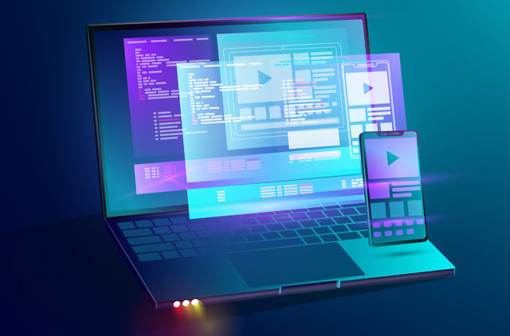
Spreadsheets: Organizing Digits in the Digital World
Spreadsheets are used to create documents and perform calculations for example Excel, Lotus 1-2-3 and more.
Spreadsheets were initially only used by accountants; now they are used by marketing professionals, students, teachers and financial analysts.
Most common spreadsheet programs used include Lotus 1-2-3, Microsoft Excel and Corel Quattro Pro.
Spreadsheet: IT Figures
Spreadsheets organize, analyze and chart/graph numerical data such as financial reports and budgets.
Spreadsheet programs are responsible for manipulation of data and creation of workbook files comprise one/more related worksheets
A worksheet or spreadsheet is a rectangle grid of rows and columns intersecting to create cells
Text entries or labels provide a structure to the worksheet through descriptions
Numeric entries can be a number or a formula for calculating and processing information; functions are prewritten formulas to perform calculations.
Spreadsheets involve ranges, text and numeric entries, functions, formulas, charts, calculations and what if analysis. There are different chart types including line, pie, column and bar which form part of the spreadsheet. They also provide other benefits like titles, legends and data labels.

Slide 9
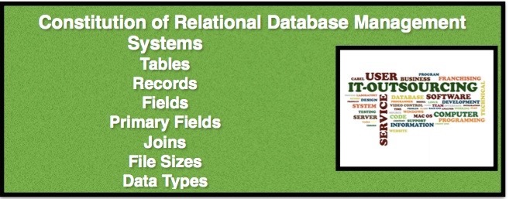
Database: Relational Data
Database is a collection of relational data, which is an electronic equivalent of a filing cabinet.
A DBMS or database management system is a program for setting up or structuring database. Databases are used in offices, educational settings and organizations of different types. 3 of the most widely used DBMS designed for microcomputers include Corel Paradox, Microsoft Access and Lotus Approach. Relational database is used most widely as a database structure. Every field in the database is assigned a field size and data type. DBMS offers numerous tools to create and use databases such as filter or criteria
Features include tools for sorting, filtering, creating forms, defining criteria and authoring reports. DBMS is able to bring information stored in separate tables through queries, forms and reports.
Query is a question or request for certain data contained in the database while queries are used for viewing data in differing ways to analyze and change existing data. Database forms replicate traditional print forms. DBMS are used chiefly for listing reports such as sales summaries, mailing labels and phone lists.
DBMS is created through a plan where you design the basic structure of the system and employees can create table structure through specification of fields, data types as well as primary key fields

Slide 10
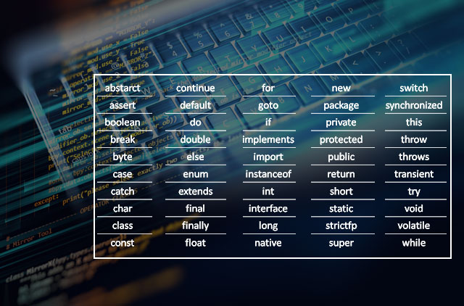
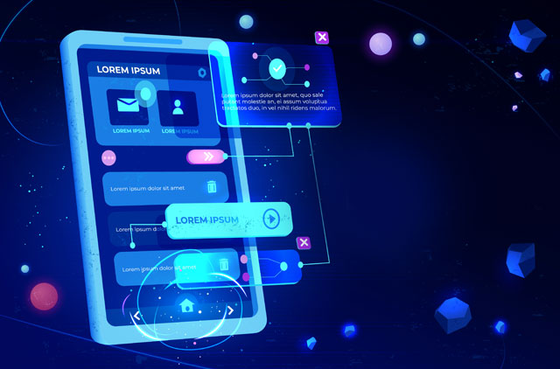
Presentation: Pixel Perfect Pictures
Information is presented visually through presentation graphics that combine numerous visual objects for creating interesting and attractive presentations. These tools are also used for communicating persuasive messages.
Slides are used for electronic presentation and there are layout, normal and slide show views. You can choose color schemes, slide layouts , special effects, animation, transitions and builds.
Software Suite: Application Software in a Group
Software suite is a group of application programs and the 4 different types are productivity, specialized, utility and personal.
Software suite is a collection of separate application programs bundled and sold as a group.

Slide 11
Built for Home: Personal Suite
Personal or home suites contain personal software applications, programs intended for domestic or personal use. Some of the best known home suites include Microsoft Works Suite.
Specialized Suites: Specific Apps
These suites focus on specific applications including graphic suites, financial planning suites and much more.
Utility Suite: Making Computing Easier
This suites are designed to make computing safer. It includes the Norton Antivirus System and Norton Internet Security Suite.
Multimedia Software: One of a Kind
Multimedia software allow users to create images, audios and videos. Examples of these include Media Player.
III. The Many Different Wares: Where Application Software is Negative

Slide 12
just like there are positive softwares, there are also negative forms of application software used for nefarious purposes. Applications software can carry the following hidden programs or utilities:
Malware: This stands for malicious software. Most common forms of malware are Trojan horses, worms and viruses.
Adware and Spyware: Adware and spyware are other common types of software. Adware includes sponsored freeware available when you register. Sometimes, adware tracks internet surfing habits to become intrusive and change into spyware. It then keeps a record of all the sites you have surfed and comes up with ads which it feels are relevant to you. Unlike adware, spyware has a negative connotation.
Greyware: This is a term used to categories all the software falling between malicious software and other codes including track-ware and spyware.
Nagware: This refers to software that comes in the form of pop ups asking users to register for a product or purchase an app
Bloatware: Software which has so many different features that it requires considerable disk space and memory resources to run
Slime ware: This refers to software which interfere with user experience by changing principal settings.
Abandonware: Software which is no longer sold or supported by publishers.

