Slide 16
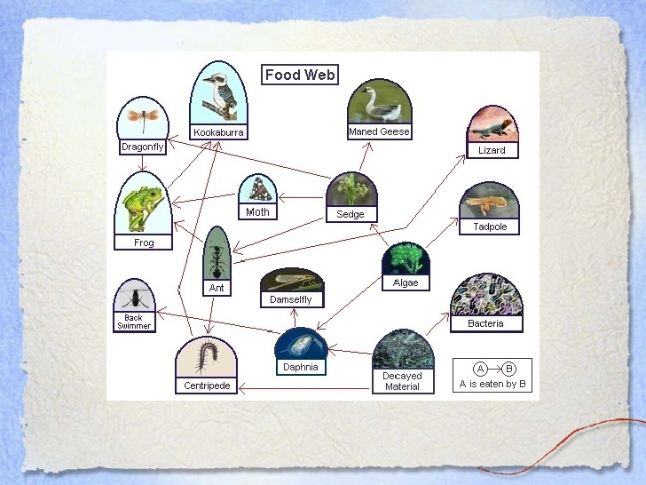

Slide 19
APPLICATIONS OF ECOLOGY

Slide 30
THANK YOU

