Slide 1
Builder Design Pattern

Slide 2
Builder
Separate the construction of a complex object from its representation so that the same construction process can create different representations.
Parse a complex representation, create one of several targets

Slide 3
Problem
An application needs to create the elements of a complex aggregate. The specification for the aggregate exists on secondary storage and one of many representations needs to be built in primary storage.

Slide 4
Structure

Slide 5
Structure
Builder Abstract interface for creating objects (product).
Concrete Builder Provides implementation for Builder. It is an object able to construct other objects. Constructs and assembles parts to build the objects.
Director The Director class is responsible for managing the correct sequence of object creation. It receives a Concrete Builder as a parameter and executes the necessary operations on it.
Product The final object that will be created by the Director using Builder.

Slide 6
Example 1
The Builder pattern separates the construction of a complex object from its representation so that the same construction process can create different representations.
This pattern is used by fast food restaurants to construct children’s meals. Children’s meals typically consist of a main item, a side item, a drink, and a toy (e.g., a hamburger, fries, Coke, and toy dinosaur).
Note that there can be variation in the content of the children’s meal, but the construction process is the same. Whether a customer orders a hamburger, cheeseburger, or chicken, the process is the same. The employee at the counter directs the crew to assemble a main item, side item, and toy. These items are then placed in a bag. The drink is placed in a cup and remains outside of the bag. This same process is used at competing restaurants.

Slide 7
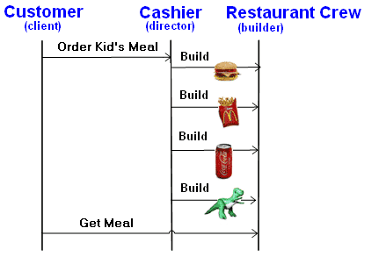

Slide 8
Example 2

Slide 9
Advantages
You can construct objects step-by-step, defer construction steps or run steps recursively.
You can reuse the same construction code when building various representations of products.
Single Responsibility Principle. You can isolate complex construction code from the business logic of the product.

Slide 10
Disadvantages
The overall complexity of the code increases since the pattern requires creating multiple new classes.
The number of lines of code increase at least to double in builder pattern, but the effort pays off in terms of design flexibility and much more readable code.
Requires creating a separate Concrete Builder for each different type of Product.

