Slide 1
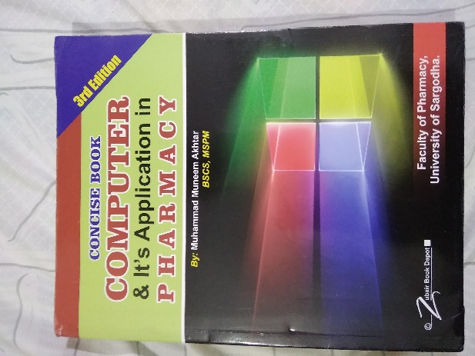
What is RAD
19
Recommended For
Pharmacy Student!
Part
Pharm-D (Doctor of Pharmacy),
DPT (Doctor of Physiotherapy) &
Pharmacy Technician.
Muhammad Munim Akhtar

Slide 2
Welcome to
Computer & its Application in Pharmacy with Munim Akhtar
Free online quality educational tutorials about Computer in Pharmacy

Slide 4
RAD Model

Slide 5
Rapid Application Development
RAD is a techniques/ method that emphasize on user involvement and evolutionary working with prototypes of a system to accelerate the system development process.
RAD is based on building prototypes that evolve into finished systems.
A prototype is a smaller-scale representation or working model of the users requirements or a proposed design for an information system.
Notes:
Conversion Notes
The rapid application development “route” is most typically associated with prototyping, JAD, and incremental or iterative approaches to system development.

Slide 6
Rapid Application Development…
A rapidly changing business environments, businesses have to respond to new opportunities and competition. This requires software rapid development and rapid delivery of software systems.
Businesses may be willing to accept lower quality software if rapid delivery of essential functionality is possible.

Slide 7
Characteristics of RAD
In RAD, the processes of application specification, design and implementation are concurrent.
There is no detailed specification and design documentation is required.
The system is developed in a series of increments.
User interfaces are usually developed using an interactive development system/tool.

Slide 8
Definition:
Rapid Application Development…
RAD is a software development methodology that uses:
Minimal planning in favor of rapid prototyping.
RAD allows software to be written much faster, and makes it easier to change requirements.

Slide 9
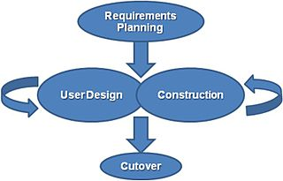
RAD Life Cycle

Slide 10
RAD Phases
RAD have three phase, also called a Martin Approach:
Requirements / Analysis.
Design / Construct.
Implementation / cutover.

Slide 11
Martin Approach to RAD

Slide 12
Requirements Planning Phase
Users and analysts meet to identify objectives of the system toward solving business problems
Requirements planning is much like traditional problem definition and systems analysis.

Slide 13
Design Phase
Design new system & refine phase till user accept the design.
GDSS (Group decision support systems) to help users agree on designs.
Programmers and analysts can build and show visual representations of the designs.
Analysts refine designed modules based on user responses.

Slide 14
Implementation or Cutover Phase
The cutover phase is similar to the traditional implementation phase.
When system built,
the new systems or partial systems are tested &
install to the organization.
Here is no need to run old systems in parallel.
Main activities includes:
training the users,
converting or installing the system & complete the necessary documentation.

Slide 15
RAD benefits
In RAD model,
tools are used to generate screens and show the overall flow of the application.
Users can approve the design with visual model.
Implementation is less stressful because users helped to design.

Slide 16
When to Use RAD
When programmers & analysts are experienced.
It deals with ecommerce application
Rad used for quick results.
When users are sophisticated and highly engaged with the goals of the company.

Slide 17
Advantages of RAD
Increase speed of system development.
Increase quality through the involvement of the user with analysis in design phase.
The software is quickly build due to less requirement analysis.

Slide 18
Disadvantages of RAD
Many try and hurry the project too much loosely documented.
Reduced features occur due to time boxing.
RAD may not be useful for large, highly complex projects.
Team ignores necessary quality parameters such as
Consistency
Reliability &
Standardization

Slide 19
Today quote
"Only a life lived for others is a life worthwhile."
-Albert Einstein

Slide 20
?

