Slide 1
Moving Coil Meters
The design of a voltmeter, ammeter or ohmmeter begins with a current-sensitive element.
Though most modern meters have solid state digital readouts, the physics is more readily demonstrated with a moving coil current detector called a galvanometer.
Since the modifications of the current sensor are compact, it is practical to have all three functions in a single instrument with multiple ranges of sensitivity.
Schematically, a single range "multimeter" might be designed as illustrated.

Slide 2
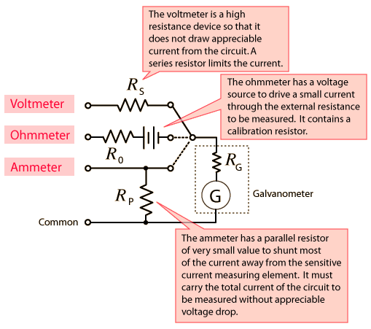
Moving Coil Meters
1

Slide 3
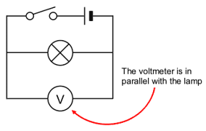
Voltage
Voltage is measured in volts (V ).
A voltage across a component is needed to make a current flow through it.
Cells or batteries often provide the voltage needed.
Voltage across a component in a circuit is measured using a voltmeter.
The voltmeter must be connected in parallel with the component.

Slide 4
Voltmeter
A voltmeter measures the change in voltage between two points in an electric circuit and therefore must be connected in parallel with the portion of the circuit on which the measurement is made.
In analogy with a water circuit, a voltmeter is like a meter designed to measure pressure difference.
It is necessary for the voltmeter to have a very high resistance so that it does not have an appreciable affect on the current or voltage associated with the measured circuit.
Modern solid-state meters have digital readouts, but the principles of operation can be better appreciated by examining the older moving coil meters based on galvanometer sensors.

Slide 5
Voltmeter
1

Slide 6
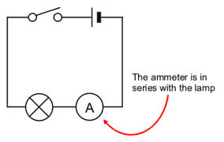
Current
Current will only flow if there is a complete circuit.
Current is measured in amperes (A).
We measure current using an ammeter.
A
An ammeter must be connected in series.

Slide 7
Ammeter
An ammeter is an instrument for measuring the electric current in amperes in a branch of an electric circuit.
It must be placed in series with the measured branch, and must have very low resistance to avoid significant alteration of the current it measures.
The analogy with an in-line flow meter in a water circuit can help visualize why an ammeter must have a low resistance, and why connecting an ammeter in parallel can damage the meter.
Modern solid-state meters have digital readouts, but the principles of operation can be better appreciated by examining the older moving coil meters based on galvanometer sensors.

Slide 8
Ammeter
1

Slide 9
Difference between Ammeter and Voltmeter:
S.No. | Ammeter | Voltmeter
1 | It is a low resistance instrument. | It is a high resistance instrument.
2 | Shunt Resistance is very small. | Resistance is very high.
3 | It is always connected in series. | It is always connected in parallel.
4 | Resistance of an ideal ammeter is zero. | Resistance of an ideal voltmeter is infinity.
5 | Its resistance is less than that of the galvanometer. | Its resistance is greater than that of the Galvanometer.
6 | It is not possible to decrease the range of the given ammeter. | It is possible to decrease the range of the given voltmeter.

