Slide 1
MERCURY (Para, Quick silver)
Properties:- heavy, silvery, volatile,
Liquid metallic mercury is not poisonous.
Not a constituent of human body.

Slide 3
TOXIC SALTS OF MERCURY
MERCURIC CHLORIDE:- (corrosive sublimate/Germicide): odorless, prismatic crystals, metallic taste, most common cause of poisoning.
MERCUROUS CHLORIDE:- (calomel): heavy, amorphous, white and tasteless powder.

Slide 4
COMMERCIAL USES/SOURES
MEDICINE:- disinfectant, purgatives, dental procedures, Diuretics
INDUSTRY:-Thermometer, barometer, mercury vapor lamp, electrical equipments, explosives and fireworks, u/v apparatus
MISCELLANOUS:- Photography, insecticides, germicides, constituents of fingerprinting powder, paint and embalming fluids.

Slide 6
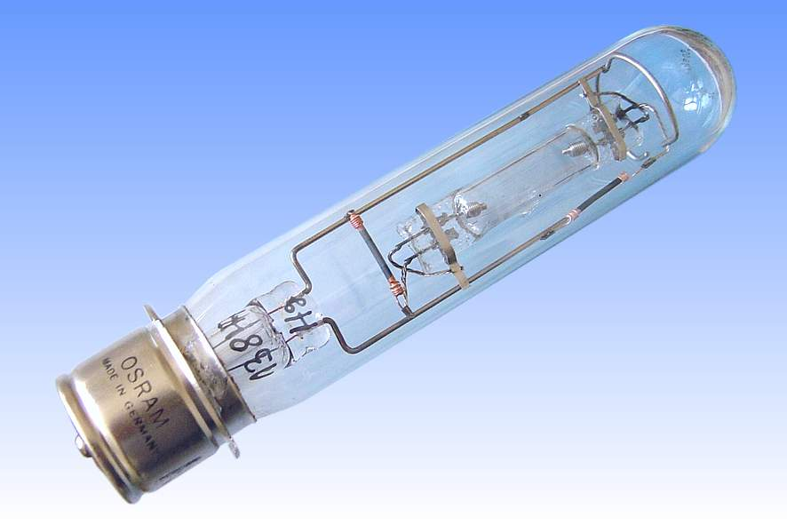

Slide 8
MECHANISM OF ACTION
Mercurial toxic salts bind with Sulfhydryl groups resulting in enzyme inhibition of oxidation , metabolic functions.
Metallic mercury vapors are toxic/ pulmonary irritation.
Mercury salts are corrosives to the skin , eyes, and GIT and nephrones and cause contact dermatitis.

Slide 9
S/S Acute poisoning
GIT:- metallic taste, constriction, hoarse voice.
Mouth , tongue, and fauces becomes corroded , mucous membrane becomes grayish white.
Hot burning pain from mouth to stomach. Vomitus contains grayish material .

Slide 10
FATAL DOSE AND PERIOD
1---4 grams of Mercuric chloride
3-------5 days

Slide 11
Lab investigation
Blood mercury level > 3.6 micrograms/dl,
24 hour urinary excretion of mercury > 15 micrograms/l indicates toxicity.
N A A

Slide 12
TREATMENT
Emesis
Egg white, milk or charcoal
G/L with 250 ml of 5% sodium formaldehyde sulphoxylate.
Egg white.
BAL
Penicillamine
Hemodialysis
electrolytes

Slide 13
POST MORTEM FINDINGS
Body looks emaciated
GIT:- inflammation, ulceration, grayish corrosion,
KIDNEY:- Tubular damage, Glomerular nephritis.
LIVER:- congestion, swelling
HEART:- subendocardial hemorrhage

Slide 14
CHRONIC MERCURY POISONING
CAUSES:--
WORKERS
THERAPUETIC USE
RECOVERY FROM LARGE DOSE
OINTMENTS

Slide 15
S/S Chronic poisoning
Metallic taste, salivation, gingivitis, glossitis, loosening of teeth, blue lines on gums.
Weight loss, anorexia, constipation, visual disturbances, jaundice, sore mouth and throat.
Impairment of kidney function.
CNS toxicity and impairment of motor speed, memory and coordination.

Slide 16
S/S Chronic poisoning
Danbury tremors/ shaking palsy/Hatter’s shake.
Mercurial erethisim
Mercurialentis
Minamata disease

Slide 21
TREATMENT
REMOVAL OF PATIENT
Penicillamine

Slide 22
M/L importance
Accidental
Abortifacient
Sulphocyanide of mercury tablets---Pharaoh’s serpents.

Slide 23
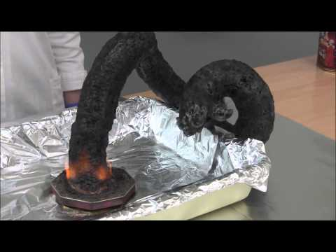

Slide 24
