Slide 1
Torts to Person
Wrongs affecting human body and safety

Slide 2
Assault
“Assault is such act of the Defendant which causes reasonable apprehension of infliction of battery upon Plaintiff.” It is also a Crime under Section 350 of Pakistan Penal Code, 1860. It is actionable per se where no actual damage is required to prove.
Following are the essential ingredients of Assault
Some gestures or preparation constituting the threat of use of force
Reasonable apprehension of force
Ability or capability of the defendant to carry out the threat

Slide 3
Continued…
Thus the essence of Assault is putting a person in present fear of violence. However, mere uttering of certain words without any preparation or gestures doesn’t amount to Assault.
Illustrations
1. A shakes his fist at Z, intending or knowing it to be likely that he may thereby cause Z to believe that A is about to strike Z, A has committed an assault 2. A begins to unloose the muzzle of a forcing dog intending, or knowing it to be likely that he may thereby cause Z to believe that he is about to cause the dog to attack Z. A has committed an assault upon Z

Slide 4
Battery
Battery is intentional use of force against another person without lawful justification or excuse. Hence, it is actual application of force in some hostile, rude or angry manner. It is also a crime under Section 350 (Criminal Force) of Pakistan Penal Code, 1860 . Following are essential ingredients of Battery
Use of force
Intentional
Without lawful justification or excuse
Illustration
A intentionally pulls up a woman's veil. Here A intentionally uses force to her and if he does so without her consent intending or knowing it to be likely that he may thereby injure, frighten or annoy her he has used criminal force to her.

Slide 5
Defences
Inevitable accident
Self defence/ property
Leave and licence
Exercise of parental or quasi-parental authority
Public Peace
Legal process

Slide 6
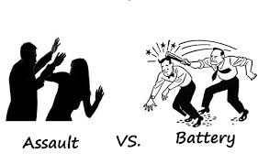
DIFFERENCE

