Slide 1
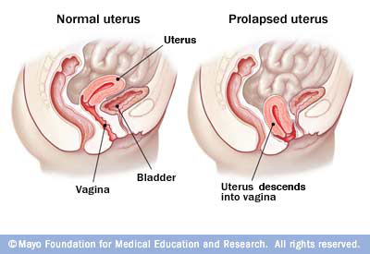
UTEROVAGINAL PROLAPSE

Slide 2
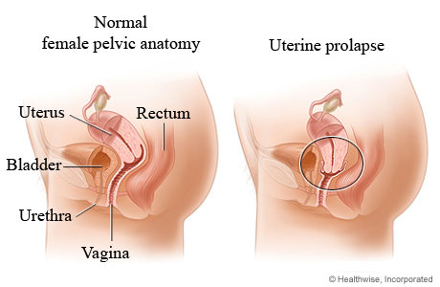
A prolapse is a protrusion of an organ or structure beyond its normal anatomical confines
Prolapses are classified according to their location and the organs contained within them.

Slide 3
Introduction
Up to half of the normal female population will develop uterovaginal prolapse during their lifetime.
Twenty percent of these women will be symptomatic and need treatment.
woman up to the age of 80 years has an 11% risk of needing surgery for pelvic floor weakness. Furthermore,
if she has an operation, she has a 29% risk of requiring further surgery.

Slide 4
Anatomic Supports
Muscular : Levator Ani (Pelvic Floor Muscle)
Ligaments : Uterosacral-Cardinal Complex
Fascial : Endopelvic (Pubocervical & Rectovaginal)

Slide 6
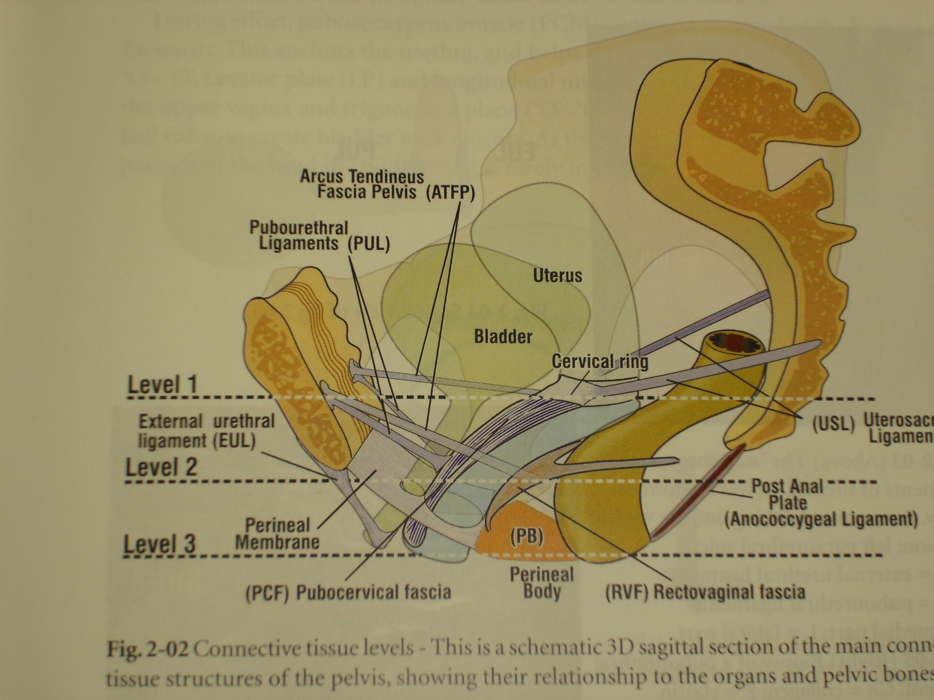

Slide 7
DeLancey connective tissue support
Level 1 (apical vaginal) – uterosacral & cardinal ligaments---damage result in uterine/vaginal vault prolapse.
Level 2 (mid vaginal)– endopelvic fascia and its lateral insertion into white line--- damage result in cystocele and rectocele.
Level 3 (distal vaginal)– incorporates endopelvic fascia anteriorly and perineal body posteriorly damage result in deficient perineal body and urethrocele.

Slide 8
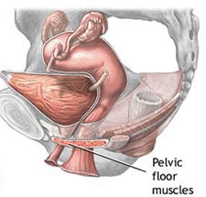
Pathophysiology of pelvic floor dysfunction
Muscle
gradual denervation with age--result in a gradual weakening of the muscle over time.
Pelvic floor muscle denervation is increased by vaginal delivery, particularly if the active second stage of labour is prolonged

Slide 9
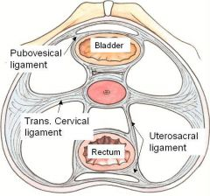
Fascia
Fascia is composed of a number of components including collagen, elastin and smooth muscle embedded in a connective tissue matrix.
Congenital
Age
Childbirth injury
Endocrine

Slide 10
Predisposing Factors
Hereditary (genetic) predisposition
Race: White > Black > Asian
Pregnancy and Vaginal Childbirth
Age and Menopause
Raised intra-abdominal pressure (e.g.: obesity, cough, constipation, lifting, etc)
Iatrogenic: surgical procedure

Slide 11
Classification
Anterior vaginal wall prolapse
Urethrocele: urethral descent
Cystocele: bladder descent
Cystourethrocele: descent of bladder and urethra
Posterior vaginal wall prolapse
Rectocele: rectal descent
Enterocele: small bowel descent
Apical vaginal prolapse
Uterovaginal: uterine descent with inversion of vaginal apex
Vault: post-hysterectomy inversion of vaginal apex

Slide 12
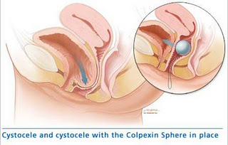

Slide 13
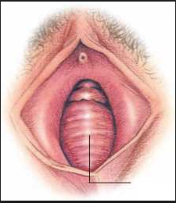
Anterior Vaginal wall prolapse

Slide 14
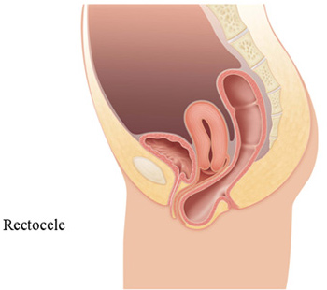
Rectocele

Slide 15
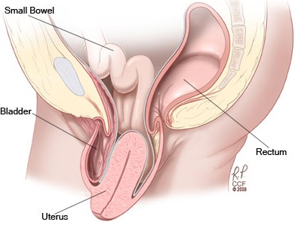
Apical prolapse

Slide 16
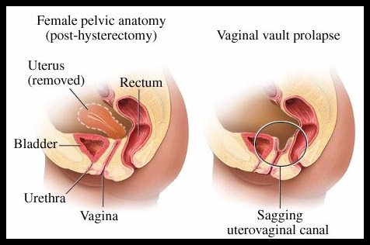

Slide 17
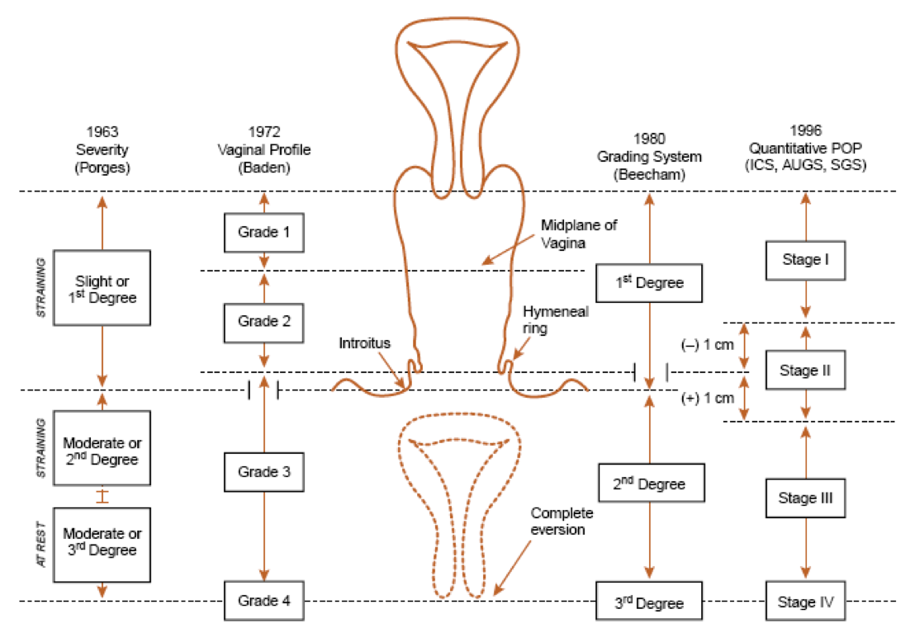

Slide 18
Symptoms of Prolapse
Pelvic floor disorders become symptomatic through either of two mechanisms:
1. Mechanical difficulties produced by the actual prolapse.
2. Bladder or bowel dysfunction, disrupting either storage or emptying.

Slide 19
Clinical presentation
Before actual prolapse. the patient feels a sensation of weakness in the perineum. particularly towards the end of the day
Later the patient notices a mass which appears on straining. and disappears when she lies down
Urinary symptoms :
a) Urgency and frequency by day
b) Stress incontinence
c) Inability to micturate unless the anterior vaginal wall is pushed upwards by the patient's fingers
d) Frequency when cystitis develops

Slide 20
Rectal symptoms
not so marked.
feels heaviness in the rectum
constant desire to defaecate.
Piles develop from straining.
Backache
Leucorrhoea
caused by the congestion and associated by chronic cervicitis.
decubitus ulcer
purulent or blood stained discharge
Coital symptoms
fear, discomfort, embarrassment

Slide 21
Examination & investigations
General examination
general medical fitness, including fitness for surgery.
Chronic chest conditions and obesity increase the risk of prolapse.
Abdominal examination -- intra - abdominal mass.

Slide 22
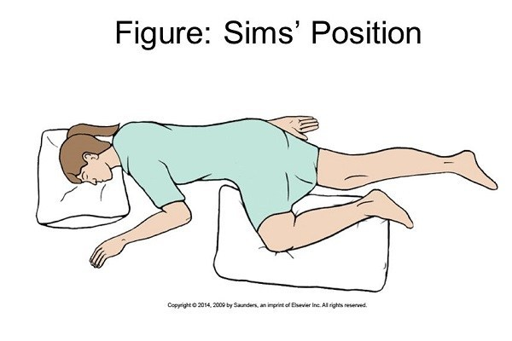
Position
horizontal position, conventionally in the left lateral position with a Sims ’ speculum.
If prolapse is not evident, even with a Valsalva manoeuvre, the patient should be examined in the upright position.
The POPQ examination gives an objective record of the prolapse stage.

Slide 23
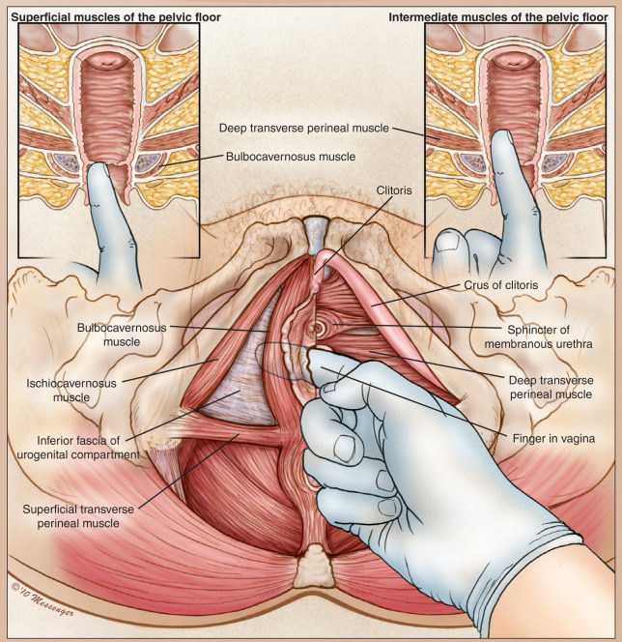
Local examination
with a careful inspection of the vulva and vagina to identify erosions, ulcerations, or other lesions
The extent of prolapse should be systematically assessed
Suspicious lesions should be biopsied

Slide 24
Per speculum examination
Per vaginal/ Bimanual examination
Cough stress test
Evaluation of tone of pelvic muscles
Recto vaginal examination

Slide 25
Investigation
Ultrasound -- exclude a pelvic mass,size of the uterus and ovaries
Urodynamic studies
Only justified when urinary symptoms present
If obstructive voiding--- good prognosis for surgical repair
If atonic bladder—less favourable prognosis
Overactive bladder– less likely that surgery will improve symptoms
Proctography
Magnetic resonance imaging
TPUS (transperineal ultrasound)
Anorectal studies if bowel dysfunction particularly fecal incontinence

Slide 26
MANAGEMENT OF UTERINE PROLAPSE
Goal of treatment
-Alleviate symptoms
-Restore anatomical structure
-Restore/Preserve sexual function
Choice of treatment depends on
-Symptoms severity
-Prolapse severity
-Fertility desire

Slide 27
Treatment---Conservative
Lifestyle advice
advice on diet and weight loss including avoidance of drinks with caffeine,water intake, fibre content, laxative use and modifi cation of drug regimes, e.g. diuretics.
Avoidance of high – impact exercise and lifting may improve symptoms.
Pelvic floor physiotherapy
earlier stage prolapse may be improved sufficiently to avoid further intervention.
Influence only the voluntary muscles
No action to the fascial supporting system
“Kegel” exercises

Slide 28
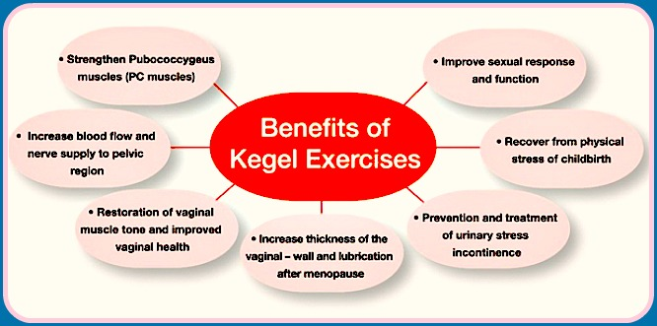
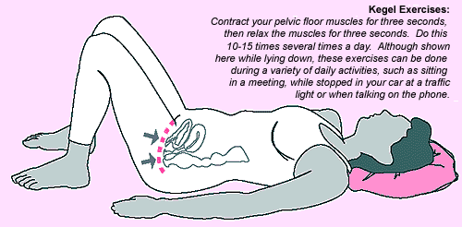

Slide 29
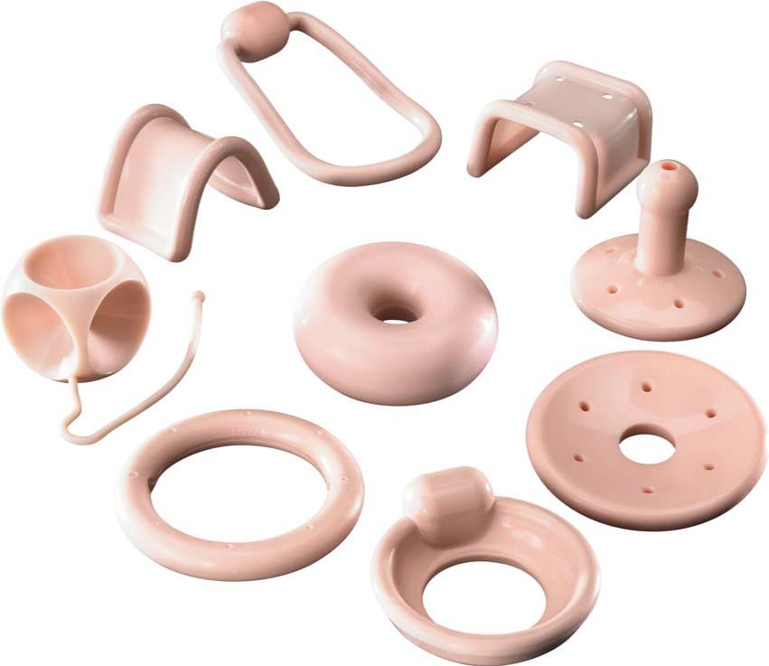
Pessary
During pregnancy
Immediately after pregnancy, during lactation
When future childbearing is intended in near future
Refusal to operation by patient
As a therapeutic test
To promote healing in a decubital ulcer
Patient has other comorbidities risk for surgery
Propylene ring pessary
Silicon rubber pessary

Slide 30
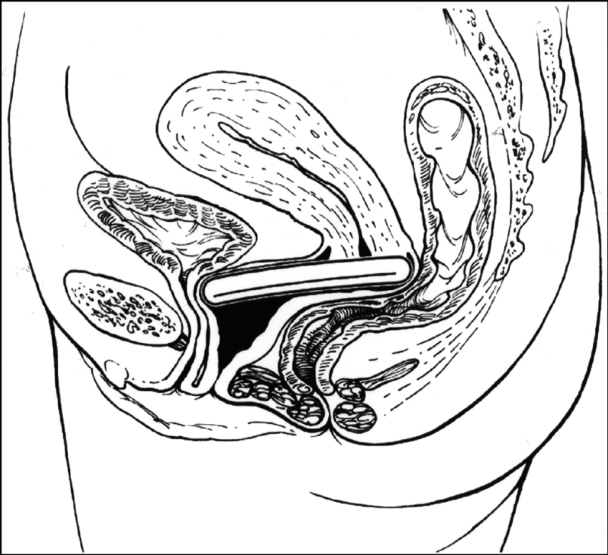
Pessary in situ

Slide 31
Complications of pessary
Constipation
Urinary incontinance
B.vaginitis, ulceration of vaginal wall
Cervicitis
Impaction of pessary
Strangulation of prolapsed tissue

Slide 32
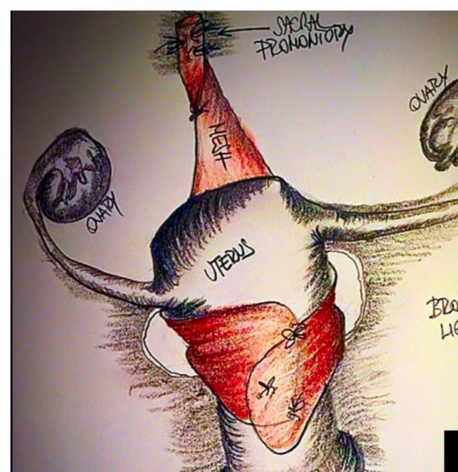
Uterine prolapse Uterine preserving surgery
Hysterosacropexy:
open route or a laparoscopic route
Mesh is attached to the isthmus of the cervix and the uterus is suspended by attaching the other part of the mesh to the anterior longitudinal ligament on the sacrum.

Slide 33
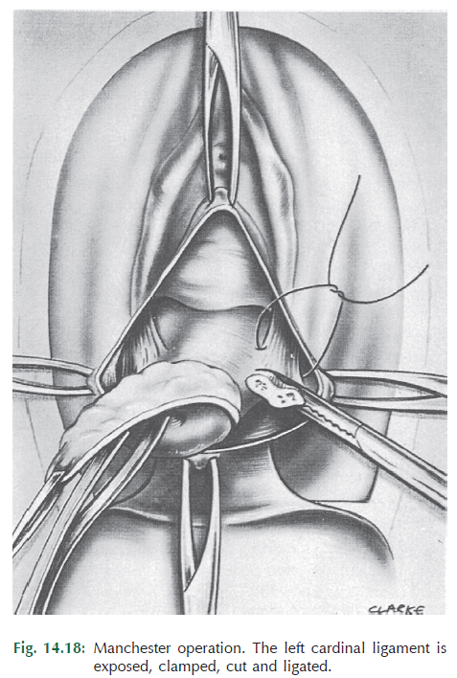
The Manchester repair:
amputating the cervix and using the uterosacral cardinal ligament complex to support the uterus.

Slide 34
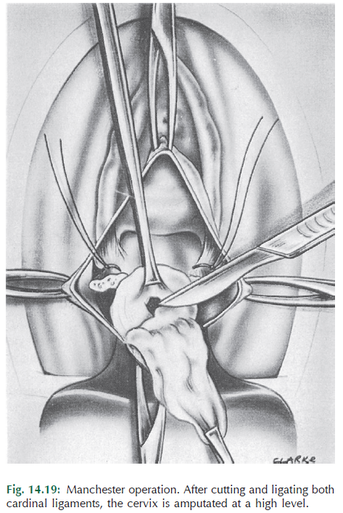
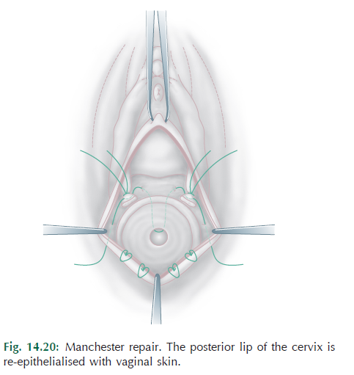

Slide 35
Le Fort colpocleisis:
unfit for major surgery and are not sexually active.
It involves partial closure of the vagina while preserving the uterus.

Slide 36
Procedures involving hysterectomy
Vaginal hysterectomy:
Total abdominal hysterectomy and sacrocolpopexy:
Subtotal abdominal hysterectomy and sacrocervicopexy:

Slide 37
Vaginal vault prolapse
Abdominal sacrocolpopexy
Success rate 74-100%
Mesh erosion 2-11%
Should be performed in Young women
Vaginal sacrospinous ligament fixation (right sided or bilateral)
Anatomical cure rate 63-97%
In frail women

Slide 38
Sacral colpopexy

Slide 39
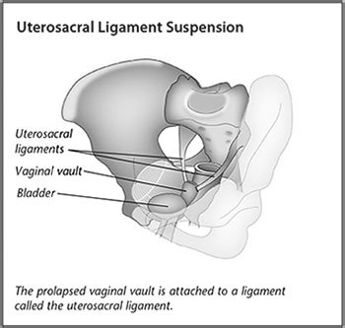
Uterosacral suspension

Slide 40
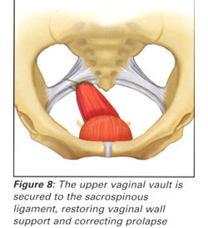
Sacrospinous suspension

Slide 41
Augmentation of vaginal repairs
The high reported risk of failure or recurrence following vaginal repair surgery has led to an increased use in recent years of implants to supplement the fascial repair.
Absorbable, non -absorbable materials
synthetic or harvested from animals or humans.
Risks—dyspareunia ,Mesh erosion 10% of cases,
macroporous, monofilament polypropylene construction with lower material weight and density than previously employed

Slide 42
Associated decubitus ulcer
To relieve congestion, the prolapse can be reposited in the vagina with the help of tompoons ar pessary and this helps in healing of the ulcer
Hygroscopic agents like acriflavin-glycerine can help reduce the congestion further

Slide 43
Prevention
During labour &puerperium
Avoid premature bearing down
Avoid long second stage
Repairs all tears &incisions accurately in layers
Use delayed absorbable suture
Do not express the uterus when attempting to deliver placenta
Encourage pelvic floor exercise
Avoid puerperal constipation-decreases bearing down

Slide 44
Prevention
At hysterectomy
Vault suspension with uterosacral and cardinal ligaments
Obliteration of deep cul-de –sac by Moschowitz sutures
Sacropexy in high risk situations like collagen disorders
Increase acceptability of estrogen replacement therapy

Slide 45
Thank you

