Slide 1
GLOBAL POSITIONING SYSTEM (GPS)

Slide 2
History of GPS
Developed by US department of defense.
1969-defence navigation satellite system(DNSS) is formed.
1973-NAVSTAR(Navigational satellite timing and ranging) global positioning system is developed.
1978-first 4 satellites are launched
1993-24th satellite launched
May 2000 military accuracy available to all users.

Slide 3
Global positioning system (GPS)
A system of earth-orbiting satellites, transmitting signals continuously towards the earth, that enable the position of the receiving device on or near the earth’s surface to be accurately estimated from the difference in arrival times of the signals.
or
A navigational system of signals from a network of satellites used to accurately determine locations on the earth's surface.

Slide 4
Working principle
Geometric principle:
you can find one’s location if u know its distance from other, already known locations
Things which need to determine:
Current location of GPS satellite
The distance between receivers position and the GPS satellites

Slide 5
GPS segments
Space Segment
Control Segment
User Segment
GPS consists of three segments:
Space segment
Control segment
User segment

Slide 6
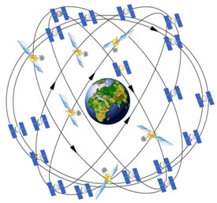
Space Segment
Space segment consist of 24 Satellites constellation
GPS satellite transmit a signal which has a number of components:
Two sine wave
Two digital code
A navigational message
Receive command from the ground
GPS satellite flying in circular orbits.

Slide 7
Control segment
Master control station located in the united states Colorado springs, Colorado.
Monitor the space segment and send commands to satellites.
User segment:
User segment include all military and civilian users.
Receiver record and interpret the radio signals broadcast by the satellite.

Slide 8
GPS satellite generation
Four GPS satellite generations: block 1, block 2/2A, Block 2R and Block 2F
-Block 1
11 satellites are launched between 1978 and 1985 on Atlas F Rockets
Life expectancy = 4.5 years
Last block 1 satellite taken out of service 18 November 1995.
Inclination angle with respect to equator 63 degree.

Slide 9
-block 2/2A
Block 2A is the new version of block 2.
28 Satellites are launched in during the period from February 1989 to November 1997.
Life expectancy = 7.5 year
Inclination angle with respect to equator was 55 degree.
Anti spoofing and selective availability are added(security features)

Slide 10
Block 2R
Block 2R generation currently being launched.it consist 21 satellites.
Life expectancy = 10 year
12 satellites under modernization program are launched at beginning
of 2003.
-block 2F
Satellite launched at beginning of 2005.It consist of 33 satellites.
Life expectancy = 15 year
New capabilities under modernization program
Improved autonomous GPS positioning accuracy

Slide 11
Current locations of GPS satellites
GPS satellite are orbiting the earth at an altitude of 11,000 miles.
The orbits and location of satellite are known in advance.
GPS receiver store this orbit information for all of the GPS satellites in ALMANC*.
*ALMANC is a file which contain positional information for all of the GPS satellite

Slide 12
DISTANCE B/W RECEIVER’S POSITION AND GPS SATELLITES.
A GPS receiver can tell its own position by using the position data of itself, and compares that data with 3 or more GPS satellites.
To get the distance to each satellite,
By measuring the amount of time taken by radio signal (the GPS signal) to travel from the satellite to the receiver.
Radio waves travel at the speed of light, i.e. about 186,000 miles per second.
The distance from the satellite to the receiver can be determined by the formula “distance = speed x time”.
Hence receiver’s position find out using trilateration.

Slide 13
GPS SIGNALS
Coarse/Acquisition code.
Precision code.
Navigation message.
Almanac.
Data updates.

Slide 14
GPS FREQUENCIES
L1 (1575.42 MHz)
L2 (1227.60 MHz)
L3 (1381.05 MHz)
L4 (1379.913 MHz)
L5 (1176.45 MHz)

Slide 15
FREQUENCY INFORMATION
The C/A code is transmitted on the L1 frequency.
The Precision-code is transmitted on both the L1 and L2 frequencies.
L3 is used by the Defense Support Program to signal detection of missile launches, nuclear detonations, and other applications.
L4 is used for additional correction to the part of the atmosphere that is ionized by solar radiation.
L5 is used as a civilian safety-of-life signal.

Slide 16
FREQUENCY L2C
Launched in 2005, L2C is civilian GPS signal, designed specifically to meet commercial needs.
L2C enables ionospheric correction, a technique that boosts accuracy.
Delivers faster signal acquisition, enhanced reliability, and greater operating range.
L2C broadcasts at a higher effective power making it easier to receive under trees and even indoors.

Slide 17
SOURCES OF GPS SIGNAL ERRORS.
Different errors can cause a deviation of +/- 50 -100 meters from the actual GPS receiver position which are :
1.Satellite clock :
One Nano second of inaccuracy in a satellite clock results in about 30 cm
(1 foot) of error in measuring the distance to that satellite.
2.Receiver clock :
Any error in the receiver clock causes inaccuracy in distance measurement.
However it is not practical to equip receiver with very accurate atomic clocks. Atomic clocks weigh more than 20 kgs, cost about US$ 50,000.
3.GPS Jamming :
It limits the effectiveness of the GPS signal.
GPS jammer is a low cost device to temporarily disable the reception of the civilian coarse acquisition (C/A) code.

Slide 18
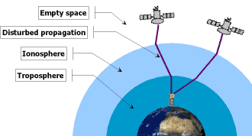
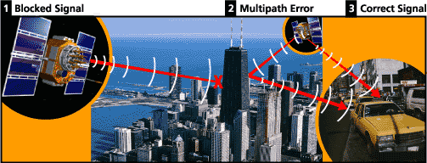
3. Atmospheric errors
Speed of GPS signal is affected by ionosphere &
troposphere.
Which cause a deviation of 0 to 30 m. from the
actual position of receiver.
.
4.Multi-path error :
Bouncing of GPS signal due to a reflecting surface before reaching to receiver antenna.
Which cause a deviation of 0 to 1 m. from the actual position of receiver.

Slide 19
Application of GPS
GPS has been available for military and civilian use for more than two decades,
GPS FOR THE UTILITIES INDUSTRIES:
Accurate and up to date maps of utilities are essential for utilities companies.
The GPS system provides a cost-effective, efficient, and accurate tool for creating utility maps.
With the help of GPS, locations of features such as gas lines can be accurately collected, along with their attributes .
Buried utilities such as electric cables or water pipes can also be mapped efficiently using GPS .

Slide 20
GPS for precision farming
GPS is used in agricultural in different ways,
Soil sample collection
Chemical application
Harvest yield
GPS is precisely used to locate the sampling points
GPS is also used to map crop yield
When GPS is integrated with an aerial guidance system, the field sprayer can be guided through a moving map display.

Slide 21
GPS for Military
GPS is used for different purpose in military. Some are given below
Navigation
Target tracking
Search and rescue

Slide 22
GPS for forestry and natural resources
GPS is successfully applied in forest industry,
Fire prevention and control
Harvesting operations
Insect infestation
Boundary determination
Aerial spraying

Slide 23
CONCLUSION.
GPS, a satellite based navigation system, thus can be used to determine the position of an object on earth.
Its application field is vast and new applications will continue to be created as the technology evolves.
GPS can also interfaced with other similar projects such EU’s GALILEO to account for unpredictable applications.
Thus, the GPS constellation, like manmade stars in the sky, can be used for guiding and navigation.

