Slide 2
PP 407 Seed and Postharvest Pathology
Objective
To study seed borne and postharvest diseases and their management

Slide 3
Seed borne Pathogens are Transmitted by Three Different Ways
Externally seed borne pathogens
The inoculum in such cases is superficial and confined to the surface of the seed usually as adhering propagules e.g. spores, sclerotia, mycelium, bacteria, nematodes, virus particles etc.
Pathogens borne on the surface of the seed include species of Alternaria, Fusarium, Helminthosporium, Stemphylium, many smuts and some rust fungi.

Slide 4
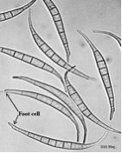
Spores
Courtesy: Google Images

Slide 5
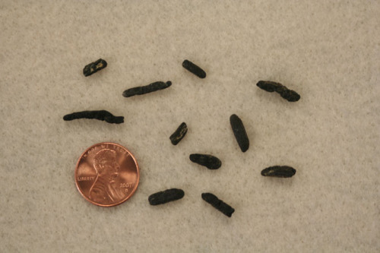
Sclerotia
Courtesy: Google Images

Slide 6
Contamination of seed surface especially by fungi is often detectable by direct observation under the microscope or by examining the seed washings.
Some common examples are:
Tilletia caries (wheat bunt), Sphacelotheca sorghi (grain smut of sorghum), Ustilago hordei (covered smut of barley), Puccinia carthami (safflower rust), Ditylenchus dipsaci (bulb and stem nematode on alfalfa), Corynebacterium michiganense (bacterial canker of tomato) and tobacco mosaic virus in tomato.

Slide 7
Internally Seed borne Pathogens
The pathogens may be carried inside the seed.
Pathogens may establish themselves in the various layers which envelop the seed such as seed coat, testa, pericarp, endosperm and embryo.
Transmission of such pathogens is through vegetative cells spores, pycnidia, nematodes or virus particles.

Slide 8
Some examples are:
Ustilago nuda (loose smut of barley), Ustilago nuda tritici (loose smut of wheat), Colletotrichum lindimuthianum (bean anthracnose), Phoma lingam (black leg of cabbage), Alternaria zinniae (Alternaria disease of zinniae), Ascochyta spp. (Ascochyta blight of pea), Xanthomonas campestris pv. malvacearum (Bacterial blight of cotton), X. campestris pv. campestris (Black rot of crucifers) common bean mosaic virus on French beans, tobacco ring spot virus on soybean.

Slide 9
Concomitant contamination
The inoculum may be present as concomitant contamination mixed with seeds in the form of infected plant debris, fungal sclerotia, nematode cysts, seeds of phanerogamic plant parasites, bacterial ooze and infected soil particles.
Inocula that produce serious disease outbreaks such as those due to downy mildews, rusts and bacterial diseases may be disseminated on plant debris that forms only small proportion of the total seed consignment.

Slide 10
Some Common Examples
Cuscuta seeds mixed with linseed, bajra, rye, gram, lentil.
Sclerotia mixed with rye (Claviceps purpurea), nematode galls (Anguina tritici) mixed with seeds of wheat.
Linseed rust (Melampsora lini) may also be carried on small pieces of plant debris mixed with the seed.
Soil mixed with bean seed lot may contain chlamydospores of Fusarium solani f. sp. phaseoli.

Slide 11
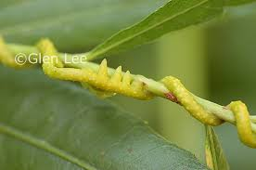
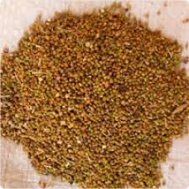
Cuscuta
Courtesy: Google Images

Slide 12
Courtesy: Google Images

Slide 13
Courtesy: Google Images

Slide 14
Wheat Seed Gall Nematode
Courtesy: Google Images

Slide 15
Linseed rust
Courtesy: Google Images

Slide 16
Courtesy: Google Images

Slide 17
Many downy mildew fungi may be carried as oospores in the infected plant debris e.g. downy mildew of bajra (Sclerospora graminicola).
A pathogen carried through the seed has a very good chance of being transmitted to the next generation.

Slide 18
Karnal Bunt
Courtesy: Google Images

Slide 19
Mechanism of Seed Infection
1. Surface contamination
Seed borne pathogens are often carried on the seed surface. Most of the species of Alternaria, Drechslera and Fusarium may be transmitted in the form of spores on the seed surface.
Many downy mildew fungi may contaminate the seed surface by their oospores and get transmitted.

Slide 20
2. Seed coat infection
Seed coat is the common site of infection of most seed borne pathogens. Such infections established as dormant mycelium have been demonstrated for many Alternaria, Cercospora, Colletotrichum, Botrytis and Drechslera species in various crops.
Phoma lingam in cabbage, Rhizoctonia solani in the seed coat of tomato, seed coat infection of Ascochyta rabiei in gram, Sclerospora philippinensis in maize are some important examples of seed coat infection.

Slide 21
Seed coat bacteria are usually confined to seed coat.
Xanthomonas campestris pv. campestris in crucifers invades the seed coat through the vascular system.
X. campestris pv. malvacearum in cotton is found in both the chalazal and micropylar halves of the seed coat.

Slide 22
Some highly infective seed borne viruses have been reported to be carried in the seed coat.
Bean common mosaic, cucumber mosaic and tobacco mosaic viruses remain in the testa of seeds of respective hosts.

Slide 23
3. Endosperm Infection
Fusarium moniliforme is often present in the endosperm of sorghum.
Drechslera oryzae invades the endosperm of paddy seeds in addition to the pericarp.
Mycelium of Sclerospora philippinensis causing downy mildew of maize has been demonstrated to be present in the endosperm and seed coat of apparently healthy maize seeds.
Certain bacterial pathogens such as Erwinia stewartii and Corynebacterium insidiosum causing wilt in maize and Lucerne, respectively have been found to infect the endosperm tissues.
Barley stripe mosaic, cucumber mosaic and tobacco mosaic (tomato) are some examples of endosperm infection by viruses.

Slide 24
4. Embryo infection
Ustilago nuda and U. nuda tritici the loose smut fungi of barley and wheat have been found present in embryo.
Diplodia zeae has been reported to be present between scutellum and inner parts of the embryo in apparently healthy maize seeds.
Embryo infection in sesamum by Alternaria sesami and in rice seeds by Curvularia lunata and Fusarium moniliforme have also been reported.

Slide 25
Pseudomonas lachrymans causing angular leaf spot in cucumber, Corynebacterium michiganense causal agent of bacterial canker of tomato, X. campestris pv. malvacearum causing black arm of cotton are some examples of embryo infection by bacteria.
Common bean mosaic virus and tobacco ring spot virus have been found in the embryo tissues of bean and soybean seeds.

Slide 26
Courtesy: Google Images

Slide 27
Courtesy: Google Images

Slide 28
5. Pericarp infection
Fruit infection my suppress development of seeds as in fruits of apple, pear, plum etc. These may be mummified by fungus Monilinia.
In some cases infected pericarp accompanies the seed.
Many species of Drechslera parasitic in cereals and grasses establish themselves as dormant mycelium in the pericarp as they do in the seed coat.

Slide 29
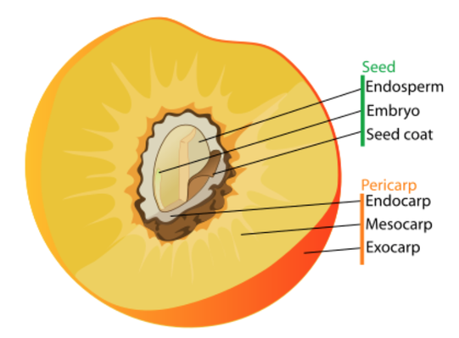
Courtesy: Google Images

Slide 30
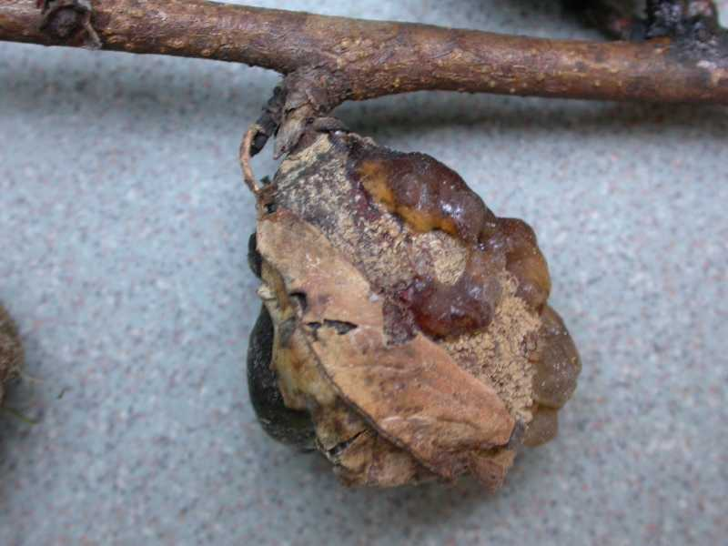
Courtesy: Google Images

Slide 31
6. Bract Infection
Resting mycelium may be carried in the inner glumes e.g. Dreschslera oryzae.
Sclerospora sorghi is borne abundantly as oosopores in the persistent glumes of sorghum.
Xanthomonas oryzae in Japan is found in the tissue of husk.

Slide 32
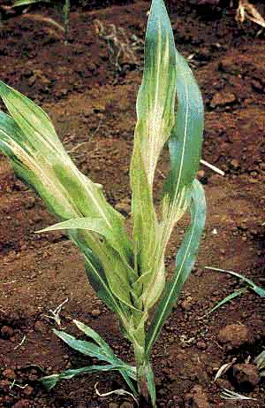
Sclerospora sorghi
Courtesy: Google Images

Slide 33
*Sources
1. Recommended books.
2. Latest research articles downloaded from
Google.
3. Google images.
*Solely for academic purpose and guidance of students.

