Slide 1
Distribution of Halophytes

Slide 2
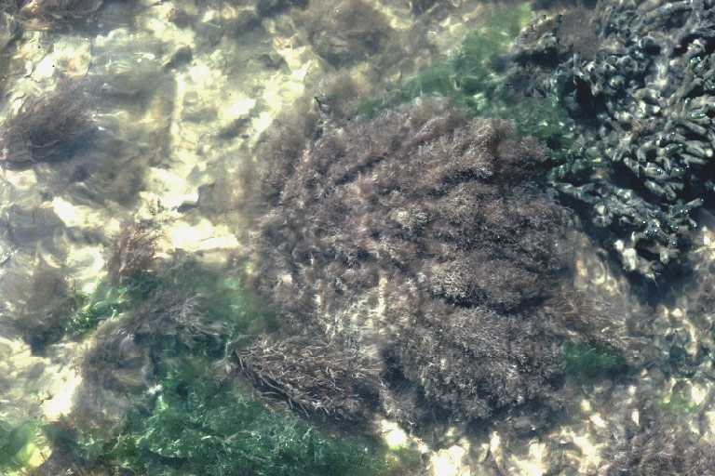
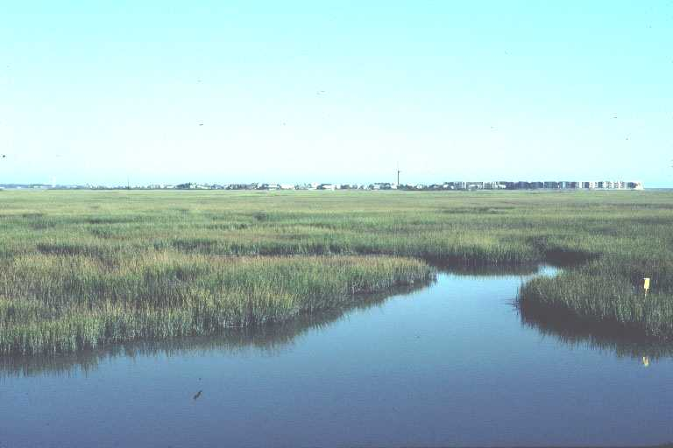
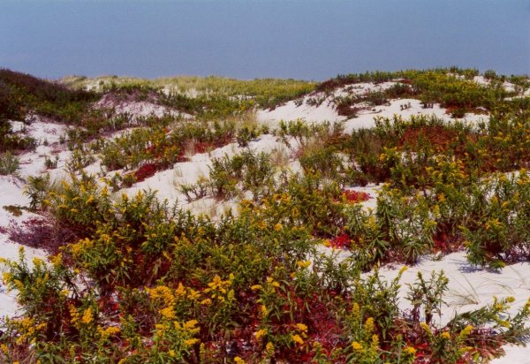
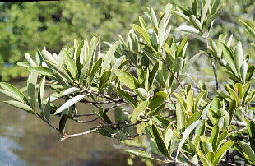
Distribution of Halophytes
Marine halophytes
Mangroves
Coastal strand
Salt marshes

Slide 3
TYPES OF HALOPHYTES
1. LITHOPHILOUS
They grow on rocks near the rocks
2. PSAMMOPHILOUS
They grow on sandy region
3. PELOPHILOUS
They grow in places where the saaline soilloam with a predominance of clay

Slide 4
5. MANGROVES
4. SALT SWAMP AND SALT DESERT
They grow in calm water and muddy spots
Mangroves or littoral swamp forest grow on sea shores in tropical and sub tropical regions

Slide 5
MANGROVES
In tropical and subtropical regions halophytes form a typical sea shore vegetation called mangroves
Mangroves are present on the coasts
Their osmotic potential is maintained at a low level to facilitate absorption of water from sea

Slide 6
Classification of Halophytes
According to Chapman (1942), halophytes have been classified into the following categories:
(i) Miohalophytes—Plants growing in the habitats of low salinity (below 0.5% NaCl)
(ii) Euhalophytes—Plants of highly saline habitats

Slide 7
Coastal angiospermic halophytes have been divided into the following groups:
(i) Submerged marine halophytes—hydrohalophytes,
(ii) Low coast plants—hygrohalophytes,
(a) Swamp halophytes, the mangrove
(b) Marsh halophytes,
(iii) High coast plant —aerohalophytes

Slide 8
Major Representatives
Acanthus cillicifolius,
Acrostichum aurem,
Aegiceras corniculatum,
Avicennia officinalis,
Azima tetracantha,
Bruguiera gymnorrhiza,
B. cylindrica,
B. sexangula,
Excoecaria agallocha,
E. indica,
Kandelia candel,
Rhizophora apiculate,
R. mucronata,
Sonneratia caseolaris,
Calophyllum etc.

Slide 9
Halophytic Cryptogams
Cryptogams are very poorly represented in the halophytic flora
Only a few mosses e.g., Pottia salina, Pottia crinita, Bryum salinum, Grimmia maritima
Ferns e.g., the polypodiaceous Acrostichum aureum and Ceratopteris thalictroides

Slide 10
Distribution in Pakistan
Halophytic vegetation of Pakistan is quite diverse with 410 species from 58 families. The highest number of halophyte species is present in the Chenopodiaceae family
The halophytes of Pakistan constitute about 19% of the flora
Most of the halophytic species in Pakistan are present in the Blaochistan plains (182), whereas, others are in coastal areas (163), moist mountains (149), arid mountains (93), the Potwar plateau (76), and deserts

