Slide 1
Introduction to ICT
Data
Information
Data processing
Electronic Data processing
Metadata
Data base
Hierarchy of data
Keys
Relationships

Slide 2
Data
A collection of raw facts and figures is called data.
Data is given to the computer for processing.
Data is collected from different resources and it may consists of numbers, characters, symbols or pictures.

Slide 3
Data
Dada can be of following different types
Numeric data
Alphabetic data
Alphanumeric data
Image data
Audio data
Video data

Slide 4
Information
The processed data is called information.
Information is more meaningful than data and is used for making decisions.

Slide 5
Difference between Data and Information

Slide 6
Data Processing
Data processing is the process of converting data into meaningful information.
Data is the input and information is the output of a data processing system.
Data
Information
Processing

Slide 7
Data Processing: Example
The marks of students in the examination are stored as data. Suppose a list of students is required who got A grade in the examination.
Some processing will be applied on marks of the students.
This process will give new information in the from of desired list.
In this data processing, marks of students is the data and list of students with A grades is the information.

Slide 8
Data Processing: Example
The data of the citizens of Pakistan is collected and stored permanently.
This data can be processed for different purpose such as
To find out the literacy rate of the country
To find out total number of PhDs in the country
To find out the poverty level in different areas of the country

Slide 9
Electronic Data Processing
In electronic data processing, all calculations and processing is performed by computers.
Different software applications are used in computers for data processing.
It takes far less time than any other data processing technique.

Slide 10
Electronic Data Processing
Some advantages of electronic data processing are
It is more efficient.
It is less time consuming.
A large amount of data can be processed easily
It is more reliable.
It is more flexible and information can be presented in different styles.
There are less chances of errors.

Slide 11
Metadata
Metadata is data about data.
It is used to describe the properties and characteristics (size, format)of some other data.
It also includes the rules and constraints about data.

Slide 12
Metadata: Example
When you create a table, you specify the data type, size, format and other constraints for entering data in different fields of the table.
This is metadata of the table as it describe the properties of the data to be stored in the table.
Metadata is very important to ensure the integrity of the data.

Slide 13
Metadata: Example
Field Name | Data Type | Length | Description
Roll No | Integer | 3 | Roll No of the student
Name | Alphabetic | 50 | Name of the student
Address | Alphanumeric | 100 | Address of the student
Metadata for a database table
Roll No | Name | Address
1 | Ejaz | Faisalabad
2 | Usman | Faisalabad
A Database Table

Slide 14
Database
Database is an organized collection of related data.
Organized means that data is stored in such a way that user can store, manipulate and retrieve data easily.
Related data means that data is about a particular subject.
All data in database is arranged in tables.

Slide 15
Database
Table is the fundamental object of database structure and its basic purpose is to store data.
It is a very convenient way to store data and users can easily manipulate data in a table.

Slide 16
Database
A table consists of rows and columns.
Rows are the horizontal part of the table.
A row is a collection of related fields.
A single row / record:

Slide 17
Database
Columns are the vertical part of the table.
For example:
Name
Ejaz
Usman

Slide 18
Database: Components
Four major components of database system are
Data
Hardware
Software
Personnel

Slide 19
Database: Components
Data is the most important component of database system.
Data is a collection of facts stored in the database.
Basic purpose of a database system is to store, maintain and process data for user.

Slide 20
Database: Components
Hardware is used to perform different tasks such as input, output, storage and processing.
Some important hardware components are as follows
Secondary storage
I/O devices
Processors
Main Memory

Slide 21
Database: Components
Three types of software are required to enable the database system work properly. These are
Operating system: It manages all hardware components and enables all other software to run on computer.
DBMS Software: It manages the database in the database system.
Application programs and utilities: These are used to access and process the data stored in the database.

Slide 22
Database: Components
Personnel are the people related to the database system.
Different type of persons in a database system are
Database Administrators
Application Programmers
End Users

Slide 23
Hierarchy of Data
Data in computer is classified in a hierarchy and different terms are used to describe data of different levels in the hierarchy.
A database contain files.
A file contains records
A record contains fields
A field consists of characters.

Slide 24
Hierarchy of Data: Field
A combination of one or more characters is called a field.
It is the smallest unit of data that can be accessed by the user.
The name of each field in a record is unique and each field contains one specific piece of information.
Field size defines the maximum number of characters that can be stored in a field.’
Field type indicates the type of data that can be stored in the field

Slide 25
Hierarchy of Data: Field

Slide 26
Hierarchy of Data: Record
A collection of related fields treated as a single unit is called a record.
For example, an employee’s record includes a set of fields that contains employee number, employee name, grade and designation etc.

Slide 27
Hierarchy of Data: File
File is a collection of related records treated as a single unit.
A database is a group of related data files.
For example a student database may have data files like students file, fee file, attendance file and exam file.

Slide 28
Keys
A key is an attribute or set of attributes that uniquely identifies a tuple (row) in file.
Keys are defined in the table to
Access stored data quickly
Arrange stored data quickly and smoothly
Keys are also used to create relationship between different tables.

Slide 29
Keys
Different types of important keys in databases are
Primary key
Candidate key
Alternate key
Composite key
Foreign key

Slide 30
Keys: Primary Key
Primary key is an attribute that uniquely identifies a row or record in a relation.
Some important points about a primary key are
A relation can have only one primary key.
Primary key attribute must have unique values
Primary key can not contain null values.

Slide 31
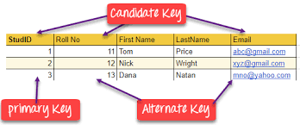
Keys: Candidate and Alternate Keys
A relation may contain many attributes that can be used as primary key.
Such an attribute is called candidate key and a relation can have many candidate keys.
The candidate keys that are not selected as primary key are known as alternate keys.

Slide 32
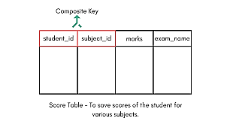
Keys: Composite Key
A primary key that consists of two or more attributes is known as composite key.

Slide 33
Keys: Foreign Key
A foreign key is an attribute in a relation whose values match a primary key in another relation.
The relation in which foreign key is created is known as dependent or child table.
The relation to which the foreign key refers is known as parent table.

Slide 34
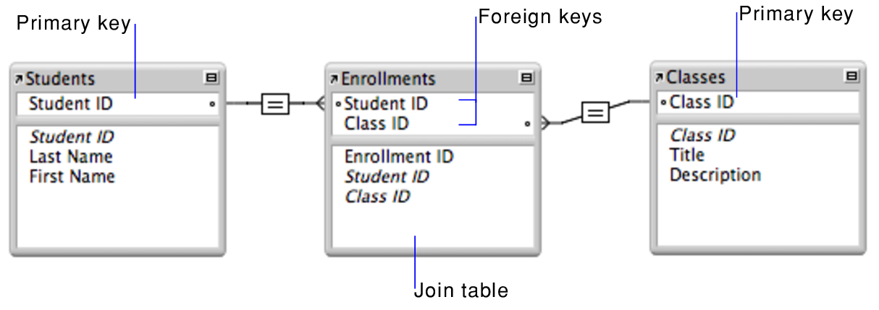
Keys: Foreign Key
Some important points of a foreign key are as follows
It has same name as the primary key from which it was referred.
The field specifications of the primary key from which it was copied have to be the same for the foreign key too.

Slide 35
Relationships
A relationship is a logical connection between different tables and is established on the basis of interaction among these tables.
The relationship is established by connecting one or more fields of two tables.
The fields used to connect two tables normally have same name, data type and size.

Slide 36
Relationships
Different types of relationship are
One-to-One Relationship
One-to-Many Relationship
Many-to-Many relationship

Slide 37
One-to-One Relationship
One-to-One relationship exists between two tables when:
For each record in the first table, there is only one record in the second table.
For each record in the second table, there is only one record in the first table.

Slide 38
One-to-One Relationship

Slide 39
One-to-Many Relationship
One-to-Many relationship exists between two tables when:
For each record in the first table, there are one or more records in the second table.
For each record in the second table, there is only one record in the first table.

Slide 40
One-to-Many Relationship

Slide 41
Many-to-Many relationship
Many-to-Many relationship exists between two tables when:
For each record in the first table, there are one or more records in the second table.
For each record in the second table, there are one or more records in the first table.

Slide 42
Many-to-Many relationship

Slide 43
Many-to-Many relationship

