Slide 1
Program Analysis: Security

Slide 2
Software bugs are serious problems
Thanks: Isil and Thomas Dillig

Slide 3
Facebook missed a single security check…
[PopPhoto.com Feb 10]
http://www.popphoto.com/news/2015/02/man-finds-easy-hack-to-delete-any-facebook-photo-album
Notes:
Facebook missed a single security check in their mobile-facing app that allowed a man to delete anybody’s photo album.
Unfortunately this is just the tip of the iceberg.
This particular bug made the news, but many more don’t. And facebook is not the only one having these kinds of problems.

Slide 4
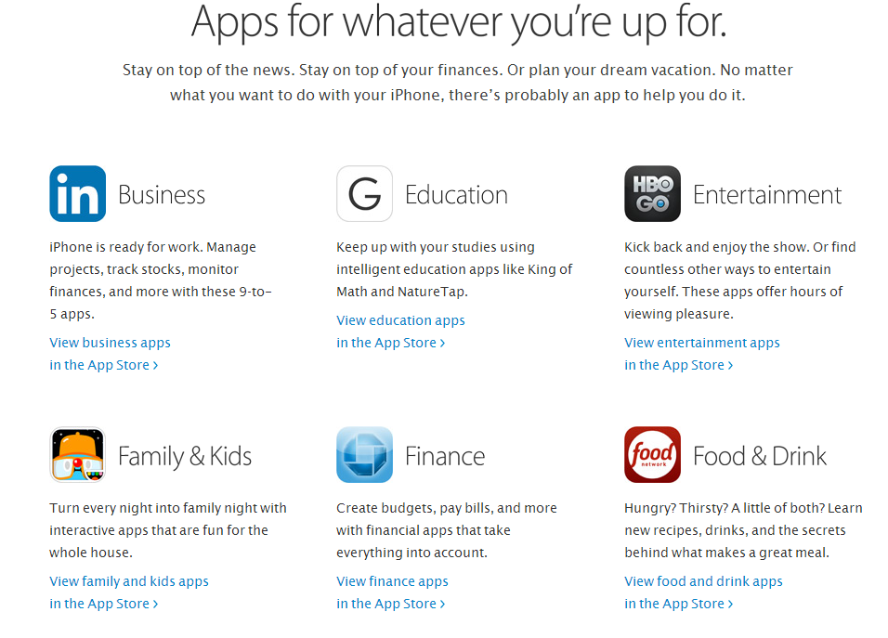
App stores

Slide 5
How can you tell whether
software you
Develop
Buy
is safe to install and run?

Slide 6
Two options
Static analysis
Inspect code or run automated method to find errors or gain confidence about their absence
Dynamic analysis
Run code, possibly under instrumented conditions, to see if there are likely problems

Slide 7
Program Analyzers
Code
Program Analyzer
Report | Type | Line
1 | mem leak | 324
2 | buffer oflow | 4,353,245
3 | sql injection | 23,212
4 | stack oflow | 86,923
5 | dang ptr | 8,491
… | … | …
10,502 | info leak | 10,921
Spec

Slide 8
Manual testing
only examines small subset of behaviors
Entry
Entry
1
1
2
2
4
4
1
3
4
1
1
1
2
4
1
2
4
1
2
4
1
3
4
2
2
3
1
2
3
1
2
4
1
3
4
1
2
4
1
2
3
1
3
4
4
4
1
2
3
1
2
3
1
3
4
. . .
1
2
4
1
2
4
1
3
4
Exit
Exit
Software
Behaviors
8

Slide 9
Static vs Dynamic Analysis
Static
Can consider all possible inputs
Find bugs and vulnerabilities
Can prove absence of bugs, in some cases
Dynamic
Need to choose sample test input
Can find bugs vulnerabilities
Cannot prove their absence

Slide 10
Cost of Fixing a Defect
Credit: Andy Chou, Coverity

Slide 11
Cost of security or data privacy vulnerability?

Slide 12
Dynamic analysis
Instrument code for testing
Heap memory: Purify
Perl tainting (information flow)
Java race condition checking
Black-box testing
Fuzzing and penetration testing
Black-box web application security analysis

Slide 13
Static Analysis
Long research history
Decade of commercial products
FindBugs, Fortify, Coverity, MS tools, …

Slide 14
Static Analysis: Outline
General discussion of static analysis tools
Goals and limitations
Approach based on abstract states
More about one specific approach
Property checkers from Engler et al., Coverity
Sample security checkers results
Static analysis for of Android apps
Slides from: S. Bugrahe, A. Chou, I&T Dillig, D. Engler, J. Franklin, A. Aiken, …

Slide 15
Static analysis goals
Bug finding
Identify code that the programmer wishes to modify or improve
Correctness
Verify the absence of certain classes of errors

Slide 16
Soundness, Completeness
Property | Definition
Soundness | “Sound for reporting correctness” Analysis says no bugs → No bugs or equivalently There is a bug → Analysis finds a bug
Completeness | “Complete for reporting correctness” No bugs → Analysis says no bugs
Recall: A → B is equivalent to (¬B) → (¬A)

Slide 17
Complete
Incomplete
Reports all errors
Reports no false alarms
Reports all errors
May report false alarms
Sound
Undecidable
Decidable
May not report all errors
Reports no false alarms
May not report all errors
May report false alarms
Unsound
Decidable
Decidable

Slide 18
Sound Program Analyzer
Analyze large
code bases
Code
Program Analyzer
Report | Type | Line
1 | mem leak | 324
2 | buffer oflow | 4,353,245
3 | sql injection | 23,212
4 | stack oflow | 86,923
5 | dang ptr | 8,491
… | … | …
10,502 | info leak | 10,921
false alarm
Spec
false alarm
Sound: may
report many
warnings
May emit
false alarms

Slide 19
Sound
Over-approximation of Behaviors
Reported
Error
Modules
. . .
False Alarm
approximation is too coarse…
…yields too many false alarms
Behaviors
Software

Slide 20
Outline
General discussion of tools
Goals and limitations
Approach based on abstract states
More about one specific approach
Property checkers from Engler et al., Coverity
Sample security-related results
Static analysis for Android malware
…
Slides from: S. Bugrahe, A. Chou, I&T Dillig, D. Engler, J. Franklin, A. Aiken, …

Slide 21
Does this program ever crash?
entry
X ← 0
Is Y = 0 ?
yes
no
X ← X + 1
X ← X - 1
Is Y = 0 ?
yes
no
Is X < 0 ?
exit
yes
no
crash

Slide 22
Does this program ever crash?
entry
X ← 0
Is Y = 0 ?
yes
no
X ← X + 1
X ← X - 1
Is Y = 0 ?
yes
no
Is X < 0 ?
exit
yes
no
crash
infeasible path!
… program will never crash

Slide 23
Try analyzing without approximating…
entry
X ← 0
X = 0
Is Y = 0 ?
yes
no
X = 0
X = 1
X = 2
X ← X + 1
X ← X - 1
X = 1
X = 2
X = 3
X = 1
X = 2
X = 3
Is Y = 0 ?
X = 1
X = 2
X = 3
yes
no
Is X < 0 ?
exit
yes
no
X = 1
X = 2
X = 3
crash
non-termination!
… therefore, need to approximate
Notes:
Show non-termination of symbolic execution

Slide 24
dataflow elements
X = 0
d_{in}
d_{out} = f(d_{in})
X ← X + 1
f
d_{out}
X = 1
dataflow equation
transfer function

Slide 25
X = 0
d_{in1}
X ← X + 1
f1
d_{out1} = f₁(d_{in1})
X = 1
d_{out1}
d_{out1} = d_{in2}
X = 1
d_{in2}
Is Y = 0 ?
f2
d_{out2} = f₂(d_{in2})
X = 1
d_{out2}

Slide 26
d_{out1} = f₁(d_{in1})
d_{in1}
d_{in2}
d_{out2} = f₂(d_{in2})
f₁
f₂
d_{join} = d_{out1} ⊔ d_{out2}
d_{out1}
d_{out2}
d_{join}
d_{join} = d_{in3}
d_{in3}
f₃
d_{out3} = f₃(d_{in3})
d_{out3}
least upper bound operator
Example: union of possible values
What is the space of dataflow elements, Δ?
What is the least upper bound operator, ⊔?

Slide 27
Try analyzing with “signs” approximation…
entry
X ← 0
X = 0
Is Y = 0 ?
yes
no
X = 0
X = 0
X ← X + 1
X ← X - 1
X = pos
X = neg
X = T
lost
precision
Is Y = 0 ?
X = T
yes
no
X = T
Is X < 0 ?
exit
yes
no
X = T
X = T
crash
terminates...
… but reports false alarm
… therefore, need more precision
Notes:
Run the signs analysis, show false alarm reported

Slide 28
X = T
true
X ≠ neg
X = T
X ≠ pos
Y = 0
Y ≠ 0
X = pos
X = pos
X = 0
X = 0
X = neg
X = neg
false
X = ⊥
X = ⊥
refined signs lattice
signs lattice
Boolean formula lattice
Notes:
finite height condition

Slide 29
Try analyzing with “path-sensitive signs” approximation…
entry
X ← 0
true
X = 0
Is Y = 0 ?
yes
no
Y=0
X = 0
X = 0
Y≠0
X ← X + 1
X ← X - 1
Y=0
X = pos
X = neg
Y≠0
no precision loss
Is Y = 0 ?
Y=0
X = pos
Y≠0
X = neg
yes
no
X = neg
Y≠0
Y=0
X = pos
Is X < 0 ?
exit
refinement
yes
no
crash
X = pos
Y=0
terminates...
… no false alarm
… soundly proved never crashes
Notes:
Run the signs analysis, show false alarm reported

Slide 30
Outline
General discussion of tools
Goals and limitations
Approach based on abstract states
More about one specific approach
Property checkers from Engler et al., Coverity
Sample security-related results
Static analysis for Android malware
…
Slides from: S. Bugrahe, A. Chou, I&T Dillig, D. Engler, J. Franklin, A. Aiken, …

Slide 31
Unsound Program Analyzer
analyze large
code bases
Code
Program Analyzer
Report | Type | Line
1 | mem leak | 324
2 | buffer oflow | 4,353,245
3 | sql injection | 23,212
4 | stack oflow | 86,923
5 | dang ptr | 8,491
… | … | …
false alarm
Spec
false alarm
Not sound: may miss some bugs
may emit
false alarms

Slide 32
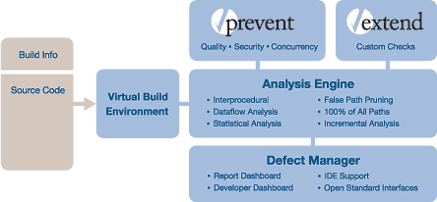

Slide 33
Demo
Coverity video: http://youtu.be/_Vt4niZfNeA
Observations
Code analysis integrated into development workflow
Program context important: analysis involves sequence of function calls, surrounding statements
This is a sales video: no discussion of false alarms

Slide 34
Bugs to Detect
Some examples
Crash Causing Defects
Null pointer dereference
Use after free
Double free
Array indexing errors
Mismatched array new/delete
Potential stack overrun
Potential heap overrun
Return pointers to local variables
Logically inconsistent code
Uninitialized variables
Invalid use of negative values
Passing large parameters by value
Underallocations of dynamic data
Memory leaks
File handle leaks
Network resource leaks
Unused values
Unhandled return codes
Use of invalid iterators
Slide credit: Andy Chou

Slide 35
Example: Check for missing optional args
Prototype for open() syscall:
Typical mistake:
Result: file has random permissions
Check: Look for oflags == O_CREAT without mode argument
int open(const char *path, int oflag, /* mode_t mode */...);
fd = open(“file”, O_CREAT);

Slide 36
Example: Chroot protocol checker
Goal: confine process to a “jail” on the filesystem
chroot() changes filesystem root for a process
Problem
chroot() itself does not change current working directory
chroot()
chdir(“/”)
open(“../file”,…)
Error if open before chdir

Slide 37
TOCTOU
Race condition between time of check and use
Not applicable to all programs
check(“foo”)
use(“foo”)

Slide 38
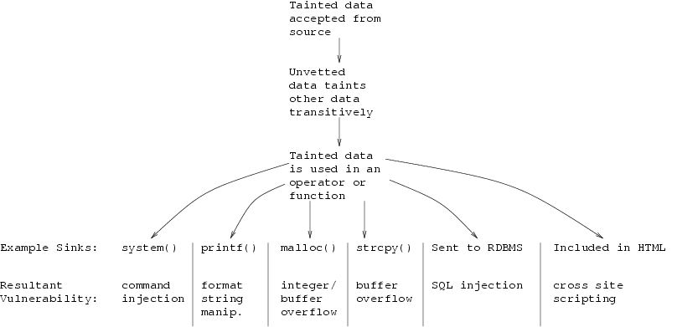
Tainting checkers

Slide 39
Example code with function def, calls
#include <stdlib.h>
#include <stdio.h>
void say_hello(char * name, int size) {
printf("Enter your name: ");
fgets(name, size, stdin);
printf("Hello %s.\n", name);
}
int main(int argc, char *argv[]) {
if (argc != 2) {
printf("Error, must provide an input buffer size.\n");
exit(-1);
}
int size = atoi(argv[1]);
char * name = (char*)malloc(size);
if (name) {
say_hello(name, size);
free(name);
} else {
printf("Failed to allocate %d bytes.\n", size);
}
}

Slide 40
Callgraph
main
atoi
exit
free
malloc
say_hello
fgets
printf

Slide 41
Reverse Topological Sort
8
main
atoi
exit
free
malloc
say_hello
7
3
4
5
6
Idea: analyze function before you analyze caller
fgets
printf
2
1

Slide 42
Apply Library Models
8
main
atoi
exit
free
malloc
say_hello
7
3
4
5
6
fgets
printf
Tool has built-in summaries of library function behavior
2
1

Slide 43
Bottom Up Analysis
8
main
atoi
exit
free
malloc
say_hello
7
3
4
5
6
Analyze function using known properties of functions it calls
fgets
printf
2
1

Slide 44
Bottom Up Analysis
8
main
atoi
exit
free
malloc
say_hello
7
3
4
5
6
Analyze function using known properties of functions it calls
fgets
printf
2
1

Slide 45
Bottom Up Analysis
8
main
atoi
exit
free
malloc
say_hello
7
3
4
5
6
Finish analysis by analyzing all functions in the program
fgets
printf
2
1

Slide 46
Finding Local Bugs
#define SIZE 8
void set_a_b(char * a, char * b) {
char * buf[SIZE];
if (a) {
b = new char[5];
} else {
if (a && b) {
buf[SIZE] = a;
return;
} else {
delete [] b;
}
*b = ‘x’;
}
*a = *b;
}

Slide 47
Control Flow Graph
char * buf[8];
Represent logical structure of code in graph form
if (a)
a
!a
b = new char [5];
if (a && b)
a && b
!(a && b)
buf[8] = a;
delete [] b;
*b = ‘x’;
*a = *b;
END

Slide 48
Path Traversal
Conceptually: Analyze each path through control graph separately
Conceptually
char * buf[8];
Actually Perform some checking computation once per node; combine paths at merge nodes
Actually
if (a)
a
!a
b = new char [5];
if (a && b)
a && b
!(a && b)
buf[8] = a;
delete [] b;
*b = ‘x’;
*a = *b;
END

Slide 49
Apply Checking
Null pointers
Use after free
Array overrun
char * buf[8];
See how three checkers are run for this path
if (a)
Defined by a state diagram, with state transitions and error states
!a
Checker
if (a && b)
!(a && b)
delete [] b;
Assign initial state to each program var
State at program point depends on state at previous point, program actions
Emit error if error state reached
Run Checker
*b = ‘x’;
*a = *b;
END

Slide 50
Apply Checking
Null pointers
Use after free
Array overrun
char * buf[8];
“buf is 8 bytes”
if (a)
!a
if (a && b)
!(a && b)
delete [] b;
*b = ‘x’;
*a = *b;
END

Slide 51
Apply Checking
Null pointers
Use after free
Array overrun
char * buf[8];
“buf is 8 bytes”
if (a)
!a
“a is null”
if (a && b)
!(a && b)
delete [] b;
*b = ‘x’;
*a = *b;
END

Slide 52
Apply Checking
Null pointers
Use after free
Array overrun
char * buf[8];
“buf is 8 bytes”
if (a)
!a
“a is null”
if (a && b)
!(a && b)
Already knew a was null
delete [] b;
*b = ‘x’;
*a = *b;
END

Slide 53
Apply Checking
Null pointers
Use after free
Array overrun
char * buf[8];
“buf is 8 bytes”
if (a)
!a
“a is null”
if (a && b)
!(a && b)
delete [] b;
“b is deleted”
*b = ‘x’;
*a = *b;
END

Slide 54
Apply Checking
Null pointers
Use after free
Array overrun
char * buf[8];
“buf is 8 bytes”
if (a)
!a
“a is null”
if (a && b)
!(a && b)
delete [] b;
“b is deleted”
*b = ‘x’;
“b dereferenced!”
*a = *b;
END

Slide 55
Apply Checking
Null pointers
Use after free
Array overrun
char * buf[8];
“buf is 8 bytes”
if (a)
!a
“a is null”
if (a && b)
!(a && b)
delete [] b;
“b is deleted”
*b = ‘x’;
“b dereferenced!”
*a = *b;
No more errors
reported for b
END

Slide 56
False Positives
What is a bug? Something the user will fix.
Many sources of false positives
False paths
Idioms
Execution environment assumptions
Killpaths
Conditional compilation
“third party code”
Analysis imprecision
…

Slide 57
A False Path
char * buf[8];
if (a)
a
!a
b = new char [5];
if (a && b)
a && b
!(a && b)
buf[8] = a;
delete [] b;
*b = ‘x’;
*a = *b;
END

Slide 58
False Path Pruning
Integer Range
Disequality
Branch
char * buf[8];
if (a)
!a
if (a && b)
a && b
buf[8] = a;
END

Slide 59
False Path Pruning
Integer Range
Disequality
Branch
char * buf[8];
if (a)
!a
“a in [0,0]”
“a == 0 is true”
if (a && b)
a && b
buf[8] = a;
END

Slide 60
False Path Pruning
Integer Range
Disequality
Branch
char * buf[8];
if (a)
!a
“a in [0,0]”
“a == 0 is true”
if (a && b)
a && b
“a != 0”
buf[8] = a;
END

Slide 61
False Path Pruning
Integer Range
Disequality
Branch
char * buf[8];
Impossible
if (a)
!a
“a in [0,0]”
“a == 0 is true”
if (a && b)
a && b
“a != 0”
buf[8] = a;
END

Slide 62
Environment Assumptions
Should the return value of malloc() be checked?
int *p = malloc(sizeof(int));
*p = 42;
OS Kernel:
Crash machine.
File server:
Pause filesystem.
Web application:
200ms downtime
Spreadsheet:
Lose unsaved changes.
Game:
Annoy user.
IP Phone:
Annoy user.
Library:
?
Medical device:
malloc?!

Slide 63
Statistical Analysis
Assume the code is usually right
int *p = malloc(sizeof(int));
*p = 42;
int *p = malloc(sizeof(int));
if(p) *p = 42;
int *p = malloc(sizeof(int));
*p = 42;
int *p = malloc(sizeof(int));
if(p) *p = 42;
3/4
deref
1/4
deref
int *p = malloc(sizeof(int));
*p = 42;
int *p = malloc(sizeof(int));
if(p) *p = 42;
int *p = malloc(sizeof(int));
if(p) *p = 42;
int *p = malloc(sizeof(int));
*p = 42;

Slide 64
Application to Security Bugs
Stanford research project
Ken Ashcraft and Dawson Engler, Using Programmer-Written Compiler Extensions to Catch Security Holes, IEEE Security and Privacy 2002
Used modified compiler to find over 100 security holes in Linux and BSD
http://www.stanford.edu/~engler/
Benefit
Capture recommended practices, known to experts, in tool available to all

Slide 65
Sanitize integers before use
Warn when unchecked integers from untrusted sources reach trusting sinks
Syscall
param
Network
packet
copyin(&v, p, len)
v.tainted
any<= v <= any
v.clean
Use(v)
memcpy(p, q, v)
copyin(p,q,v)
copyout(p,q,v)
array[v]
while(i < v)
…
ERROR
Linux: 125 errors, 24 false; BSD: 12 errors, 4 false

Slide 66
Example security holes
Remote exploit, no checks
/* 2.4.9/drivers/isdn/act2000/capi.c:actcapi_dispatch */ isdn_ctrl cmd; ... while ((skb = skb_dequeue(&card->rcvq))) { msg = skb->data; ... memcpy(cmd.parm.setup.phone,
msg->msg.connect_ind.addr.num, msg->msg.connect_ind.addr.len - 1);

Slide 67
Example security holes
Missed lower-bound check:
/* 2.4.5/drivers/char/drm/i810_dma.c */
if(copy_from_user(&d, arg, sizeof(arg)))
return –EFAULT;
if(d.idx > dma->buf_count)
return –EINVAL;
buf = dma->buflist[d.idx];
Copy_from_user(buf_priv->virtual, d.address, d.used);

Slide 68
User-pointer inference
Problem: which are the user pointers?
Hard to determine by dataflow analysis
Easy to tell if kernel believes pointer is from user!
Belief inference
“*p” implies safe kernel pointer
“copyin(p)/copyout(p)” implies dangerous user ptr
Error: pointer p has both beliefs.
Implementation: 2 pass checker
inter-procedural: compute all tainted pointers
local pass to check that they are not dereferenced
Notes:
Ran over exokernel code that I was involved with for my thesis. Fortunately caught this after I got my day job.

Slide 69
Results for BSD and Linux
All bugs released to implementers; most serious fixed
Linux BSD
Violation Bug Fixed Bug Fixed
Gain control of system 18 15 3 3
Corrupt memory 43 17 2 2
Read arbitrary memory 19 14 7 7
Denial of service 17 5 0 0
Minor 28 1 0 0
Total 125 52 12 12

Slide 70
Outline
General discussion of tools
Goals and limitations
Approach based on abstract states
More about one specific approach
Property checkers from Engler et al., Coverity
Sample security-related results
Static analysis for Android malware
…
Slides from: S. Bugrahe, A. Chou, I&T Dillig, D. Engler, J. Franklin, A. Aiken, …

Slide 71
STAMP Admission System
Static Analysis
More behaviors, fewer details
Static
STAMP
Dynamic
Alex Aiken,
John Mitchell,
Saswat Anand,
Jason Franklin
Osbert Bastani,
Lazaro Clapp,
Patrick Mutchler,
Manolis Papadakis
Dynamic Analysis
Fewer behaviors, more details

Slide 72
Data Flow Analysis
getLoc()
Source: Location
sendSMS()
Sink: SMS
sendInet()
Sink: Internet
Location
SMS
Location
Internet
Source-to-sink flows
Sources: Location, Calendar, Contacts, Device ID etc.
Sinks: Internet, SMS, Disk, etc.

Slide 73
Applications of Data Flow Analysis
Malware/Greyware Analysis
Data flow summaries enable enterprise-specific policies
API Misuse and Data Theft Detection
FB API
Source: FB_Data
Send Internet
Sink: Internet
Automatic Generation of App Privacy Policies
Avoid liability, protect consumer privacy
Privacy Policy
This app collects your:
Contacts
Phone Number
Address
Vulnerability Discovery
Web
Source: Untrusted_Data
SQL Stmt
Sink: SQL

Slide 74
Challenges
Android is 3.4M+ lines of complex code
Uses reflection, callbacks, native code
Scalability: Whole system analysis impractical
Soundness: Avoid missing flows
Precision: Minimize false positives

Slide 75
STAMP Approach
Too expensive!
App
App
Model Android/Java
Sources and sinks
Data structures
Callbacks
500+ models
Whole-program analysis
Context sensitive
Android
Models
STAMP
OS
HW

Slide 76
Building Models
30k+ methods in Java/Android API
5 mins x 30k = 2500 hours
Follow the permissions
20 permissions for sensitive sources
ACCESS_FINE_LOCATION (8 methods with source annotations)
READ_PHONE_STATE - (9 methods)
4 permissions for sensitive sinks
INTERNET, SEND_SMS, etc.

Slide 77
Identifying Sensitive Data
android.Telephony.TelephonyManager: String getDeviceId()
Returns device IMEI in String
Requires permission GET_PHONE_STATE
@STAMP(
SRC ="$GET_PHONE_STATE.deviceid",
SINK ="@return"
)

Slide 78
Data We Track (Sources)
Account data
Audio
Calendar
Call log
Camera
Contacts
Device Id
Location
Photos (Geotags)
SD card data
SMS
30+ types of sensitive data

Slide 79
Data Destinations (Sinks)
Internet (socket)
SMS
Email
System Logs
Webview/Browser
File System
Broadcast Message
10+ types of exit points

Slide 80
Currently Detectable Flow Types
396 Flow Types
Unique Flow Types = Sources x Sink

Slide 81
Example Analysis
Contact Sync for Facebook (unofficial)

Slide 82
Contact Sync Permissions
Category | Permission | Description
Your Accounts | AUTHENTICATE_ACCOUNTS | Act as an account authenticator
 | MANAGE_ACCOUNTS | Manage accounts list
 | USE_CREDENTIALS | Use authentication credentials
Network Communication | INTERNET | Full Internet access
 | ACCESS_NETWORK_STATE | View network state
Your Personal Information | READ_CONTACTS | Read contact data
 | WRITE_CONTACTS | Write contact data
System Tools | WRITE_SETTINGS | Modify global system settings
 | WRITE_SYNC_SETTINGS | Write sync settings (e.g. Contact sync)
 | READ_SYNC_SETTINGS | Read whether sync is enabled
 | READ_SYNC_STATS | Read history of syncs
Your Accounts | GET_ACCOUNTS | Discover known accounts
Extra/Custom | WRITE_SECURE_SETTINGS | Modify secure system settings

Slide 83
Possible Flows from Permissions
Sources
Sinks
READ_CONTACTS
INTERNET
READ_SYNC_SETTINGS
WRITE_SETTINGS
READ_SYNC_STATS
WRITE_CONTACTS
GET_ACCOUNTS
WRITE_SECURE_SETTINGS
INTERNET
WRITE_SETTINGS

Slide 84
Expected Flows
Sources
Sinks
READ_CONTACTS
INTERNET
READ_SYNC_SETTINGS
WRITE_SETTINGS
READ_SYNC_STATS
WRITE_CONTACTS
GET_ACCOUNTS
WRITE_SECURE_SETTINGS
INTERNET
WRITE_SETTINGS

Slide 85
Observed Flows
FB API
Source: FB_Data
Write Contacts
Sink: Contact_Book
Read Contacts
Source: Contacts
Send Internet
Sink: Internet

Slide 86
Example Study: Mobile Web Apps
Goal
Identify security concerns and vulnerabilities specific to mobile apps that access the web using an embedded browser
Technical summary
WebView object renders web content
methods loadUrl, loadData, loadDataWithBaseUrl, postUrl
addJavascriptInterface(obj, name) allows JavaScript code in the web content to call Java object method name.foo()

Slide 87
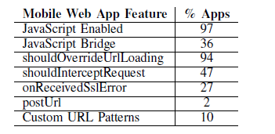
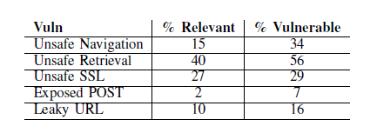
Sample results
Analyze 998,286 free web apps from June 2014

Slide 88
Summary
Static vs dynamic analyzers
General properties of static analyzers
Fundamental limitations
Basic method based on abstract states
More details on one specific method
Property checkers from Engler et al., Coverity
Sample security-related results
Static analysis for Android malware
STAMP method, sample studies
Slides from: S. Bugrahe, A. Chou, I&T Dillig, D. Engler, J. Franklin, A. Aiken, …

