Slide 1
Notes:
1

Slide 2
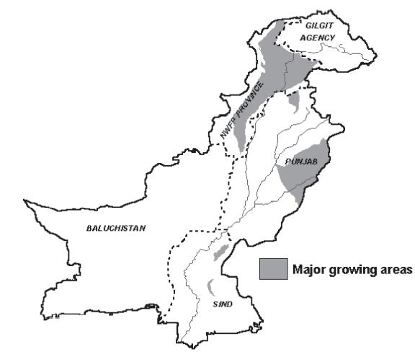
MAJOR MAIZE GROWING AREAS

Slide 3
IMPORTANCE OF MAIZE
Maize is the third major cereal crop in Pakistan after Wheat and Rice.
Maize has more yield potential as compared to Wheat and Rice.
Successfully grown in spring and Kharif seasons in Punjab.
Maize accounts for 4.8% of the total cropped area and 3.5% of the value of agricultural output.

Slide 4
Maize is a 4F crop i.e. source of Food, Feed, Fodder and Fuel.
70 % of total maize production is being used in poultry feed in Pakistan.
Many products are being made from corn e.g starch, glucose, corn oil, corn flakes, corn cake, ethanol etc.
Maize is being used for many specialties e.g sweet corn, pop corn, baby corn.

Slide 5
Maize Products and Products that use Maize
Baby Food
Breakfast cereals
Canned vegetables
Colour carrier in textile printing
Cosmetics
Dextrose
Dyes
Edible oil

Slide 6
Maize Products and Products that use Maize
Ethyl alcohol
Flour
Fructose
Fuel ethanol
James: jellies
Leather tanning
Livestock and poultry feed
Paper manufacturing
Pharmaceuticals
Starch and glucose
Whiskey

Slide 7
Nutritional Facts
Due to high no. of calories maize is placed in Nutritional grade A
1 ear weighing 143 g contains:
Total calories 123
Calories from fat 15
Total fat 3%
Saturated fat 1%
Cholesterol 0%
Dietary Fiber 15%
Protein 4.6%
Carbohydrates 9%

Slide 8
QUALITY COMPARISON OF CORN OIL WITH OTHER EDIBLE OILS
Type of Oil | Saturated fatty acids % |  |  | Unsaturated fatty acids % |  |  | Linoleic | Others
 | Total | Palmitic | Stearic | Total | Palmitic | Stearic
Olive | 11 | 09 | 02 | 89 | 88 | 08 | - | 1
Corn | 10 | 08 | 02 | 84 | 28 | 53 | 01 | 02
Soybean | 15 | 09 | 06 | 80 | 20 | 52 | 07 | 01
Sunflower | 12 | 06 | 06 | 83 | 20 | 63 | - | -
Palm | 45 | 39 | 06 | 49 | 49 | 40 | Traces | 01

Slide 9
Maize Hybrids in field (Local and Commercial)
Hybrids | Cost of Seed / acre (Rs) | Average Yield (kg/ha) | Income/acre (Rs)
FH-810 | 4000 | 9469 | 95000
Y. Wala Hybrid | 4000 | 9039 | 90000
YH-1898 | 4000 | 9833 | 98000
FH-949 | 4000 | 9949 | 99000
FH-1036 | 4000 | 9859 | 99000
NT-6621 (Syngenta) | 6000-7000 | 9879 | 99000
30Y87 (Pioneer) | 6000-7000 | 9442 | 94000
NK-8711 (Syngenta) | 6000-7000 | 8513 | 85000

Slide 10
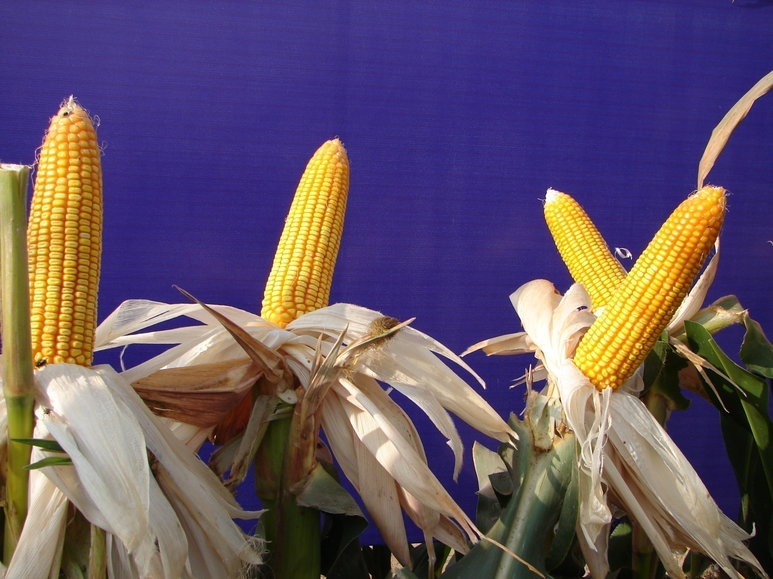
FH-810

Slide 11
Maize Hybrid FH-810

Slide 12
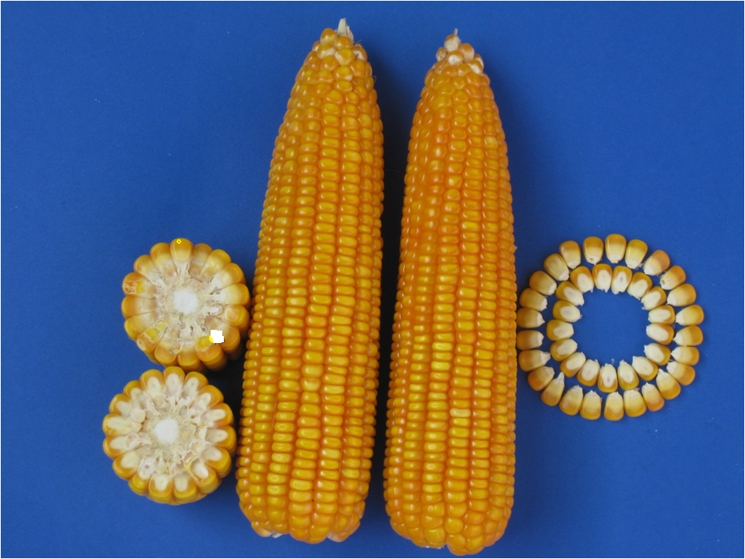
FH-810

Slide 13
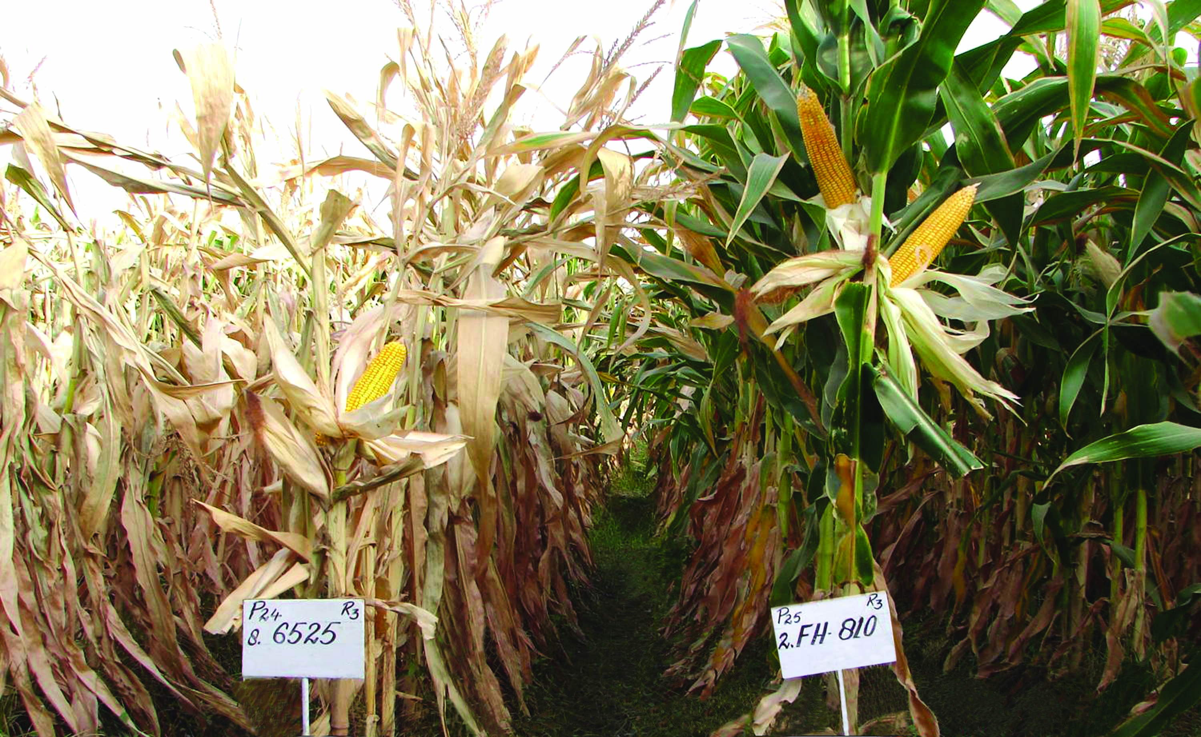
Stay Green character of FH-810
Sowing Date 05-02-2010
Picture date 28-05-2010

Slide 14
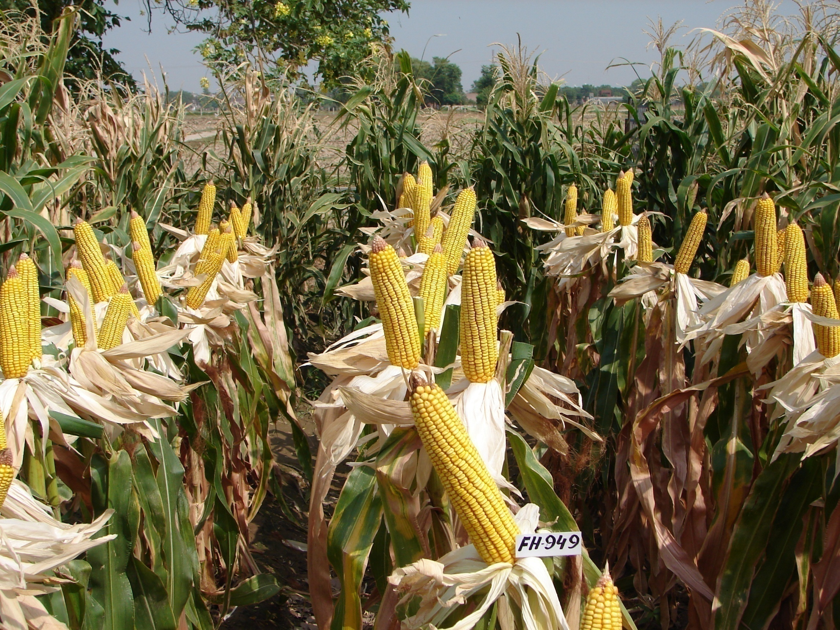

Slide 15
FACTORS TO BE CONSIDERED FOR GRAIN YIELD
Soil selection and preparation.
Quality seed and seed rate.
Timely planting and planting method.
Optimum plant population.
Judicious use of irrigation water.
Integrated weed management.
Balanced Fertilizer use.
Insect Pest & disease control.
Timely Harvesting

Slide 16
SOIL SLECTION

Slide 17
SUITABLE SOIL
Loam to heavy loam soil with pH 7.5 is most suitable
Avoid to grow on poorly drained or sandy soil
Avoid salt affected or water logged soils
Underground water should be fit

Slide 18
SOIL FERTILITY
Inherent soil fertility
Availability of water, air and nutrients in optimum quantities as per requirement
Soil structure which enhances root growth, exchange of gaseous elements, water availability /storage capacity
Organic matter contents in the soil.

Slide 19
SOIL FERTILITY ENHANCING & CONSERVING METHODS
Addition of organic matter
Farm yard manure , poultry drooping,
Green manures, Crop residues directly
Handling organic fertilizers in such a way that nutrients are not lost by leaching or volatilized by high temperature or solar radiation.
Inoculating the soil with microorganisms
Reducing run-off and soil erosion, which removes nutrients and organic matter.
Crop rotation with Leguminous crops.

Slide 20
SOIL FERTILITY ENHANCING & CONSERVING METHODS
Reducing burning of vegetation when farming is intensified, as this leads to losses of organic matter
Reducing leaching by maintaining a high humus content in the soil, soil cover and intercropping plant species with different rooting depths;

Slide 21
LAND PREPARATION
Primary Tillage
Sub soiler
Chisel Plow
M.B. Plow
Laser land leveler
Secondary Tillage
Cultivator
Rotavator
Ridger
3-4 deep ploughing with planking.

Slide 22
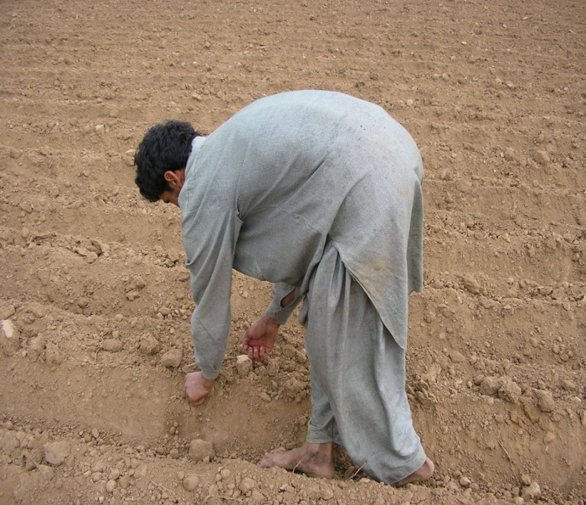
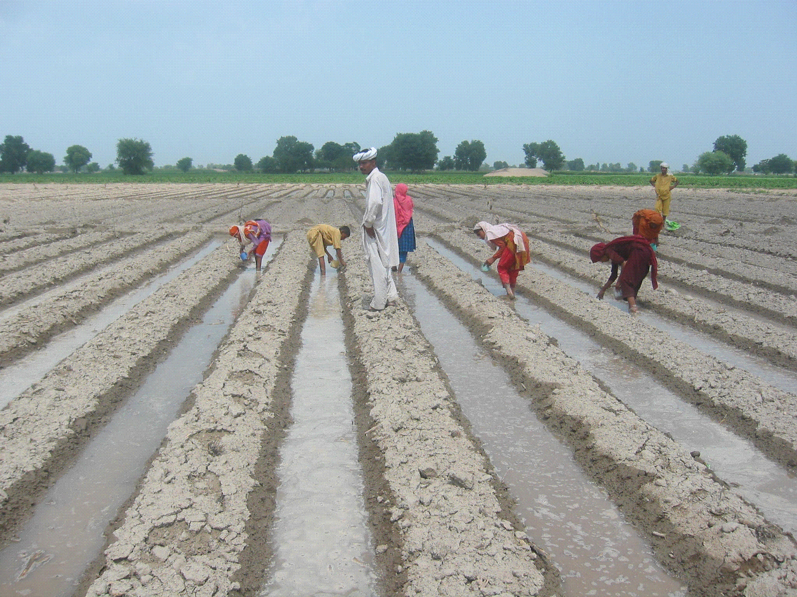
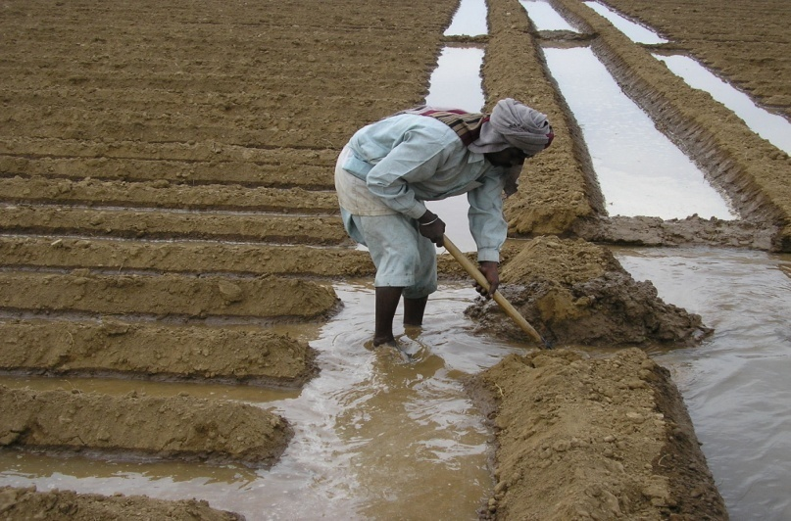
Corn Planting
Notes:
Occurs 10-20 days after emergence or 315-370 GDU.
V3 is marked by 3 visible collars.
Leaves begin photosynthesis thereby replacing the seed as a food source,

Slide 23
TIMELY SOWING
Spring
Mid January to End February
Autumn
Start of July to 10th August
Early maturing varieties can be sown up to 20th August

Slide 24
POINTS TO BE CONSIDERED DURING PLANTING
Seed Bed Preparation
Fine seed bed is required (Ridges/ raised beds)
Row to row 2.25-2.50 ft
Plant to plant 6-8 inches
East –West ridge in early planting
Early planting is better in spring and timely in autumn
Seed treatment.
Confidor 70WS @ 7 gm/Kg seed
Topsin-M 70 WP @ 2 gm/Kg seed

Slide 25
SEED RATE
10 Kg per acre for ridge sowing
12-15 Kg for drill sowing
It largely depends upon
Plant architect / leaf angle
Erect leaves
Semi erect
Spreading

Slide 26
PLANT POPULATION:
Plant population plays pivotal role for obtaining maximum grain yield of maize because plant density not only enhances light penetration but also improves photosynthetic efficiency of plants
Maize being a mono tiller crop, it is very important to maintain its population for obtaining maximum grain yield
Optimum plant population is 32000-36000 plants/acre

Slide 27
IRRIGATION REQUIREMENTS
Irrigation water is also one of the most important agronomic factors for obtaining maximum grain yield of maize crop
Maize being a water consumptive crop needs 28-34 acre inches delta of water

Slide 28
Recommended Irrigation frequencies.
For Spring crop = 11-12 irrigations
For Kharif crop = 10-11 irrigations
Critical growth stages:
Seedling stage
Grand growth stage.
Tasseling stage.
Silking stage.
Soft dough Stage.
Hard dough stage.

Slide 29
How we can manage irrigation water :
By using better method of sowing (Ridge sowing).
Land leveling.
Increasing the organic matter of the soil.
Controlling the Weeds.
Lining the Sub-water channels.
Bed planting.

Slide 30
WEED MANAGEMENT
What is weed?
Any plant standing in the field out of its proper place is known as weed.
Integrated weed management
All the field operations and possible measures adopted collectively to control the growth of weeds, starting from pre-sowing to post sowing, is designated as integrated weed management

Slide 31
Weeds compete with crop for
Sun light
Nutrients
Irrigation Water

Slide 32
Status Of Weeds In Pakistan
Total Species of weeds = 267
Weeds in Punjab = 160
Worst Weeds = 10
Worst weeds present in Pakistan = 08
Worst weeds are
Khabbal, Deela, Swanki, Baru, Dhiddan, Moti Khabbal, Jangli Jai & Dumbi Sittee
Ref. Manual on Punjab weeds & Progressive farming PARC.

Slide 33
Botanical Classification of Weeds
1 Narrow Leaved Weeds
a. Grasses: Swanki, Madhana, Khabbal etc.
b. Sedges: Deela
2 Broad Leaved Weeds
Itsit, Tandla, Bathu, Krund etc.

Slide 34
Important Weeds Of Maize
Broad leaved.
It sit, Bathu, Krund, Tandla, Lehli, Bakhra, Kulfa, Jangli Palik, Jangli haloon, Chibber, Dodhak, Chulai.
Narrow Leaved.
a. Grasses Swanki, Madhana, Khabbal & Baru etc.
b. Sedges Deela,
1. Cyperus rotundus
2. Cyperus irria
3. Cyperus deformis

Slide 35
Trianthema portulacastrum It sit

Slide 36
Chenopodium murale Krund

Slide 37
Digera arvensis Tandla

Slide 38
Euphorbia granulata Hazardani dodhak

Slide 39
Convolvulus arvensis Lehli

Slide 40
Tribulus terrestis Bakhra

Slide 41
Portulaca oleracea Qulfa

Slide 42
Rumex obtusifolius Jangli palak

Slide 43
Euphorbia prostrata Dodhak

Slide 44
Amaranthus viridis Jangli cholai

Slide 45
Cronopus didymus Jangli halon

Slide 46
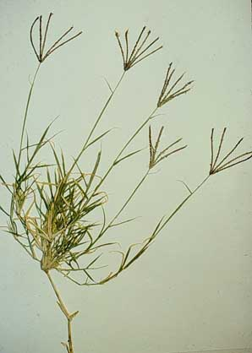
Cynodon dactylon
(Khabbal Grass)

Slide 47
Cyperus rotundus Deela

Slide 48
Echinochloa colona Swanki Grass

Slide 49
Weed Management Methods
Two Types
Pre-sowing
a) Crop rotation
b) Dab Method
c) Soil Solarization
Post Sowing
a) Hoeing.
b) Use of herbicides c) Use of Allelochemicals

Slide 50
Common Selective Herbicides
Primextra-Gold 720 SC @ 800ml/ac
Stomp 330 E @ 1000-1500 ml/ac
Acetachlor 50 EC @ 600-800 ml/ac
Atrazine 38 SC @ 400 ml/ac
Water = 100-120 l/ac

Slide 51
Methods of Application
Pre-plant in-corporation e.g. Stomp & Dual Gold
Pre-emergence e.g. Primextra Gold
Post-emergence e.g. Atrazine group
Broadcast with shaking bottle e.g. Sunstar

Slide 52
Precautions for use of herbicides
Use of proper Nozzles i.e. T-Jet or Flat Fan.
Proper volume should be maintained with 100-120 lit. of water/ac.
Uniform & equal distribution of spray
Do not spray during Wind storm & rain
No need of hoeing after spray.
Not recommended in Sandy soils.
Calibration of sprayer should be done.

Slide 53
Pre-emergence control
(Narrow and broad leaves)

Slide 54
Post Emergence control

Slide 55
Good weed control

Slide 56
Excellent weed control

Slide 57
INSECT PESTS AND DISEASES OF MAIZE & THIER CONTROL

Slide 58
IMPORTANT INSECT PEST OF MAIZE
Maize Stem Borer
Shoot Fly
Army Worm
American Worm
Aphid
Jassid
Mites
Termites

Slide 59
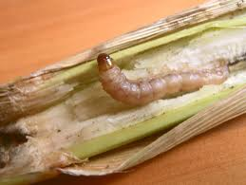
MAIZE STEM BORER
Major loss occurs due to maize borer in Kharif Maize i.e. about 1/4th of the crop
In sever attack, total crop destroys
Attack appears at 4” height of the crop
Larvae enter in the stem and cut off the shoot/whirl, resultantly the shoot dries
In many cases larvae attack on tassels as well as on cobs
In spring maize, it attacks at the end of March to start of April

Slide 60
MAIZE STEM BORER
CONTROL
Carbofuran (Furadon 3G, Sun Furan 3G etc.)@ 4-6 kg/acre at 4-6 leaves stage. 4-5 grains per whirl and irrigate the crop soon after granule application

Slide 61
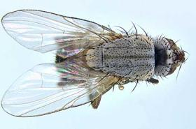
SHOOT FLY
Mostly attacks in Spring Maize
It attacks on the crop from germination to one month later
It appears in the last week of February and attacks upto April
Female lays eggs on leaves of tiny plants separately
Larvae come out from the eggs within 2-3 days
They pierce the leaves and reach in the central parts of leaves and suck the juice until the whirl comes dry, growth stunts and resultantly low yield.

Slide 62
SHOOT FLY
CONTROL
Confidor 70 WS (Imidacloprid) 7 gm/kg seed treatment save the crop from shoot fly’s attack in preliminary 40 days
Confidor 200 SL (Imidacloprid) @ 200ml/acre or Arrivo 10 EC @ 250ml/acre
Repeat the same after 8-10 days

Slide 63
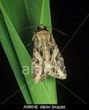
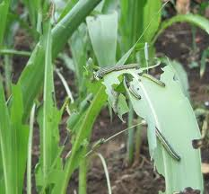
ARMY WORM
Actually this is the insect of Tobacco and Cotton, but it also attacks on maize
Its larva attacks on the crop in large quantity
They eat the leaves of plants just like sheep
In severe attack these larvae eat all the leaves and only the stem left behind
It also cuts the silks of the cobs and in this way the yield decreases ultimately

Slide 64
ARMY WORM
CONTROL
Spray of Bestox 5EC, Timer 1.9EC @ 200-250ml per acre in 120 liters of water

Slide 65
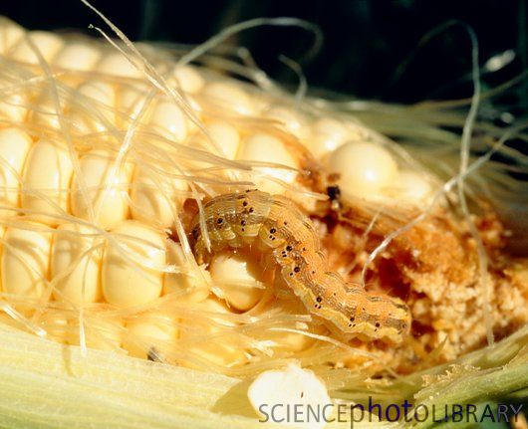
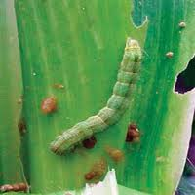
AMERICAN WORM
This worm at initial stage is of white color, and it turns into green color later on, this insect eats the tiny leaves of the plant
Later on it cuts the silks of the cobs and enters in the cobs
After entering, it eats the grains of the cobs which results in low yield

Slide 66
AMERICAN WORM
CONTROL
Spray of Bestox 5EC, Timer 1.9EC @ 200-250ml per acre in 120 liters of water

Slide 67
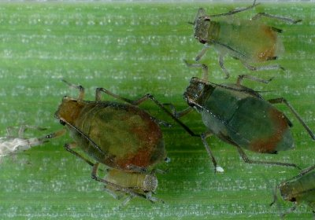
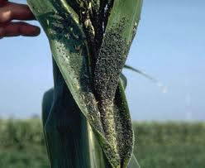
APHID
It attacks before the cob formation and sucks the juice of the plants
It oftenly attacks on upper leaves (Leaf Boot) and male flower (Tassel)
In severe attack the pollination is stunted and yield decreases

Slide 68
APHID
CONTROL
Spray of Advantage 20EC, Azodrin 40WSC etc. @ 500ml/acre

Slide 69
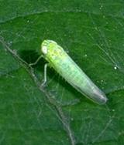
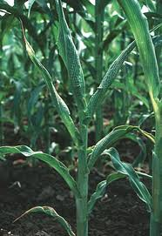
JASSID
It attacks on Spring Maize soon after the attack of shoot fly
It sucks the juice of the plants, resultantly white spots appears on the leaves, and leaves start to dry slowly
In severe attack all the leaves dry, except some upper leaves which reduce yield

Slide 70
JASSID
CONTROL
Spray of Advantage 20EC, Azodrin 40WSC etc. @ 500ml/acre

Slide 71
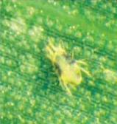
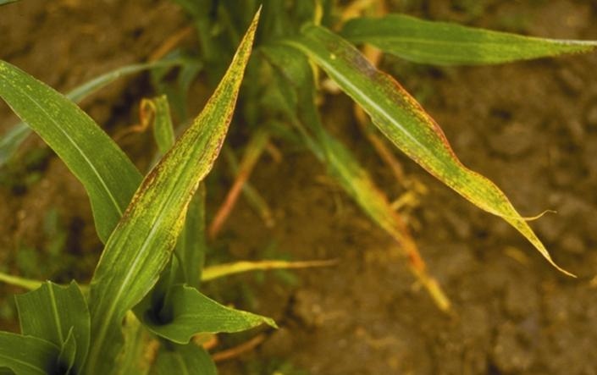
MITES
It attacks mostly on Spring Maize
It sucks the juice from the leaves & in severe attack plants dry
CONTROL
Pyrida or Current 15EC @ 400-500ml/acre spray

Slide 72
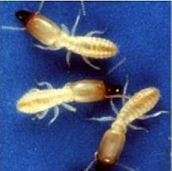
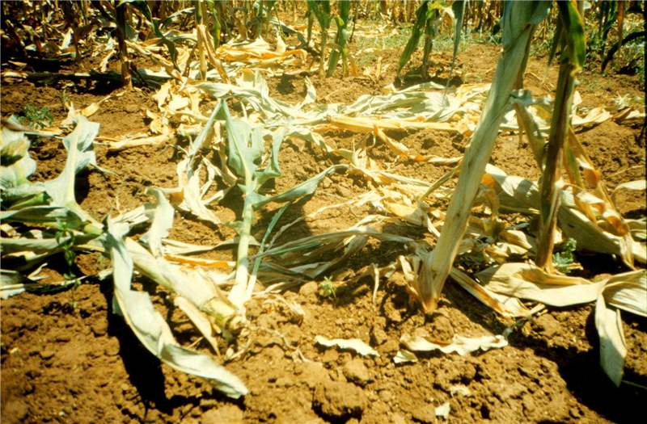
TERMITES
It attacks on the roots and plant becomes dry & lodging occur which adversely affect the yield
CONTROL
Chloropyriphos 40 EC @ 1.5-2.0 liter/acre or Imidacloprid 200 SL @ 250 ml/acre with irrigation at the time of sowing or attack

Slide 73
DISEASES OF MAIZE
Seed and Seedling diseases
Leaf blight
a. Northern leaf blight
b. Southern leaf blight
c. Yellow leaf blight
Rust of maize
Smut of maize
Stalk rot
a. Fusariun & Gibberella Ear Rot
b. Penicillium Ear Rot
c. Aspergillus Ear Rot

Slide 74
SEED AND SEEDLING DISEASES
Sick seed does not grow properly
If the some seeds grow, the plants wilt and necrosis of plant occur
Wilting of newly grown plants occur mostly in the early growing crops due to high temperature
Furarium, Pythium, Nigrospora, Diplodia etc. fungi cause seed and seedling disease

Slide 75
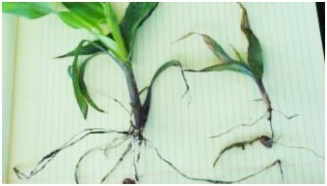
SEED AND SEEDLING DISEASES

Slide 76
SEED AND SEEDLING DISEASES
CONTROL
Use of healthy seed
Use of resistant varieties/hybrids
Seed treatment with Topsin-M @ 2 gm/Kg of seed

Slide 77
LEAF BLIGHT
Northern Leaf Blight
C:O Helminthosporium turcicum
It is mostly found in cold & hilly areas
The disease appears first on lower leaves & then spread on all the leaves of plant
Elongated & spindle-shaped necrotic lesions appear on leaves
In severe attack, leaves become dry due to which plants can’t synthesize food & production is reduced.

Slide 78
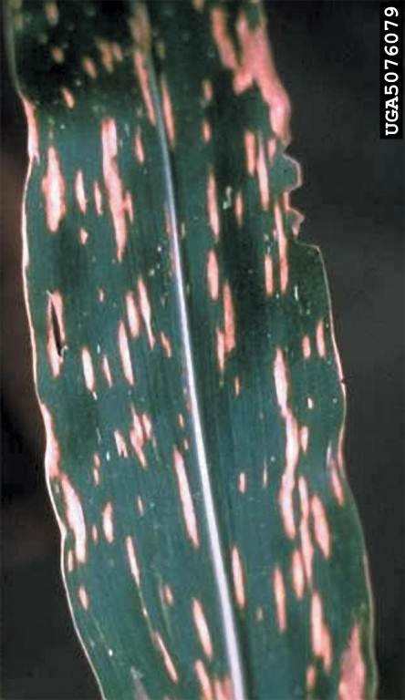
LEAF BLIGHT
Southern Leaf Blight
C:O Helminthosporium maydis
It is mostly found in plain areas
The disease appears first on lower leaves & then spread on all the leaves of plant
Brown oval shaped spots are produced on leaves which spread rapidly at 25-30C°
In Punjab, this disease attacks on the crop near maturity

Slide 79
LEAF BLIGHT
Yellow Leaf Blight
C:O Phyllosticta maydis
Humid warm weather favours the disease development
Young diseased plants show the symptoms similar to those observed in nitrogen deficient plants
In mature plants, lesions are narrow, necrotic and parallel to the veins
In older leaves, lesions develop further and produce blightening near the tip

Slide 80
LEAF BLIGHT
CONTROL
Destroy the plant disease debris of previous crop
Spray the fungicide Dithane M-45 @ 500 gm/acre or Benlate @ 500 gm/acre or Antracol @ 2 gm/liter of water at the appearance of disease
Repeat the spry after 10 days

Slide 81
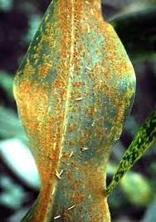
RUST OF MAIZE
C:O Puccinia sorghi
This disease attacks on maize crop in spring season
High temperature and high humidity favour the disease
Leaves loose their green color, dry up and drop on the ground
In severe cases, plants do not bear the cobs

Slide 82
RUST OF MAIZE
Yellow spots appear on leaves which turn into reddish brown in colour and then become postules.
The postules burst soon, dislodging the reddish brown powdery mass
CONTROL
Use resistant varieties

Slide 83
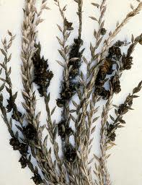
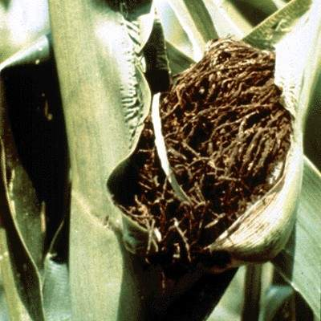
SMUT OF MAIZE
C:O Ustilago maydos
This disease is mostly found in hilly areas & appears in the form of small tumors/galls on any part of the plant above the ground
First gall is seen on leaves when plant is more than a foot high
On the appearance of tassels, small galls appear on it

Slide 84
SMUT OF MAIZE
Cob is frequently attacked. Grains are not produced near galls development
The galls remain covered by a thin whitish membrane when the membrane ruptures, the powdery mass of spores are disseminated in the air and fall on the other plants in the field

Slide 85
SMUT OF MAIZE
CONTROL
Crop rotation
Field Sanitation
Use of resistant varieties
Seed Treatment
Destroy the plant disease debris of affected crop
Do not grow the crop in the affected fields for some years

Slide 86
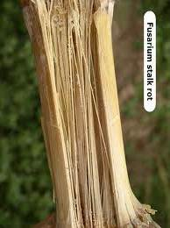
STALK ROT
C:O Fusarium moniliforme ,
F, verticillioides
This disease is spreading very rapidly since last some years
In stalk rot, plants start rottening from the 2nd internode, leaves turn pale, dry up & plants fall on the ground

Slide 87
STALK ROT
When infected stalks are split, the phloem appears dark brown and there is browning of tissues and pith is shredded off
Cobs droop down, grains of the cobs remain small which reduce production

Slide 88
STALK ROT
CONTROL
Use of resistant varieties
Seed treatment with Topsin-M @ 2 gm/Kg of seed
Ridge sowing also reduces the disease
Maize crop should not grow in the affected field for 4-5 years and crop rotation should be adopted
Fungus is present in previous plants debris, it should be destroyed
Use of nitrogenous fertilizer should be minimized
Potash should not be deficit in the field
Irrigation of chlorinated water also reduces the disease

Slide 89
HARVESTING
AT PHYSIOLOGICAL MATURITY
Dry internal husks
Dry grain
A black layer on the tip of the grain
Grain moisture content preferably less than 30%
PROCEDURE
Remove cobs from plants
Spread cobs on raised floors
Shuffle cobs occasionally

Slide 90
HARVESTING
SHELLING
Grain moisture around 15%
STORAGE
Grain moisture less than 10%
Airy, clean stores
Use fumigation in stores before storage

