Slide 1
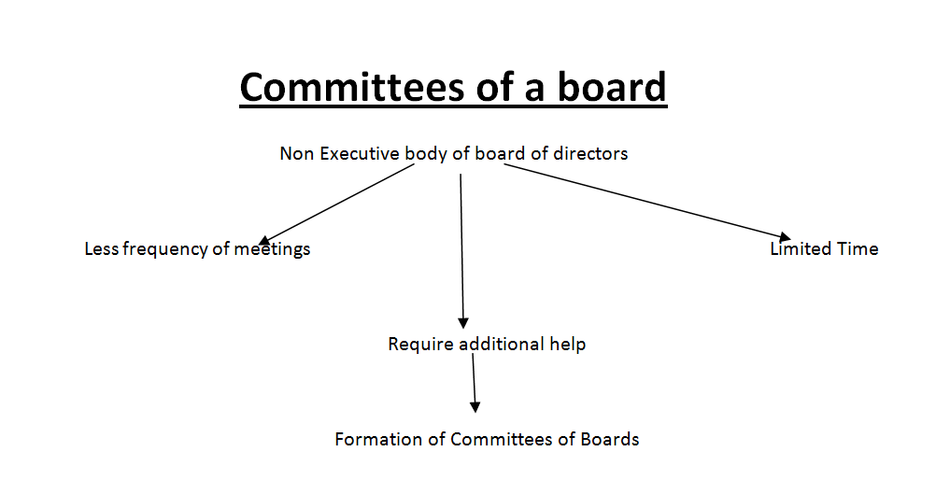
Chapter 5

Slide 2
.

Slide 5
Nature of Audit Committee
It cannot approve or implement policies.
It cannot perform internal or external audit.
It cannot issue directives on any issue to management.
Audit committee can directly communicate with shareholders, bypassing chairman of the board.

Slide 6
Relationship between audit committee and external auditor
Checking of qualification of auditor nominated in the AGM
Find out linkages between auditor and company to check the independence.
Rotation of external auditors after suitable time.
Check the performance of external auditor and reporting to the board of directors.
Bridge of communication between mangers and external auditors

Slide 7
.
Remuneration Committee
It should comprise of non-executive directors
Recruitment, motivation , promotion retention, of executive and non-executive directors.

Slide 8
Responsibilities of remuneration committee
Finding suitable directors:
Identification
Interviews
Terms of engagement
Formulation of policy regarding remuneration
Periodic performance evaluation of executive and non executive directors.
Succession planning
Recommendations on board size
Check the independency of INEDs
Setting standards for bonuses
Check the proper disclosure of remuneration of directors

Slide 9
Basis of Remuneration
Fixed salary approach
Performance based pay:
Cash Bonuses
Bonuses in the form of free shares
Bonus in the form of share options.
How companies can make balance of Remuneration

Slide 10
Some other Committees in the corporate sector of Pakistan
Executive Committee
Investigation committee
Negotiation committee
Projects committee
Communications committee

