Slide 1
Dysautonomia
By
Dr. Amir Nazir

Slide 5
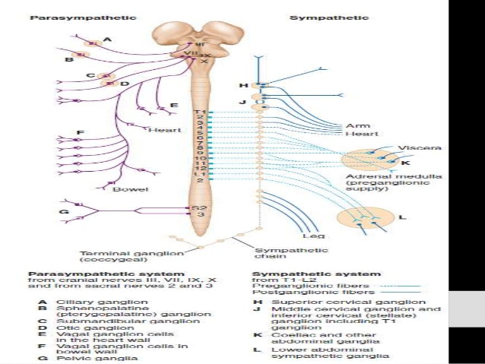

Slide 8
