Slide 1
Population strcture

Slide 2
Population ecology
A branch of ecology that studies the structure and dynamics of population

Slide 3
Population structure
Population structure is the make up of total population in a country or area where people are grouped by age and sex.
The graphical technique used to summarize age structure is population pyramid

Slide 4
Population pyramid
this is made up by putting two bar graphs one for male and one for female side by side
Population is divided into 5 year age groups
Horizontal lines represent the percentage of male and female group

Slide 6
What does shapes of population pyramid tell us
Information of birth and death rate
Information of life expectancy
People living in a particular country or place

Slide 7
Population dynamics
Size
Density
dispersion

Slide 8
Size
Population of organism able to change over time
Increase in population size usually due to the natality rate(birth rate)
Decrease in population size as a result of mortality(death rate)

Slide 9
Natality
It is expressed as the number of births per 1000 people per year
Mortality
It can be defined as the rate at which individuals die
It is expressed as the number of deaths per 1000 people per year

Slide 10
Density
density of a population is measured as the number of individuals per unit area
example; the number of paddy plants per square meter of a paddy field
Measuring density of population is a difficult task
We can count individuals and can estimate population number

Slide 11
Dispersion
Dispersion of population is the pattern of spacing among individuals with in a geographic boundaries

Slide 13
Uniform dispersion
Pattern of equally spaced individuals
Caused by the ability to survive any where in the habitat
Used the resources found immediately around them

Slide 14
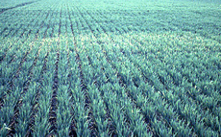
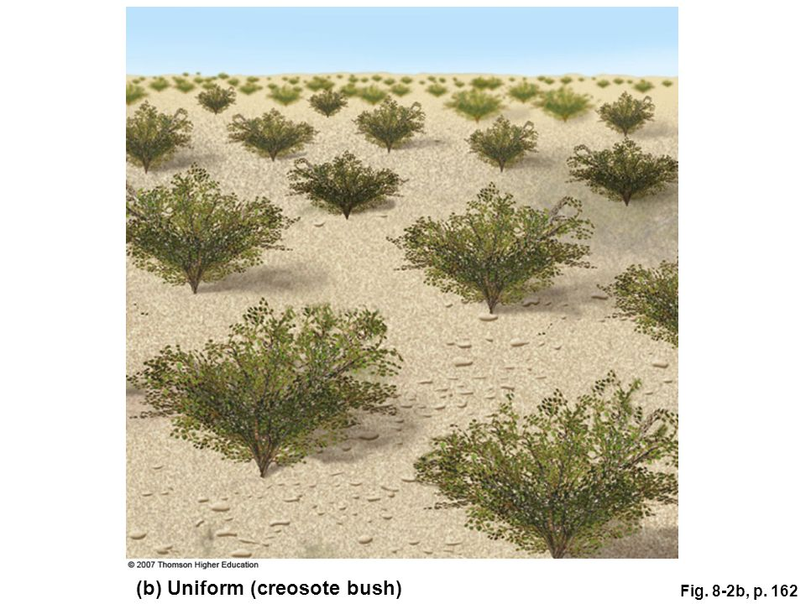

Slide 15
Random dispersion
Spacing pattern based on total unpredictability
Individual in a population are spaced all over an area in a way that in unrelated to the presence of others

Slide 16
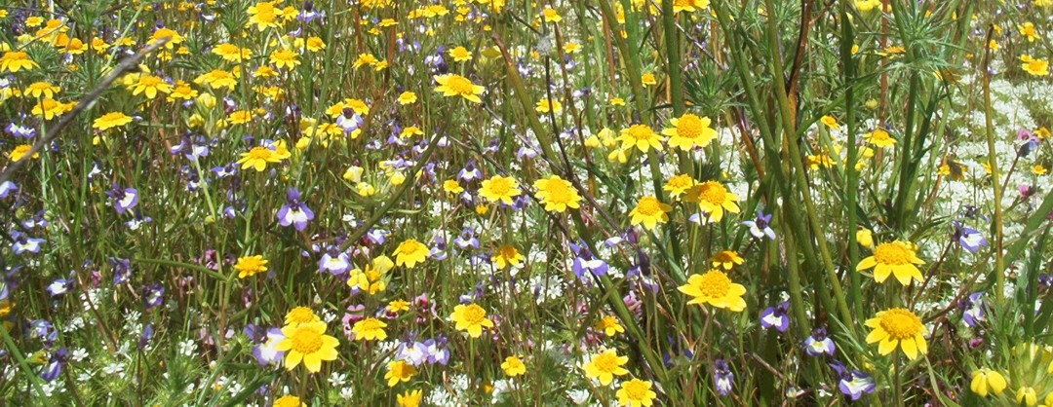

Slide 18
Clumped dispersion
Also known as aggregated distribution
Individuals aggregate in patches
Caused by environment where the resources concentrated in patches

