Slide 1
HORT 308
MEDICINAL AND AROMATIC PLANTS

Slide 2
Cinchona

Slide 3
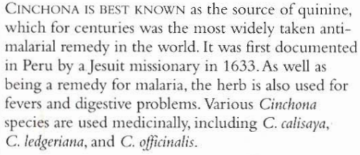
B.N Cinchona spp. Family: Rubiaceae

Slide 4
Habitat & Cultivation
Native to mountains, tropical regions of South America specially Peru
Now Cultivated in India
Java
Parts of Africa
Bark Produced 8000 tons/Year

Slide 5
Key Constituents
Alkaloids
Bitter triterpenic glycosides
Tannins
Quinic Acid

Slide 6
Key Actions
Bitters
Reduce fever
Antimalarial
Tonic
Stimulates appetite
Antispasmodic
Astringent
Antibacterial

Slide 7
Research
Proved all pharmacological actions

Slide 8
Traditional and Current uses
Fevers
Digestive problems
Infections(Peru)
Antimalarial
Digestive stimulant
Gargle
Muscle spasms

Slide 9
Parts Used
Bark

Slide 10
Key Preparation
Powder
Decoction
Tincture

Slide 11
Caution
Avoid in Pregnancy
Excessive use can cause “cinchonism” which leads to coma and death

Slide 12
Cinnamon

Slide 13
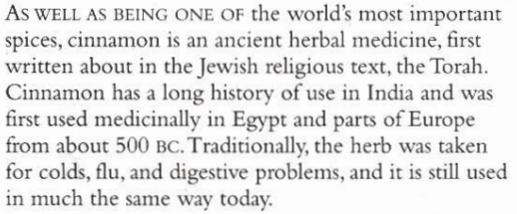
B.N Cinnamomum verum Family: Lauraceae

Slide 14
Habitat & Cultivation
Native to India & Sri Lanka
Growing in tropical forests about 500m tall

Slide 15
Key Constituents
Volatile oil 4%
Tannins
Coumarins
Mucilage

Slide 16
Key Actions
Warming stimulant
Carminative
Antispasmodic
Antiseptic
Antiviral

Slide 17
Research
In Japan 1980, proved sedative and analgesic
Bark extract: Antibacterial and Antifungal

Slide 18
Traditional and Current uses
Volatile Oil: Antiviral and Antifungal
Warming for cold often in combination with ginger
Stimulate circulation (Fingers and toes)
Digestive problems (Nausea, vomitting)
Strengthening herb for digestion
Gynecological remedy stimulate uterus and encouraging menstrual bleeding
In India used as contraceptive after child birth

Slide 19
Parts Used
Inner bark

Slide 20
Key Preparation
Tincture
Essential oil
Infusion
Powder

Slide 21
Precaution
Don’t use in excess
Don’t use essential oil internally
Avoid in pregnancy

