Slide 1
Median

Slide 2
Introduction:
Median is the middle most value of the observations arranged in ascending and descending order of magnitude.
Half of the observation are above the median and half are below the median.

Slide 3

For ungroup data Median = $\left(\frac{n+1}{2}\right)$^{th}

Slide 4

(For Grouped data) Median = l + $\frac{h}{f}\left(\frac{n}{2} −c\right)$ l = lower class boundaries of the median class h = width of class interval. f = frequency of median class. n = sum of frequencies. Where c = cumulative frequency before the median class. .

Slide 5

Example: (Ungrouped data) Find the median.45,32,21,65,36,53,48,76,27 Solution: Arrange the data 21,27,32,36,45,48,53,65,76 Median =$\left(\frac{n+1}{2}\right)$^{th} n = 9 Median = $\left(\frac{9+1}{2}\right)$^{th} = $\left(\frac{10}{2}\right)$^{th} = 5th value = 45

Slide 6
Example: (Grouped data) Calculate the median from the following data. Groups Frequency 10-14 5 15-19 12 20-24 30 25-29 25 30-34 6

Slide 7
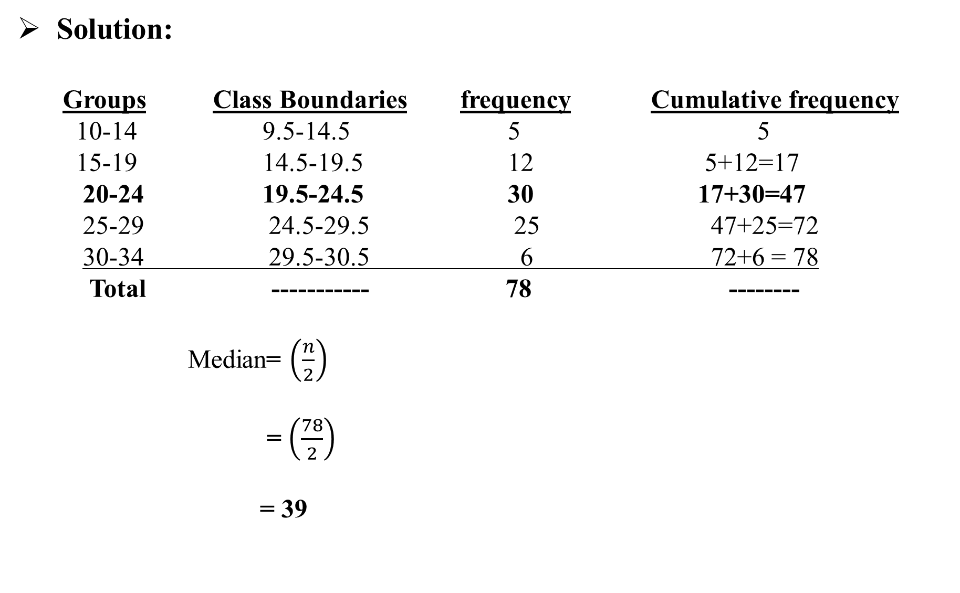
Solution: Groups Class Boundaries frequency Cumulative frequency 10-14 9.5-14.5 5 5 15-19 14.5-19.5 12 5+12=17 20-24 19.5-24.5 30 17+30=47 25-29 24.5-29.5 25 47+25=72 30-34 29.5-30.5 6 72+6 = 78 Total ----------- 78 -------- Median= $\left(\frac{n}{2}\right)$ = $\left(\frac{78}{2}\right)$ = 39

Slide 8

Median = l + $\frac{h}{f}\left(\frac{n}{2} −c\right)$
l= 19.5 , h = 5 , f = 30 , $\frac{n}{2}$ = 39 , c = 17
Median = 19.5 + $\frac{5}{30}\left(39 −17\right)$
Median = 19.5 + $\frac{5}{30}\left(22\right)$
Median = 19.5 + 3.67
Median = 23.17

Slide 9
Merits of Median:
It is easily calculated and understood.
It is not affected by extreme observations.
It is a useful average, when the data are qualitative nature.

Slide 10
Demerits of Median:
It is not rigorously defined.
It is not capable of lending itself to further statistical treatment.
It necessitates the arrangement of data into an array which can be
time consuming for a large body of data.

Slide 11
Assignment: Question no 01: Find the median. (a) 34,29,90,21,47,83,10,63,120 (b) 14,42,53,27,53,78,38,52,92,29 Question no 02: Find the median, for the distribution of examination marks given below: Marks No. of students 30-39 8 40-49 87 50-59 190 60-69 304 70-79 211 80-89 85 90-99 20

Slide 12
(b)Find the median from the following grouped data. Class Interval Frequency 118-126 3 127-135 5 136-144 9 145-153 12 154-162 5 163-171 4 172-180 2

