Slide 1
ANTI VIRAL DRUG
Submitted by:
Wajeeha khan (M.phil Pharmacology)
Submitted to:
DR.Abdul maalik

Slide 3
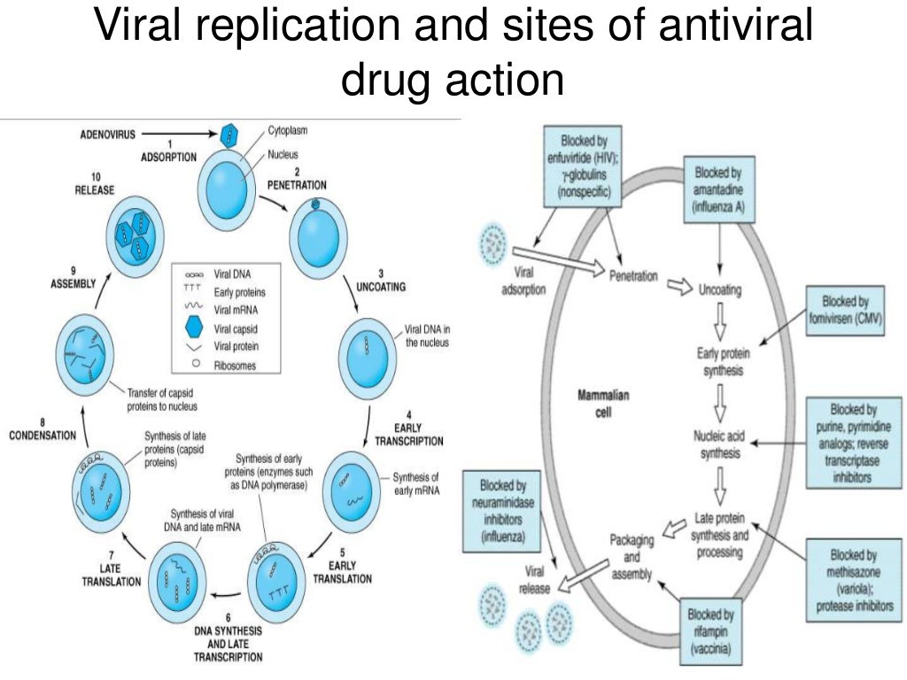

Slide 4
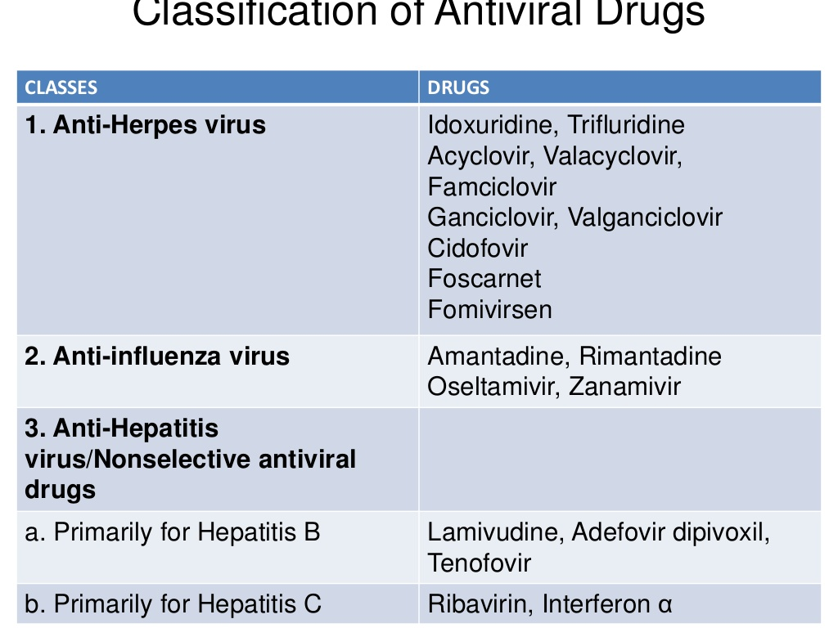

Slide 5
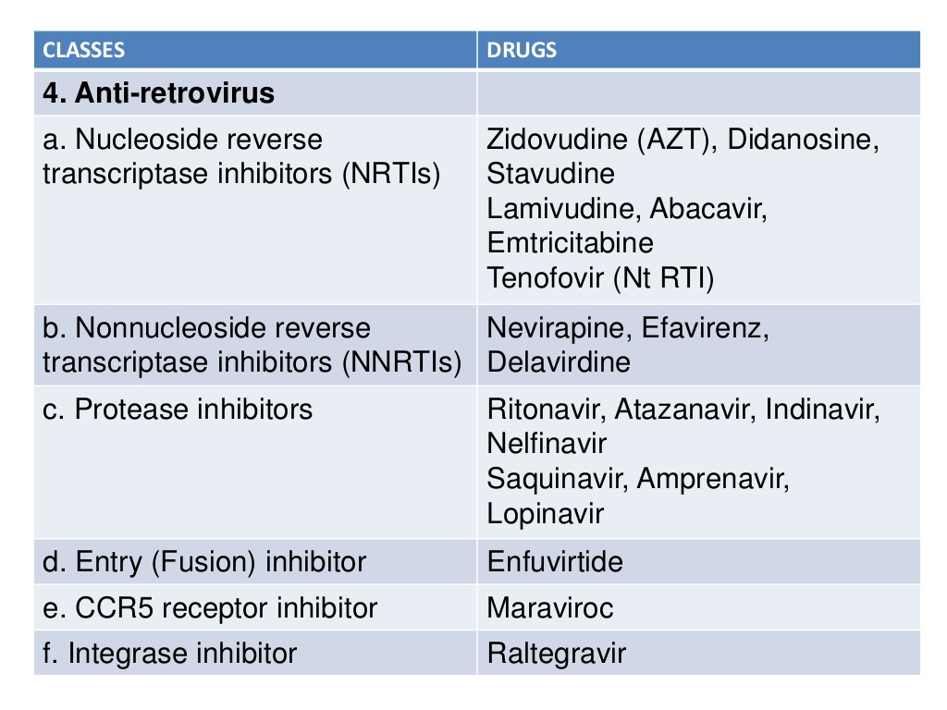

Slide 35
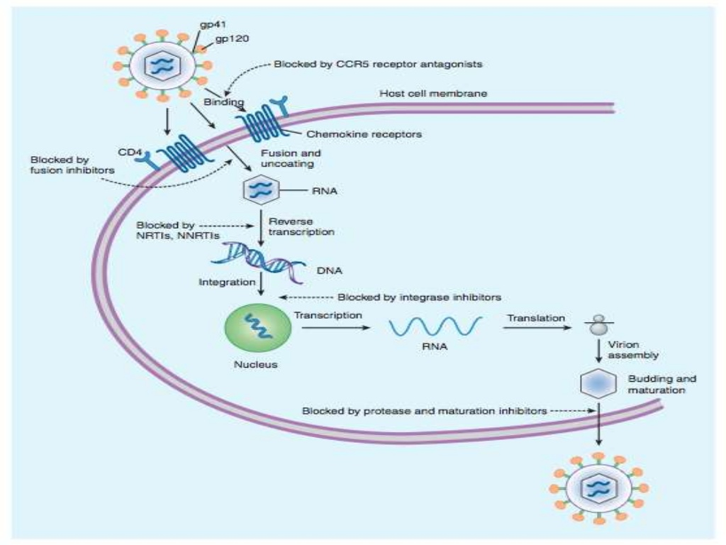

Slide 69
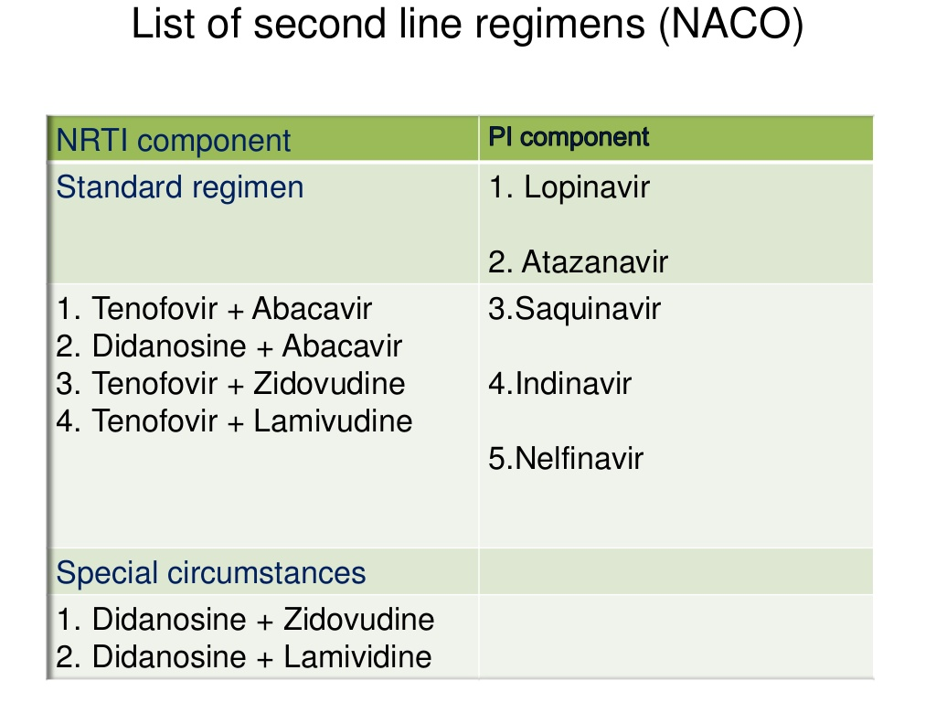

Slide 75
Protocols of COVID19:
Several early investigation master protocols or master forms for COVID-19 are given below:
1 - The First Few X (FFX) Cases and contact investigation protocol for COVID-19 infection
The following protocol has been designed to investigate the number of cases and their close contact
epidemiological exposure data and biological samples can be systematically collected and shared rapidly in a format that can be easily aggregated, tabulated and analyzed across many different settings globally for timely estimates of COVID-19 infection
FFX is the primary investigation protocol to be initiated upon identification of the initial laboratory-confirmed cases of COVID-19 in a country.

Slide 76
2 - Household transmission investigation protocol for COVID-19 infection:
The household transmission investigation is a case-ascertained prospective study of all identified household contacts of a laboratory confirmed COVID-19 infection
It is intended to provide rapid and early information on the clinical, epidemiological and virological characteristics of COVID-19
3 - Protocol for assessment of potential risk factors for COVID-19 infection among health care workers in a health care setting:
The following protocol has been designed to investigate the extent of infection and risk factors for infection among health care workers
Follow-up and testing of respiratory specimens and serum of health care workers within a facility in which a confirmed case of COVID-19 infection
these are important for limiting amplification events in health care facilities

Slide 77
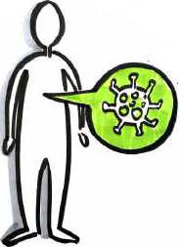
4 - Population-based age-stratified seroepidemiological investigation protocol for COVID-19 virus infection:
This protocol is a population-based, age-stratified prospective study for assessing COVID-19 virus infection
It is intended to provide key epidemiological and serologic characteristics of COVID-19 virus in the general population
This includes the extent of infection in:
the general population
age-specific infection cumulative incidence, as determined by seropositivity
the fraction of asymptomatic or subclinical infection

Slide 78
5- Surface sampling of coronavirus disease COVID-19 virus: A practical “how to” protocol for health care and public health professionals:
The role of environmental contamination in transmission of COVID-19 virus is currently not clear
This protocol has been designed to determine (viable) virus presence and persistence on fomites in various locations where a patient infected with COVID-19 is currently receiving care or being isolated
To understand how this may relate to COVID-19 transmission events in these settings
It is therefore important that it is done as part of a comprehensive outbreak investigation and that information obtained by environmental studies is combined with the results of epidemiological, laboratory and sequence data from COVID-19 patient investigations

