Slide 1
Chapter 2: The Project Management and Information Technology Context

Slide 2
Projects Cannot Be Run In Isolation
Projects must operate in a broad organizational environment
Project managers need to use systems thinking:
taking a holistic view of carrying out projects within the context of the organization
Senior managers must make sure projects continue to support current business needs

Slide 3
A Systems View of Project Management
A systems approach emerged in the 1950s to describe a more analytical approach to management and problem solving
Three parts include:
Systems philosophy: an overall model for thinking about things as systems
Systems analysis: problem-solving approach
Systems management: address business, technological, and organizational issues before making changes to systems

Slide 4
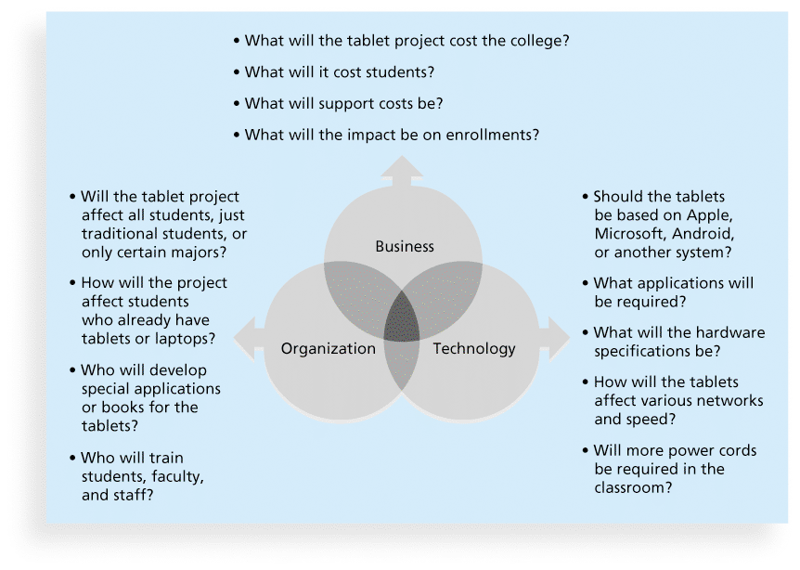
Figure 2-1. Three Sphere Model for Systems Management

Slide 5
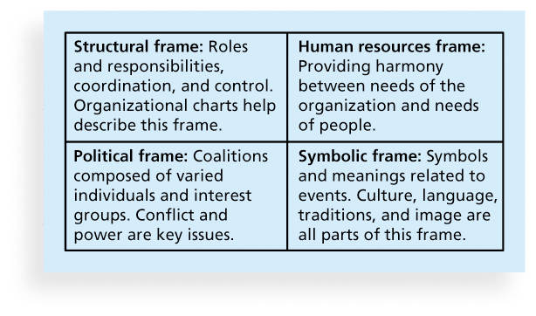
Figure 2-2. The Four Frames of Organizations

Slide 6
What Went Wrong?
In a paper titled “A Study in Project Failure,” two researchers examined the success and failure of 214 IT projects over an eight-year period in several European countries.
The researchers found that only one in eight (12.5 percent) were considered successful in terms of meeting scope, time, and cost goals.
The authors said that the culture within many organizations is often to blame
Among other things, people often do not discuss important leadership, stakeholder, and risk management issues

Slide 7
Organizational Structures
3 basic organization structures
Functional: functional managers report to the CEO
Project: program managers report to the CEO
Matrix: middle ground between functional and project structures; personnel often report to two or more bosses; structure can be weak, balanced, or strong matrix

Slide 8
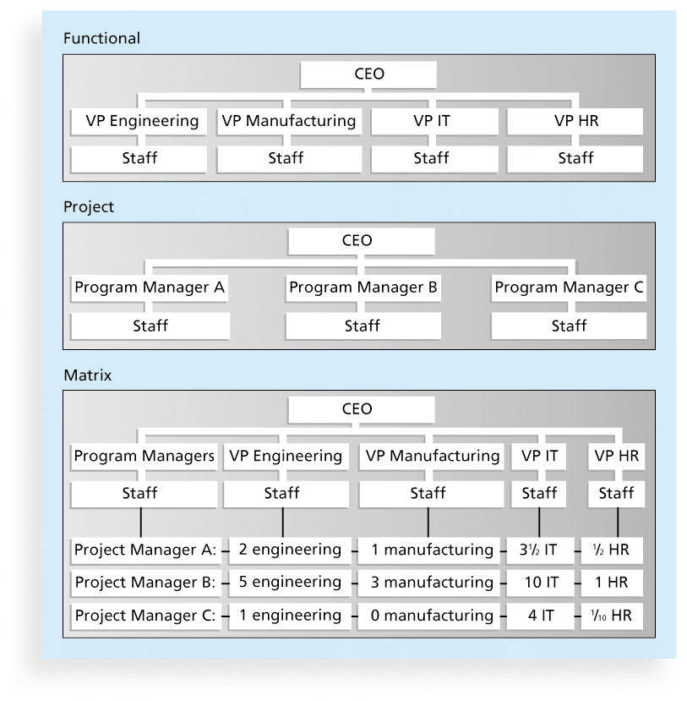
Figure 2-3. Functional, Project, and Matrix Organizational Structures

Slide 9
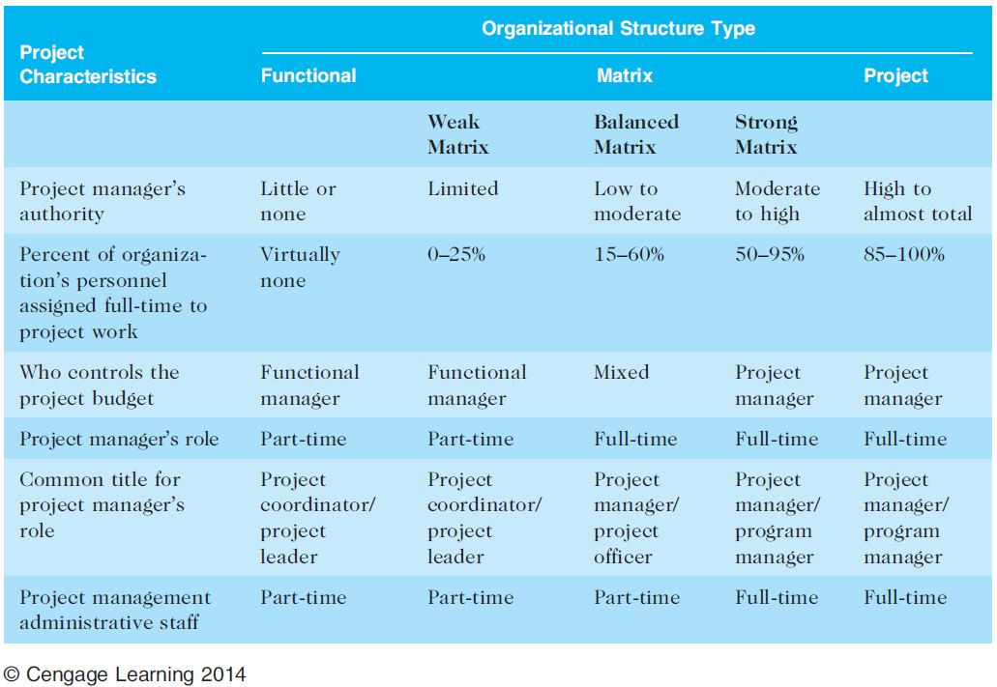
Table 2-1. Organizational Structure Influences on Projects

Slide 10
Organizational Culture
Organizational culture is a set of shared assumptions, values, and behaviors that characterize the functioning of an organization
Many experts believe the underlying causes of many companies’ problems are not the structure or staff, but the culture

Slide 11
Ten Characteristics of Organizational Culture
Member identity*
Group emphasis*
People focus
Unit integration*
Control
Risk tolerance*
Reward criteria*
Conflict tolerance*
Means-ends orientation
Open-systems focus*
*Project work is most successful in an organizational culture where these items are strong/high and other items are balanced.

Slide 12
The Importance of Top Management Commitment
People in top management positions are key stakeholders in projects
A very important factor in helping project managers successfully lead projects is the level of commitment and support they receive from top management
Without top management commitment, many projects will fail.
Some projects have a senior manager called a champion who acts as a key proponent for a project.

Slide 13
How Top Management Can Help Project Managers
Providing adequate resources
Approving unique project needs in a timely manner
Getting cooperation from other parts of the organization
Mentoring and coaching on leadership issues

Slide 14
Project Phases and the Project Life Cycle
A project life cycle is a collection of project phases that defines
what work will be performed in each phase
what deliverables will be produced and when
who is involved in each phase, and
how management will control and approve work produced in each phase
A deliverable is a product or service produced or provided as part of a project

Slide 15
More on Project Phases
In early phases of a project life cycle
resource needs are usually lowest
the level of uncertainty (risk) is highest
project stakeholders have the greatest opportunity to influence the project
In middle phases of a project life cycle
the certainty of completing a project improves
more resources are needed
The final phase of a project life cycle focuses on
ensuring that project requirements were met
the sponsor approves completion of the project

Slide 16
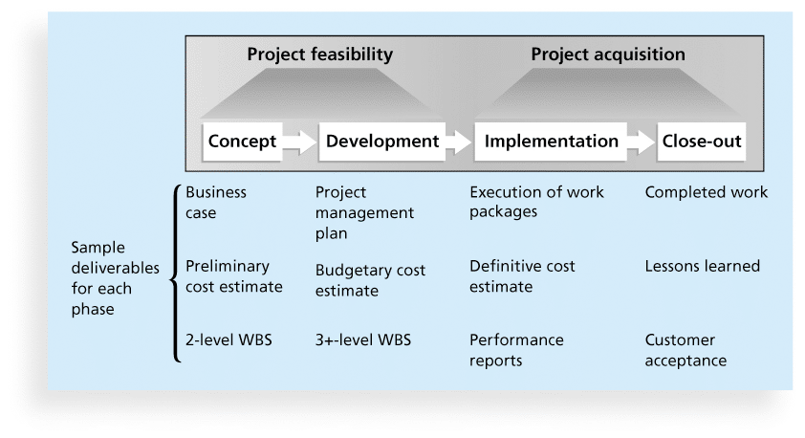
Figure 2-4. Phases of the Traditional Project Life Cycle

Slide 17
Product Life Cycles
Products also have life cycles
The Systems Development Life Cycle (SDLC) is a framework for describing the phases involved in developing and maintaining information systems
Systems development projects can follow
Predictive life cycle: the scope of the project can be clearly articulated and the schedule and cost can be predicted
Adaptive Software Development (ASD) life cycle: requirements cannot be clearly expressed, projects are mission driven and component based, using time-based cycles to meet target dates

Slide 18
Predictive Life Cycle Models
Waterfall model: has well-defined, linear stages of systems development and support
Spiral model: shows that software is developed using an iterative or spiral approach rather than a linear approach
Incremental build model: provides for progressive development of operational software
Prototyping model: used for developing prototypes to clarify user requirements
Rapid Application Development (RAD) model: used to produce systems quickly without sacrificing quality

Slide 19
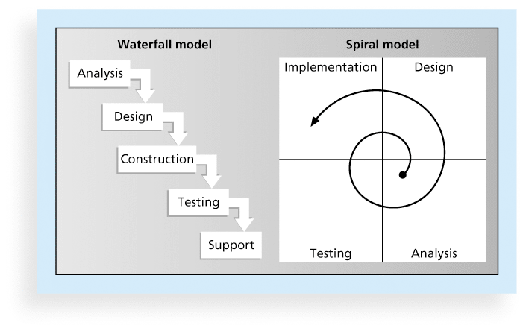
Figure 2-5. Waterfall and Spiral Life Cycle Models

Slide 20
Agile Software Development
Agile software development has become popular to describe new approaches that focus on close collaboration between programming teams and business experts

Slide 21
The Importance of Project Phases and Management Reviews
A project should successfully pass through each of the project phases in order to continue on to the next
Management reviews, also called phase exits or kill points, should occur after each phase to evaluate the project’s progress, likely success, and continued compatibility with organizational goals

Slide 22
The Context of IT Projects
IT projects can be very diverse in terms of size, complexity, products produced, application area, and resource requirements
IT project team members often have diverse backgrounds and skill sets
IT projects use diverse technologies that change rapidly. Even within one technology area, people must be highly specialized

Slide 23
Recent Trends Affecting IT Project Management
Globalization
Outsourcing: Outsourcing is when an organization acquires goods and/or sources from an outside source. Offshoring is sometimes used to describe outsourcing from another country
Virtual teams: A virtual team is a group of individuals who work across time and space using communication technologies
Agile project management

Slide 24
Important Issues and Suggestions Related to Globalization
Issues
Communications
Trust
Common work practices
Tools
Suggestions
Employ greater project discipline
Think global but act local
Keep project momentum going
Use newer tools and technology

Slide 25
Outsourcing
Organizations remain competitive by using outsourcing to their advantage, such as finding ways to reduce costs
Their next challenge is to make strategic IT investments with outsourcing by improving their enterprise architecture to ensure that IT infrastructure and business processes are integrated and standardized (See Suggested Readings)
Project managers should become more familiar with negotiating contracts and other outsourcing issues

Slide 26
Global Issues
Outsourcing also has disadvantages. For example, Apple benefits from manufacturing products in China, but it had big problems there after its iPhone 4S launch in January 2012 caused fighting between migrant workers who were hired by scalpers to stand in line to buy the phones.
When Apple said it would not open its store in Beijing, riots resulted and people attacked security guards. The Beijing Apple Store has had problems before. In May 2011, four people were injured when a crowd waiting to buy the iPad 2 turned ugly.

Slide 27
Virtual Teams Advantages
Increasing competiveness and responsiveness by having a team of workers available 24/7
Lowering costs because many virtual workers do not require office space or support beyond their home offices.
Providing more expertise and flexibility by having team members from across the globe working any time of day or night
Increasing the work/life balance for team members by eliminating fixed office hours and the need to travel to work.

Slide 28
Virtual Team Disadvantages
Isolating team members
Increasing the potential for communications problems
Reducing the ability for team members to network and transfer information informally
Increasing the dependence on technology to accomplish work
See text for a list of factors that help virtual teams succeed, including team processes, trust/relationships, leadership style, and team member selection

