Slide 1
Inorganic Chemistry
Organic Reagents use in Inorganic Analysis

Slide 2
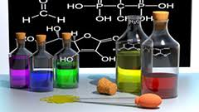
Organic Reagents
Reagent is generally known as the substance used in a chemical reaction to detect, measure, examine or produce other substances. Because of the reactions it causes.
They are mainly used in analysis and synthesis
Organic reagents are used for detection or estimation of inorganic or organic substances by micro or macro analysis are called organic reagents

Slide 3
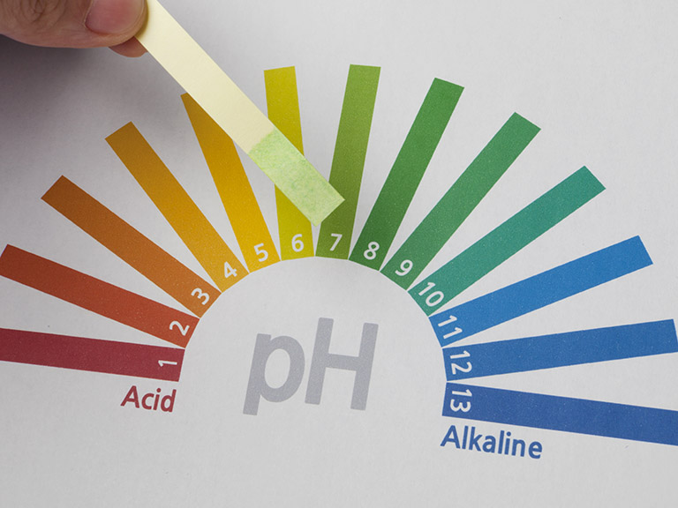
History
In the 17th century Boyle, who has been considered to the father of scientific method in analytical chemistry, used various organic reagents in inorganic analysis. They were mostly vegetable extracts; e.g. litmus was used as an acid-base indicator.
The first ever reported organic reagent was α-nitroso-β-naphthol which was used as a reagent for the identification of cobalt

Slide 4
Characteristics of Organic Reagents
The requirements for the organic reagent are dictated by the analytical method used
Should complex Forming agents (Form complexes with metals ion to be determined/identified.
Should form colored solutions or precipitates with metal ions
Should have Large Surface area
Should stable complexes with metal ions
Should have high molecular weight to give large amount of precipitates

Slide 5
Cont….
Must be highly specific for desired metal analysis
Should be highly selective
Should be Sensitive
specificity : Method's ability responding to one single analyte only,
selectivity is used when the method is able to respond to several different analytes in the sample.

Slide 6
Classification of Organic Reagents
Organic Reagents
Adsorption
Acidic
Basic
Salt Forming
Normal
Complex
Acidic
Basic
Aliphatic
Aromatic
Aromatic
Aliphatic

Slide 7
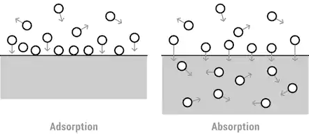
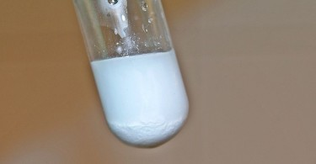
1 Adsorption Organic Reagent
They have high tendency to adsorb on soluble complex
or precipitates
React with metal ions Non Stoichiometrically
Conditions
Should give sufficient amount of precipitates
Precipitates should be in colloidal form
Should have opposite charge as of metal ion or anions
Should give Sharp change in color
They have Acidic Functional groups as binding sites like –OH ,-COOH etc
Colloidal precipitates consist of particles that have a diameter less than which cannot be seen by naked eyes

Slide 8
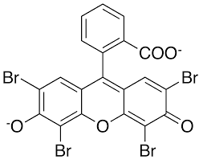
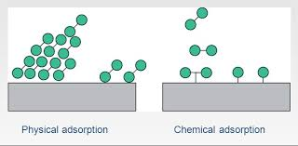
Acidic Organic Reagent
Have acidic functional groups as binding sites like –OH, -COOH etc
Eosin
Fluorescein (Physical Adsorption)
Fluorescein & Eosin Use in Silver Nitrate Titration
Determine : Chloride & Bromide ion

Slide 9
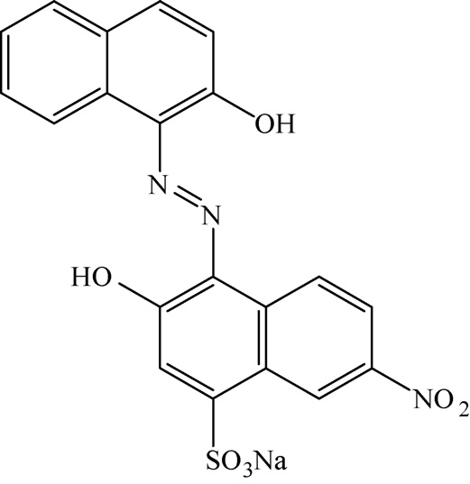
EBT (Eriochrom black-T or Solochrome Black-T)
Determine : Different Metal ions like Calcium, Magnesium Ions
Used in EDTA Titration
Chemical Adsorption

Slide 10
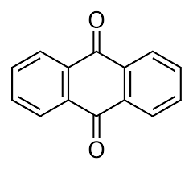
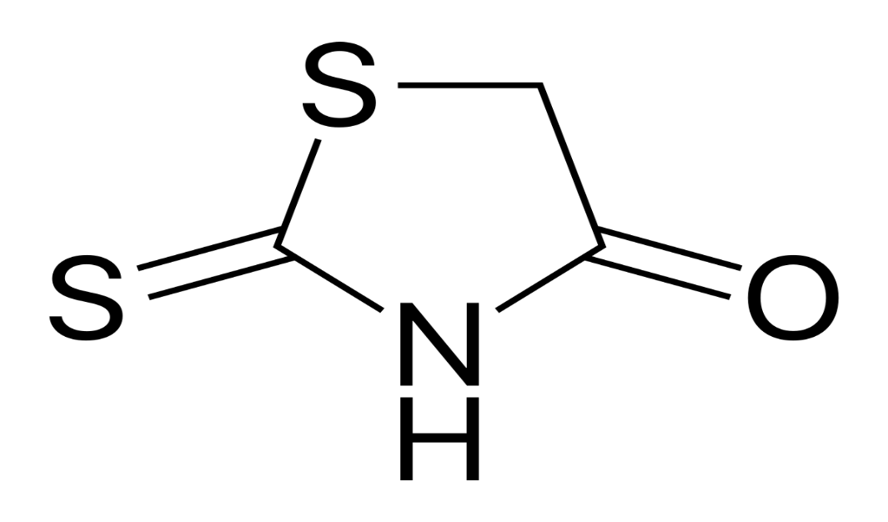
Basic Organic Reagents
They contain basic functional groups as binding sites like -NH
Rhodanine
Used in Iodide Analysis
Anthraquinone
Used in Cr³⁺ & Al³⁺ Analysis

Slide 11
Salt Forming Complex Salt forming Organic Reagent
They have acidic or basic functional groups like –COOH, -NO₂ ,-OH
having coordination sites for making complex ring structures with metal ions.
Gravimetric Analysis | Volumetric Analysis | Spectrophotometric Analysis
Gravimetric analysis is a technique through which the amount of an analyte (the ion being analyzed) can be determined through the measurement of mass. | Volumetric analysis, any method of quantitative chemical analysis in which the amount of a substance is determined by measuring the volume that it occupies. | Spectrophotometry is a tool for quantitative analysis of molecules depending on how much light is absorbed by colored compounds.

Slide 12
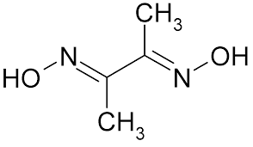
DMG (Dimethyl Glyoxime)
Bidentate Ligand
Used for
Gravimetric Analysis of Pb²⁺& Ni²⁺
Spectrophotometric determination of Fe²⁺ Co ²⁺and Ni⁴⁺
Volumetric determination of Ni⁴⁺
EDTA (Ethylene Diamine Tetra Acetic Acid )
Hexadentate Ligand
Highly Selective Organic reagent
Useful in spectrophotometric & volumetric analysis
Partial soluble in water and completely soluble in ethanol

