Slide 1
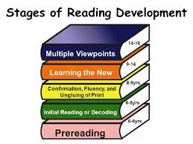
Stages of Reading Development
Language Comprehension and presentation skills

Slide 3
Introduction
Reading is the most important activity in any language class. A person may read in order to gain information or verify existing knowledge, or in order to critique a writer’s ideas or writing style. A person may also read for enjoyment, or to enhance knowledge of the language being read.

Slide 4
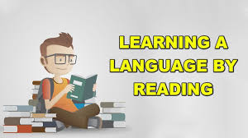
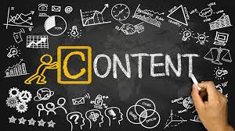
Importance and Ways of Learning Reading
Reading is not only a source of information and pleasurable activity, but also an essential part of language instruction at every level because it supports learning in multiple ways:
• Reading to learn the language: Reading material is language input. By giving students a variety of materials to read, teachers provide multiple opportunities for students to absorb vocabulary, grammar, sentence structure, and discourse structure as they occur in authentic contexts.
• Reading for content information: Students’ purpose for reading in their native language is often to obtain information about a subject they are studying and it gives students both authentic reading material and an authentic purpose for reading.

Slide 5
Reading for cultural knowledge and awareness: Reading everyday materials that are designed for native speakers can give students insight into the lifestyles and world‑ views of the people whose language they are studying.

Slide 6
Strategic approaches to foreign language reading include different kinds of reading activities, such as using titles and illustrations to understand a passage, skimming for an overview, scanning for specific information, guessing or predicting meaning, applying background knowledge about the text’s genre and context, etc.

Slide 7
Of course, these activities vary according to the phase, approach and specific aims of the lesson, and they are both staged and sequenced to help students develop reading skills. Awareness of those reading strategies that help learners understand the text is essential for reading success.

Slide 8
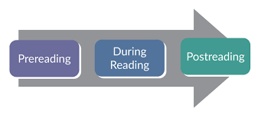
Stages for Reading Development
Generally, a reading lesson has three major stages: a pre-reading stage; a while-reading stage and a post-reading stage

Slide 9
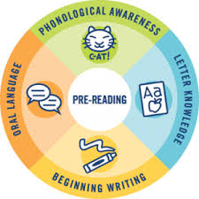
Pre-reading stage
By pre-reading activities, we mean tasks/activities that students do before they read the text in detail. The purpose of this stage is to facilitate while-reading activities. Garmer calls this stage of reading Lead-in, where the students and teacher prepare themselves for the tasks and familiarize themselves with the topic of the reading exercises.

Slide 10
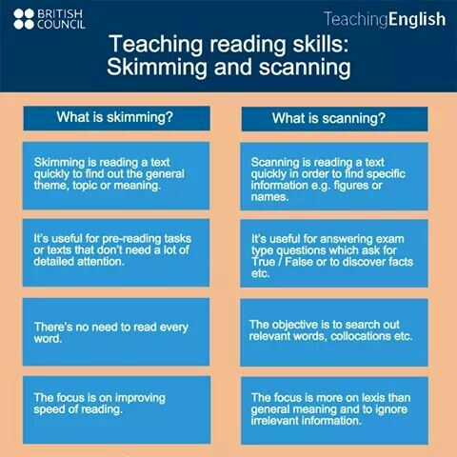
Pre-Reading Activities
Predicting based on the title
Predicting based on vocabulary
Predicting based on the true or false questions
Skimming
Scanning

Slide 11
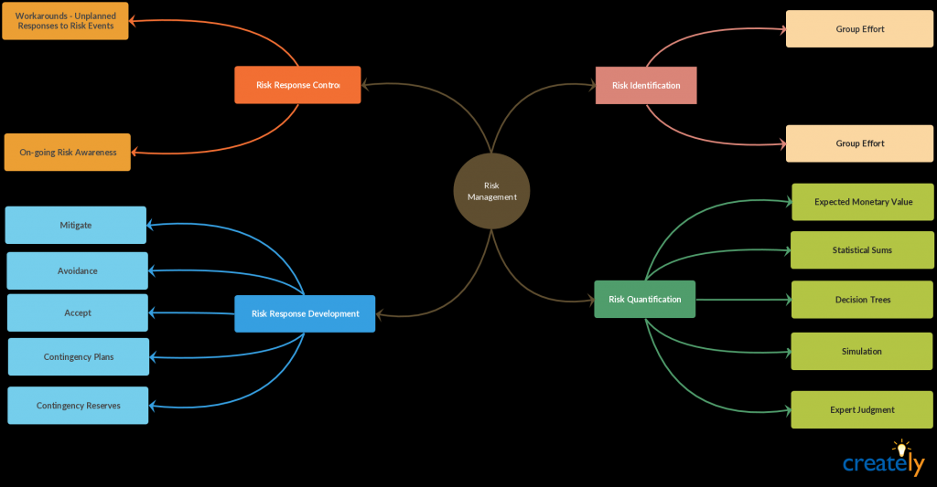
Eliciting word games
Word spider
Discussions
Brainstorming

Slide 12
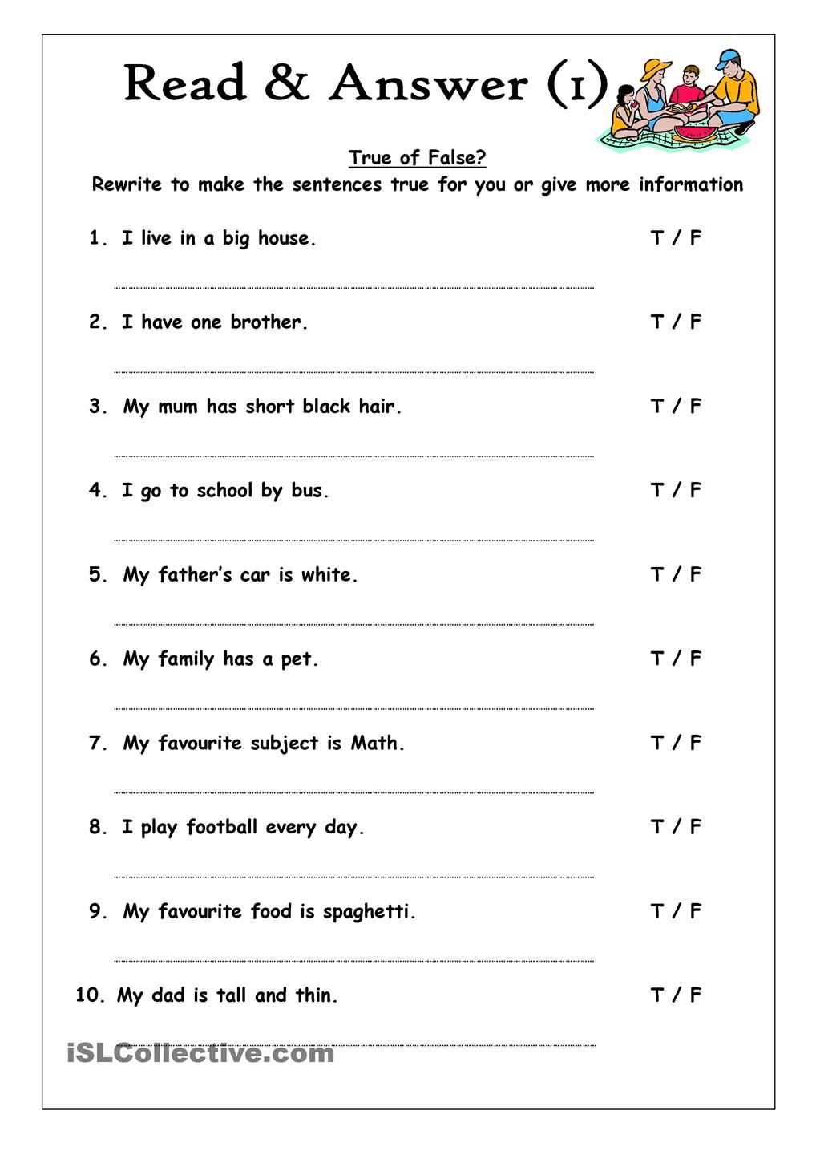
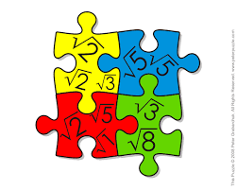
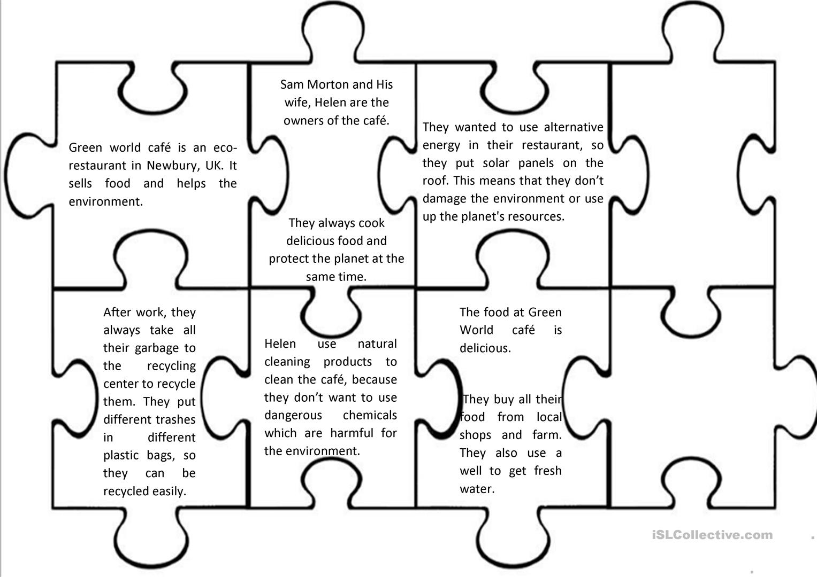
While-reading stages-
These include activities that a pupil engages in while reading the text and the purpose of these activities would be to enable pupils to achieve the lesson aims by handling the text in different ways. Reading discussion, Answering the questions, Predicting what is next, Matching, Jigsaw reading, Reading puzzles, True/ False activities are while-reading activities

Slide 13
Post-Reading Stage
the purposes of this stage are: to help students use their acquired knowledge in similar readings, to have them integrate their reading skills both with the other language skills: listening, speaking, writing and with the foreign culture, to make use of key words and structures to summarize the reading passage, to ex‑ tract the main idea of a paragraph or a reading text and to interpret descriptions (outlining and summarizing). Useful and interesting activities of this stage are: Retelling, Reporting, Discussion, Writing a paragraph, Role play, Gap-filling, Summarizing. These activities provide the students with opportunities to relate what they have read to what they already know or what they feel.

Slide 14
Conclusion
Reading is an excellent way for students to make progress in language learning and implementing different pre-, while, post reading activities not only practical to integrate the other skills, but also very beneficial and effective way of developing students reading and understanding comprehension

