Slide 1
Plastid biosynthesis, types, function and structure

Slide 2
What are plastids?
Plastids are double membrane bounded organelle
Plastids are found in the cells of plants and algae.
Plastids are responsible for the making and storing the food.
Plastids contain pigments that are used in photosynthesis.

Slide 3
Who first discovered plastid?
Plastid was first discovered and named by Ernst Haeckel in 1866.
Andreas Schimper was the first to give the clear definition of plastid in 1883.
He also explained the relationship between the different types.

Slide 4
Plastids
Round or oval bodies containing pigment and commonly found in plants.

Slide 5
Function of plastids:
Storage of starch , pigments ,and other cellular products.
Chief power factory of plant in food synthesis.

Slide 6
Origin of plastid:
Plastid are thought to be endosymbiotic cyanobacteria
The primary endosymbiosis event occurred around 1.5 billion years ago and enabled to carry out oxygenic photosynthesis.
The secondary endosymbiosis engulfs another eukaeyotic organism that contain a primary plastid.

Slide 7
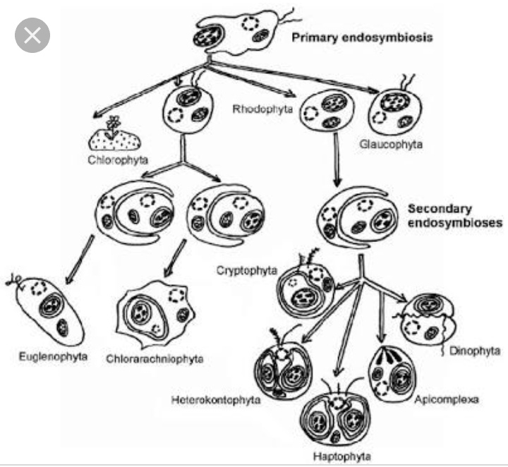

Slide 8
Evolution of plastid:
Approximately 2 billion years after cyanobacteria like organism had invented photosynthesis
Plastid may derive from cyanobacteria.
They entered into an endosymbiotic partnership with a eukaryotic host and evolved into plastid creating an autotrophic lines of nucleus – containing cells that were powered by light.

Slide 9
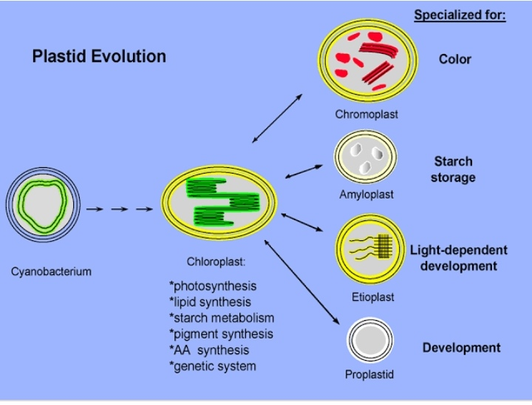

Slide 10
Complex plastid and Simple plastid
the simple plastids in the chlorophytes, rhodophytes and glaucocystophytes, which have two delimiting membranes, and the complex plastids (Sitte, 1993) in practically all other algae, which have three or more delimiting membranes.

Slide 11
Biosynthesis of plastid:
Plastid are the organelles of carotenoid biosynthesis and storage in plant cell.
They exist in various types, which include proplastids , etioplastids , chloroplast , amyloplast and chromoplast.
These plastids have dramatic differences in their capacity to synthesize and sequester carotenoids.

Slide 12
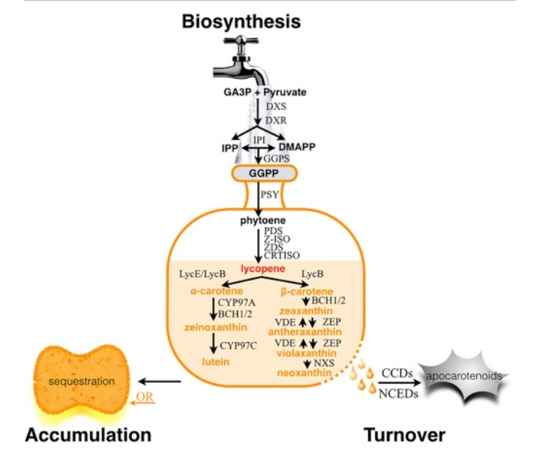

Slide 13
Plastids types,structure and function:
Chloroplast
Chromoplast
Leucoplast
Grenotoplast
Amyloplast
Elaioplast
Proteinoplast

Slide 14
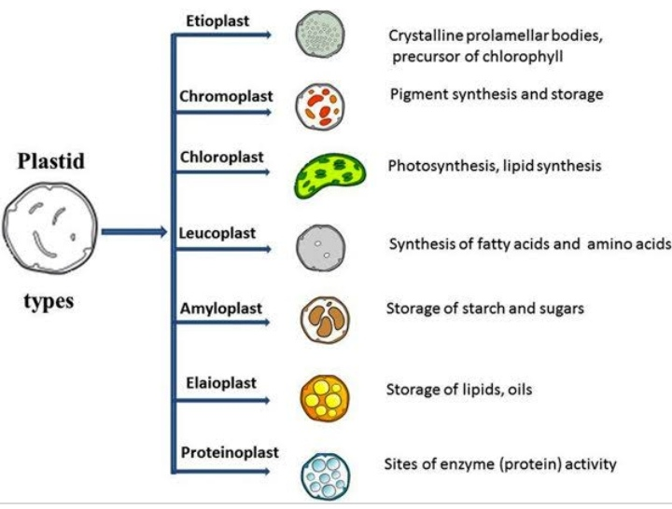

Slide 15
Chloroplast:
The chloroplast are probably the most known of plastid.
These are responsible for the photosynthesis.
The photosynthetic pigment chlorophyll capture the energy from sunlight.
This energy is converted and stored in the energy storage molecules ATP and NADPH while freeing oxygen from water in plant and algal cells.

Slide 16
Structure of chloroplast:
Chloroplast are the food producers of the cell.
Two membranes:
Outer membrane
Inner membrane
The inner membrane surrounds the Stroma and the Grana.
Granum:
One thylakoid stack is called a granum.
The stacks of thylakoid sacs are connected by Stroma lamella.

Slide 17
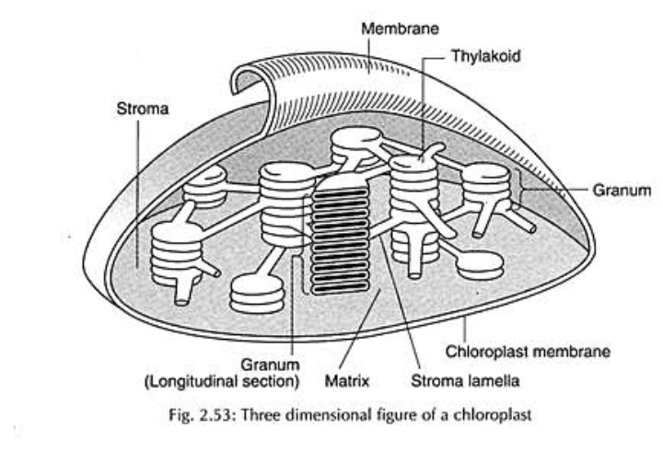

Slide 18
Location of chloroplast:
Chloroplast are present in the cells of all green tissues of plant and algae.
Chlorophyll are also found in photosynthetic tissues that do not appear green such as brown blades of giant kelp or red leaves of the certain plants.
In plants chloroplast are concentrated particularly in parenchyma cells of the leaf mesophyll.

Slide 19
Chromoplast:
Chromoplast , a place for the pigments to be stored and synthesized in the plant.
Location:
These are found in flowering plants, fruits and aging leaves.
The chloroplast actually convert into chromoplasts.
There are carotenoid pigments here that allow for the different
Colors you see in fruits and the fallen leaves.

Slide 20
Chromoplast:
One of the main reason for these structures and colors is to attract the pollinators.

Slide 21
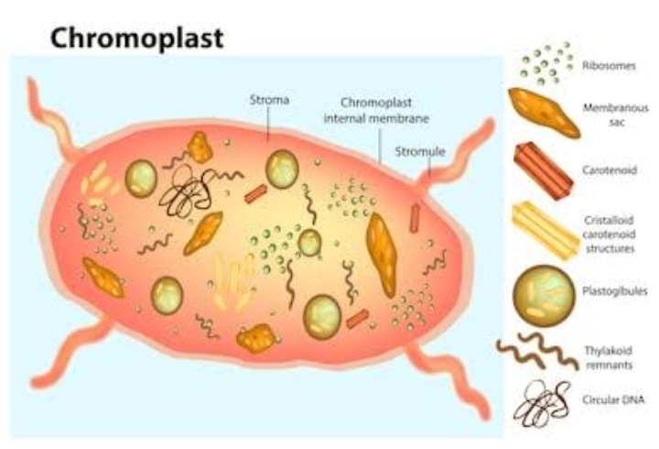

Slide 22
Structure of the chromoplast:
The first type is composed of proteic stroma with granules.
The second is composed protein crystals and amorphous pigment granules.
The third type is composed of protein and pigment crystals.
The fourth type is chromoplast which only contain the crystals.

Slide 23
Function of chromoplast:
These are heterogeneous organelle.
Chromoplast is responsible for pigment synthesis.
It is also responsible for the storage of food in specific photosynthetic eukaryotes.
Chromoplast are found in fruits, flowers, roots and stressed and aging leaves and responsible for their distinctive color.
Help in massive increase in the accumulation of carotenoid pigments.

Slide 24
Leucoplast:
Leucoplast are the non-pigmented organelles.
They are found in the non-photosynthetic parts of the plant such as roots.
Depending on what the plant needs, they may become essentially just storage sheds for starches, lipids and proteins.
They are more readily used for the synthesizing amino acids and fatty acids.

Slide 25
Leucoplast:
Leukoplasts are a category of plastids and as such organelles that are found in plant cells. In contrast to other plastids such as chloroplast, they are not pigmented. Without photosynthetic pigments, leukoplasts are not green and are found in non-photosynthetic tissues of plants

Slide 26
Classification of leucoplast:
Leucoplast are further subdivided into three layers:
Amyloplast
Proteinoplast
Elaioplast

Slide 27
Amyloplast:
Amyloplast are the largest of the three and charged with the storing starch.
Amyloplast is non pigmented containing plastids.
It produce and store starch within internal membrane compartments.
They are commonly found in the vegetative plant tissues such as..
Tubers and bulbs.

Slide 28
Proteinoplast:
Proteinoplast are specialized organelles found only in plant cells.
They lack pigments.
They contain crystalline bodies of the protein and can be sites of an enzymes activity involving those protein.
Location:
proteinoplast are found in many seeds, such as brazil nuts, peanuts and pulses.

Slide 29
Elaioplast:
It is a type of leucoplast.
The main function of elaioplast are synthesis and storage of fatty acids, terpenes and other lipids.
Location:
Elaioplast are found in the embryonic leaves of the oilseeds citrus fruits, as well as the anther of many flowering plants.

Slide 30
Gerontoplast:
The term gerontoplast was first introduced in 1977.
It is plastid that develops from a chloroplast during the senescing of plant foliage.
Gerontoplast development is generally seen to be process of grana being unstacked, loss of thylakoid membranes, and large accumulation of plastoglobuli.

Slide 31
Gerontoplast:
A gerontoplast is a plastid that develops from a chloroplast during the senescence of plant leaves. The development of gerontoplastics is generally viewed as the process of unstacking Grana, losing thylakoid membranes, and the large accumulation of plastoglobuli.

Slide 32
Main functions of plastids:
They provide colour to fruits and flowers.
They help in storage of protein, starch and oil.
They trap solar energy to manufacture food through the process of photosynthesis.
They show green colours due to presence of chlorophyll pigment.
Function in algae:
The plastids of algal protists function like the chloroplast of plants with respect to photosynthesis.
Its main function is plastid have its own DNA.

Slide 33
THANK YOU

