Slide 1
FARM FORESTRY
‘Farm Forestry’ came into common use in Australia in the early and mid-1990s
At the time, there was a desire to differentiate
the practice of growing commercial trees
on farms from the popular image
of ‘plantations’ as being large-scale
industrial ‘wall-to-wall’ plantings

Slide 2
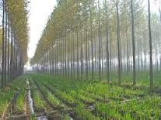
FARM FORESTRY
The incorporation of productive tree growing into farming systems
Improves agricultural production by providing shelter for stock and crop
Provides substantial environmental benefits such as water table and salinity reduction
(National Farm Program – Australian
Government funding program 1995-2000)

Slide 3
Various Concepts of Farm Forestry
Farm forestry differs from industrial-scale forestry in that:
Smaller planting scale
Site fertility can sometimes be higher due to fertilization/land
Larger proportion of edge trees and ongoing interaction between trees and agricultural uses
Tree spacing
(Lott, Keenan and Lewty, 1998)
“A major criticism of the approach taken by state forest agencies to promoting private forestry, especially to farmers and other smaller growers, was of the implicit assumption that farm forestry should look just like conventional industrial plantation forestry.” (Donaldson 1998)

Slide 4
Various Concepts of Farm Forestry
Byron and Boutland (1987) noted that farm forestry was more than forestry on farms for industrial wood production”
(Donaldson 1998)
“Industrial plantation monocultures have traditionally been established for the singular, legitimate goal of maximizing wood fiber production for industrial use, while it is possible to conceive of farm forestry as a kind of subset of plantation forestry, with many similarities, the differences are still substantial.” (Alexandra and Hall 1998)

Slide 5
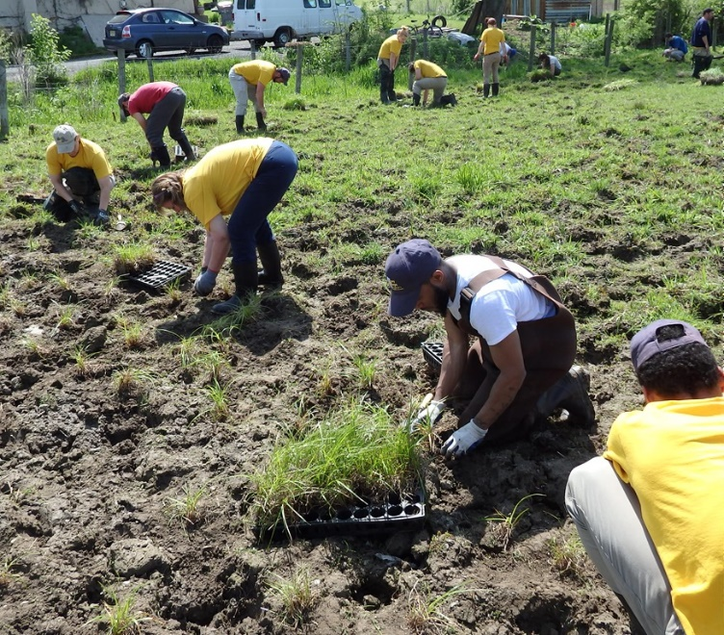
Farm Forestry: How is it different?
1. Farm forestry is not about finding farmland that is appropriate for conventional forestry plantations rather, is about the development of forestry opportunities, appropriate for farmers
2. Farm forestry is not about getting farmers to hand over their land to foresters rather, is about foresters handing over their knowledge, skills and
tools for farmers
3. Farm forestry is not about more
people and land supporting forestry
rather, is about forestry supporting more
people and more land

Slide 6
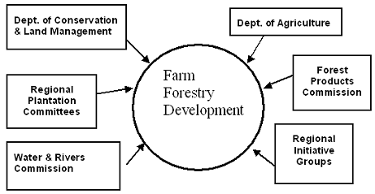
The main organizations and groups contributing to the development of Farm Forestry

Slide 7
FARM FORESTRY IN PAKISTAN: AN EVALUATION OF USAID ASSISTANCE
October 1992, A.I.D.'s Center for Development Information and Evaluation (CDIE) sent a team to Pakistan to conduct an evaluation of the Pakistan farm forestry program
The evaluation team found that the farm forestry model has several important features:
Uses private sector profit incentives as an engine to sustain its activities
Employs an emerging partnership between the Government and independent farmers to accomplish its objectives
Introduces basic, low-cost technologies with quick and visible pay-offs to attract and hold the interest of participants
Produces environmental benefits that help the entire country

Slide 8
LESSONS LEARNED
Markets supply powerful forces capable of driving individual and institutional participation in farm forestry programs
Encouraging tree planting on private land is an effective strategy when it capitalizes on existing conditions of land and tree tenure security
Farm forestry "sells" best when participants have access to low-cost technologies with reasonable pay-back periods
Flexible project design permits program managers to respond effectively to new conditions and opportunities

Slide 9
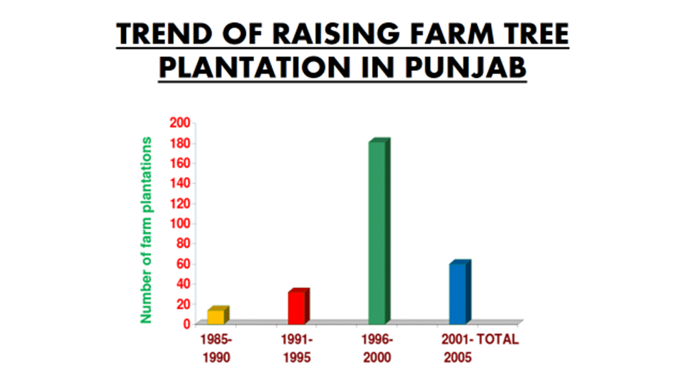

Slide 10
Farm Profit and Farm Profitability
What is a Farm Profit?
When operating costs and depreciations are subtracted from the annual farm income, result is the net farm profit.
What is Farm Profitability?
Profitability is the state of mind in which a farm manager carefully controls every aspect of the operation to make the most profitable use of the resource available to farm business.

Slide 11
Assessing Farm Profitability
1. Cash Farm Income
Income statement
List of sources and values of cash farm income
Income received from custom work
2. Cash Operating Expense
Operations on farm business
Fixed cash expenses (tax, insurance etc.)

Slide 12
Assessing Farm Profitability
3. Inventory Changes
A problem arises when inventories of crops, market livestock and other items are higher or lower at the end of accounting period than at the beginning
Farm income is either understated or overstated
4. Depreciation and other farm capital
Calculated by subtracting beginning inventories and capital purchase from each asset category from the ending inventories and capital sales
Accrual income statement will give a picture of farm profit for the accounting period

Slide 13
Assessing the Financial Viability of Farm Forestry
Financial Module should be designed:
To aid in the understanding of the concepts and techniques used to assess financial viability of farm forestry
To develop basis computer skills in assessing the financial viability of farm forestry
To evaluate net present value and internal rate of return

Slide 15
Economic Analysis
The data entry and financial analysis procedures are set out to be followed step by step to derive financial performance criteria, using the spreadsheet package Excel and calculate:
Benefit-cost Ratio
Net present value (NPV)
Internal rate of return (IRR)
Sensitivity Analysis

Slide 16
BENEFIT-COST RATIO ANALYSIS
Inputs for stabling AFS included cost for planting tending and harvesting while income included benefits from selling products.
Benefit-cost analysis are done by divided discounted rate of benefits with that of discounted rate of cost.
For this purpose a formula is used :
$BCR= \frac{\sum_{r−1}^{r}{\frac{B_{t}}{{(1+r)}^{t}}}}{\sum_{r−1}^{r}{\frac{C^{t}}{{(1+r)}^{t}}}}$

Slide 17
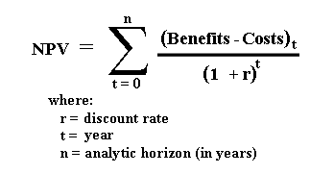
NET PRESENT VALUE (NPV)
The total sum of all discounted prices of all cash flow of an investment is called net present value.
It is calculated by following formula :

Slide 18
INTERNAL RATE OF RETURN (IRR)
The rate of interest which makes the net present value equal to zero is called internal rate of return.
Given formula was used to analyze internal rate of return :

Slide 19
SENSITIVITY ANALYSIS
In sensitivity analysis the analyst checks the results of economic analysis conducting the effects of changes in the value of key variables as follows:
Output prices remain same while input prices increased to 10% from the current input cost.
Input prices remain constant while output prices decreased by 10% from current output value.

Slide 20
MAXIMIZING THE EFFECTIVENESS OF FARM FORESTRY PROGRAMMES
Role of Forest Department
Local Organization
Extension Efforts
Public Information and Program Promotion
Seedling Distribution Programs
Finding Ways of Reducing Risk
Credit Schemes for Tree Growing
Market Support Measures
Cash Incentives

Slide 21
Role of Forest Department
New goals for forestry also require introducing new systems of professional education for both forestry officers and extension personnel
In Pakistan, for example, farmers were reluctant to become involved in a farm forestry programs because the Forest Department was viewed with suspicion and distrust. When the project was initiated, over 50,000 forest offences were pending in the courts, which meant that one out of six families was involved in disputes with the Forest Department (Cernea, 1981)
It is crucial that forestry departments assign qualified men and women foresters, social scientists and others to implement rural forestry programs

Slide 22
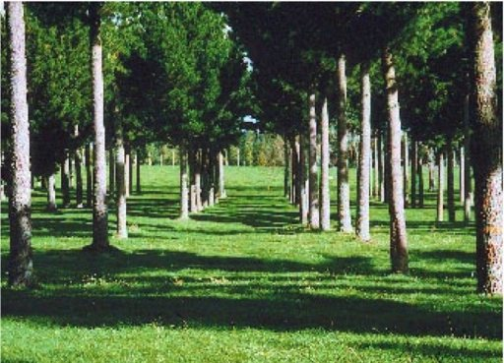
Local Organization
Lack of local organizations is the chief barrier to effective rural development
The types of local institutions that have filled
this essential role have often been informal
Some were formed at the initiative of groups within communities or villages that have common interests in the use of tree resources and felt the need for some kind of institutional framework (Chandrasekharan, 1983)

Slide 23
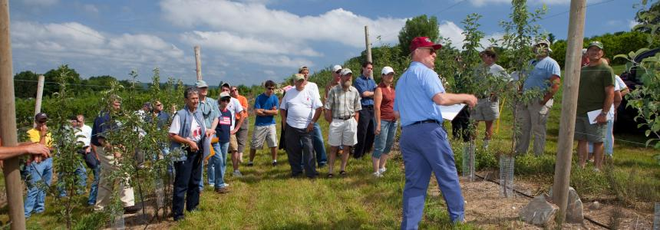
Extension Efforts
Extension is a process through which people become familiar with new knowledge and skills of direct relevance to their lives, and through which government support services can learn about local priorities and needs.
Extension must follow the strategy:
First identifying the real problems and their causes
Selecting those problems which can in some way be addressed by information
Design ways to get that information to the right person in an effective manner

Slide 24
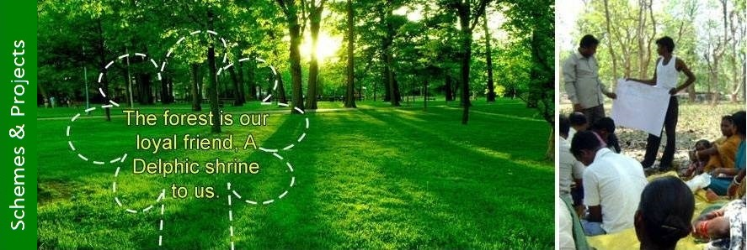
Qualities of an Extension Worker
Extension worker must have:
Listening skills
Sense that they can learn from residents information needed to make them more capable as extension workers
Trained as generalists
Familiar with technical and social issues
Able to recognize when his own knowledge is inadequate and call on more qualified experts.

Slide 25
Public Information and Program Promotion
Tackling and provision of information can be fairly straightforward through publicity and promotional activities
Means for spreading such information are as diverse
Includes:
Promotional sticker/Posters/newspaper advertisements
Messages on billboards/Booklets
Story tellers or singers
Puppet theatres/film strips/movies/radio
Tree-planting festivals
National campaigns/political pronouncements
The effect of these types of activities can be difficult to gauge, but active program promotion can be helpful

Slide 26
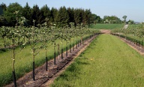
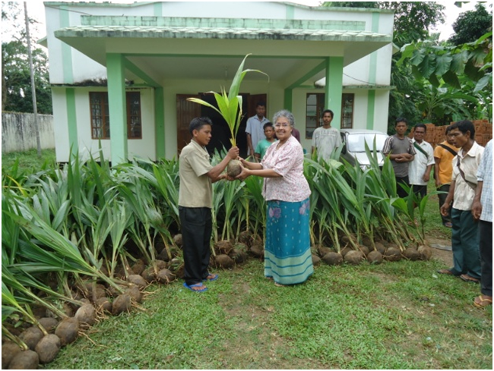
Seedling Distribution Programs
Distributing the seedlings free or at a subsidized cost
After popularity of such programs, there should be
no need for such incentives
Continued subsidized seedling distribution serves no particularly useful function and will only inhibit farmers from establishing their own nurseries
Surveys can establish the desirability of
particular types of trees
Monitoring and evaluation is an
essential tool

Slide 27
Finding Ways of Reducing Risk
Alternative public sector support mechanisms may be necessary to reduce the farmer’s risks
Includes:
Marketing mechanisms
Price controls
Technical assistance
Extension
One especially important aspect of reducing risk is the certainty that the technical alternatives being suggested will work

Slide 28
Credit Schemes for Tree Growing
Availability of credit on appropriate terms for smallholders to undertake farm forestry
Commercial banks are willing or flexible enough to undertake the burden of administering a program of smallholder farm forestry finance
FOR EXAMPLE:
In Sudan, smallholders traditionally mortgaged their gum Arabic production to merchants in return for high interest loans to purchase subsistence commodities. As part of its farm forestry program, Government introduced regulated credit facilities to reduce the negative impacts of traditional credit schemes.

Slide 29
Market Support Measures
Improvements are needed in:
Marketing arrangements
Transportation infrastructure
Formalized marketing structures may help protect smaller farmers unused to commercial dealings with wood merchants and felling contractors
Help farmers tap potentially large markets outside the immediate zone

Slide 30
Cash Incentives
Governments can provide incentives to the private sector to encourage development of wood-based industries
Lowering costs of tree growing can be an important way of providing incentives for smallholders

Slide 31
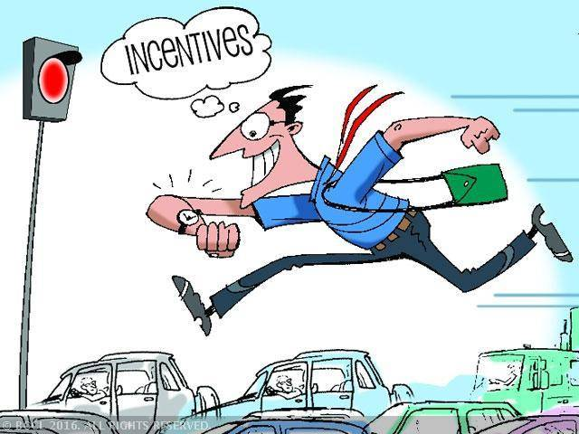
Cash Incentives
Subsidies are often a means of involving rural poor where benefits of tree planting may not seem obvious, especially where farmers must have an intermediate source of income before the trees are harvested and sold
Programs which have paid farmers to plant
trees usually have other objectives but
some schemes like “food for work”
projects have provided a payment-in-kind
for tree planting

Slide 32
Local Constraints to Tree Growing
Cf. Burley (1982)
- Economic:
sufficient land, capital and labor
Benefits of tree cultivation, both in economic and financial terms, must exceed the net benefits from alternative resource
Social/Cultural:
Productive relationships and the pattern of resource ownership should have culturally accepted strategies
Availability of appropriate and culturally sensitive technical expertise
Environmental:
Interventions or adaptive strategies must be responsive to the water availability, temperature regimes, soil types etc.

Slide 33
CONCLUSION
Farm forestry is one of the solutions to overcome accelerated rate of deforestation in natural forest areas
There is an urgent need to adopt a policy with a provision of livelihood opportunities by providing local and regional markets
In this way planting of indigenous species can also be promoted
The main help required from government is provision of proper species and facilities for irrigation
Poplar is a favored species and can be further encouraged by taking care of pest control
To avoid the pesticide associated hazard, indigenous practices may be evaluated so that there may become part of the integrated pest management

