Slide 1
Measures of central Tendency/ Location
Measures of location as mostly referred to as averages. The purpose of measure of location is to point out the center of the data . An average is a numerical value that shows the Centre of the data.

Slide 2
Measure of location
Mean/ Arithmetic Mean
Median
Mode
Geometric mean
Harmonic mean

Slide 3
Arithmetic Mean:

Slide 4
Arithmetic Mean:
The mean is defined to be the sum of the data values divided by the number of values. Arithmetic Mean=$\frac{Sum of all the observations}{Number of the observations}$
$\overline{x}$ = $\frac{x_{1}+x_{2}+\text{ … }x_{n}}{n}$
$\overline{x}$ = $\frac{{Ʃx}_{i}}{n}$

Slide 5
Properties
Every set of data has its mean
Mean utilized all the observations
$\sum{\left(x−\overline{x}\right)}$=0
For example the mean of 3,8,4 is 5 then
$\sum{\left(x−\overline{x}\right)}=\left(3−5\right)$+$\left(8−5\right)$+$\left(4−5\right)$=0.

Slide 6
Mean
Population mean
Sample mean
Data
Mean for group data
Mean for ungroup data

Slide 7
Formulas for Ungroup Data
µ = $\frac{Ʃxi}{N}$ population $\overline{x}$ = $\frac{{Ʃx}_{i}}{n}$ Sample

Slide 8
Population Mean
The Greek symbol µ is represents the population mean. The symbol µ is read as “mu”. N is the size of the finite population. µ = $x_{1}+x_{2}+$ … $x_{N}$ N = $\frac{{Ʃx}_{i}}{N}$

Slide 9
Sample Mean
The symbol $\overline{X}$ represents the sample mean. $\overline{X}$ is read as “X bar” . The Greek symbol $Ʃ$ is read as “sigma” and it means “to sum”. $\overline{x}$ = $\frac{x_{1}+x_{2}+\text{ … }x_{n}}{n}$ = $\frac{{Ʃx}_{i}}{n}$

Slide 10
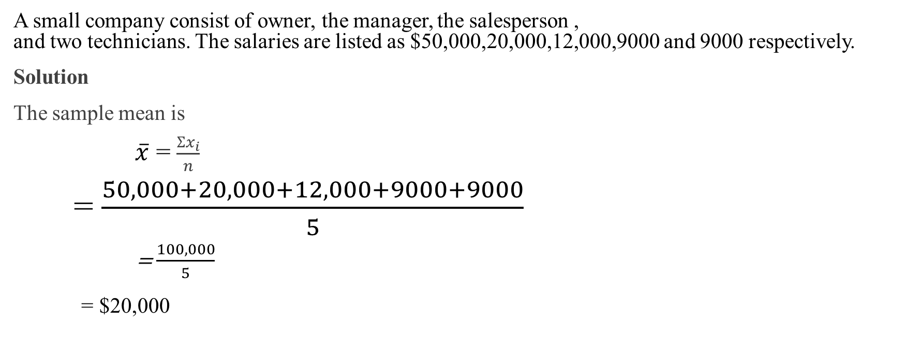
How to calculate mean
A small company consist of owner, the manager, the salesperson , and two technicians. The salaries are listed as $50,000,20,000,12,000,9000 and 9000 respectively.
Solution
The sample mean is
$\overline{x}$ = $\frac{{Ʃx}_{i}}{n}$
= $\frac{50,000+20,000+12,000+9000+9000}{5}$
= $\frac{100,000}{5}$ = $20,000

Slide 11
Question no#2
The ages in weeks of a random sample of six kittens at an animal shelter are 3,8,5,12,14, and 12. Find the average age of this sample.
Solution The sample mean is $\overline{x}$ = $\frac{{Ʃx}_{i}}{n}$ = $\frac{3+8+5+12+14+12}{6}$ = $\frac{54}{6}$ = 9 weeks

Slide 12
Home Assignment
Question:01 The marks obtained by 9 students are given below: 45,32,37,46,39,36,41,48,36,54,17,34,27,29 calculate the arithmetic mean.
Question:02 Calculate the arithmetic mean of the annual incomes of families as given below Rs.60,80,90,96,120,150,200,360,480,520,1060, 1200,1450,2500,7200.

