Slide 1
JSP Expression

Slide 2
JSP Scripting Elements
Jsp Expression <%= some java Expression %>
JSP Scriptlet <% some java code: 1 to many list %>
JSP Declaration <%! Variable or method declaration %>

Slide 3
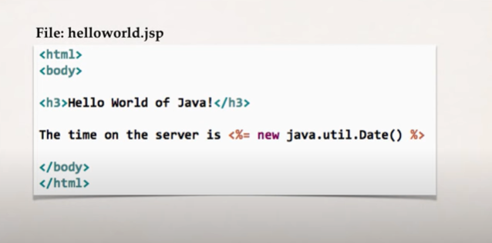
JSP Expression
Compute an expression
Result is include in HTML returned to browser

Slide 4
Jsp Expression more example
Converting a string to uppercase: <%= String (“hello world”).toUpperase() %>
25 multiplied by 4 equals: <%= 25*4 %>
Is 75 less than 69? <%= 75 < 69 %>

Slide 5
JSP Scriptlets
Insert 1 to many lines of java code
To include content in the page use : out.println(…)
<%
// some lines of java code
%>

Slide 6
JSP Scriptlet Example
<html>
<body>
<h3>Hello World of java</h3>
<%
} for (int i=1; i<= 5; i++){
Out.println(“<br/> welcome to jsp :” + i);
%>
</body>
</html>

Slide 7
JSP Declarations
Declare a method in the jsp page
Call the method in the same jsp page
<%!
// declare a method
%>

Slide 8
<%!
String makeItLowerr(String data) {
Return data.toLowercase();
}
%>
Lowe case “Hello world”: <%= makeItLower(“Hello world”) %>

Slide 9
Call a Java class from JSP

